Slide 1
L3 – Small Molecule Microarrays
February 15, 2018
Notes:
Today we will talk about the method we are using to search for small molecules to bind to FKBP12. This is a method that is near and dear to my heart because it goes all the way back to 1998, probably when most of you were still in diapers.

Slide 2
The view from 2000

Slide 3
~ 15 years on from the Human Genome Project

Slide 4
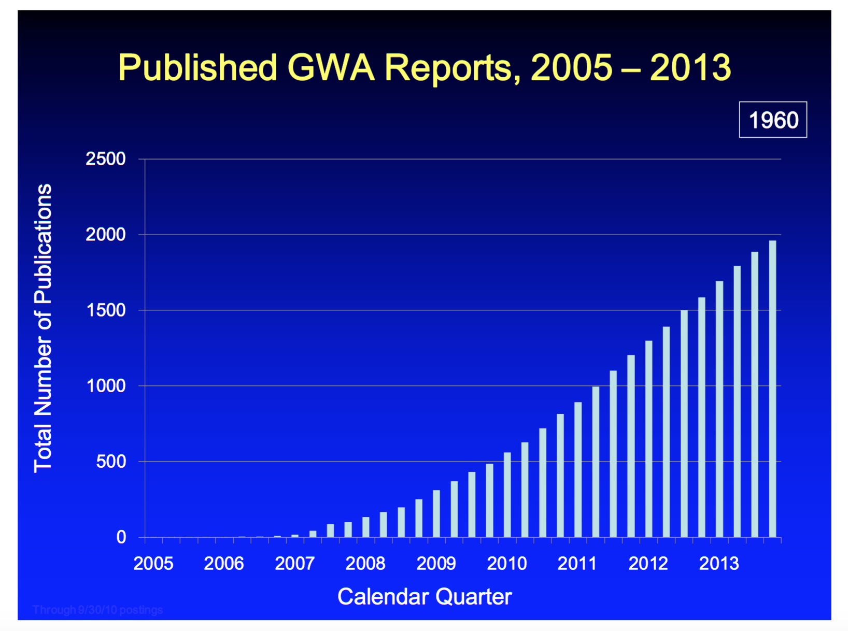
~ 15 years on from the Human Genome Project

Slide 5
~ 15 years on from the Human Genome Project

Slide 6
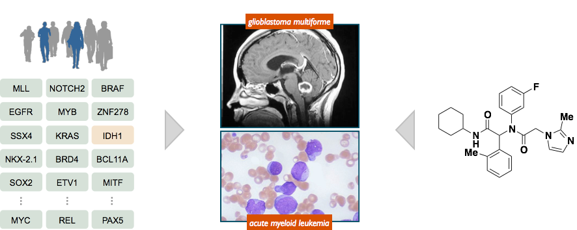
Chemical probes of disease biology
patient samples reveal
list of disease genes
physiologic settings to test
the impact of disease genes
discover or develop small
molecules that reverse the
impact of disease genes
Approach: use small molecules to test emerging concepts in human disease
in physiologically relevant settings
Output: validated small-molecule probe to facilitate human clinical development
or diagnostic applications
Notes:
Why does someone like me care so much about small molecules? Probes of biology!
Unlike other types of probes dose control, temporal control, spatial control, MANY PROTEINS HAVE MORE THAN ONE FUNCTION, Modulate individual functions
Finally, small molecules can serve as leads for drug development or lower the activation barrier for the development of other drugs against a target.

Slide 7
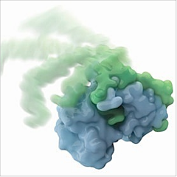
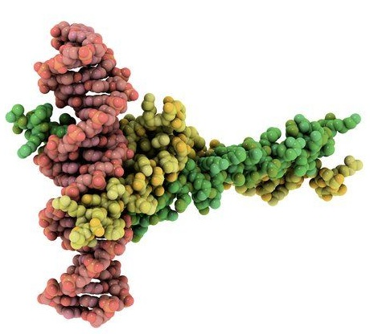
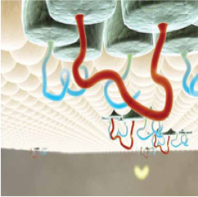
‘Undruggable’ targets are aplenty
disordered proteins
e.g. amyloids, transcription factors, enzymes
DNA binding proteins
protein-protein interactors
e.g. transcription factors,
extracellular growth factors,
scaffold proteins
integral membrane proteins
e.g. cell adhesion proteins,
enzymes, receptors

Slide 8

1998 – ‘on-bead’ binding assays
Library = 2.18M on
90 µm Tentagel beads
’Gradbot’
Angela
no binding
fluorescent
bead
rhodamine dye
540/625 nm
assay positive

Slide 9
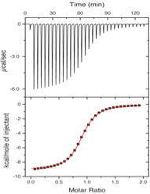
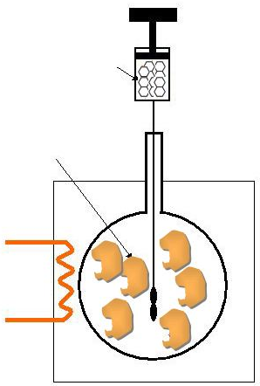
1998 - other binding assay formats
Ligand
Protein
K_{Deq}, ΔG, ΔH
isothermal titration calorimetry
measure changes in temperature
upon binding
fluorescence polarization
measure changes in rate of rotation
upon binding
Notes:
ITC is a quantitative technique that can determine the binding affinity (K_{a}), enthalpy changes (ΔH), and binding stoichiometry (n) of the interaction between two or more molecules in solution. From these initial measurements, Gibbs energy changes (ΔG) and entropy changes (ΔS) can be determined using the relationship:
ΔG = -RTlnK_{a} = ΔH-TΔS where R is the gas constant and T is the absolute temperature).
ITC is one of the latest techniques to be used in characterizing binding affinity of ligands for proteins. It is typically used as a secondary screening technique in high throughput screening. ITC is particularly useful as it gives not only the binding affinity, but also the thermodynamics of the binding. This thermodynamic characterization allows for further optimization of compounds.^{[4]}
Observations are plotted as the power needed to maintain the reference and the sample cell at an identical temperature against time. As a result, the experimental raw data consists of a series of spikes of heat flow (power), with every spike corresponding to one ligand injection. These heat flow spikes/pulses are integrated with respect to time, giving the total heat exchanged per injection. The pattern of these heat effects as a function of the molar ratio [ligand]/[macromolecule] can then be analysed to give the thermodynamic parameters of the interaction under study. It should be noted that degassing samples is often necessary in order to obtain good measurements as the presence of gas bubbles within the sample cell will lead to abnormal data plots in the recorded results. The entire experiment takes place under computer control.

Slide 10
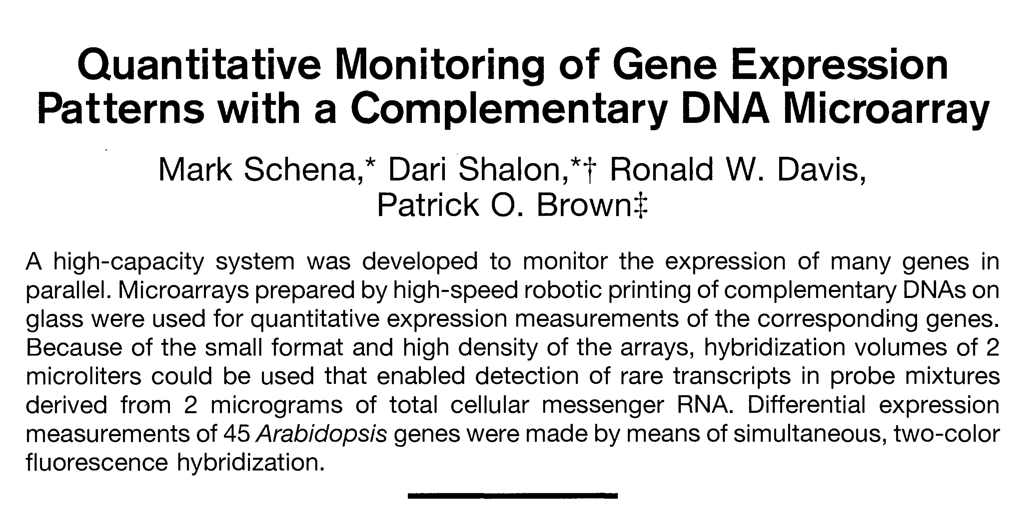
Late 1990s - ‘Spatially addressable systems’
Pat Brown, Stanford
follow changes in gene expression during yeast sporulation
Notes:
Briefly, thousands of discrete DNA sequences (e.g. all of the 6,200 known and predicted genes in s. cerevisiae) are robotically printed onto a glass microscope slide using an arrayer (X-Y-Z robot). To compare the relative abundance of genes in two samples (for example the total mRNA populations isolated from 2 cell populations) two smaples are labeled with different fluorescent dyes (e.g. a red and gree dye). The samples are mixed and applied to the array (called hybridization) and fluorescence measurements are made to determine a ratio of red to green.
This was one of a couple of array-based methods that were being developed in the mid-90s, mostly in companies, but the simplicity of this design took hold in academia. TheStanford team went so far as to publish all of the methods for making the robot on the Brown lab website.
One week after running my bead screen, we started constuction of a clean room to make the robot.

Slide 11
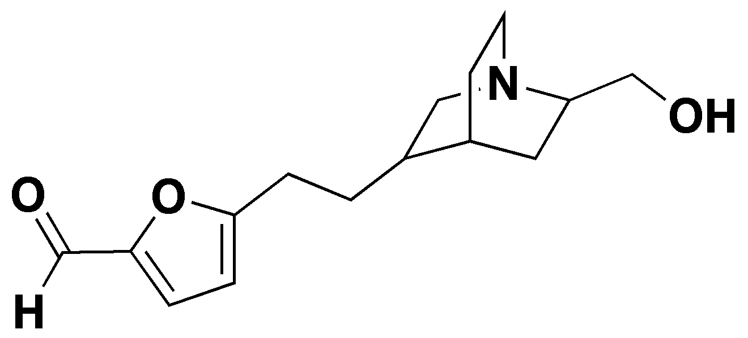
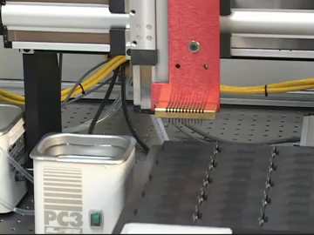
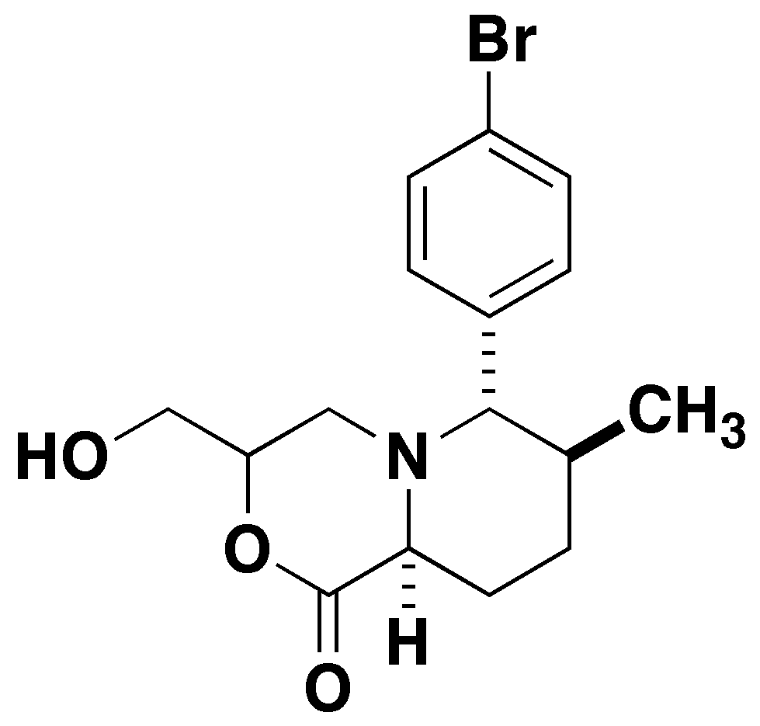
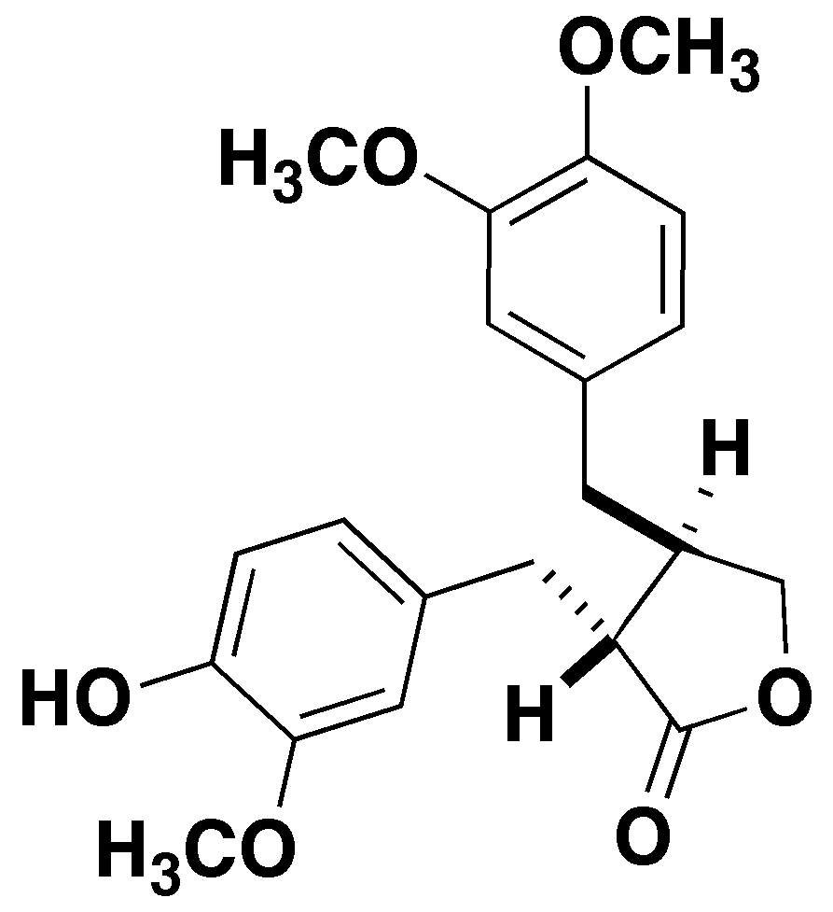
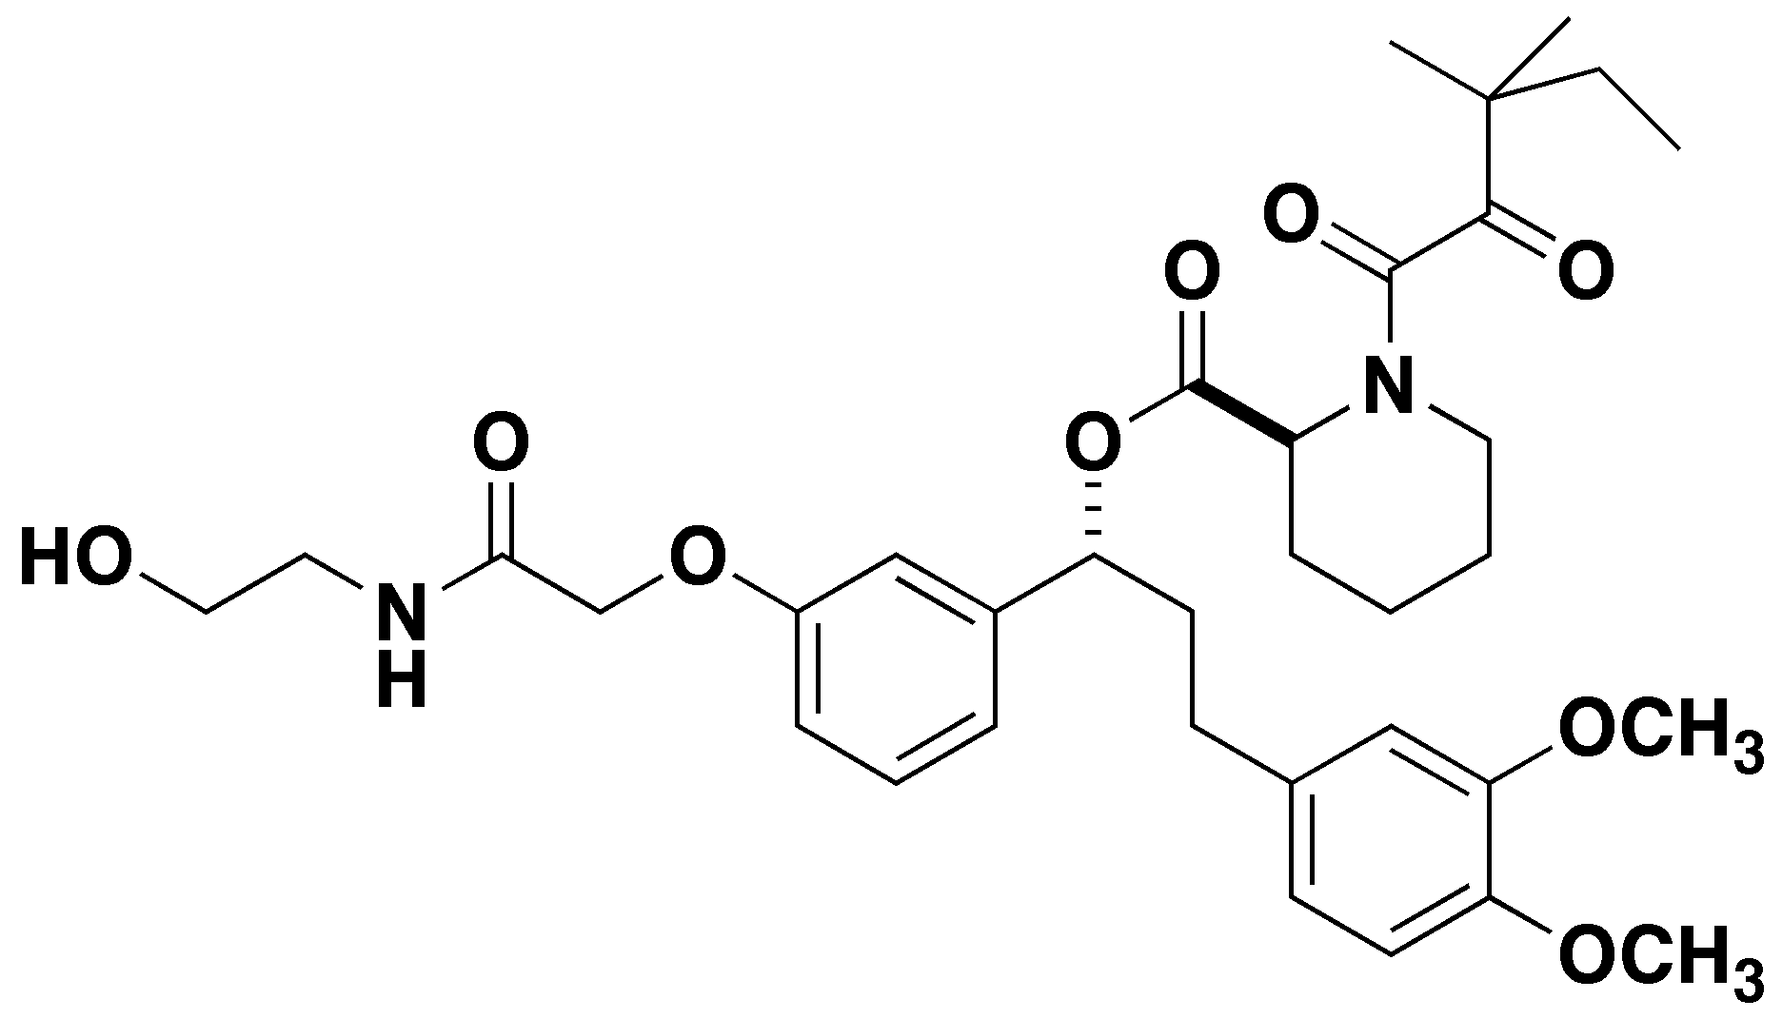
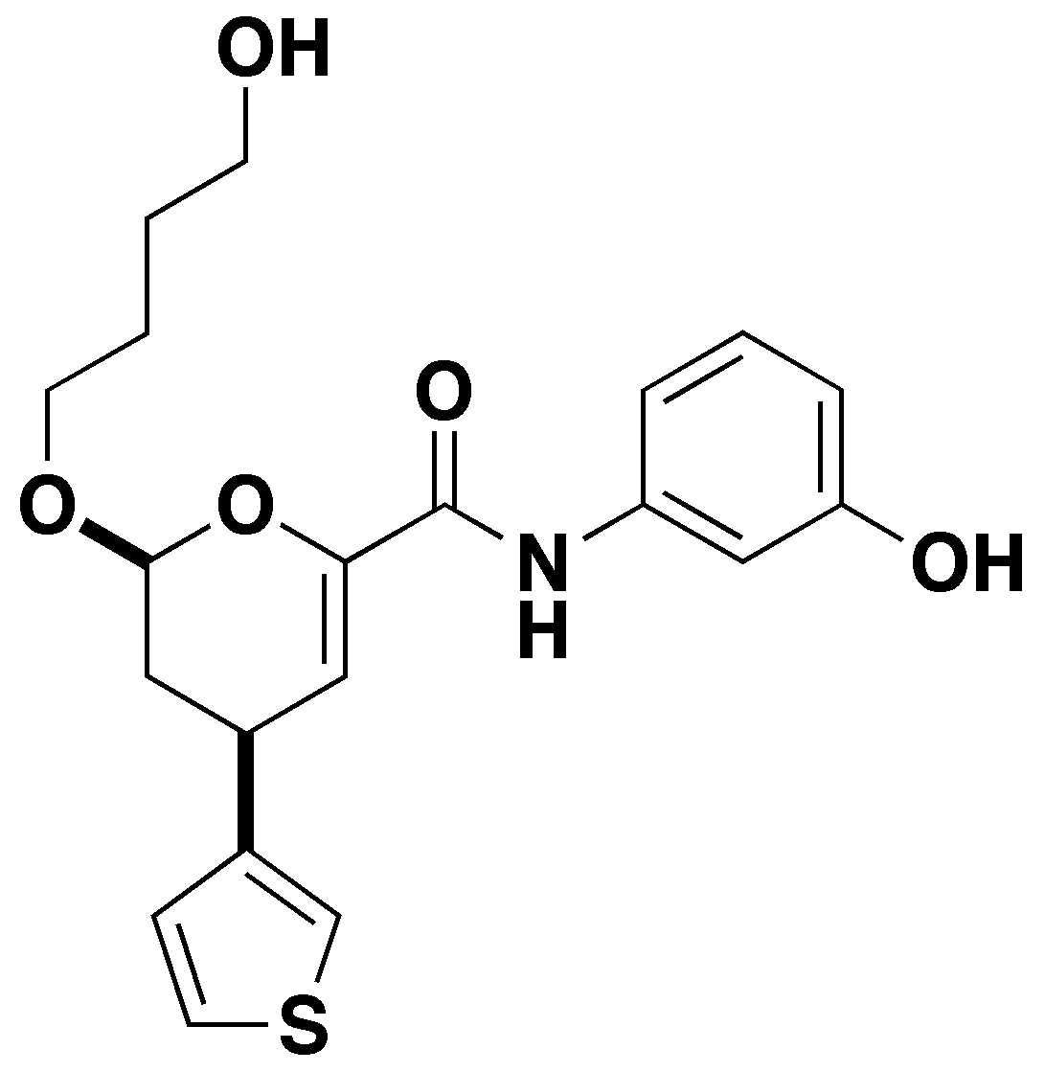
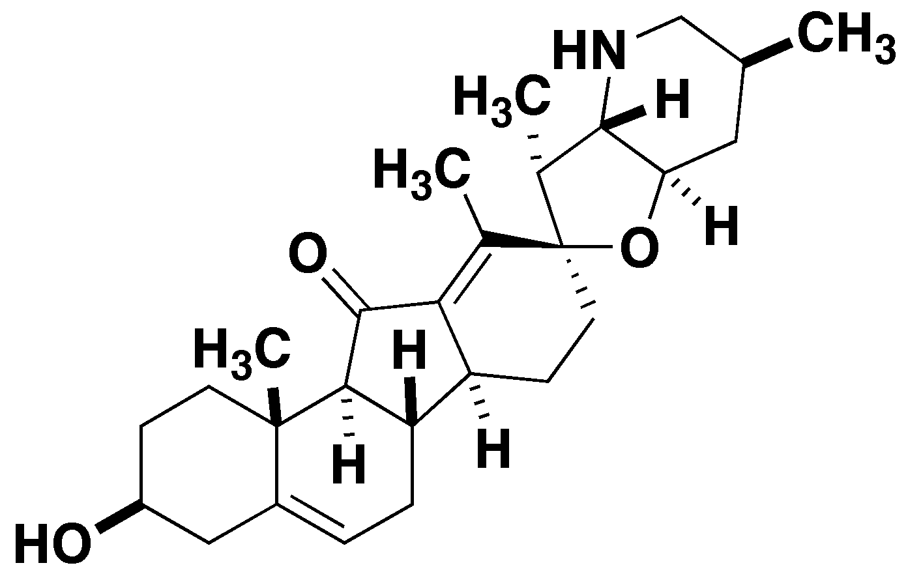
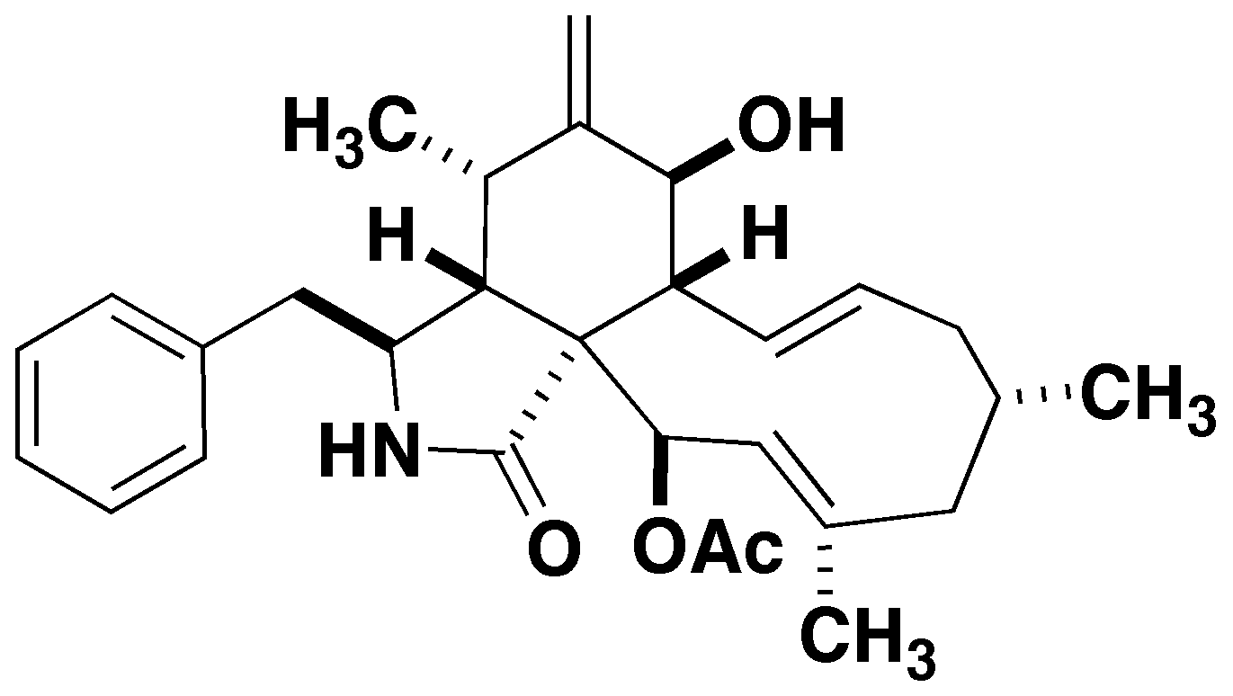
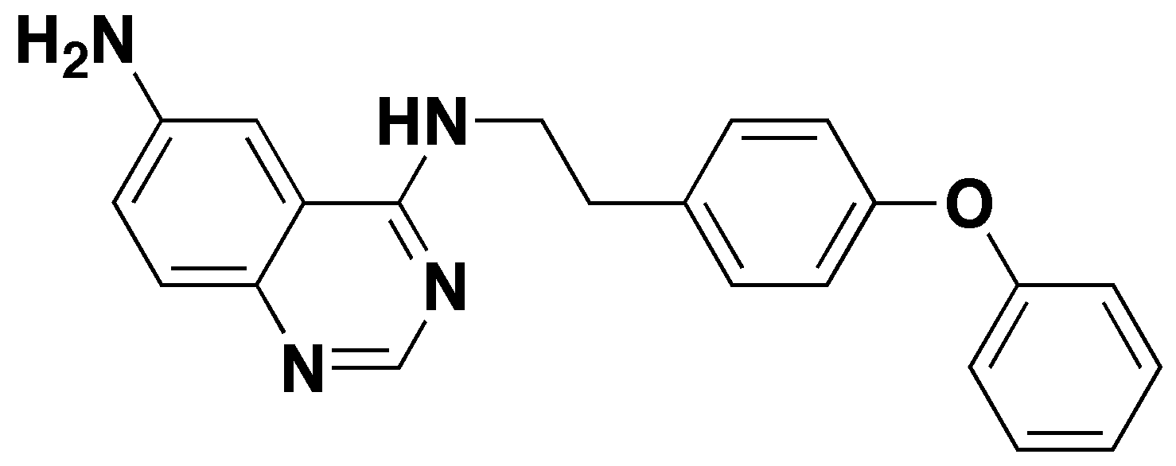
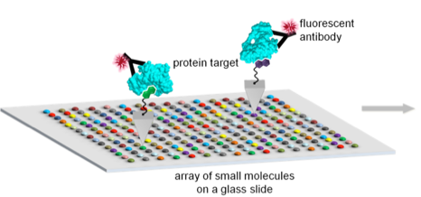
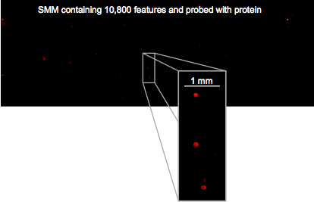
Small Molecule Microarrays (SMMs)
compound stock solutions
SMM manufacture and screening
screened SMM

Slide 12
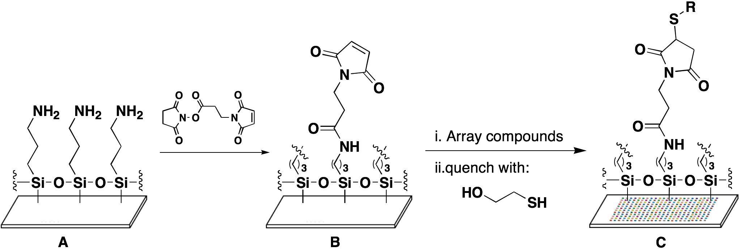
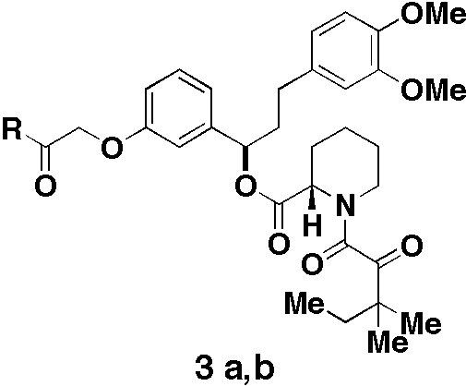
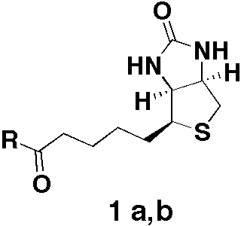
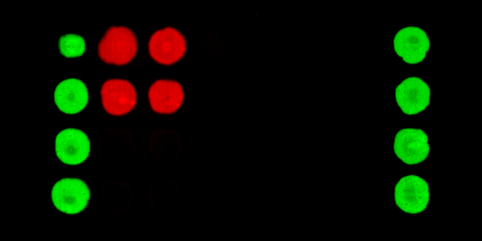
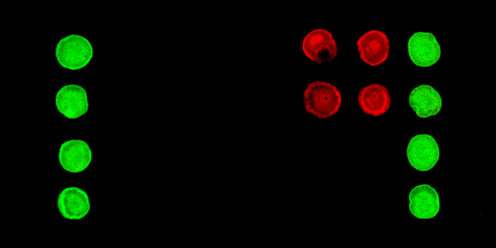
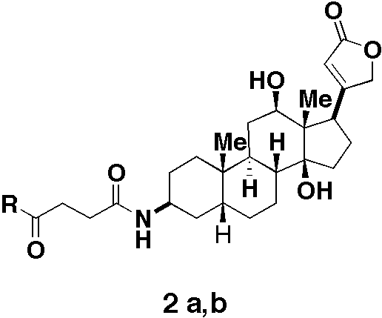
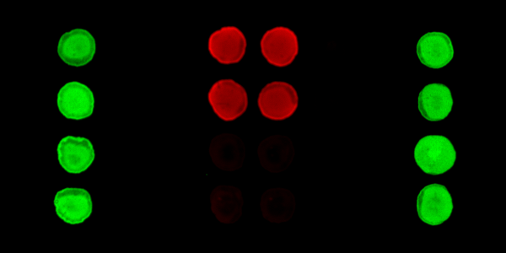
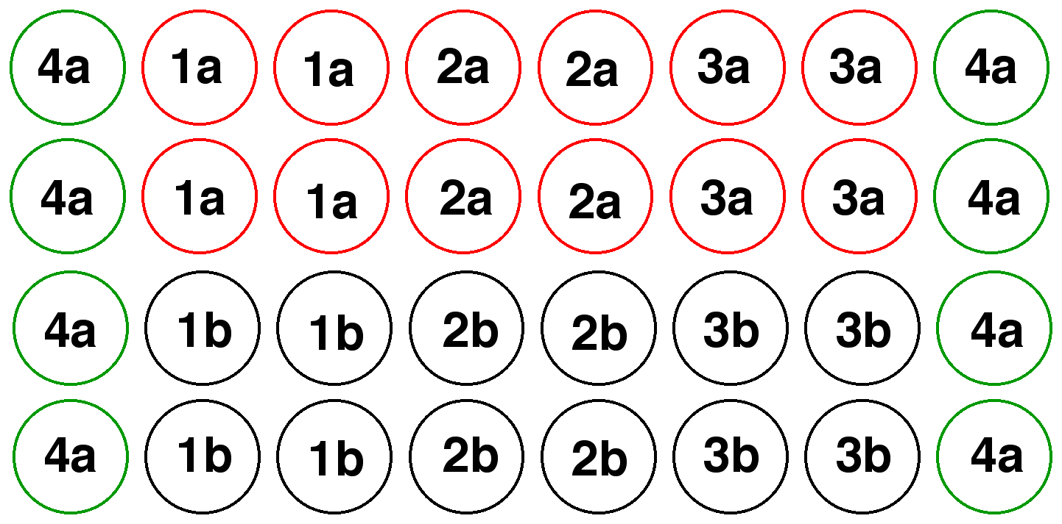
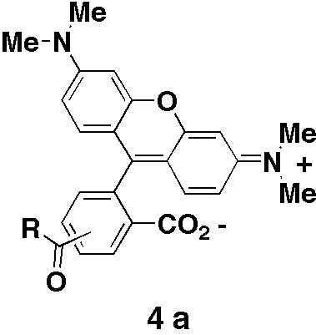
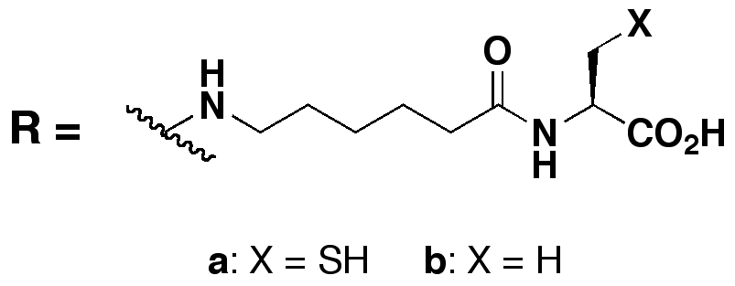
Proof-of-concept experiments for SMMs
detecting known protein-ligand interactions
Streptavidin
FKBP12
Anti-Digoxin mAb
J. Am. Chem. Soc. 121, 7967-7968, 1999

Slide 13
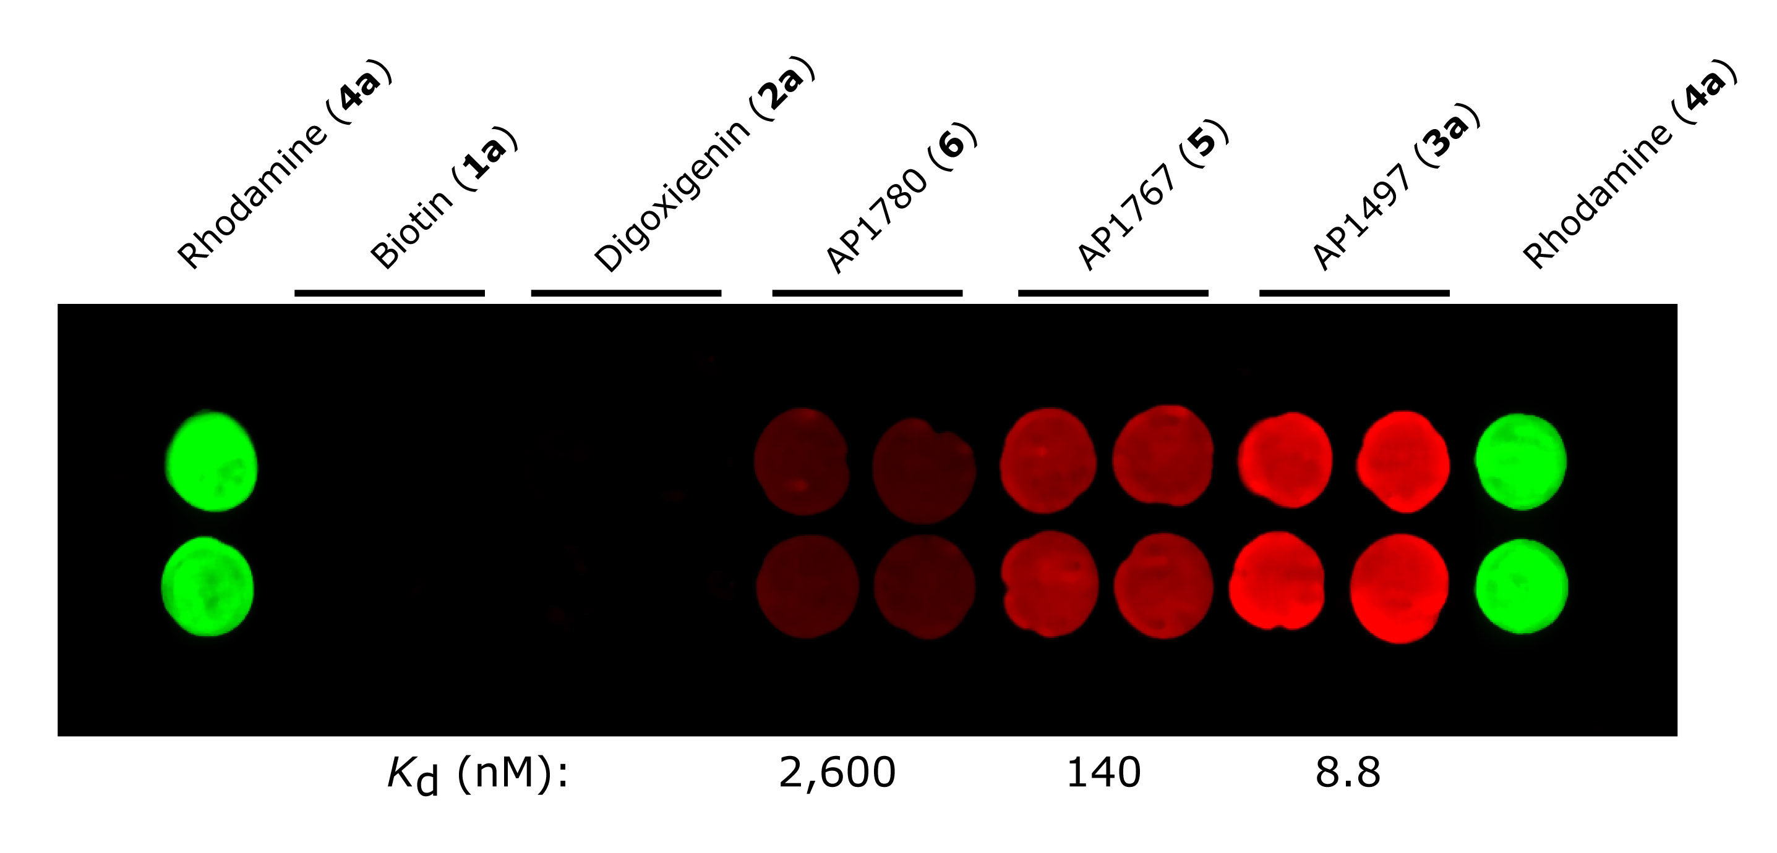
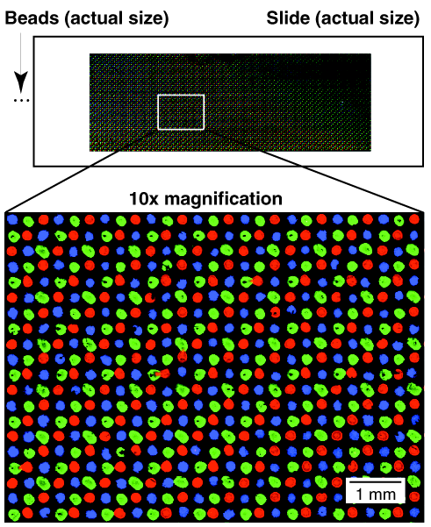
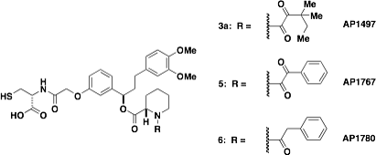
Proof-of-concept experiments for SMMs
evaluating affinities and multiplexed formats
K_{D} (nM): 2,600 140 8.8
J. Am. Chem. Soc. 121, 7967-7968, 1999

Slide 14
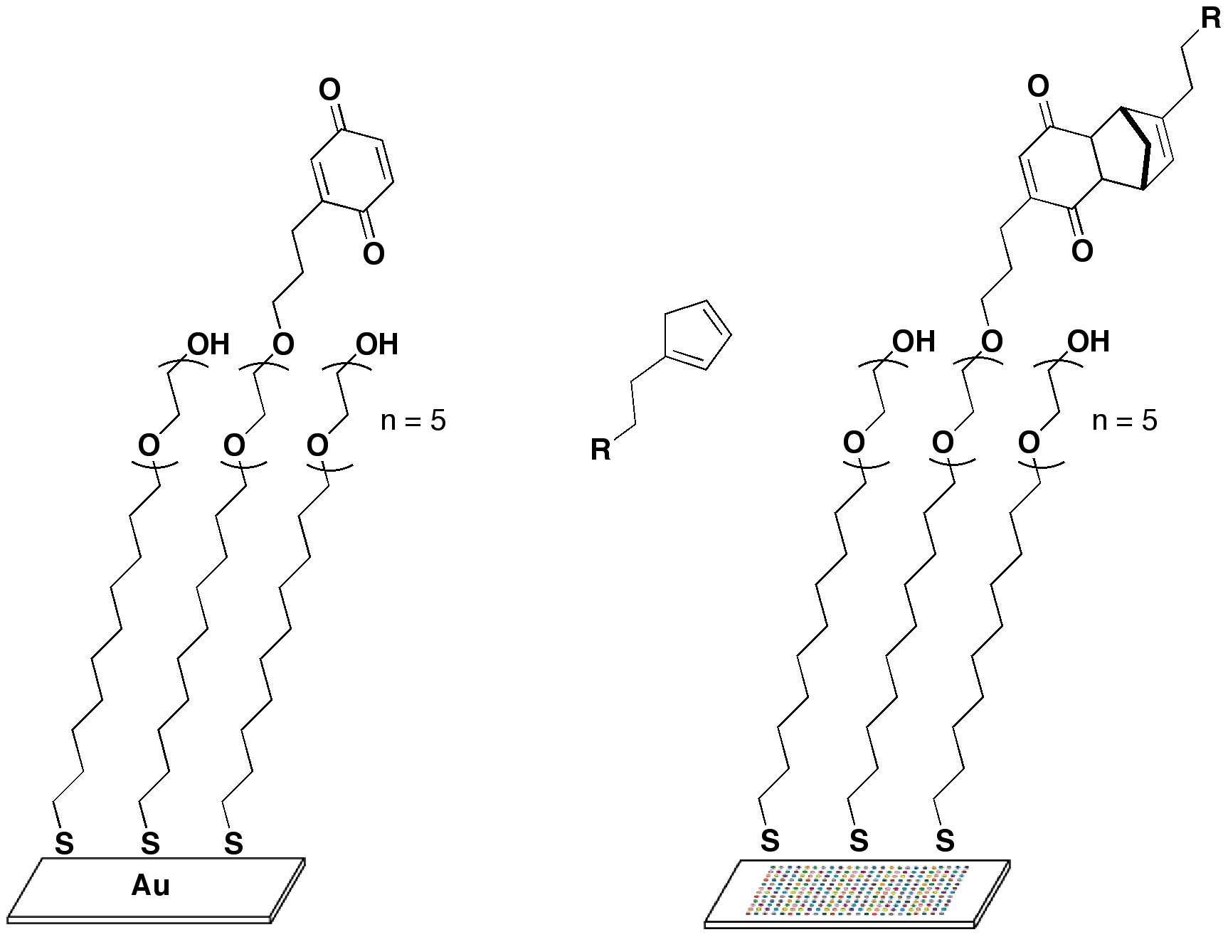
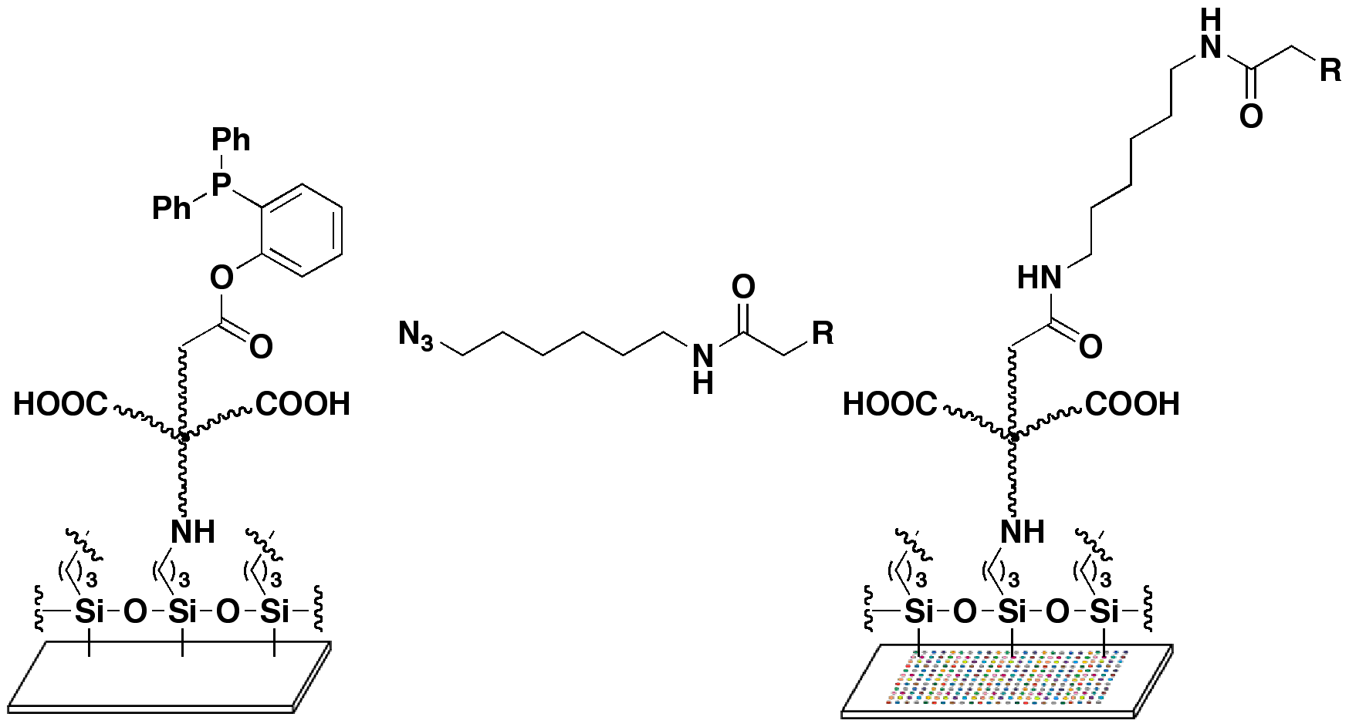
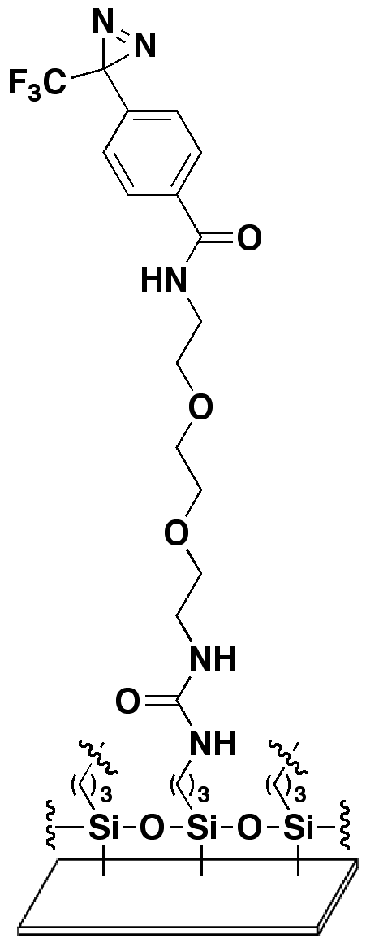
Capture chemistries for making SMMs
Diels-Alder
Staudinger ligation
benzoquinone
SAM
phosphine glass
Köhn et al., Angew. Chem. Int. Ed. 42, 5830-5834, 2003
Houseman, B.T., Mrksich, M. Chem. Biol. 9, 443-454, 2002
Photoaffinity
capture
Hergenrother et al., J. Am. Chem. Soc. 122, 7849-7850, 1999
Kanoh et al., Angew. Chem. Int. Ed. 42, 5584-5597, 2003
Barnes-Seeman et al., Angew. Chem. Int. Ed. 42, 2376-2379, 2003

Slide 15

Capture chemistries for making SMMs
Diels-Alder
Staudinger ligation
benzoquinone
SAM
phosphine glass
Köhn et al., Angew. Chem. Int. Ed. 42, 5830-5834, 2003
Houseman, B.T., Mrksich, M. Chem. Biol. 9, 443-454, 2002
Photoaffinity
capture
Hergenrother et al., J. Am. Chem. Soc. 122, 7849-7850, 1999
Kanoh et al., Angew. Chem. Int. Ed. 42, 5584-5597, 2003
Barnes-Seeman et al., Angew. Chem. Int. Ed. 42, 2376-2379, 2003

Slide 16
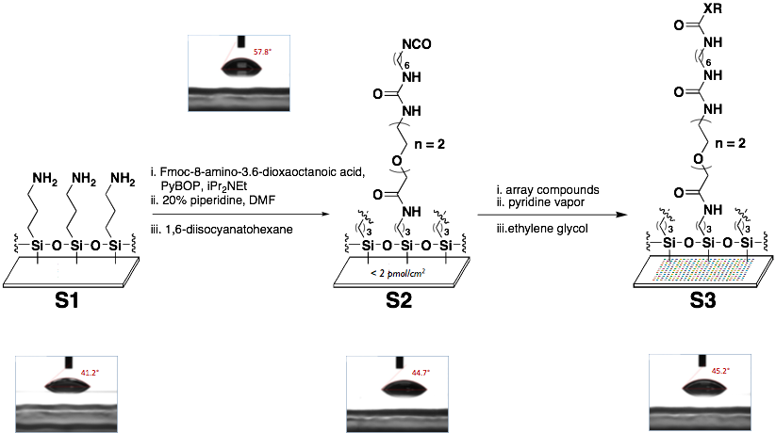
Capture chemistries for making SMMs
Bradner, J. E., McPherson, O. M., Mazitschek, R. M., Barnes-Seeman, D., Shen, J. P., Dhaliwal, J., Stevenson, K., Duffner, J. L., Park, S. B., Nghiem, P. T., Schreiber, S. L., Koehler, A. N., Chem Biol, 13, 493-504 (2006)
Bradner, J. E., McPherson, O. M., Koehler, A. N., Nature Protocols, 1, 2344-2352 (2006)

Slide 17
SMMs contain compounds from a variety of sources
In silico analysis of 400,000 ‘National Library’ for screens:
>75% isocyanate-reactive

Slide 18
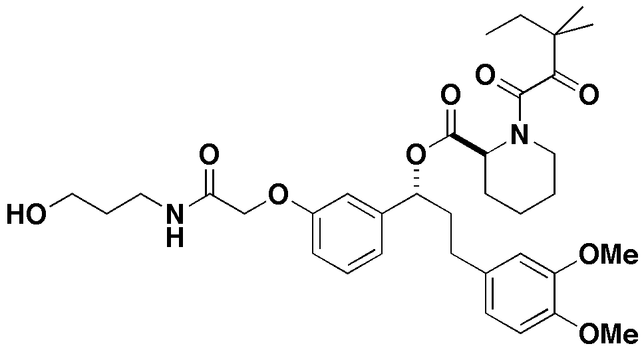
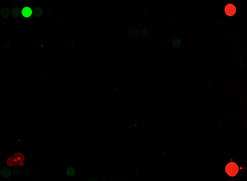
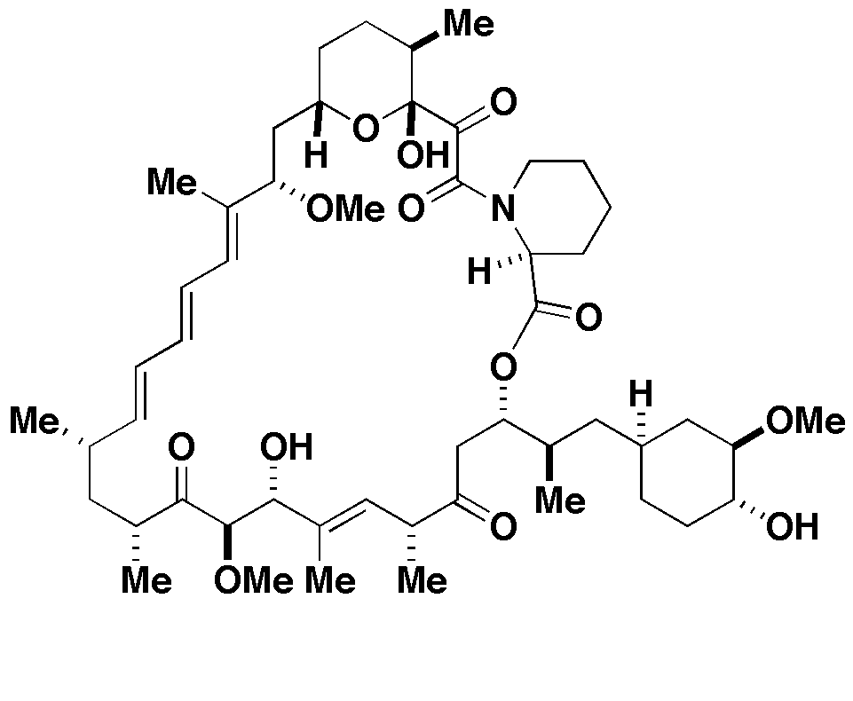
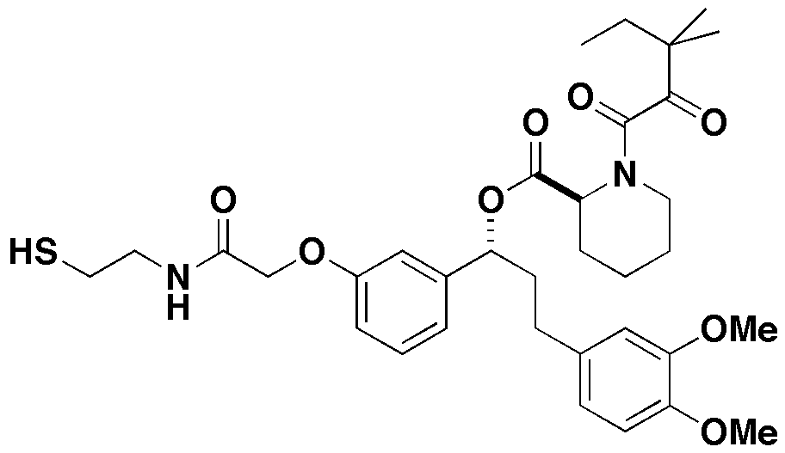
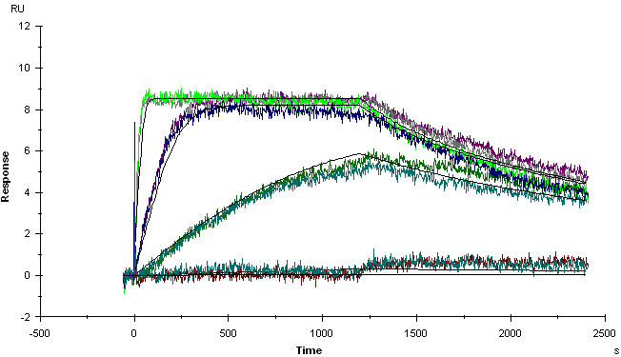
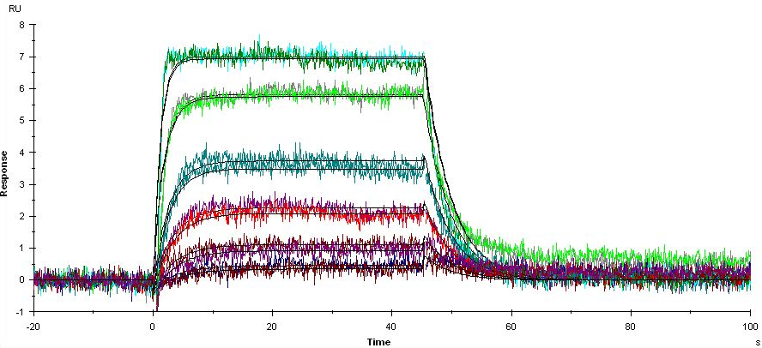
Interactions with varying kinetics can be visualized
350 µm
rapamycin
AP1497
42 min
2 min
K_{D} = 0.5 nM
K_{d} = 0.000965 sec⁻¹
K_{D} = 18 nM
K_{d} = 0.226 sec⁻¹

Slide 19
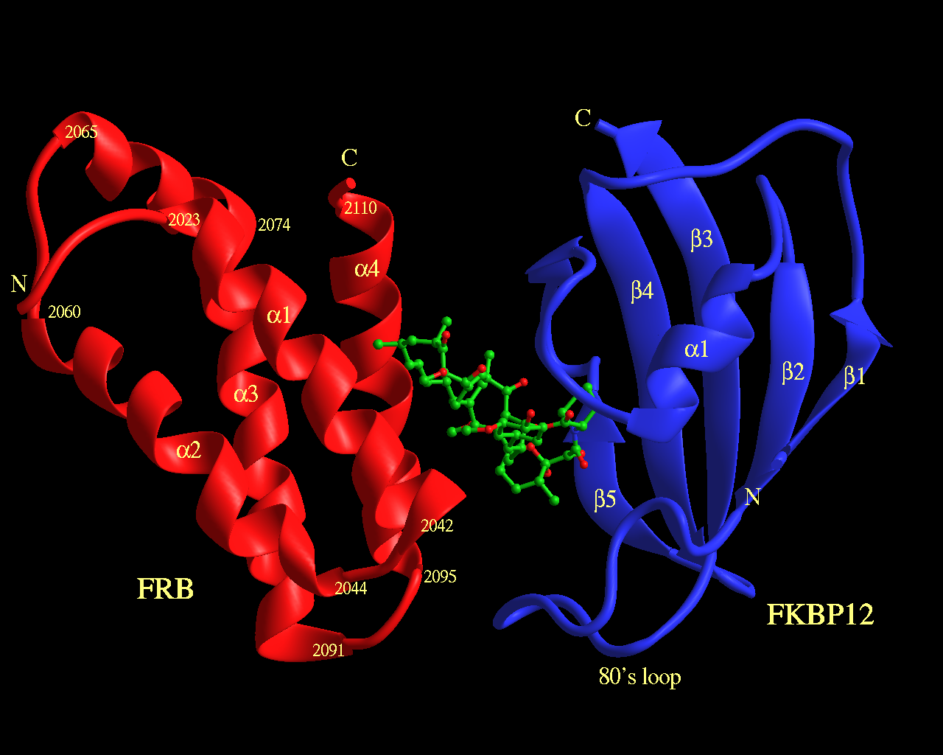


Detecting multiple interactions with Rapamycin
J Choi, J Chen, S L Schreiber, J Clardy, Science 1996, 273, 239-242.
FKBP12
FRB
K_{D} = 26 µM
K_{D} = 0.5 nM
1 mM Rapamycin
0.2 mM Rapamycin
FKBP12
FRB
domain
of mTOR
300 µm

Slide 20
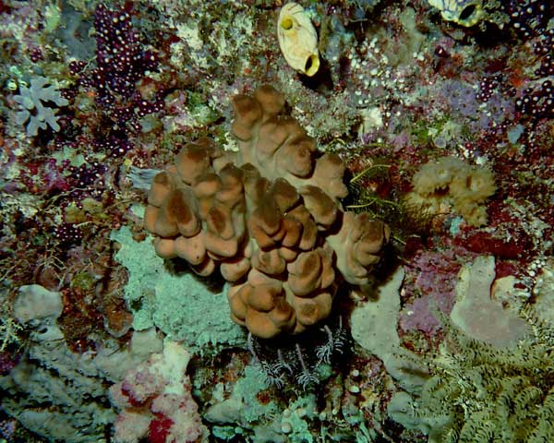
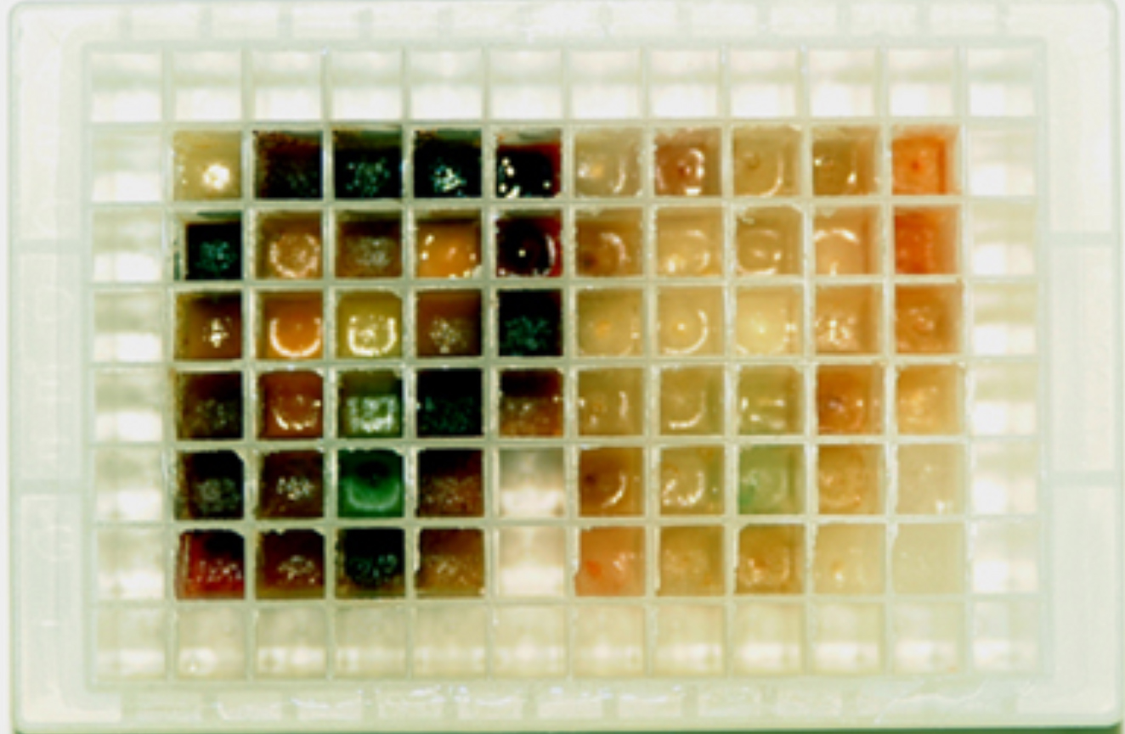
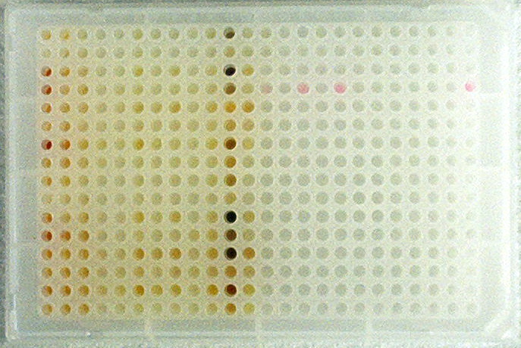
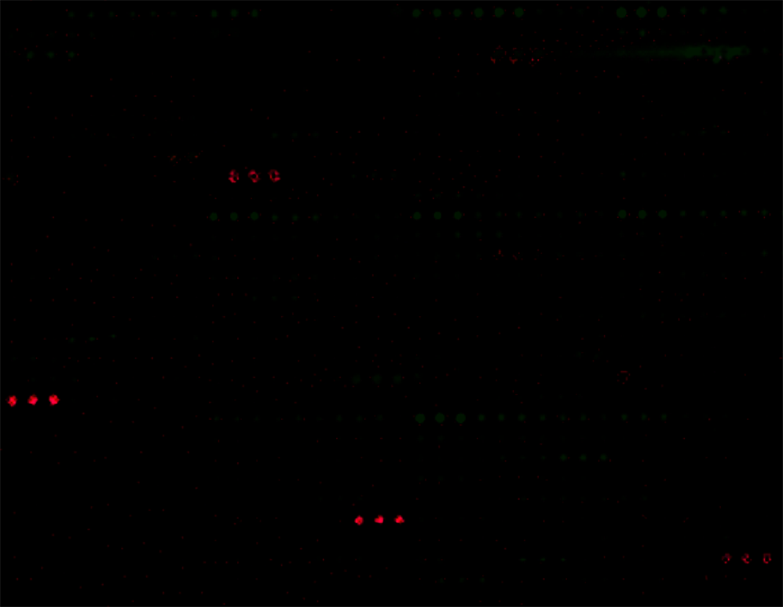
SMMs containing natural product extracts
Didemnum roberti
crude extracts
fractions of varying purity
SMM of extract fractions
manzamine A
eIF4a binder
stimulates IRES- and
cap-dependent translation
misakinolide A
tubulin binder
1000 µm
Schmitz, K., Haggarty, S.J., McPherson, O. M., Clardy, J., Koehler, A. N., J. Am. Chem. Soc., 129, 11346-11347, 2007

Slide 21
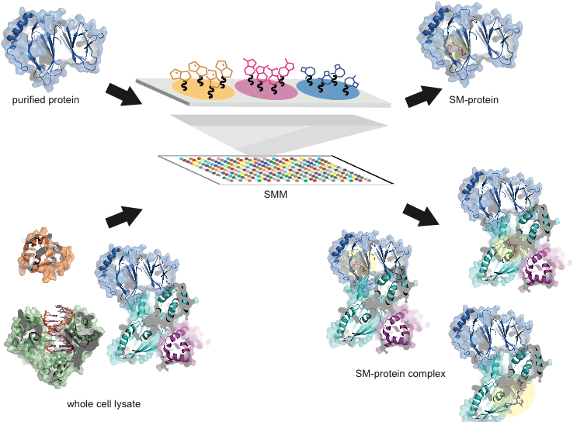
SMMs enable a new type of screen
target-directed assays in a native environment

Slide 22
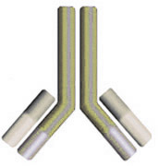
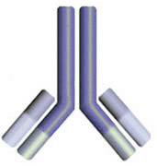


Binding screens involving cell lysates
HEK-293T Cells
control
transfection
(empty vector)
Flag-FKBP12
transfection
lyse cells
lyse cells
Tag
FKBP12
FKBP12
Bradner, J. E., McPherson, O. M., Koehler, A. N., Nature Protocols, 1, 2344-2352 (2006)

Slide 23




Comparing detection methods using lysates
Flag
1 2 Captopril Glutathione
FKBP12
eGFP
Detection via a Fluor-Labeled
Secondary Antibody
FKBP12
FKBP12
Detection via Green
Fluorescent Protein
Detection via anti-FKBP12 Antibody
and Labeled Secondary
500 µm
Bradner, J.E., McPherson, O.M., Mazitschek, R., Barnes-Seeman, D., Shen, J.P., Dhaliwal, J., Stevenson, K., Duffner, J.L.,
Park, S.B., Nghiem, P., Schreiber, S.L., Koehler, A.N. Chem. Biol. 13, 493-504, 2006

Slide 24
Binding screen using FKBP12 in cell lysates
Bradner, J.E., McPherson, O.M., Mazitschek, R., Barnes-Seeman, D., Shen, J.P., Dhaliwal, J., Stevenson, K., Duffner, J.L.,
Park, S.B., Nghiem, P., Schreiber, S.L., Koehler, A.N. Chem. Biol. 13, 493-504, 2006

Slide 25

Analysis pipeline – the simple version

Slide 26

A community effort

Slide 27

A community effort

Slide 28
Representative probes discovered by SMMs
Pirin from cell lysates
Sonic hedgehog
Aβ peptide
K_{D} = 0.6 µM (ITC)
inhibits pirin-Bcl3 interaction in cells
inhibits melanoma cell migration
Miyazaki et al, ACS Chem Biol 2010
K_{D} = 3.1 µM (SPR)
analog of SMM hit that inhibits Shh signaling in cells and synthetic skin model
Stanton et al, Nature Chem Biol 2010
K_{D} Aβ40_{mon} ~ 9-17 µM (various methods) inhibits Aβ42-induced cytotoxicity in PC12 cells, accelerates fibril formation
Chen et al, J. Am. Chem. Soc. 2010
Calmodulin
calmoduphilin
HDAC inhibitor
BRD-2577
Ure2p
uretupamine
Calmodulin
calmodioxane
FKBP12
FKL-01
Hap3p
haptamide
AURKA
1106.I16
Fyn
TAL-Cl
Fyn
Bi-TAL
Calmodulin
NPC-15437
Fyn
TAL
Discovery stories highlighted in - Vegas, A.J., Fuller, J. H., Koehler, A.N. Chem. Soc. Rev. 37, 1385-1394, 2008

Slide 29

Public access for SMM data sets

Slide 30




ChemBank: an analytical tool for the community
assays (cell-based, biochemical, binding)
relationship of structure to screen performance
small molecules
relationships between assays (protein and phenotype)

Slide 31
Spring 2017 FKBP12 screens
’Gradbot’
Rob

Slide 32
Spring 2017 FKBP12 screens
’Gradbot’
Rob
each team screened
5,000 unique
compounds
16x16x48 = 12,288
2 replicate slides
4 replicates for each compound

Slide 33
Spring 2017 FKBP12 screens
each team screened
5,000 unique
compounds
16x16x48 = 12,288
2 replicate slides
4 replicates for each compound

Slide 34




Spring 2017 FKBP12 screen summary
Identify fluorescent spots on microarray images
Establish a threshold for statistical significance
Validate hits by eye
(76 compounds pass)

Slide 35
Conserved substructures

Slide 36


Our path to evaluate FKBP12 ligands
+
in silico cloning; overexpress FKBP12
lab days 1 & 2
purify and analyze FKBP12
lab days 3 and 4
re-analyze screen data
lab day 2
IC₅₀ = X µM
ΔT = Y °C
test FKBP12 and ligands
in enzyme activity assay
lab day 5
test ligands in FKBP12
binding assay
lab day 6
complete data analysis
prioritize best ligands
lab day 7

Slide 37
Our path to evaluate ligands - lectures
2/8/17 Lecture 1 Intro to chemical biology: small molecules, probes, and screens
2/13/17 Lecture 2 For the love of proteins: FKBP12 and immunophilins
2/15/17 Lecture 3 Small-molecule microarrays
2/21/17 No Lecture
2/22/17 Lecture 4 Quantitative evaluation of protein-ligand interactions
2/27/17 Lecture 5 A ligand discovery vignette: sonic hedgehog
3/1/17 Lecture 6 Engineering transcriptional responses with a small molecule
3/7/17 Lecture 7 Wrap up discussion: suggestions for how to report your findings

