Slide 1
1
Module 3 overview
lecture lab
1. Introduction to the module 1. Examine protein structure
2. Rational protein design 2. Identify mutants
3. Binding behavior 3. Analyze protein data
4. Fluorescence and sensors 4. Design new mutants
5. High throughput screening 5. Write mini-report

Slide 2
2
Lecture 5: High throughput protein engineering
I. Protein evolution
A. Principles of directed evolution
B. Library construction
II. Screening methods
A. Comparison of techniques
B. Common problems and solutions

Slide 3
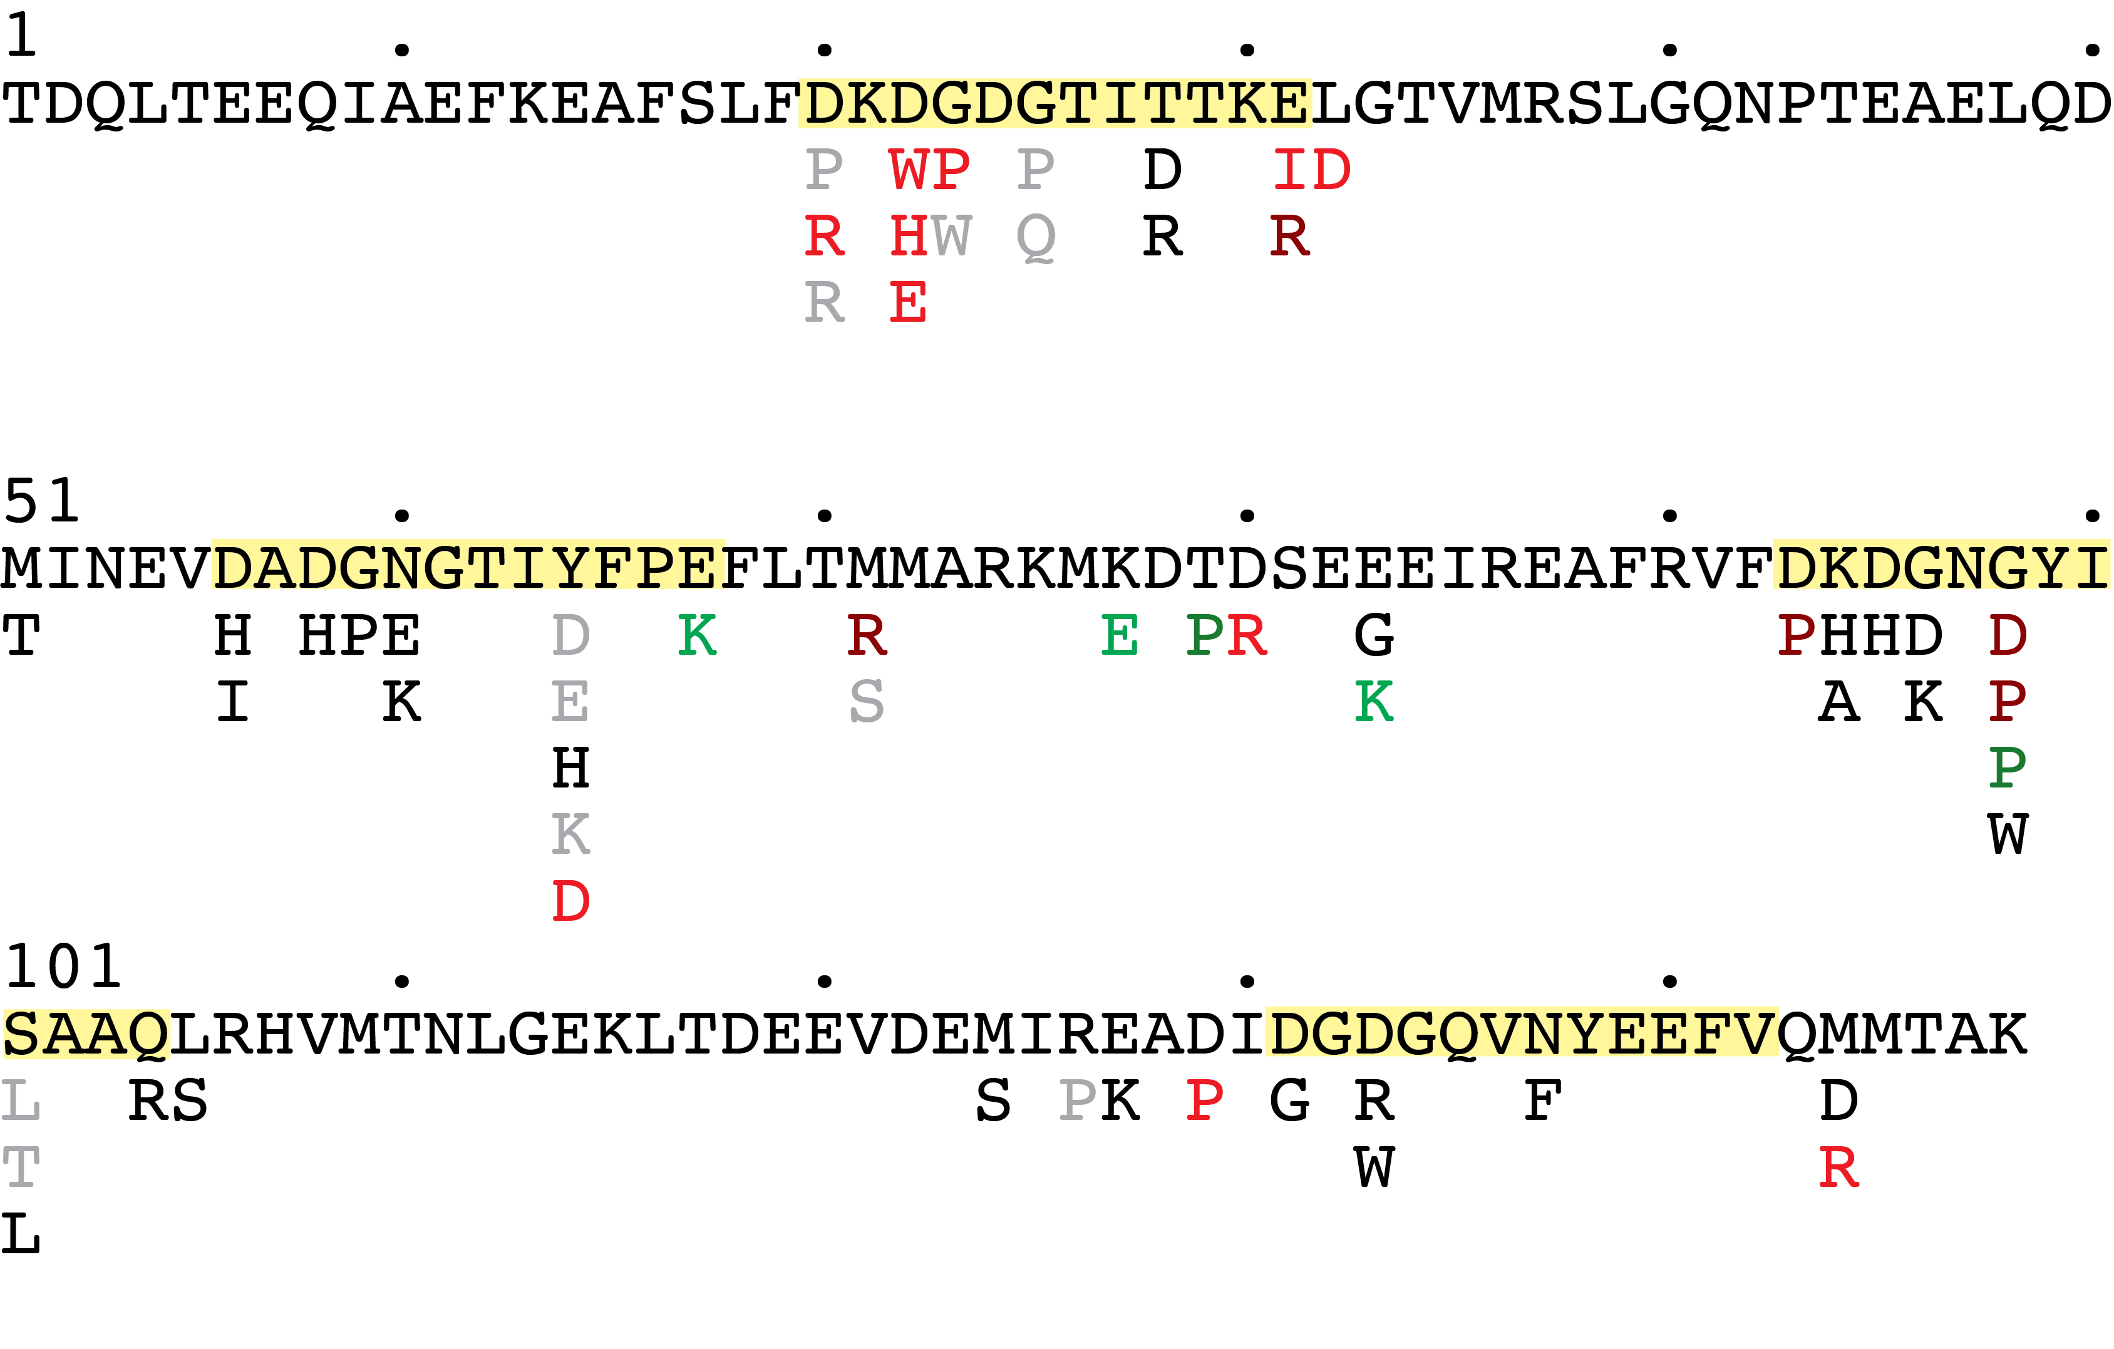
3
class mutants
2008-13
this represents efforts of dozens of
students over multiple years…
Wouldn’t it be nice if there were a faster
way to screen mutants and optimize the
protein, even if it needs to be less “rational”?

Slide 4
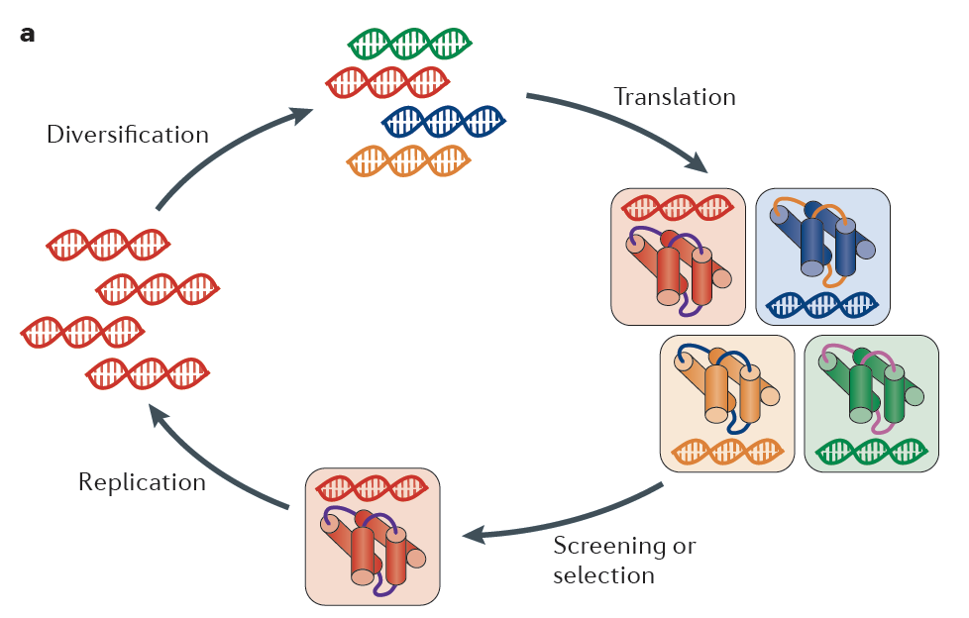
“Irrational” high throughput protein engineering
Selection for desired properties from libraries of random variants
4
“directed evolution”
library generation
amplifies “hits”
essential to keep
genotype associated
with phenotype
Packer & Liu (2015) Nat Rev Genetics

Slide 5
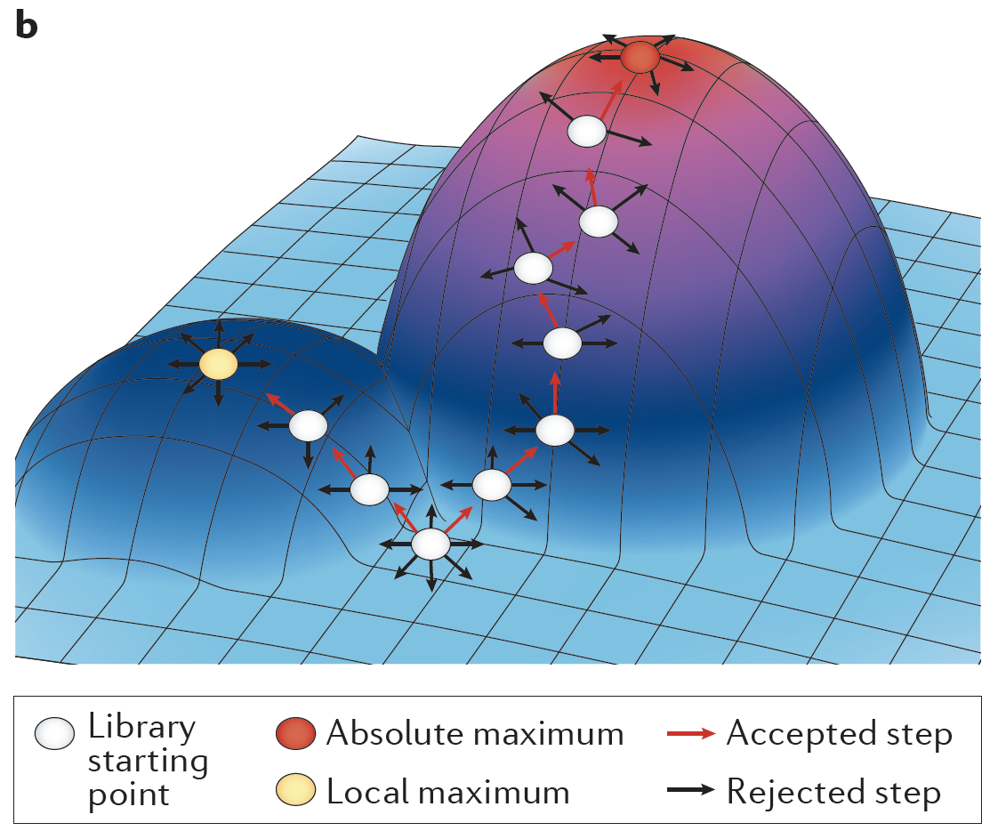
Because all possibilities cannot be generated and screened,
stepwise progression is sought...
5
“fitness landscape”
Packer & Liu (2015) Nat Rev Genetics

Slide 6
6
Methods for generating mutant genetic libraries:
• degenerate DNA sequences
• error-prone PCR
• gene shuffling
Degenerate DNA
gat aag gac ggc gat gcc acg att acc acc
D K D G D G T I T T
ga(c/g)
D/E
xcc
S/P/T/A
xxx
X
• not all combinations of AAs possible at each position
• number of combinations expands exponentially
• degenerate primers synthesized by split-pool method
• standard primer design criteria must be considered

Slide 7
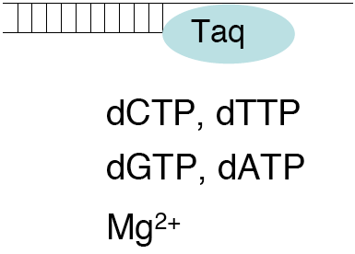
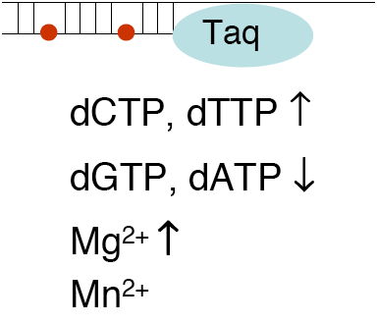
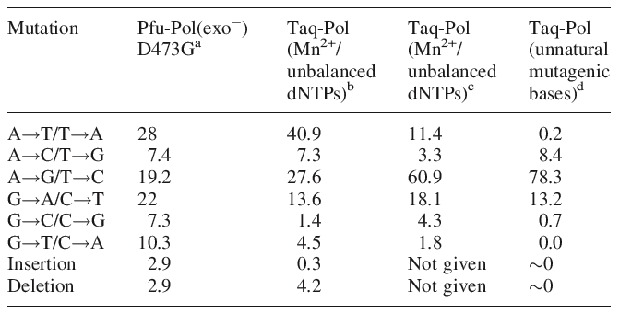
PCR polymerase and conditions may be chosen to promote mutations
7
error rate = mutation load ÷ template doublings
normal PCR
error-prone PCR
some mutations are
more likely than others
How much mutagenesis
should one do?
Biles & Connolly (2004) Nucl. Acids Res.

Slide 8
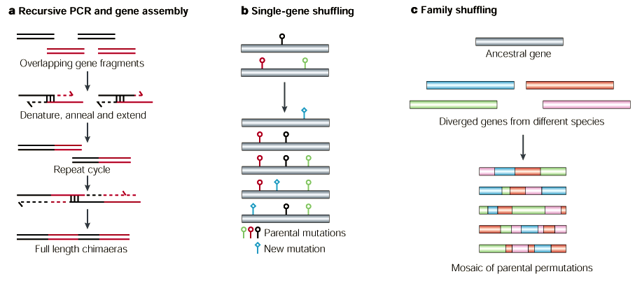
8
Gene shuffling techniques mimic diversity due to meiotic recombination:
• fragments of homologous genes combined
• diversity may arise from error prone PCR or multiple input genes
many alternatives...
Brannigan & Wilkinson (2002) Nat. Rev. Mol. Cell. Biol. 3: 964-70

Slide 9
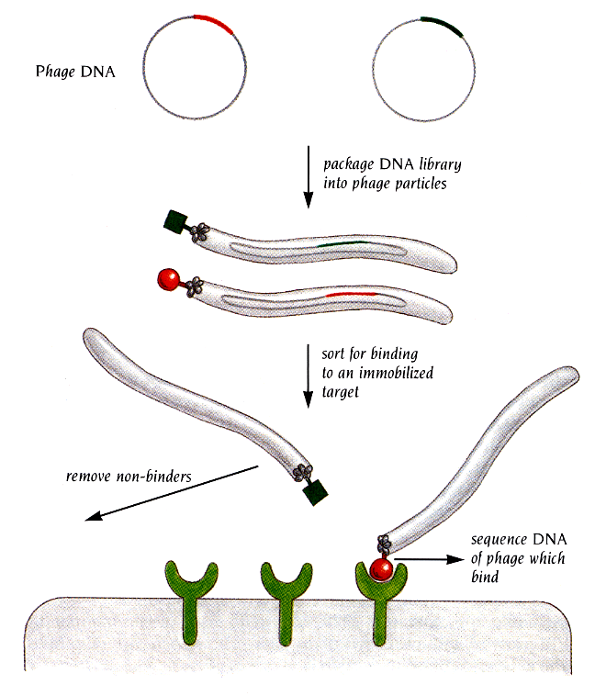
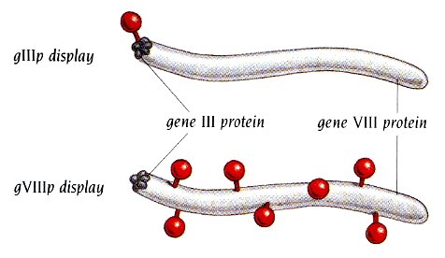
How are libraries of mutant proteins screened?
9
All major methods include a strategy to keep DNA sequence info associated with the proteins that are being screened.
Phage display is a versatile high throughput method to do this:
protein “displayed” on the coat
of a bacteriophage, by fusing to
a natural phage coat protein
M13 phage
(contains DNA)
Branden & Tooze, Introduction to Protein Structure

Slide 10
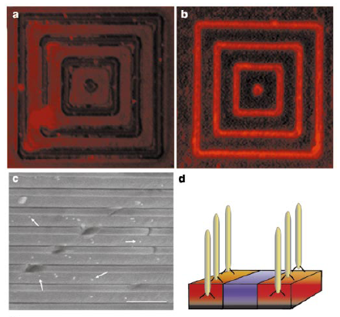
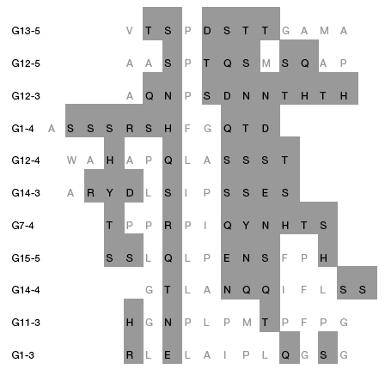
10
Application: phage-displayed peptides that bind to GaAs
selected sequences
phages patterned on target substrate
Whaley et al. (2000) Nature 405: 665-8.

Slide 11
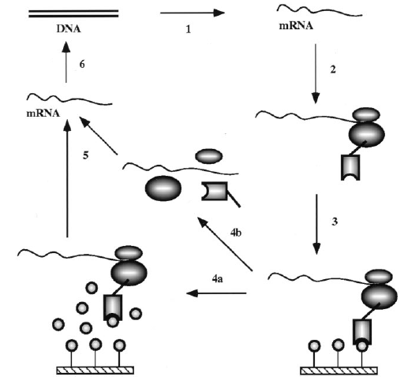
11
Ribosome display: mRNA and synthesized proteins held together non-covalently on a ribosome
What are advantages of this technique over phage display?
• screening not in the presence of large particles
• incorporation of unnatural amino acids
omit stop
codon, etc.
Hanes & Plückthun (1997) Proc. Natl. Acad. Sci. USA 94: 4937-42
Josephson et al. (2005) J. Am. Chem. Soc. 127: 11727-35

Slide 12
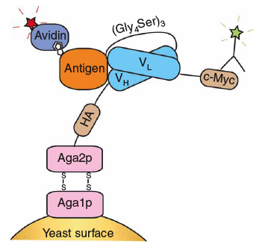
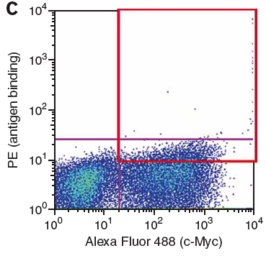
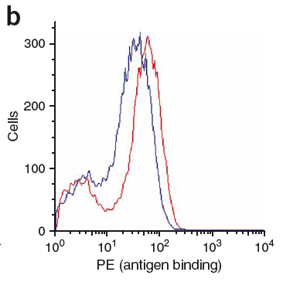
Yeast display: similar to phage
display, but with proteins fused to
a Saccharomyces cell wall protein
(DNA in yeast)
12
What are advantages compared with other techniques?
In this example, a po-pulation of scFvs was screened for binding to an antigen
left: selection criterion for FACS assay
right: comparison of wt (blue) and selected (red) scFv binding
Why not more stringent selection?
Chao et al. (2006) Nat. Protoc. 1: 755-68

Slide 13
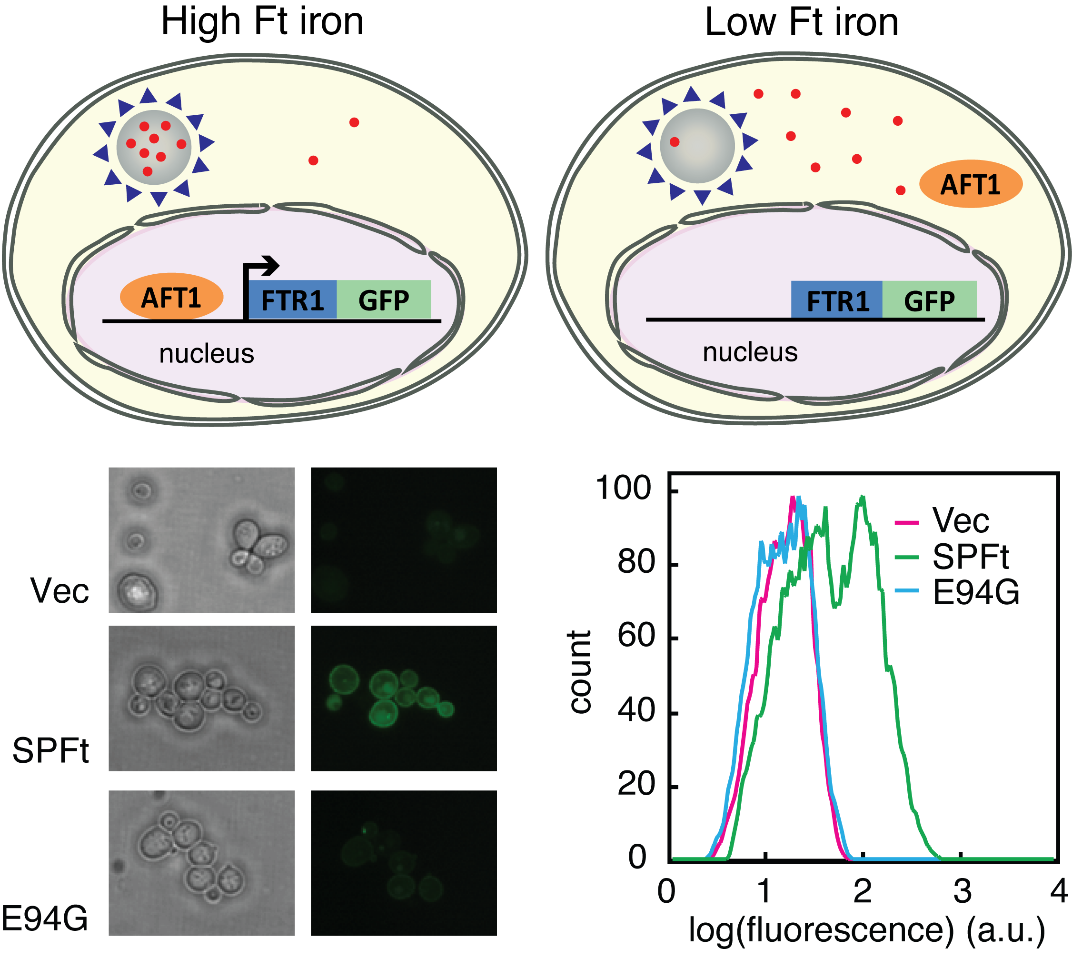
What about screening for properties other than binding?
13
screening for a
“hypermagnetic”
metalloprotein
iron sequestration
by Ft detected
Matsumoto et al. (2015) Nat Commun 6: 8721

Slide 14
What are the limitations of screen-based engineering methods?
14
Library size...
screen method throughput other notes
SELEX 10¹⁵ selection of DNA/RNA
ribosome display 10¹⁵ in vitro protein synthesis
phage display 10¹¹ best for small proteins/peptides
yeast display 10⁸ compatible w/eukar. proteins
plate/colony assays < 10⁵ versatile but more complex
number of variants in a library
x residues = 20^{x} protein variants, 4^{x} DNA/RNA variants
12 AA residues = 4 x 10¹⁵ variants
lesson: impossible to cover sequence space except with short sequences (or few positions) and only the most high throughput techniques

Slide 15
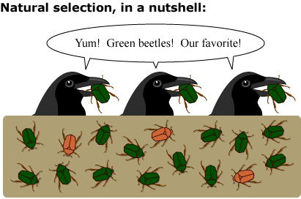
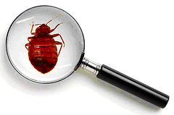
The First Law of Directed Evolution: “You get what you screen for”
15
screen for binding to immobilized dyes
get molecules that bind resin, tethered dyes
screen for enzymes that catalyze a reaction in yeast
get enzymes that only work in yeast
What can you do about these issues?
negative selection
careful characterization of hits
http://evolution.berkeley.edu/evolibrary/images/interviews/naturalselection1.gif
http://mobileportland.com/sites/default/files/BedBugMagnifyingGlass.png

Slide 16
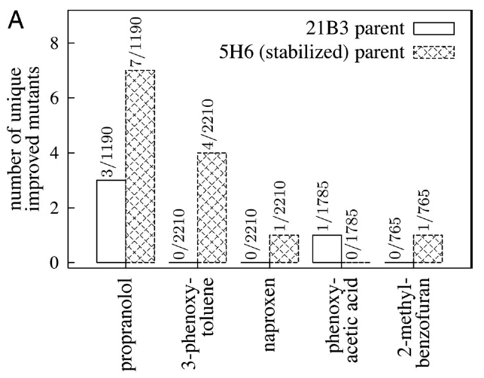
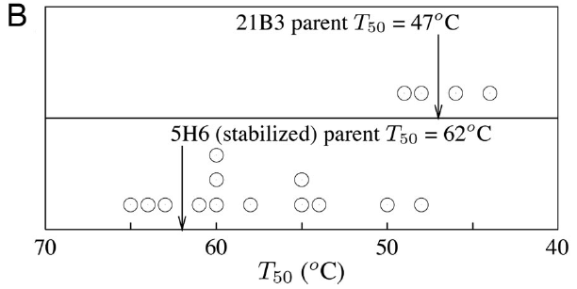
Evolution hurts molecules: most mutations destabilize
16
T_{m} = 47°C
T_{m} = 62 °C
Why does the more stable
protein yield more hits?
What might account for the
exception (phenoxyacetate)?
many of the mutations in
the more stable protein were
themselves destabilizing
Bloom et al. (2006) PNAS

Slide 17
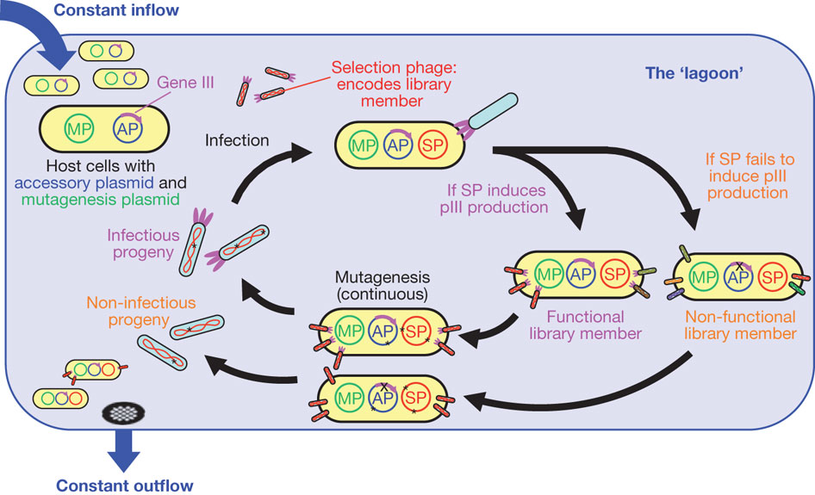
Speed of directed evolution is often slow; how can we speed it up?
17
phage-assisted continuous evolution (PACE)
(bioreactor)
pIII functions as a reporter; selected protein must turn it on
can be used for protein-DNA, protein-protein interactions, etc.
Esvelt et al. (2011) Nature

