Slide 1
to 20.109!
Laboratory Fundamentals of Biological Engineering
2/4/20

Slide 2
Insight from previous 109ers
Words of wisdom…

Slide 3
Notes:
Our goal in this class is to teach effective scientific communication…it doesn’t matter what you discover if you can’t make the information understandable / relevant…jargon

Slide 4
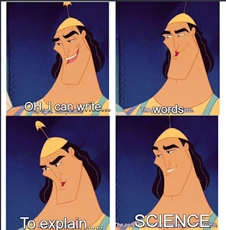
Notes:
We will spend a lot of time discussing how to best communicate your results…and how to make the information accessible to a broad audience…concise / clear communication

Slide 5
Notes:
To accomplish this, you will complete several rounds of practice…homework assignments can be overwhelming, but all are intended to help you with the major assignments

Slide 6
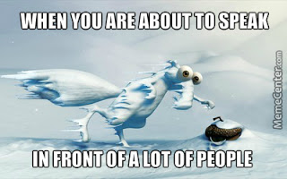
However, the experience was such a great learning experience. It taught me … how to communicate what was necessary … how to craft effective slides … the importance of practicing ... Thus, even though the Journal Club presentation was nerve-racking, it was a valuable experience.
Notes:
Will complete both verbal and written assignments, verbal assignments…

Slide 7
Notes:
Written assignments…

Slide 8
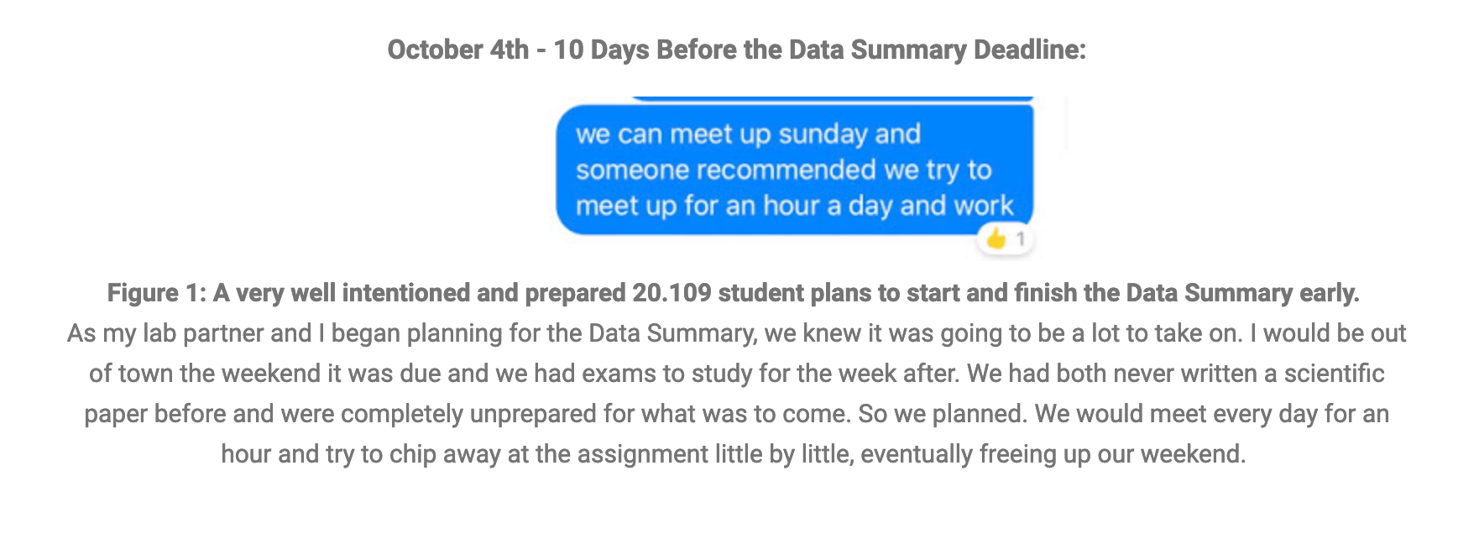
Notes:
Get started early!

Slide 9
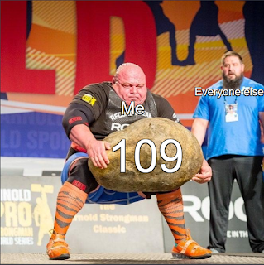
Notes:
109 can be challenging at different times in the semester

Slide 10
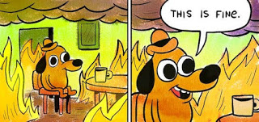
Notes:
Don’t get overwhelmed…we are here to help

Slide 11
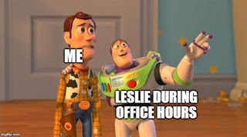
Notes:
Instructors have regularly scheduled OH and host additional OH for major assignments…

Slide 12
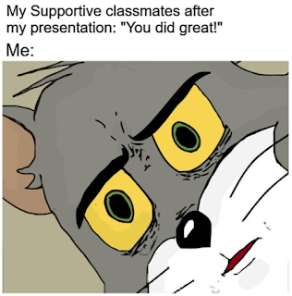
Notes:
And your peers are here for you! Lasting friendships and study groups often formed in this class that continue throughout undergraduate classes to come…

Slide 13
A brief introduction to 20.109
Meet the team
Core mission
Building a better bioengineer
Experimental outline
Module 1: Screening ligand binding
Module 2: Measuring gene expression
Module 3: Engineering antibodies
Logistics

Slide 14
Meet the 20.109 teaching team
Lecture / Laboratory Instructors
Prof. Angela Koehler (M1)
Prof. Ernest Fraenkel & Dr. Noreen Lyell (M2)
Dr. Leslie McClain (M3)
Dr. Becky Meyer
Communication Instructors
Dr. Sean Clarke
Dr. Prerna Bhargava
Teaching assistants
Kevin Chung (T/R)
Joe Kreitz (W/F)
Research Assistants
Rob Wilson
Anne Shen
Sarah Cowles

Slide 15
Core mission of 20.109
To prepare students to be the future of Biological Engineering
To teach cutting edge research skill and technology through an authentic research experience
To inspire rigorous data analysis and its thoughtful communication

Slide 16
You will complete three projects!
Module 1: Screening ligand binding (Prof. Koehler)
Module 2: Measuring gene expression (Prof. Fraenkel & Dr. Lyell)
Module 3: Engineering antibodies (Dr. McClain)

Slide 17
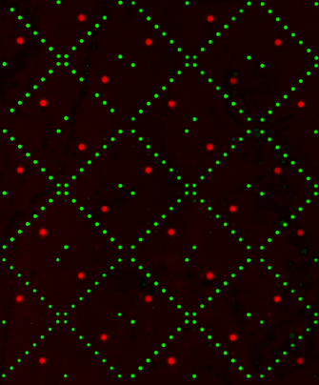
Module 1: High-throughput ligand screening
Experiments
Purify protein and assess purity / concentration
Screen small-molecule microarray
Lab skills
Molecular biology techniques
High-throughput screening
Data analysis

Slide 18
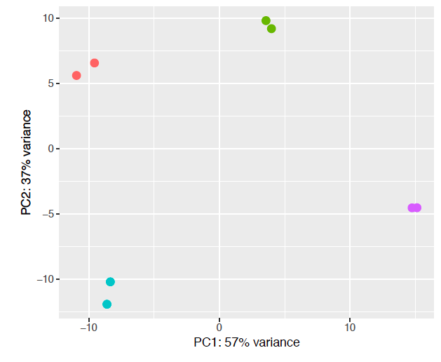
Module 2: Measuring gene expression
Experiments
Measure gene expression using qPCR and RNA-seq
Examine cell survival in response to drug treatment
Lab skills
Mammalian tissue culture
Molecular biology techniques
Big data analysis

Slide 19
Module 3: Engineering antibodies
Experiments
Screen antibody library using fluorescence activated cell sorting
Test single antibody binding to antigen using flow cytometry
Lab skills
Molecular biology techniques
High-throughput screening
Data analysis

Slide 20
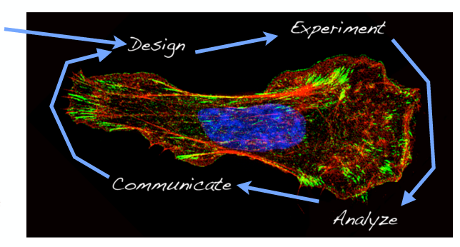
Workflow in 20.109
We start here…
But, you can’t design an experiment without analyzing some data!

Slide 21
Workflow in 20.109
Research!
We start here…
But, you can’t design an experiment without analyzing some data!

Slide 22
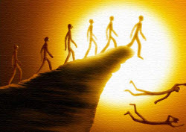
Experiments in 20.109 are real science
We aim to prevent ‘just follow the protocol’ syndrome
Will discuss not only how experiments are completed, but what each step actually does

Slide 23
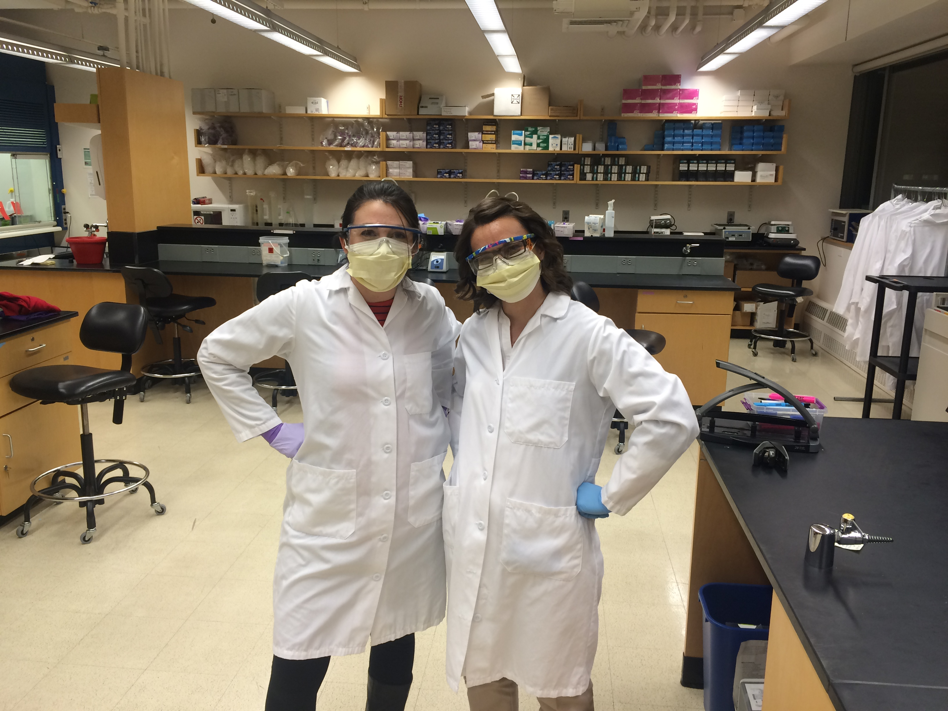
Experiments in 20.109 are real science
We do relevant and cutting edge research
Will discuss best practices for data collection and personal / environmental safety

Slide 24
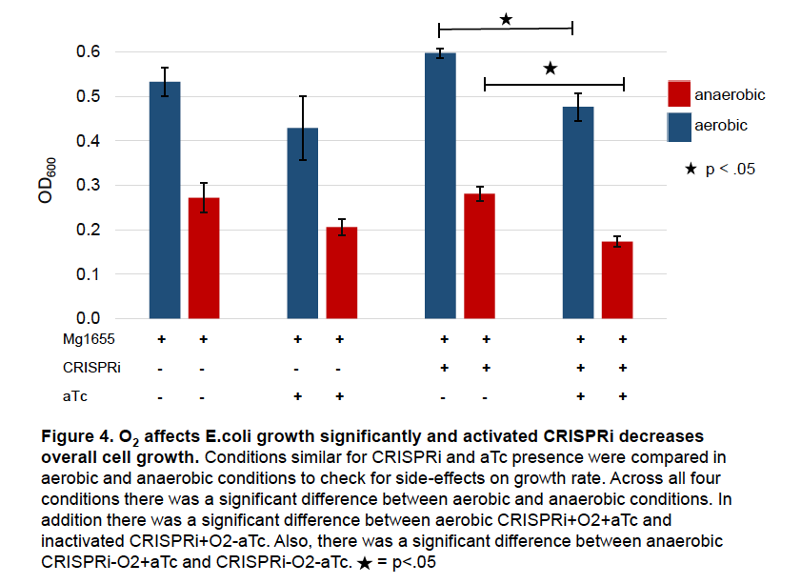
We analyze and report real data in 20.109

Slide 25
Written and verbal communication are critical
Written communication assignments = 40%
Verbal communication assignments = 40%
Daily work and participation = 20%

Slide 26
Why communicate your science?
http://nrelscience.org/2013/09/26/why-scientists-should-tell-more-stories/

Slide 27
Why scientists should tell more stories
“Story is the number one way we learn from past experiences, to be better people, and share in experiences. Yet as scientists we feel the need to separate ourselves from this proven method of communication…
…encourage the use of narrative in science, but with caution. I would argue that narrative is imperative for science communication. Data already incorporates a narrative; we just need to find ways to bring it to light.”

Slide 28
We are here to help!
20.109 Teaching faculty
BE Communications Lab
Instructors
Dr. Sean Clarke
Dr. Prerna Bhargava
Writing fellows

Slide 29
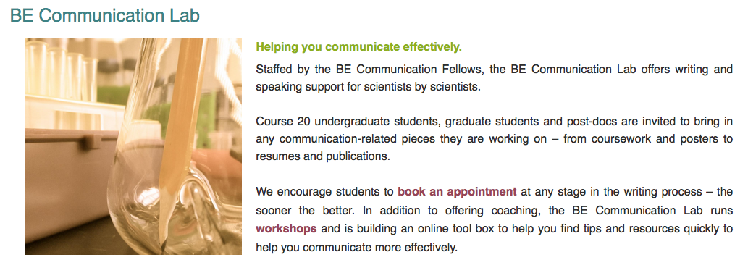
BE Communication Lab is a great resource
mitcommlab.mit.edu/be

Slide 30
Schedule and Course logistics
Lectures meet Tuesday and Thursday 11-12p in 56-154
Prof. Koehler ➔ Dr. Fraenkel & Dr. Lyell ➔ Dr. McClain
Class divided into two laboratory sections
Tuesday and Thursday 1-5p in 56-322
Wednesday and Friday 1-5p in 56-322
Details
You will work in pairs throughout the semester
Collaboration with integrity is key!

Slide 31
Expectations in 20.109
Your expectations of us…
We will come to class and laboratory prepared
We will be clear and reasonable in all assignments
We will treat every 109er with respect
We will give everyone equal chance at success

Slide 32
Expectations in 20.109
Our expectations of you…
You will come to class
You will be prepared for lecture and laboratory
You will not interfere with each other’s learning
You will invest the very best of yourself
You will be honest with your peers and the teaching faculty

Slide 33
Our goals for you this semester
Organize a constructive laboratory notebook
Implement laboratory protocols and troubleshoot
Interpret and analyze data
Recognize the utility of models and assays
Critically examine scientific literature
Communicate your science
Work as a team
Provide constructive and helpful feedback

Slide 34
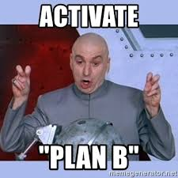
Final notes for laboratory this week
Due to oversubscribed class, we need to go to Plan B!
Please arrive to laboratory tomorrow on time
Complete the laboratory-specific training prior to arriving
In laboratory, you will be alerted to other training you must complete
Please wear / bring pants and closed toed shoes
We will be working in the laboratory

