Slide 1
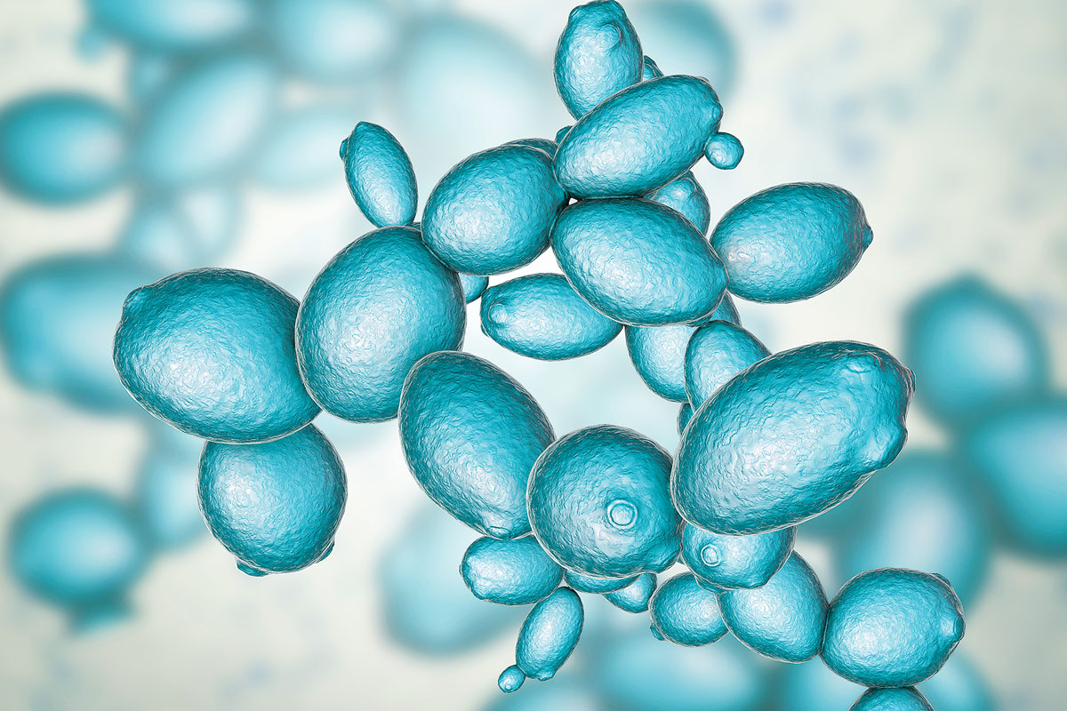
Screening a system—laboratory approaches to assessing features of a bioremediation system
3/23/23

Slide 2
Module Outline
M2D1: Environmental heavy metal contamination
Intro
M2D2: Model system – target selection and engineering approach
M2D3: Model system – choosing a chassis host
Design
M2D4: Screening a system—assessing features of a bioremediation system
M2D5: Analysis of elemental metals – laboratory and field approaches
Test
M2D6: Applying remediation strategies—advantages and pitfalls
M2D7: Engineering a problem-specific bioremediation solution
Apply
M2D8: Comm Lab
Review

Slide 3
Lecture overview
3 key parameters of our bioremediation system should be established
Is our mutant protein expressed?
Does our mutant transporter show any differential ability to take up metal?
Does our cell tolerate metal exposure and uptake?

Slide 4
Protein expression

Slide 5
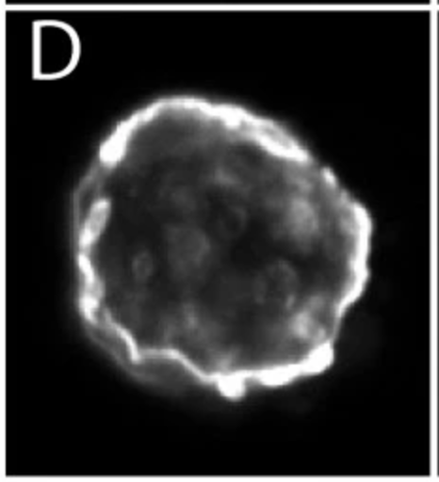
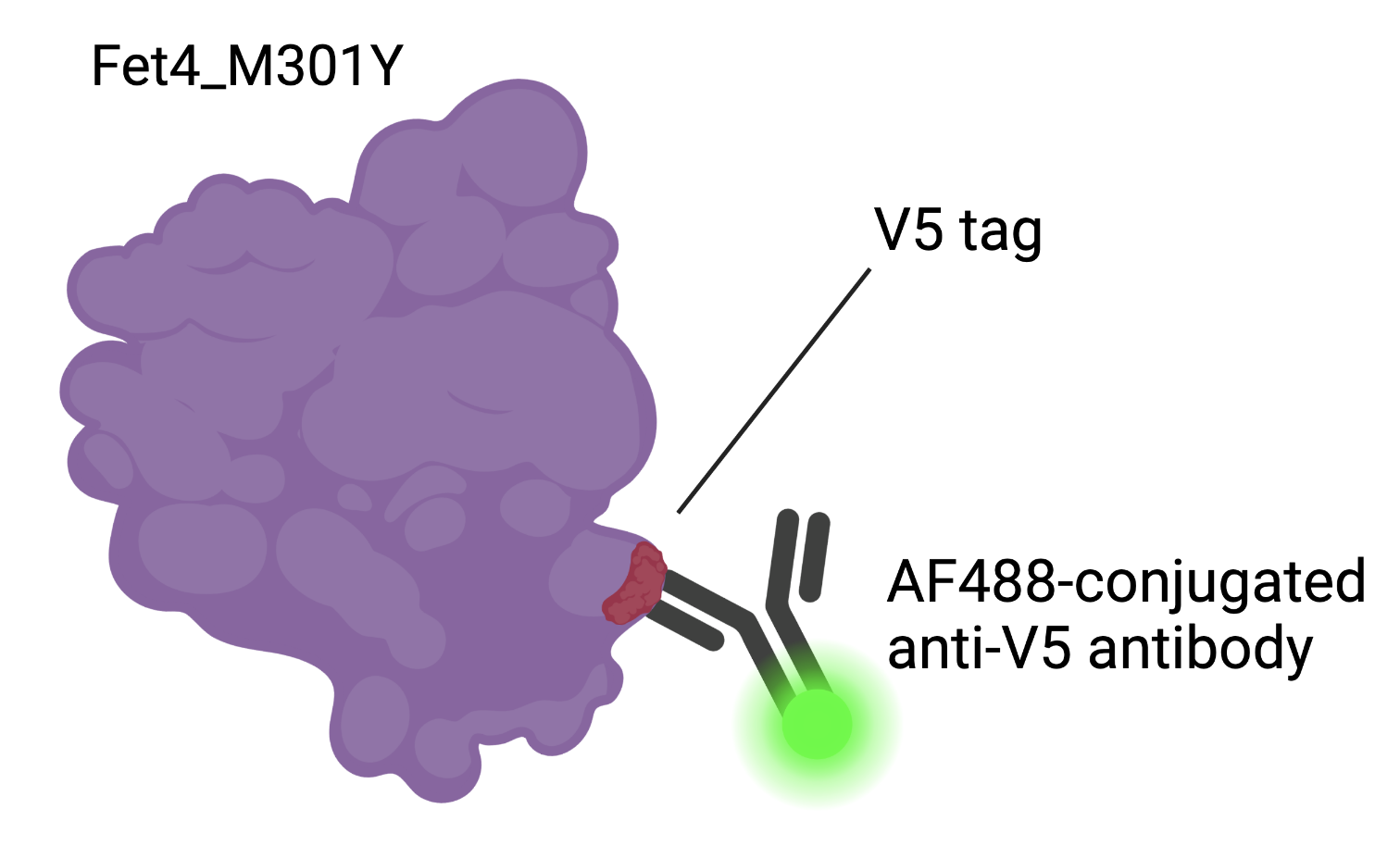
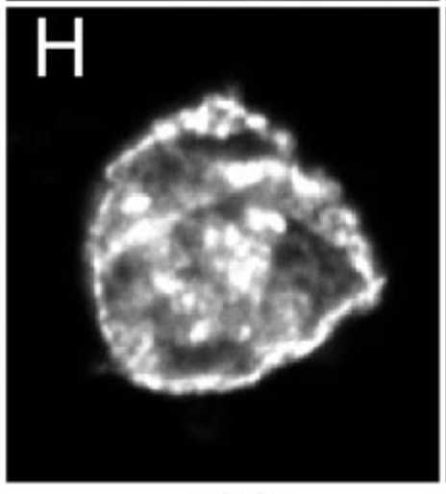
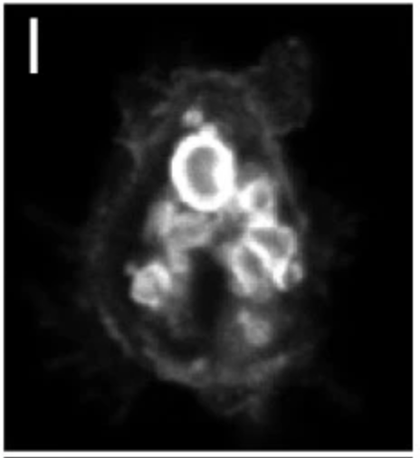
Fet4 mutant expression can be established with immunofluorescence
Antibodies against protein or incorporated tag
Confirms that mutant protein is translated and trafficked as expected
Automated 96 well microscopy for adherent cells

Slide 6
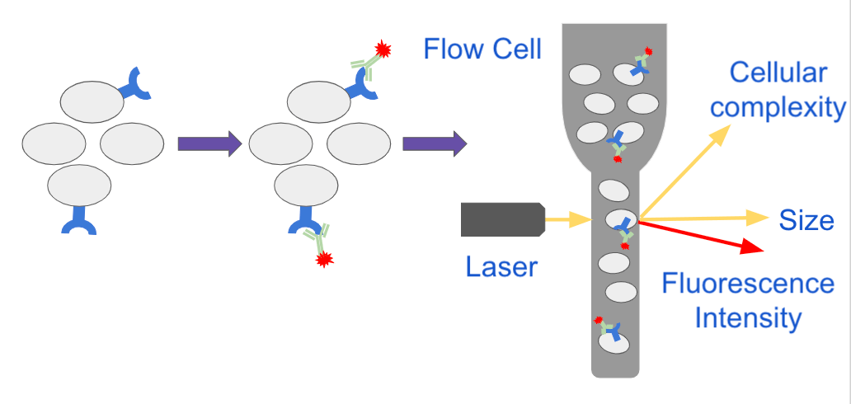
Flow cytometry can also be used to quantify protein expression
Cells expressing mutant protein are labeled with fluorescent antibodies
Labeled cells are passed in single file in front of a laser and visible light source
the scatter of the visible light provides information about cell size and granularity
fluorescent signal indicates protein labeling by antibody
side scatter
forward
scatter
Rego. 2021. Addgene

Slide 7
Metal uptake

Slide 8
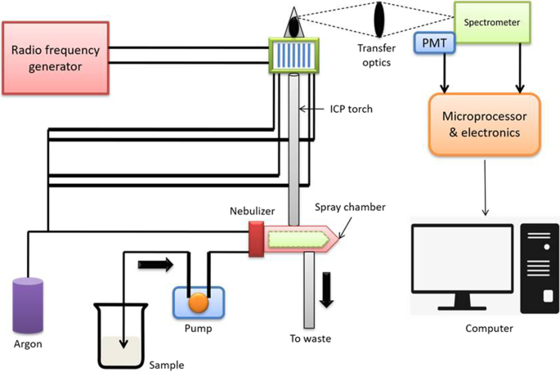
ICP-OES/MS can measure elemental concentration in a sample
Metal concentration can be directly quantified
Inductively Coupled Plasma Optical Emission Spectroscopy (ICP-OES)

Slide 9
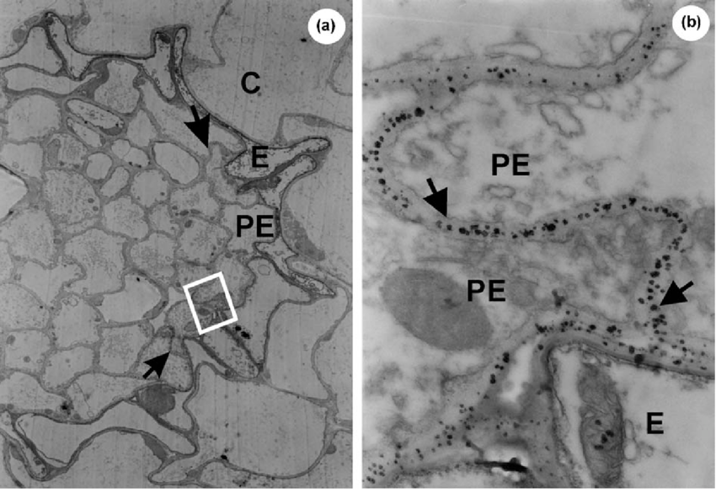
Electron microscopy can visualize metal collection in a cell
Transmission Electron Microscopy (TEM)
send electron beam through a sample
generated image is shaded according to density
TEM micrograph of root section from plant exposed to Cd for 14 days
Identified granules containing Cd in the cell wall of pericycle cells
2000x magnification
20,000x magnification
Wojcik, 2004
Notes:
TEM= transmission electron microscopy– better for internal composition of materials, where SEM (Scanning electron microscopy) shows us more about morphology

Slide 10
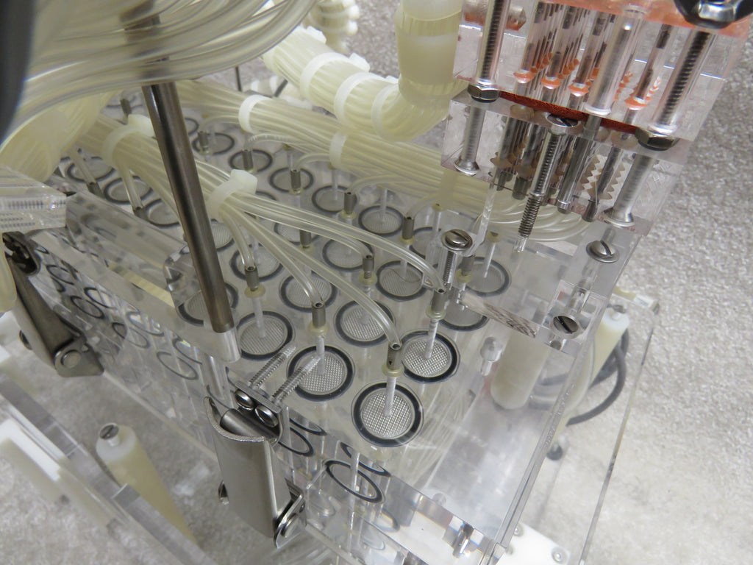
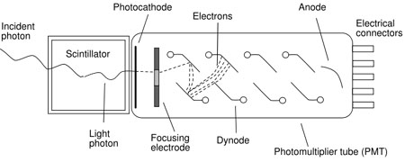
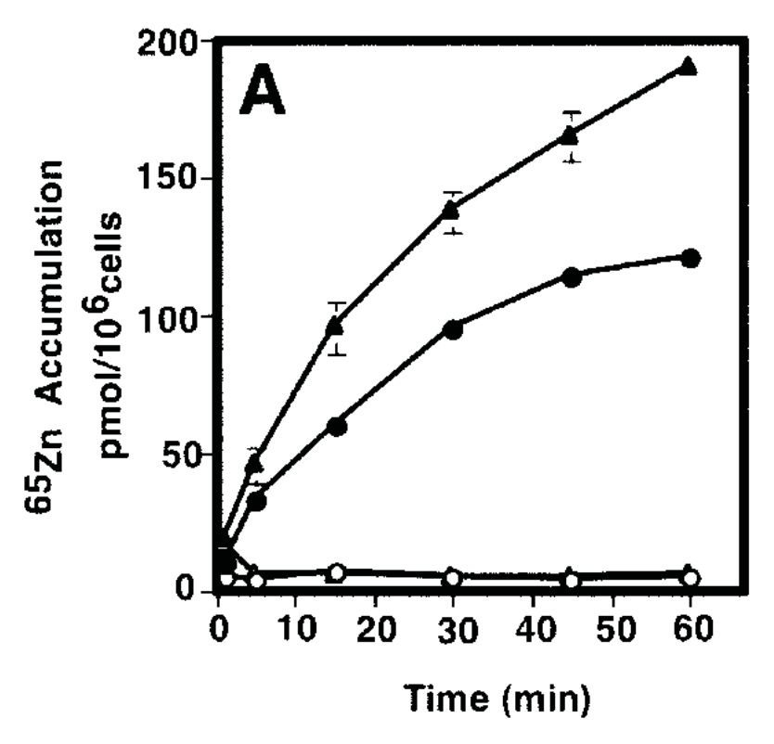
Radioactive metal isotopes can be utilized to monitor metal presence
Incubate cells with radioactive isotope of metal
Rapid wash to remove any radioactive material not bound to or accumulated within the cell
Use gamma scintillation counter to convert radioactive decay to light to an electrical pulse
High sensitivity
Brandel Cell Harvester
Stanford Scintillation Materials Group
Gaither, 2001

Slide 11
Engineered sensors can be used to detect metal in a cell
Förster Resonance Energy Transfer (FRET)
Laser excited donor fluorophore
Acceptor fluorophore emits fluorescent signal
Bioluminescence Resonance Energy Transfer (BRET)
Bioluminescent luciferase excites the acceptor flurophore
Fluorescent probes
small enough to cross a membrane and bind to intracellular metal
not as sensitive as the sensors
Aper. 2016

Slide 12
Cell tolerance of metal accumulation

Slide 13
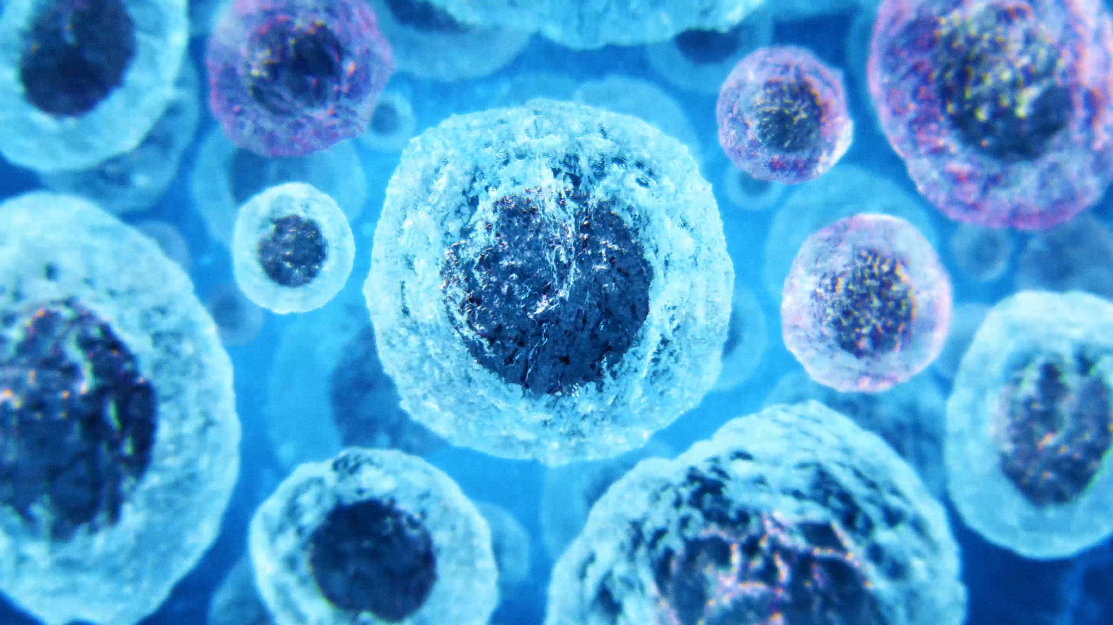
Different metrics can be used to assess cell viability
Growth rate
Membrane integrity
Metabolic activity

Slide 14
Spotting assay can be used to count colonies and compare growth under different conditions
Commonly used to evaluate bacterial or yeast growth and survival
Measure the density of cells within a single spot of defined size
Count colonies
Densitometry
Identify common dilution that will allow for most accurate comparison across groups
Petropavlovskiy. 2020

Slide 15
Vital dyes can be used to establish membrane integrity of cells
Colormetric dyes
Neutral red
weak cation dye
passes across intact plasma membranes to concentrate in organelles like vacuoles and lysosomes
damage to those membranes prevents the incorporation of the dye
Red= alive
Evans blue
anionic dye
impermeable to membrane of living cells but able to accumulate in cells with compromised plasma membrane
Blue = dead
trypan blue is another example
Evans blue dye
Neutral red

Slide 16
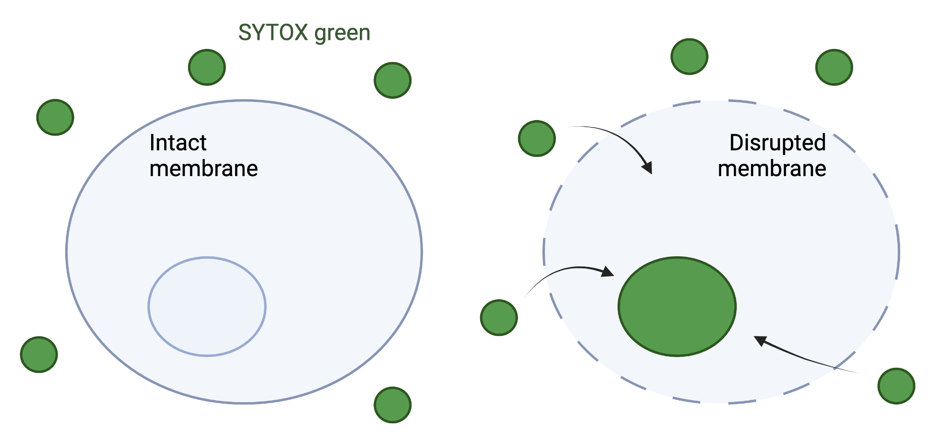
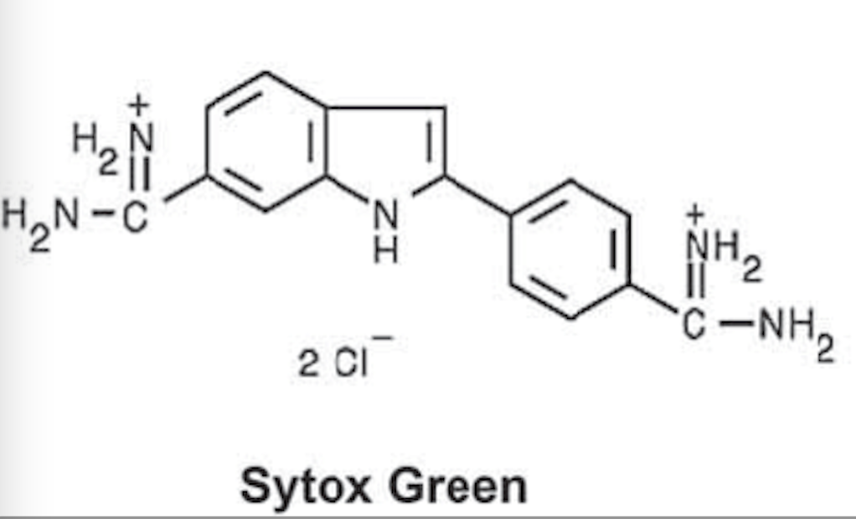
Nuclear fluorescent dyes can be used to indicate loss of membrane integrity
SYTOX Green is a probe that cannot cross intact membranes
One inside the nucleus, it binds to nucleic acids and fluoresces

Slide 17
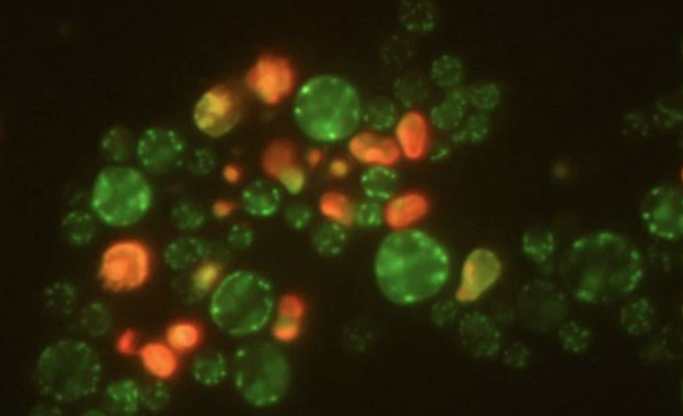
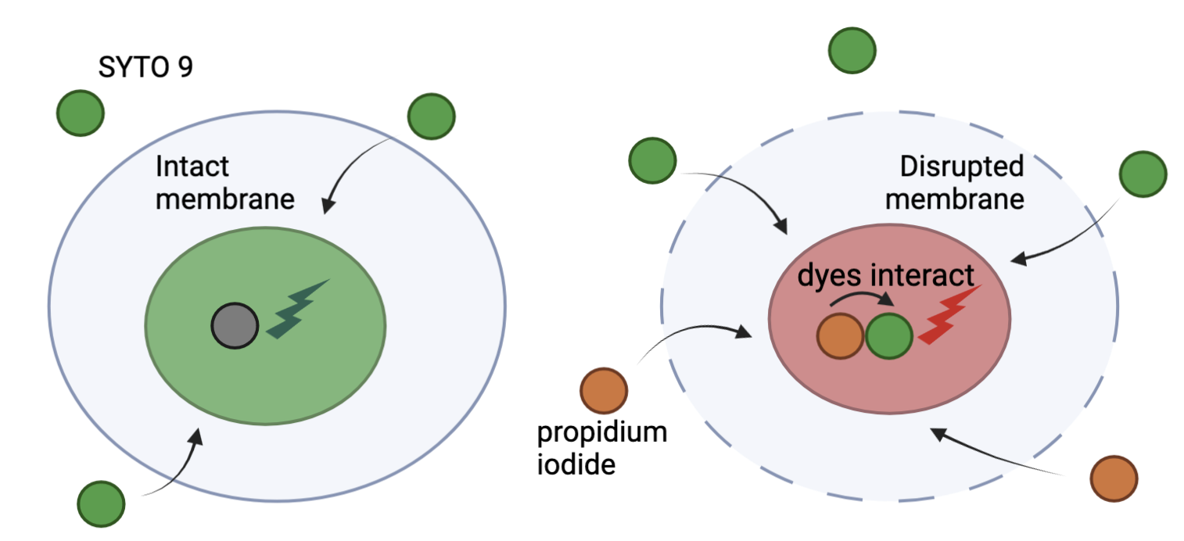
LIVE/DEAD assays can simultaneously mark both states of cells within a population
SYTO 9 green-fluorescent nucleic acid stain
Can cross intact membranes and label all cells in a population
Propidium iodide red-fluorescent nucleic acid stain
Only enters cells with damaged membranes
Causes a reduction in the SYTO 9 stain fluorescence via FRET
Cells with intact membranes stain fluorescent green
Cells with damaged membranes stain fluorescent red

Slide 18
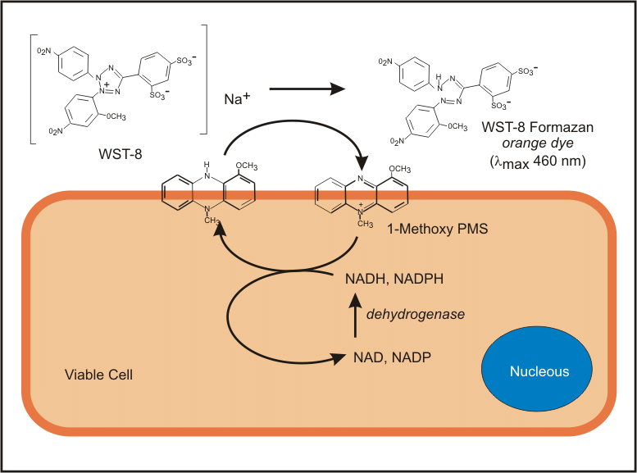
Reduction of tetrazolium salts creates color change proportional to metabolic activity
Tetrazolium salts can reduced into formazan as a by product of metabolic processes such as oxidative phosphorylation
Color change is proportional to metabolic activity
MTT = purple formazan precipitates
production kills cells
less sensitive
less expensive
WST-8 = soluble orange formazan
cells survive assay
more sensitive
more expensive
Held. 2009

Slide 19
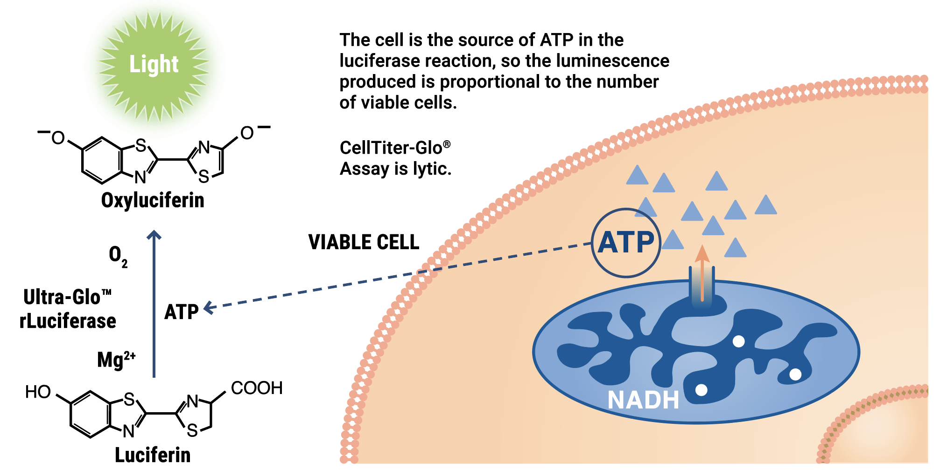
ATP content can be used as a proxy for cellular physiology and metabolic activity
Luciferase utilizes ATP to oxidize Luciferin to Oxyluciferin
Emits light as a result
Luminescence is proportional to ATP and thus to cell metabolic activity
Metabolic activity can change without resulting in cell death
In contrast to loss of membrane integrity
Promega

Slide 20
What are you doing in lab today?
Experimental lull!
Biology moves slower than grand plans…
Align sequencing to determine presence of mutations
Prepare coverslips for the immunofluorescence experiment that begins after Spring break/ Journal article presentation week

