Slide 1
20.109 Guest Lecture
Sarah Cowles
March 16, 2021

Slide 2
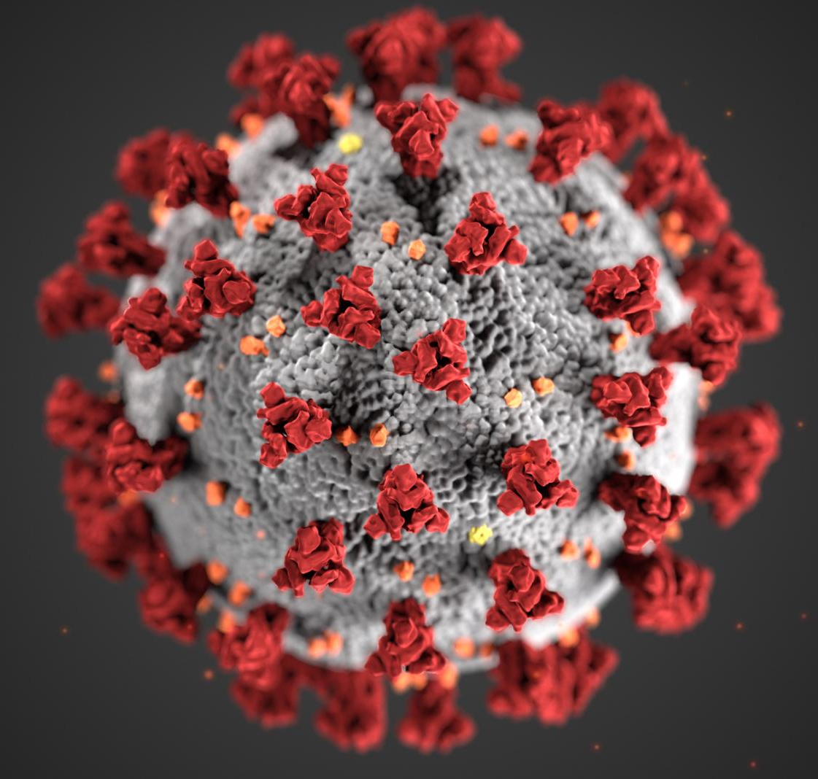
Effect of affinity on anti-PD-1
immune checkpoint blockade therapy
Antibodies and COVID-19
AF647
Streptavidin
Secondary
StrepAF647
Biotin
PD-1
C-myc
Y
Y
V_{H}
AF488
V_{L}
HA
Primary
Chicken α C-myc
Secondary
Goat α Chicken
Aga2
Aga1

Slide 3
PD-1 negative costimulatory receptor pathway
In the Wittrup lab, we uses a variety of protein engineering strategies to develop effective cancer biopharmaceuticals…
PD-1
Anti-PD-1
Tumor Cell
Tumor Cell
PD-1 expression leads to T cell dysfunction and no tumor cell killing
Blocking PD-1 with an antibody leads to proper T cell activation and tumor cell killing
https://www.nobelprize.org/uploads/2018/10/press-medicine2018.pdf
Notes:
PD-1, which is a cell surface protein, acts as a regulator of immune function. In the context of cancer, PD-1 disrupts T cell activation and prevents T cells from attacking the tumor. And thus, can be seen as a pushing the brake on the immune response.
Fortunately, by blocking PD-1 with an antibody, we can release the break and allow the T cells to kill the tumor cells.

Slide 4
Physiologically-based Pharmacokinetic (PBPK) modelling
Plasma
Tumor
IP or IV Bolus Dose
k_{on} / k_{off}
PD-L1
k_{on} / k_{off}
PD-1
PD-1
PD-1
Lymph Node
$$\frac{2PR_{cap}}{R_{k}^{2}}\frac{V_{T}}{V_{p}}$$
K_{syn} / k_{int}
k_{int}
k_{int}
Cell trafficking
What cell types?
k_{clear}
T cells
Tumor Cells
Other immune cells: Macrophages, Myeloid Cells
Notes:
In my group, we often used PBPK modeling to think about our particular drug of interest

Slide 5
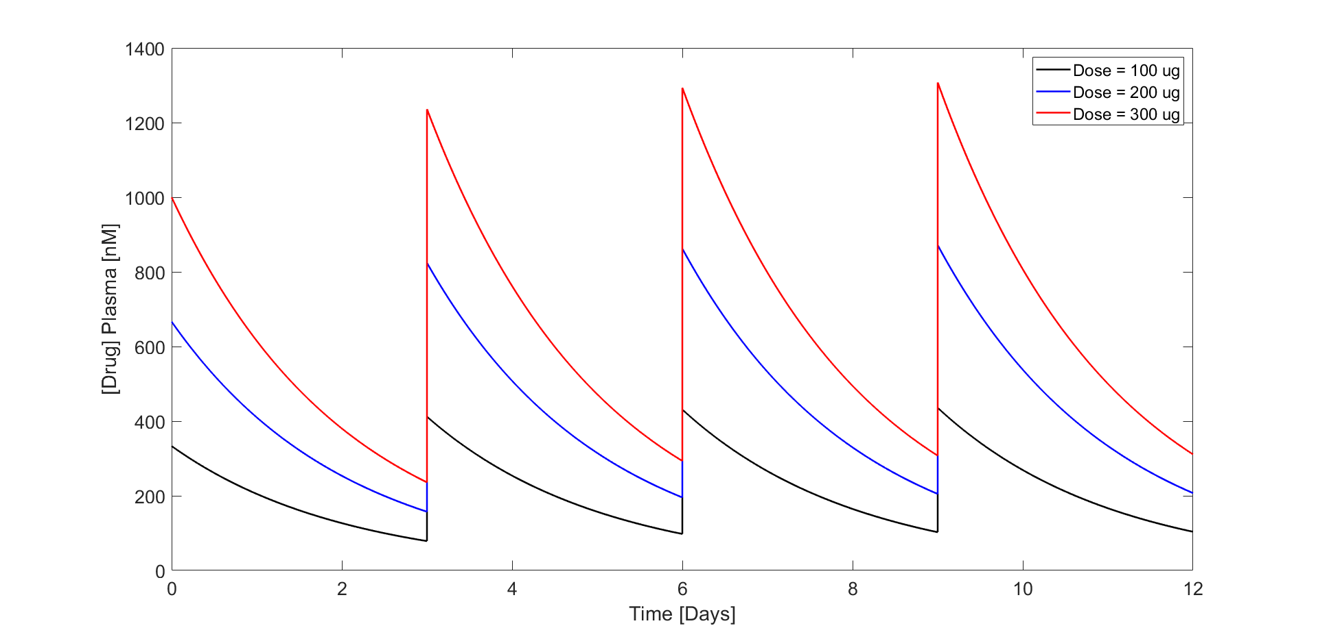
Modeling the concentration of drug in plasma
Notes:
Using our model, we can determine the expected concentration of the drug in the blood overtime. We can vary the dosing schedule or the dose amount in order to adjust the trough concentration

Slide 6
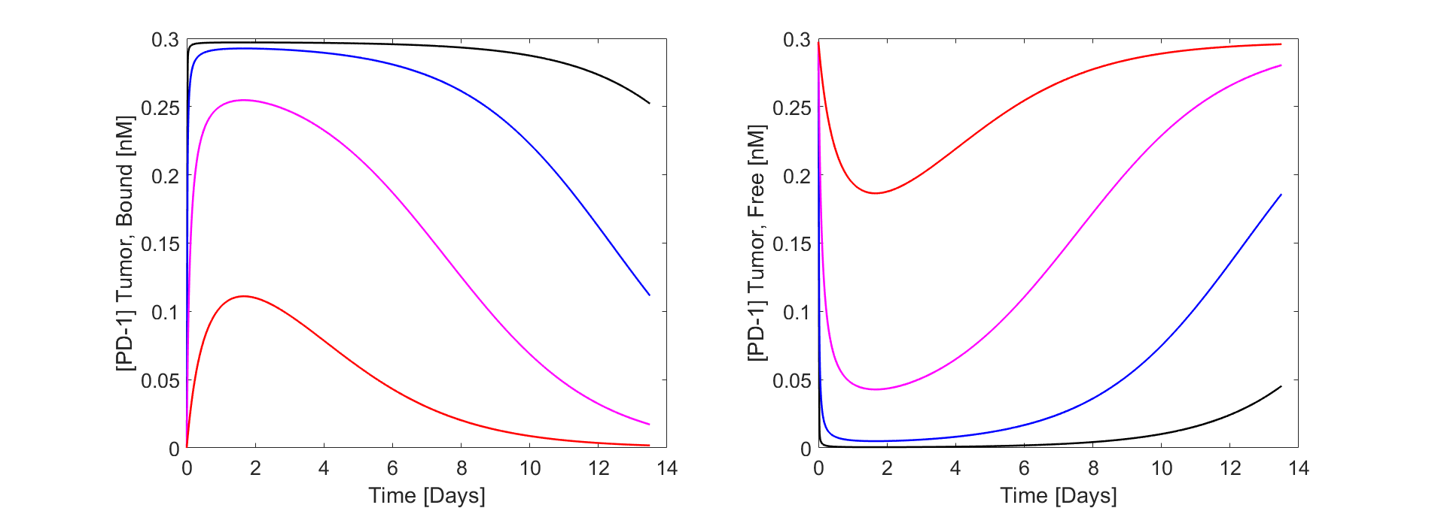
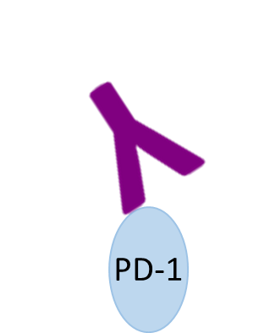
Modeling the receptor occupancy in the tumor
PD-1
Notes:
We can also model the receptor occupancy in the tumor. After a single dose of anti-PD-1 antibody, I’ve shown the concentration of PD-1 that we expect to be blocked with antibody vs. free PD-1 receptor for antibodies of various affinities. Here you can see a 50 nM Kd antibody doesn’t fully saturate the PD-1 in the tumor, where as a 0.5 nM antibody could block most of the PD-1 in the tumor for more than a week.

Slide 7
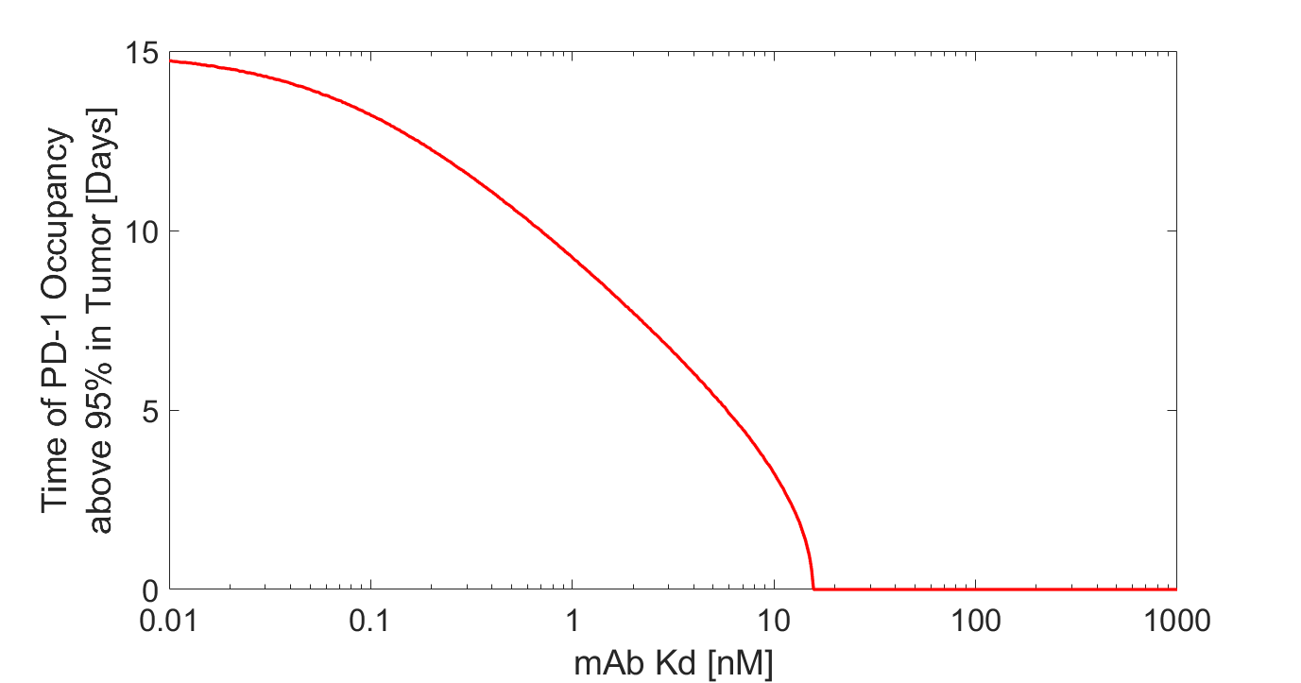
How long does drug stay bound to PD-1 in tumor?
Dose bi-weekly
Dose weekly
Can’t saturate tumor
Can we replicate this in vivo?
We need to make a set of anti-PD-1 antibodies with varying affinities
Notes:
Here I’ve plotted this another way. On the x-axis I have the Kd of the antibody, so the lower the Kd the stronger the antibody. And the Y access shows how long 95% of the PD-1 will stay blocked in the tumor with a single dose. You can see that an antibody above about 15 nM kd will never saturate the tumor…etc.

Slide 8
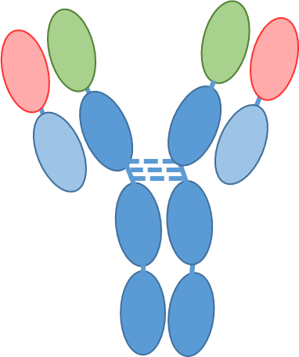
What is yeast surface display?
Biotin
Antigen
Antigen
Antigen
29F V_{H}
C-myc
V_{H}
29F V_{L}
29F V_{H}
29F V_{L}
V_{L}
HA
Kappa
Aga2
Aga1
mIgG2c C_{H}2
C_{H}3
mIgG2c C_{H}2
C_{H}3
Yeast cell surface
8
Figures not to scale
Notes:
Aga1 is a native protein expressed on the surface of yeast. Aga2 is a native secreted protein that binds to Aga2. In Yeast surface display, we force the yeast to express the Aga2 protein fused to the scFv (or variable fragment of an antibody) such that the yeast is now covered in expressed antibody.

Slide 9
What is yeast surface display?
Strepavidin
Biotin
Antigen
C-myc
V_{H}
Y
Y
V_{L}
HA
Antigen Binding
Aga2
Aga1
Yeast cell surface
Display (C-myc Tag)
9
Figures not to scale
Notes:
The scFv has two tags, HA and c-myc which can be probed to see if the yeast is in fact displaying the scFv. We can then incubate the displaying yeast with our labeled antigen of interest. We use flow cytometry to see which yeast are displaying the scFv on the x axis and if these yeast are indeed binding to the antigen.

Slide 10
What is yeast surface display?
Strepavidin
Biotin
Antigen
C-myc
V_{H}
Y
Y
V_{L}
HA
Aga2
Aga1
Yeast cell surface
10
Figures not to scale
Notes:
We can collect many of these flow plots by titrating different concentrations of antigen with our displayed yeast and create a titration curve in order to calculate the equilibrium dissociation constant (or Kd) as show here

Slide 11
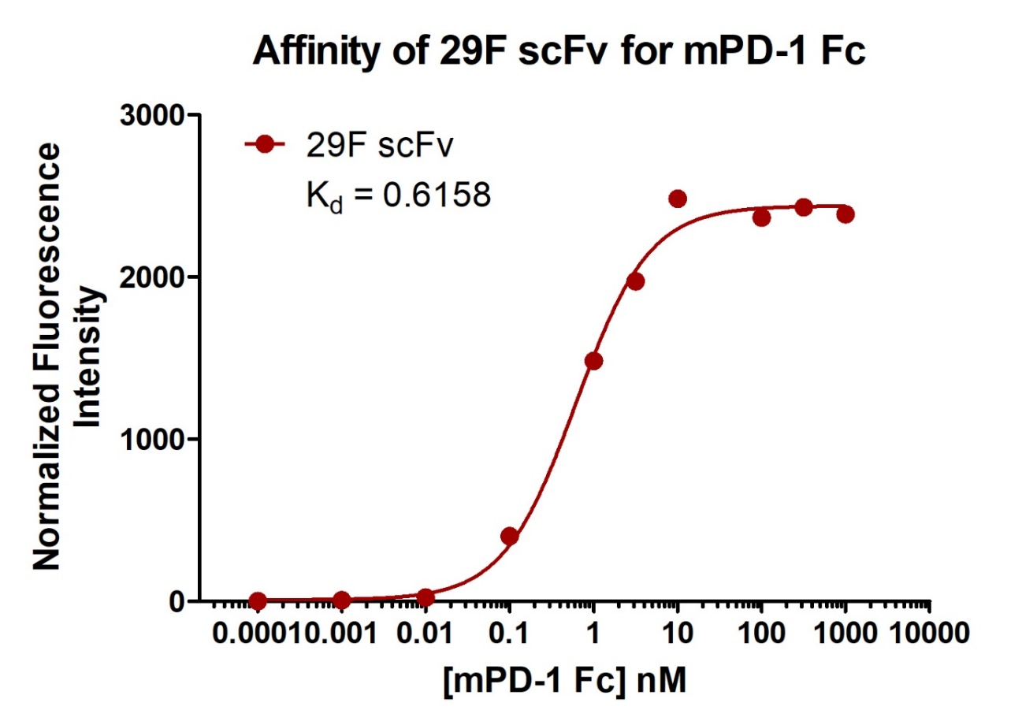
What is yeast surface display?
Strepavidin
Biotin
Antigen
C-myc
k_{D} = 0.6158 nM
V_{H}
Y
Y
V_{L}
HA
Aga2
Aga1
Yeast cell surface
11
Figures not to scale
Notes:
We can collect many of these flow plots by titrating different concentrations of antigen with our displayed yeast and create a titration curve in order to calculate the equilibrium dissociation constant (or Kd) as show here

Slide 12
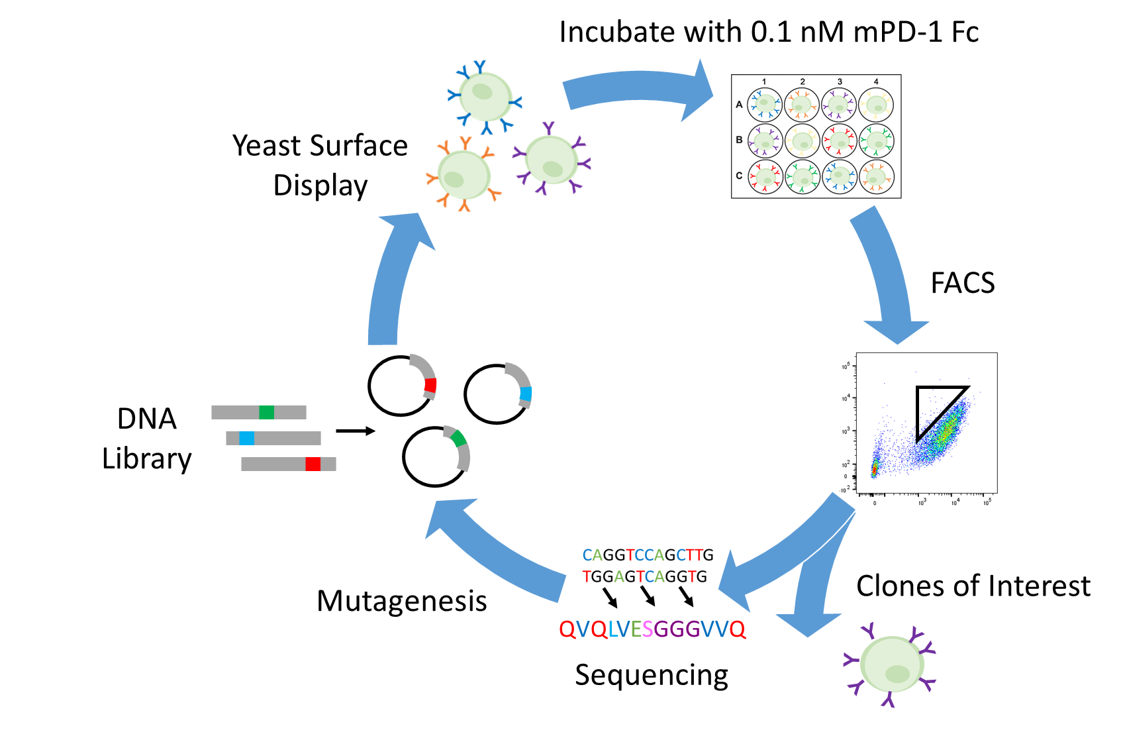
How do we change the binding affinity of anti-PD-1?
Affinity Maturation
Notes:
So how do we change the binding affinity of anti-PD-1

Slide 13
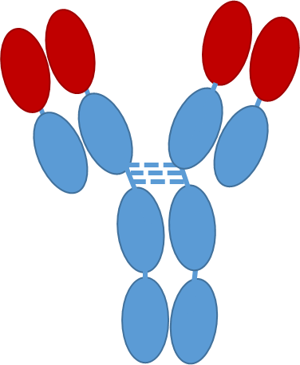
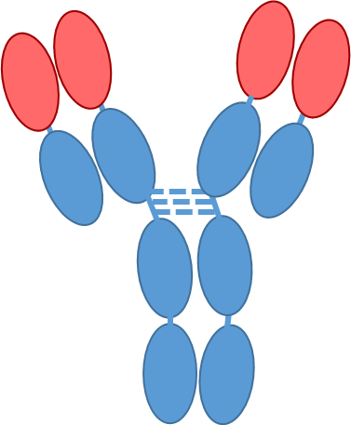
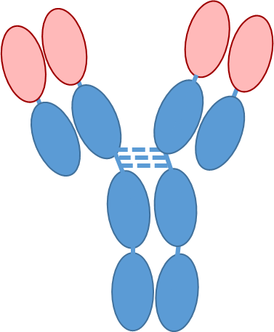
29F.1A12 anti-PD-1 clone
k_{D} = 0.6158 nM
Y
Y
Y
Y
Y
Y
Y
Panel of Antibodies with Varying Affinities to PD-1
Notes:
- To do this, we will use affinity maturation to develop a panel of varying affinity antibody clones to mouse PD-1
We will produce and characterize the antibodies in house
We will then use model cell lines to determine impacts of affinity on receptor trafficking and look to supplement existing PD-1 models
And finally, we will use animal models to compare the therapeutic efficacy of our antibodies and investigate the impact on the TME

Slide 14
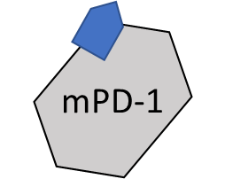
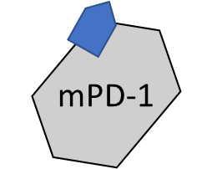
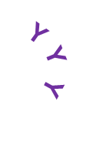
Affinity maturation to find lower and higher affinity binders
Equilibrium sorting
for lower affinity binders
Kinetic sorting
for higher affinity binders
Y
Y
Y
Y
Y
Y
Y
Y
Y
Y
Y
Y
Incubate displaying yeast with labeled antigen until equilibrium reached
Incubate displaying yeast with labeled antigen until equilibrium reached
Notes:
To produce our panel, we employed two strategies, sorting for lower affinity binders and higher affinity binders.
First, I’ll discuss…we used repeated equilibrium sorts to find clones

Slide 15
Affinity maturation to find lower and higher affinity binders
Equilibrium sorting
for lower affinity binders
Kinetic sorting
for higher affinity binders
Y
Y
Y
mPD-1 Binding
Y
Y
Y
Yeast display of scFv
Incubate displaying yeast with labeled antigen until equilibrium reached
Sort for low affinity binders
Notes:
To produce our panel, we employed two strategies, sorting for lower affinity binders and higher affinity binders.
First, I’ll discuss…we used repeated equilibrium sorts to find clones

Slide 16
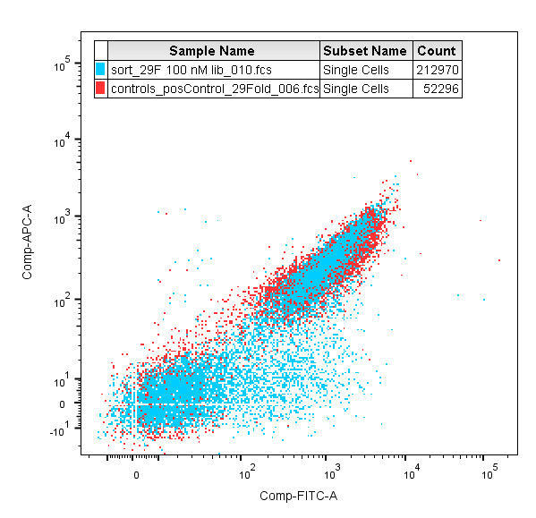
Equilibrium sort of 29FeL1 library
Equilibrium sort of 10⁸ yeast at 100 nM mPD-1
Positive Control
(29F.1A12 scFv) (right)
is fully saturated at 100 nM
The library (left and right) shows lower affinity clones as sorted in population P4 (left)
mPD-1 Binding
Display (C-myc Tag)
16
Notes:
Equilibrium sort
Positive control is fully saturated at this concentration
Pull out binders that were hopefully less than fully saturated in this P4 populations

Slide 17
Assaying equilibrium binding of mutants
1000 nM
100 nM
10 nM
29F
Negative
Control
29F
Mut 1
10 nM
Mut 2
100 nM
Mut 6
1000 nM
Mut 7
29FeL1.7
Mut 8
Negative
Control
Mut 9
Mut 10
10 nM
100 nM
mPD-1 binding
1000 nM
mPD-1 binding
Notes:
We then sequence and re-transform these mutants as single clones and assess equilibrium binding at varying concentrations.
See how mut7 equilibrium binding shifts across these concentrations unlike 29F indicating that it is a weaker binder.
This can is a bit more obvious in the dot plots on the right

Slide 18
Equilibrium sort of new 29FeL2 library
Equilibrium sort of 10⁸ yeast at 200 nM mPD-1 (100 nM sort used to find 29FeL1.7)
mPD-1 Binding
Display (C-myc Tag)
Notes:
We created a new error-prone PCR library from mut7 and performed an additional equilibrium sort at 200 nM
We pulled out individual clones from both these P4 and P5 populations

Slide 19
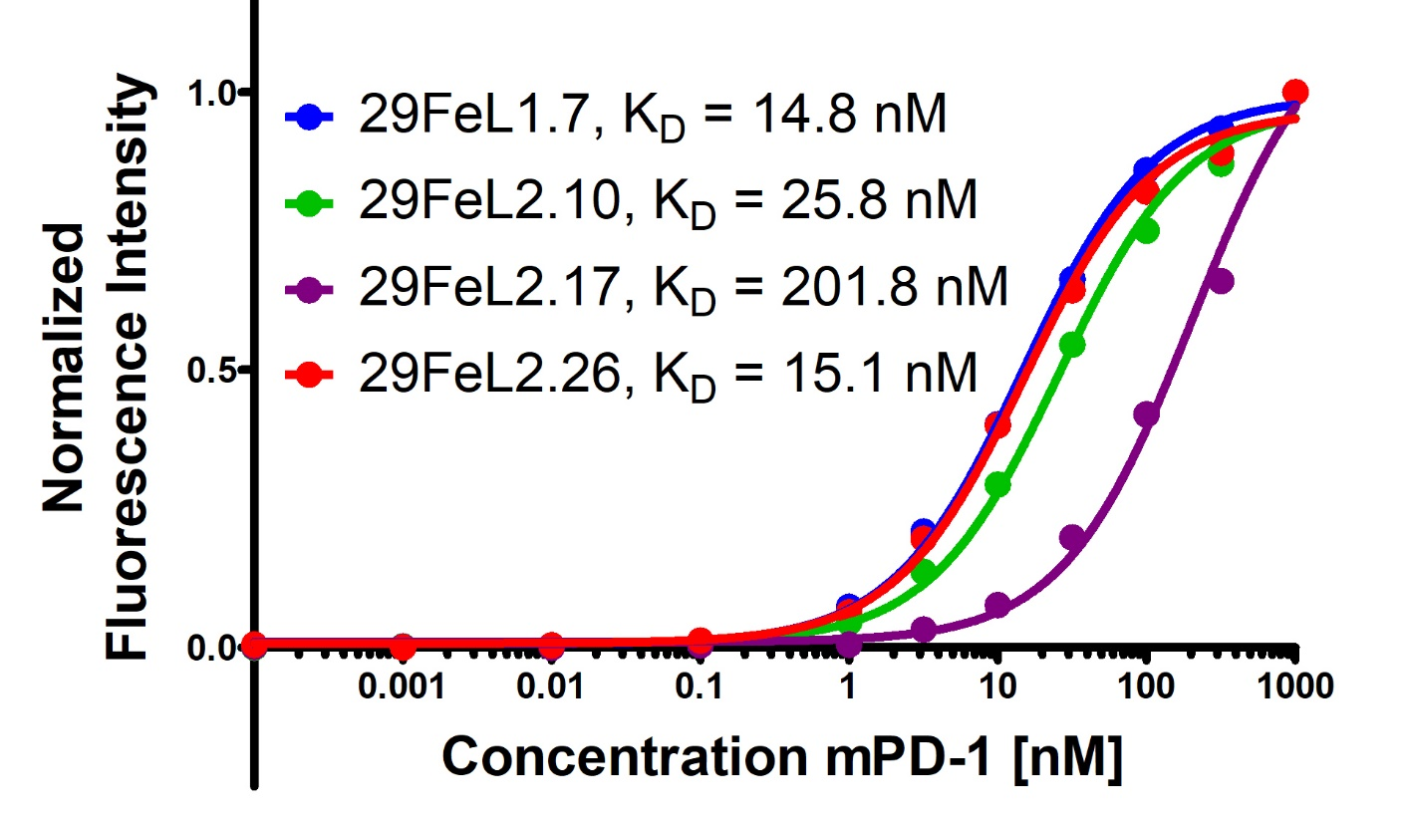
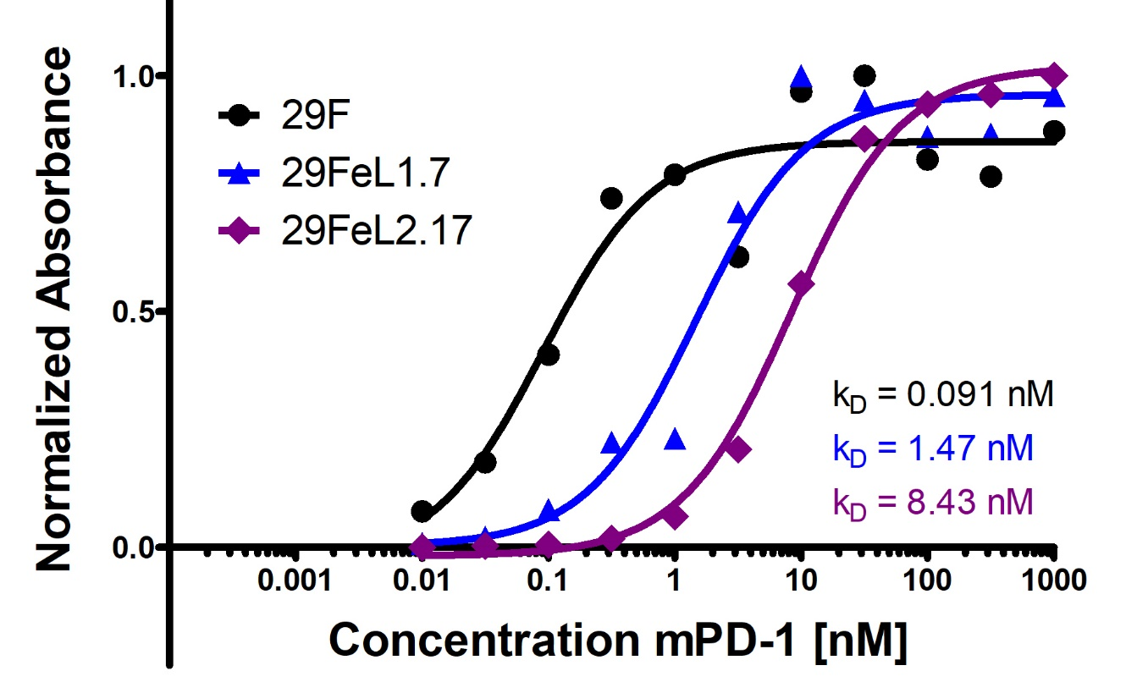
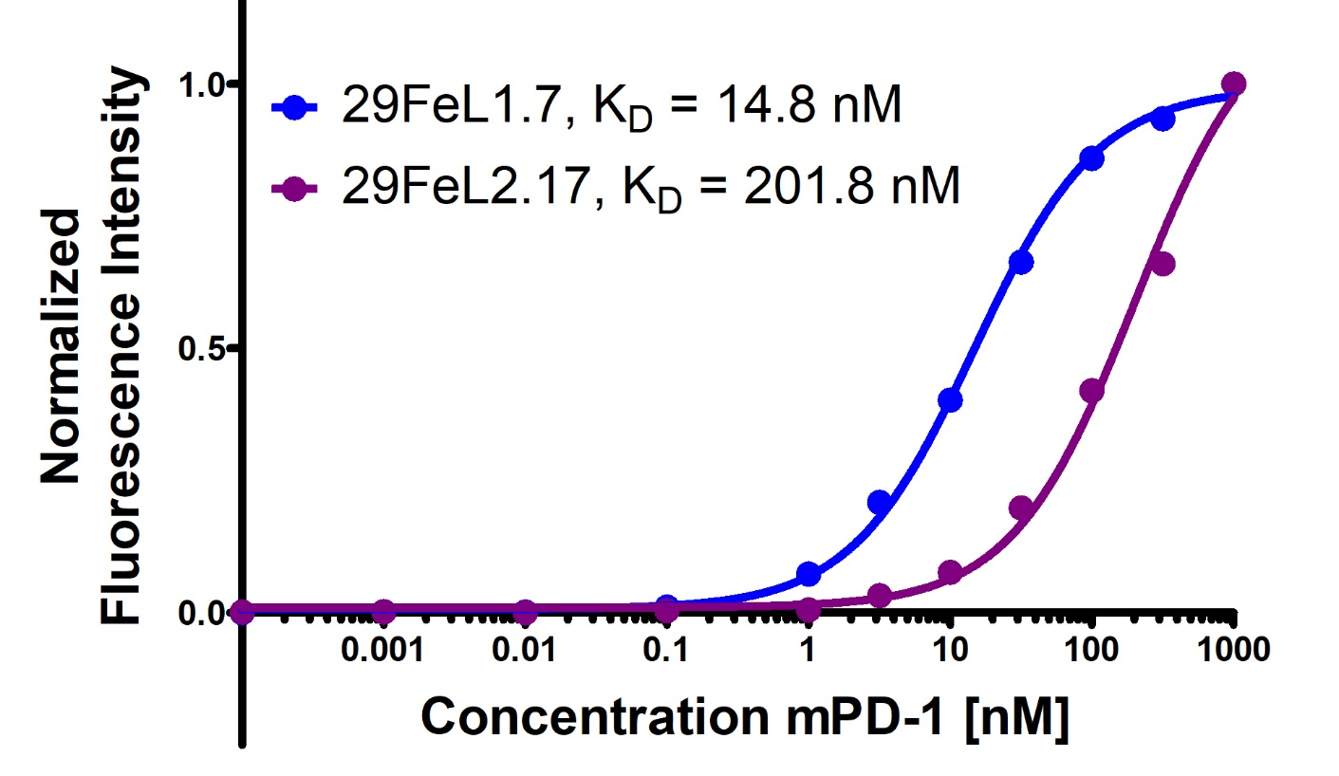
Two clones with lower affinity than 29F
Yeast Titration
ELISA
29FeL1.7 and 29FeL2.17 added to the panel as low affinity clones
Heavy Chain Alignment
Light Chain Alignment
Notes:
After testing the most promising clones via yeast titration, we selected two lower affinity clones and confirmed via ELISA that they do indeed have significantly higher Kds then 29F
Both mutants have mutations in the CDRH3 as well as a framework mutation before the CDRH1. The lowest affinity mutant has an additional mutation in the CDRL3

Slide 20
Affinity maturation to find lower and higher affinity binders
Equilibrium sorting
for lower affinity binders
Kinetic sorting
for higher affinity binders
Y
Y
Y
Y
Y
Y
Y
Y
Y
Y
Y
Y
Incubate displaying yeast with labeled antigen until equilibrium reached
Incubate displaying yeast with labeled antigen until equilibrium reached
Notes:
With affinities approaching the low nanomolar and picomolar ranges , equilibrium sorts are not longer feasible do to volume restrictions so we then moved on to kinetic sorting to find higher affinity mutants…

Slide 21
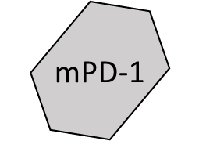
Affinity maturation to find lower and higher affinity binders
Equilibrium sorting
for lower affinity binders
Kinetic sorting
for higher affinity binders
Y
Y
Y
Y
Y
Y
Y
Y
Y
Y
Y
Y
Wash away unbound antigen and resuspend with excess non-labeled antigen
Incubate displaying yeast with labeled antigen until equilibrium reached

Slide 22
Affinity maturation to find lower and higher affinity binders
Equilibrium sorting
for lower affinity binders
Kinetic sorting
for higher affinity binders
Y
Y
Y
Y
Y
Y
Y
Y
Y
Y
Y
Y
Incubate for many hours until only highest affinity clones remain bound to labeled antigen
Incubate displaying yeast with labeled antigen until equilibrium reached

Slide 23
Affinity maturation to find lower and higher affinity binders
Equilibrium sorting
for lower affinity binders
Kinetic sorting
for higher affinity binders
40 hr Library Sort
40 hr Positive Control
0.5%
<0.1%
Y
Y
Y
Y
mPD-1 binding
mPD-1 binding
Y
Y
29F parent
Library
Yeast display of scFv
Yeast display of scFv
Incubate displaying yeast with labeled antigen until equilibrium reached
Sort for yeast with binding higher than the positive control

Slide 24
29Fe1 Library
Equilibrium sort of 10⁸ yeast at 100 nM to select binders
Round 1 Kinetic sort of 10⁸ yeast at 25°C
24 hr Positive Control
24 hr Library Sort
0.8%
2.3%
29F parent
mPD-1 Binding
Display (C-myc Tag)
Notes:
After making our 29F library we first started with an equilibrium sort to eliminate any clones where the mutations disrupted binding in entirety. We took this P5 population and grew it back up and performed a first round of kinetic sorts at room temperature where we saw modest enrichment

Slide 25
29Fe1 Library
Equilibrium sort of 10⁸ yeast at 100 nM to select binders
Round 2 Kinetic sort of 10⁸ yeast at 25°C
24 hr Positive Control
24 hr Library Sort
0.2%
1.2%
29F parent
mPD-1 Binding
Display (C-myc Tag)
Notes:
We proceeded with a second round and saw greater enrichment

Slide 26
Kinetic testing of 29Fe1 mutants – 36 hours at 25°C
Control 29F
Clone 29Fe1.1
Clone 29Fe1.2
Clone 2: S→T CDRH3, and N→K Framework CDRH2 Clone 3: S→T CDRH3
Clone 4: S→P CDRH1 Framework, and T→I CDRH1
Clone 29Fe1.3
Clone 29Fe1.4
Clone 29Fe1.7
Clone 29Fe1.8
Clone 29Fe1.12
Clone 29Fe1.11
Notes:
We tested a number of clones from that last sort by individually which an extended incubation. Compared to the 29F parental control, we selected a number of clones of interest that remained strongly bound to the initial biotinylated mPD-1

Slide 27
29Fe2 Library
Equilibrium sort of 10⁸ yeast at 100 nM to select binders
Round 1 Kinetic sort of 5x10⁷ yeast at 30°C
24 hr Positive Control
24 hr Library Sort
0.1%
2.7%
mPD-1 Binding
29Fe1.4
Display (C-myc Tag)
Notes:
We made a new library from the last sort and proceeded again with an equilibrium sort and two rounds of extened kinetic testing at a higher temperature (now 30C).

Slide 28
29Fe2 Library
Equilibrium sort of 10⁸ yeast at 100 nM to select binders
Round 2 Kinetic sort of 5x10⁷ yeast at 30°C
40 hr Positive Control
40 hr Library Sort
<0.1%
0.5%
mPD-1 Binding
29Fe1.4
Display (C-myc Tag)

Slide 29
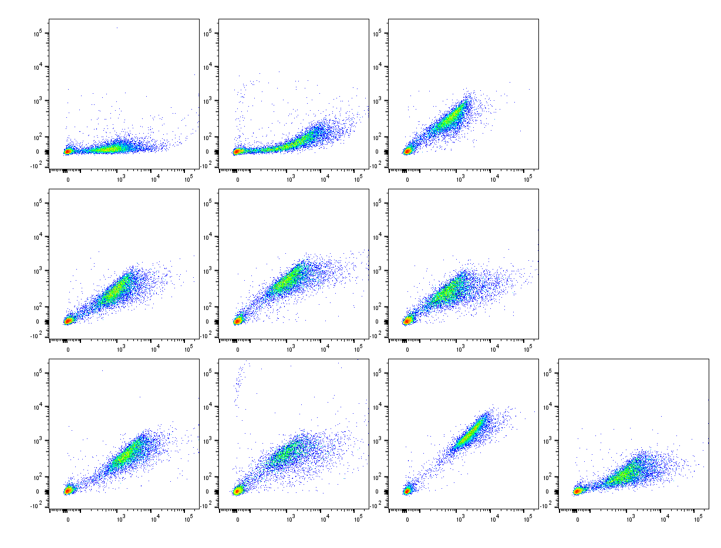
Kinetic testing of 29Fe2 mutants – 48 hours at 30°C
Control 29F
Control 29Fe1.4
Clone 29Fe2.2
Clone 13 → positive charge added in framework, P&LP mutations in CDRL2
Clone 29Fe2.3
Clone 29Fe2.5
Clone 29Fe2.8
Clone 29Fe2.10
Clone 29Fe2.11
Clone 29Fe2.13
Clone 29Fe2.15
Notes:
When we tested individual clones from this sorted population, there were a number of clones that showed strong binding compared to the parental 29F and 29Fe1.4 clones but really only one that looked like a clean binder

Slide 30
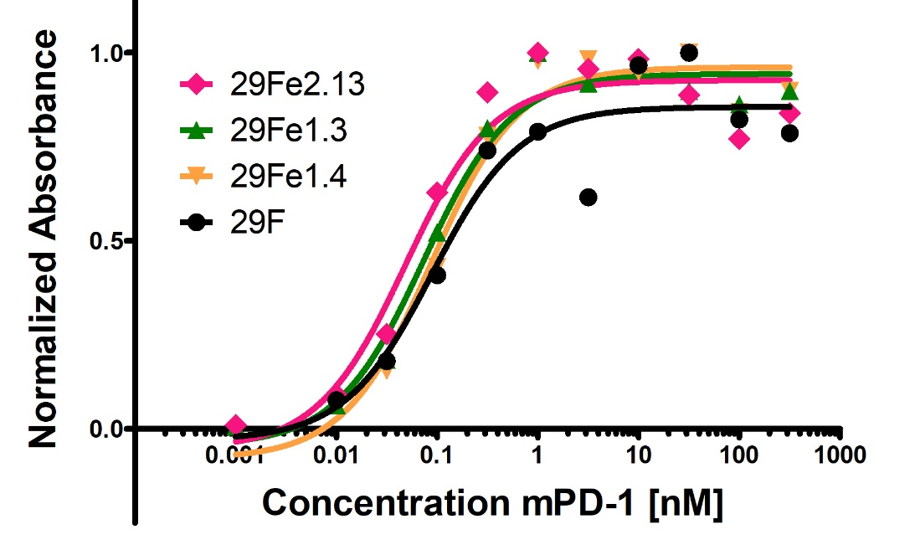
29F panel of varying affinity antibodies
Heavy Chain Alignment
Light Chain Alignment
Notes:
So at this point we have our panel of varying affinity antibodies to mouse PD-1. Unlike the low affinity clones where we can see differentiation by ELISA, the high affinity clones look very similar to the parental 29F on an ELISA since an ELISA relies on a measurement equilibrium binding which is challenging to obtain at reasonable volumes and reasonable incubation times.

Slide 31
29F panel of varying affinity antibodies
Heavy Chain Alignment
Light Chain Alignment
Additional in vitro characterization:
Kinetic Exclusion Assay
Biolayer Interferometry (ForteBio Octet Instrument)
Notes:
Thus, we need are going to use the octet as well as a form of the kinetic exclusion assay to get more bonafide Kd values for our panel

Slide 32
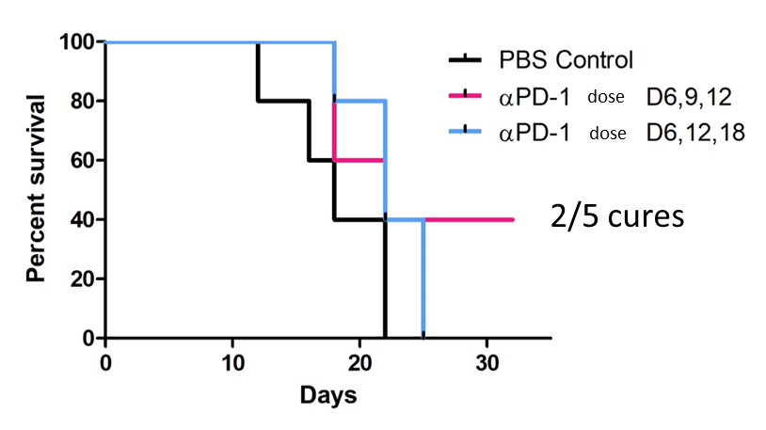
In vivo validation
0.001 nM
0.01 nM
0.1 nM
1 nM
10 nM
100 nM
1000 nM
High Affinity
Low Affinity
More permanent and sustained blockade of PD-1 by high affinity clones yields increased therapeutic efficacy
Clearance or internalization leads to similar efficacy of high and low affinity clones
Incomplete/transient blockade of PD-1 leads to T cell exhaustion and improper priming and decreased therapeutic efficacy
Transient on/off binding leads to better blockade of newly infiltrating or circulating immune cells
Next steps:
Test panel of anti-PD-1 antibodies in vivo
Characterize any differential immune response
In collaboration with Yash Agarwal
Notes:
Jar200 cells, Induced at 30 C, two selectable markers
Ura3 → media lacks uracil
Trp1 → media lacks tryptophan
Casamino acids have all essential amino acids (including Leucine) but no tryptophan
Heavy Chain, followed by CH1-hinge-(G4S)x3-Aga2-V5 → upper hinge region with two Cys substituted with Ser (SPPSP)
Light Chain, followed by Kappa Chain – (GGS)x4-C-myc tag
http://www.jmb.or.kr/submission/Journal/024/JMB024-03-15_FDOC_1.pdf

Slide 33
Effect of affinity on anti-PD-1
immune checkpoint blockade therapy
Antibodies and COVID-19
AF647
Streptavidin
Secondary
StrepAF647
Biotin
PD-1
C-myc
Y
Y
V_{H}
AF488
V_{L}
HA
Primary
Chicken α C-myc
Secondary
Goat α Chicken
Aga2
Aga1

Slide 34
Antibodies and COVID-19
There are three major ways to think about the role of antibodies in COVID-19:
Rapid COVID diagnostic test
Retained Immunity to COVID-19
Antibody Treatment
Notes:
in this case, you might propose to make a set of antibodies that bind to SARS-CoV-2 to neutralize the virus (prevent it from infecting healthy cells and hijacking their machinery) and allow other immune cells to more easily identify the virus (coated now with antibodies) and destroy it (ex. Complement Pathway, Phagocytosis via macrophages). If this is the type of proposal that you want to write, you’ll need to consider how you’ll screen for antibodies that bind to SARS-CoV-2. You’ll still need to make antigen from the virus to perform sorts. Also, will you pull clones from a synthetic library (https://www.ncbi.nlm.nih.gov/pubmed/17406305) or will you screen recovered patients’ plasma B cells to try to pull out native neutralizing clones developed through B cell receptor somatic hypermutation (https://www.ncbi.nlm.nih.gov/pmc/articles/PMC7095806/)? Some important things to think about here will be the affinity needed for complete neutralization, the stability of your antibody in solution (think about other things added to the final drug formulation to prevent aggregation), the specific antigen to which the antibodies will bind, etc.

Slide 35
Rapid Tests for Detection of COVID-19
Rapid development of paper-based COVID-19 Immunoassay
Hadley Sikes Lab
Eric Miller, Ki-Joo Sung, et al.
Notes:
in this case, you might propose to make a set of antibodies that bind to SARS-CoV-2 to neutralize the virus (prevent it from infecting healthy cells and hijacking their machinery) and allow other immune cells to more easily identify the virus (coated now with antibodies) and destroy it (ex. Complement Pathway, Phagocytosis via macrophages). If this is the type of proposal that you want to write, you’ll need to consider how you’ll screen for antibodies that bind to SARS-CoV-2. You’ll still need to make antigen from the virus to perform sorts. Also, will you pull clones from a synthetic library (https://www.ncbi.nlm.nih.gov/pubmed/17406305) or will you screen recovered patients’ plasma B cells to try to pull out native neutralizing clones developed through B cell receptor somatic hypermutation (https://www.ncbi.nlm.nih.gov/pmc/articles/PMC7095806/)? Some important things to think about here will be the affinity needed for complete neutralization, the stability of your antibody in solution (think about other things added to the final drug formulation to prevent aggregation), the specific antigen to which the antibodies will bind, etc.

Slide 36
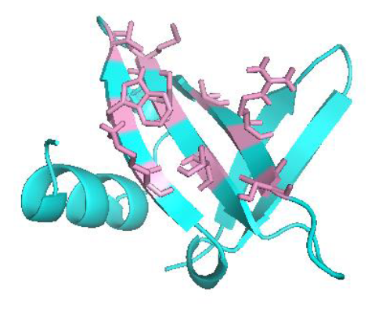
Rapid development of paper-based COVID-19 Immunoassay
^{Sso7d vs. Antibody}
9 amino acid binding pocket
Thermally stable
Size
Miller, E. A. et al. ACS Comb. Sci., 2020, 22, 1, 49-60
Sung, K. et al. Analyst, 2020, 145, 2515-2519

Slide 37
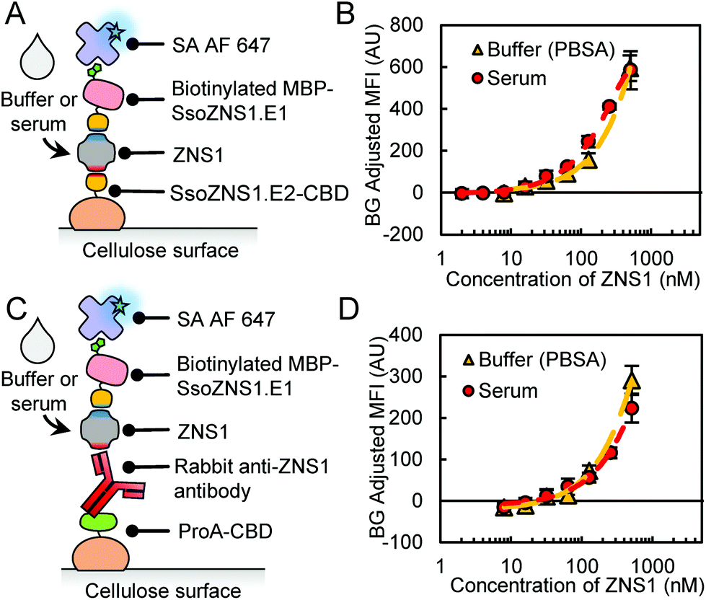
Paper-based Zika Immunoassay
Miller, E. A. et al. ACS Comb. Sci., 2020, 22, 1, 49-60
Sung, K. et al. Analyst, 2020, 145, 2515-2519
Notes:
Zika nonstructural protein 1

Slide 38
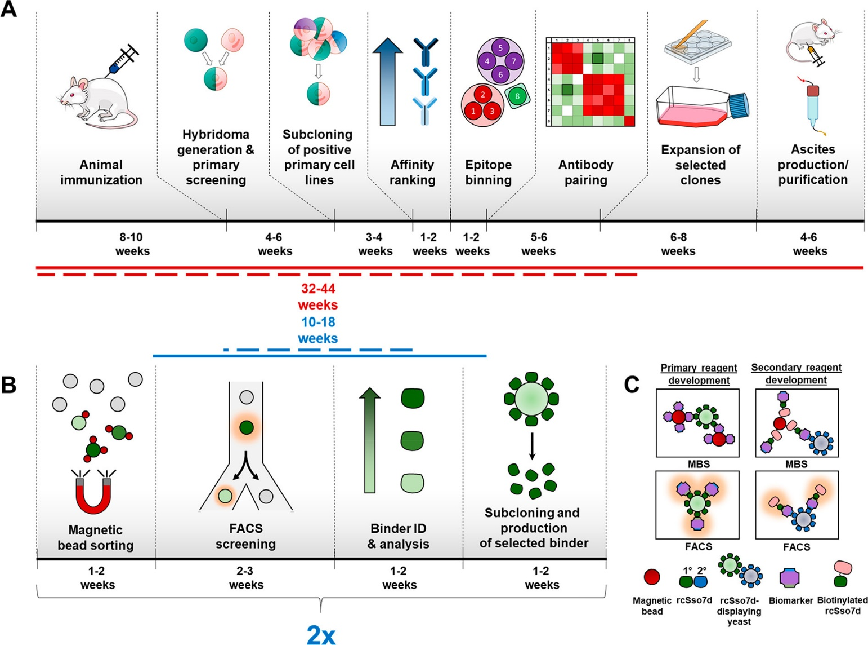
Rapid development of paper-based COVID-19 immunoassay
E. coli
Miller, E. A. et al. ACS Comb. Sci., 2020, 22, 1, 49-60
Sung, K. et al. Analyst, 2020, 145, 2515-2519
Notes:
https://www.centerforhealthsecurity.org/covid-19TestingToolkit/molecular-based-tests/current-molecular-and-antigen-tests.html
3M to produce paper based COVID assay

Slide 39
Antibodies and COVID-19
There are three major ways to think about the role of antibodies in COVID-19:
Rapid COVID diagnostic test
Retained Immunity to COVID-19
Antibody Treatment
Notes:
in this case, you might propose to make a set of antibodies that bind to SARS-CoV-2 to neutralize the virus (prevent it from infecting healthy cells and hijacking their machinery) and allow other immune cells to more easily identify the virus (coated now with antibodies) and destroy it (ex. Complement Pathway, Phagocytosis via macrophages). If this is the type of proposal that you want to write, you’ll need to consider how you’ll screen for antibodies that bind to SARS-CoV-2. You’ll still need to make antigen from the virus to perform sorts. Also, will you pull clones from a synthetic library (https://www.ncbi.nlm.nih.gov/pubmed/17406305) or will you screen recovered patients’ plasma B cells to try to pull out native neutralizing clones developed through B cell receptor somatic hypermutation (https://www.ncbi.nlm.nih.gov/pmc/articles/PMC7095806/)? Some important things to think about here will be the affinity needed for complete neutralization, the stability of your antibody in solution (think about other things added to the final drug formulation to prevent aggregation), the specific antigen to which the antibodies will bind, etc.

Slide 40
Sustained B cell memory (Antibody factories still in business ☺)
Prolonged evolution of the human B cell response to SARS-CoV-2 infection
Sakharkar et al.
Science Immunology 23 Feb 2021:
DOI: 10.1126/sciimmunol.abg6916
Notes:
in this case, you might propose to make a set of antibodies that bind to SARS-CoV-2 to neutralize the virus (prevent it from infecting healthy cells and hijacking their machinery) and allow other immune cells to more easily identify the virus (coated now with antibodies) and destroy it (ex. Complement Pathway, Phagocytosis via macrophages). If this is the type of proposal that you want to write, you’ll need to consider how you’ll screen for antibodies that bind to SARS-CoV-2. You’ll still need to make antigen from the virus to perform sorts. Also, will you pull clones from a synthetic library (https://www.ncbi.nlm.nih.gov/pubmed/17406305) or will you screen recovered patients’ plasma B cells to try to pull out native neutralizing clones developed through B cell receptor somatic hypermutation (https://www.ncbi.nlm.nih.gov/pmc/articles/PMC7095806/)? Some important things to think about here will be the affinity needed for complete neutralization, the stability of your antibody in solution (think about other things added to the final drug formulation to prevent aggregation), the specific antigen to which the antibodies will bind, etc.

Slide 41
Decreasing antibody levels in the serum overtime
https://immunology.sciencemag.org/content/6/56/eabg6916
Notes:
3 patients with severe disease and 5 patients with mild disease, serum antibody levels (spike, receptor binding domain, N-terminal domain). All showed elevated binding to S proteins of seasonal corona viruses (OC43 and HKU1) → broadly cross-reactive antibodies

Slide 42
Sustained SARS-CoV-2 specific B cells overtime
High titers of serum Abs are required for sterilizing immunity
But memory B cells rapidly re-activate following re-infection and can protect against severe disease
Antibody secretion
Further B cell receptor diversification
https://immunology.sciencemag.org/content/6/56/eabg6916
Notes:
Although high titers of serum nAbs are required for sterilizing immunity, memory B cells rapidly re-activate following a secondary infection and can contribute to protection against severe disease or death (12). Human MBCs can differentiate into antibody-secreting cells to provide an immediate source of serum antibody or they can enter secondary germinal centers (GCs) to re-diversify their B cell receptors (BCRs) in response to evolving or antigenically related pathogens

Slide 43
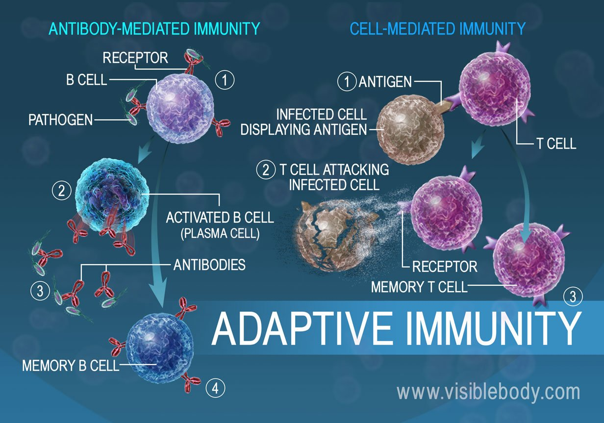
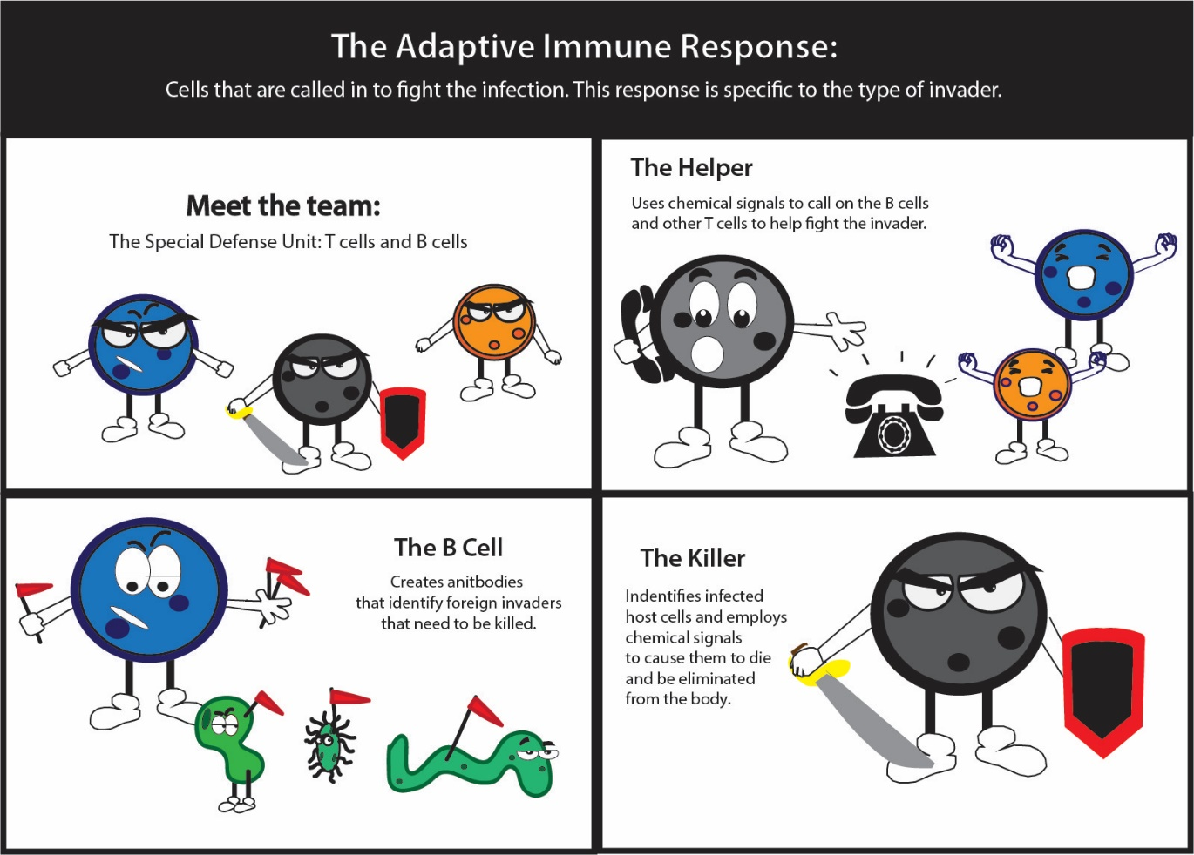
Why memory B cells and antibodies aren’t the full story…

Slide 44
Antibodies and COVID-19
There are three major ways to think about the role of antibodies in COVID-19:
Rapid COVID diagnostic test
Retained Immunity to COVID-19
Antibody Treatment
Notes:
in this case, you might propose to make a set of antibodies that bind to SARS-CoV-2 to neutralize the virus (prevent it from infecting healthy cells and hijacking their machinery) and allow other immune cells to more easily identify the virus (coated now with antibodies) and destroy it (ex. Complement Pathway, Phagocytosis via macrophages). If this is the type of proposal that you want to write, you’ll need to consider how you’ll screen for antibodies that bind to SARS-CoV-2. You’ll still need to make antigen from the virus to perform sorts. Also, will you pull clones from a synthetic library (https://www.ncbi.nlm.nih.gov/pubmed/17406305) or will you screen recovered patients’ plasma B cells to try to pull out native neutralizing clones developed through B cell receptor somatic hypermutation (https://www.ncbi.nlm.nih.gov/pmc/articles/PMC7095806/)? Some important things to think about here will be the affinity needed for complete neutralization, the stability of your antibody in solution (think about other things added to the final drug formulation to prevent aggregation), the specific antigen to which the antibodies will bind, etc.

Slide 45
Potent antibody treatment to slow disease progression
SARS-CoV-2 Neutralizing Antibody LY-CoV555 in Outpatients with Covid-19
Chen et al.
N Engl J Med 2021; 384:229-237
DOI: 10.1056/NEJMoa2029849
Notes:
in this case, you might propose to make a set of antibodies that bind to SARS-CoV-2 to neutralize the virus (prevent it from infecting healthy cells and hijacking their machinery) and allow other immune cells to more easily identify the virus (coated now with antibodies) and destroy it (ex. Complement Pathway, Phagocytosis via macrophages). If this is the type of proposal that you want to write, you’ll need to consider how you’ll screen for antibodies that bind to SARS-CoV-2. You’ll still need to make antigen from the virus to perform sorts. Also, will you pull clones from a synthetic library (https://www.ncbi.nlm.nih.gov/pubmed/17406305) or will you screen recovered patients’ plasma B cells to try to pull out native neutralizing clones developed through B cell receptor somatic hypermutation (https://www.ncbi.nlm.nih.gov/pmc/articles/PMC7095806/)? Some important things to think about here will be the affinity needed for complete neutralization, the stability of your antibody in solution (think about other things added to the final drug formulation to prevent aggregation), the specific antigen to which the antibodies will bind, etc.

Slide 46
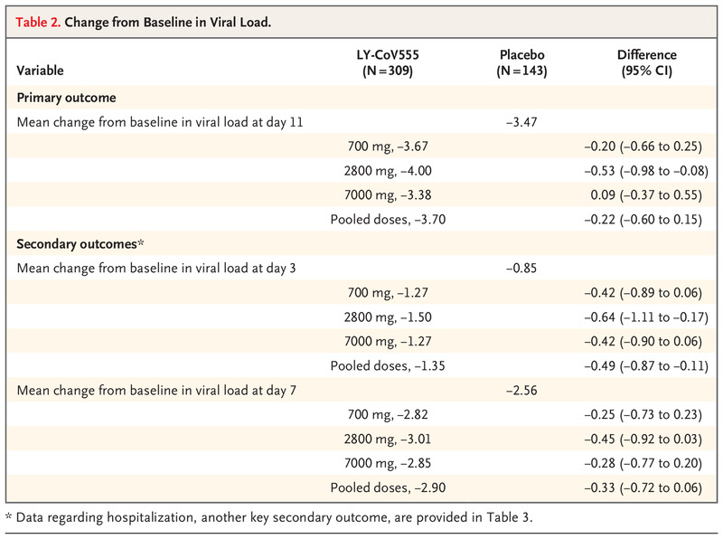
Reduces viral load and leads to fewer hospitalizations
https://www.nejm.org/doi/full/10.1056/NEJMoa2029849

Slide 47
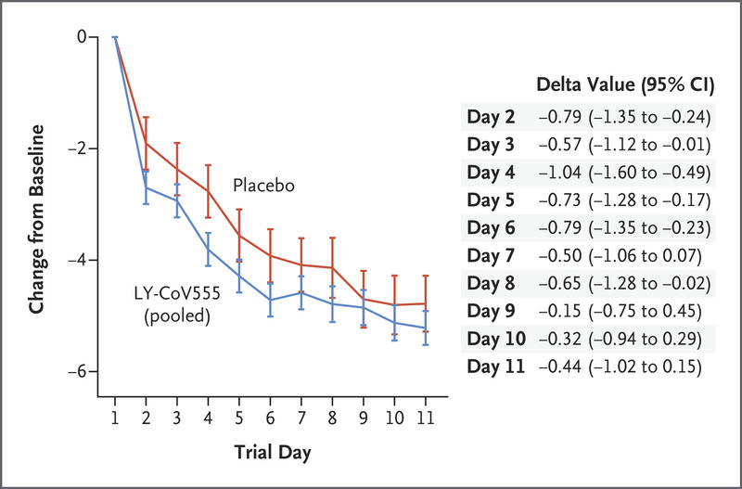
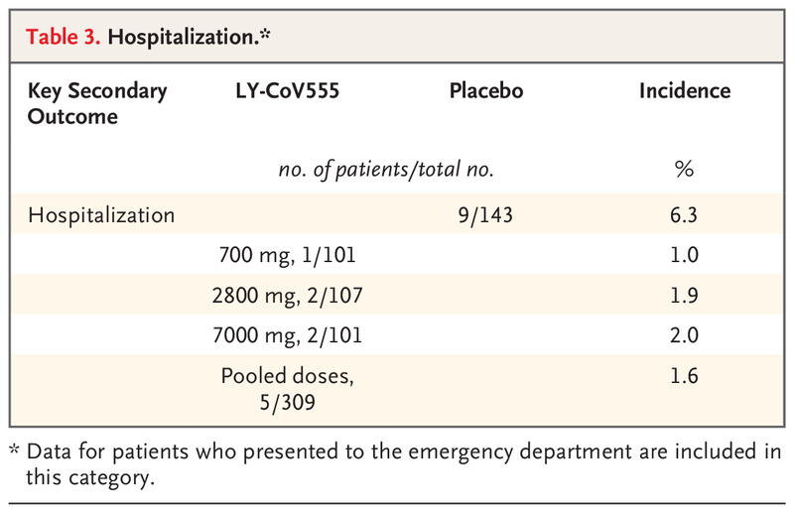
Reduces viral load and leads to fewer hospitalizations
https://www.nejm.org/doi/full/10.1056/NEJMoa2029849

Slide 48
Broadly cross-reactive neutralizing antibodies
Broad and potent activity against SARS-like viruses by an engineered human monoclonal antibody
Rappazzo et al.
Science, 19 Feb 2021:
DOI: 10.1126/science.abf4830
Notes:
in this case, you might propose to make a set of antibodies that bind to SARS-CoV-2 to neutralize the virus (prevent it from infecting healthy cells and hijacking their machinery) and allow other immune cells to more easily identify the virus (coated now with antibodies) and destroy it (ex. Complement Pathway, Phagocytosis via macrophages). If this is the type of proposal that you want to write, you’ll need to consider how you’ll screen for antibodies that bind to SARS-CoV-2. You’ll still need to make antigen from the virus to perform sorts. Also, will you pull clones from a synthetic library (https://www.ncbi.nlm.nih.gov/pubmed/17406305) or will you screen recovered patients’ plasma B cells to try to pull out native neutralizing clones developed through B cell receptor somatic hypermutation (https://www.ncbi.nlm.nih.gov/pmc/articles/PMC7095806/)? Some important things to think about here will be the affinity needed for complete neutralization, the stability of your antibody in solution (think about other things added to the final drug formulation to prevent aggregation), the specific antigen to which the antibodies will bind, etc.

Slide 49
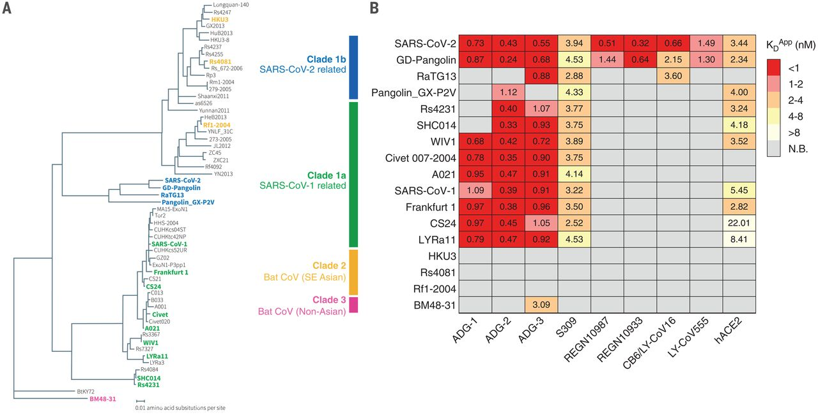
Broad yet strong binding affinity to various sarbecoviruses
https://science.sciencemag.org/content/371/6531/823
Notes:
Here they compare the binding affinity of their antibodies across a number of different related corona viruses as compared to some clinically available antibodies

Slide 50
Using YSD to epitope map virus binding site
https://science.sciencemag.org/content/371/6531/823
Notes:
Here they create a library using YSD displaying the SARS-CoV-2 receptor binding domain with random mutations. They then select for mutants that no longer bind their antibody of interest. This helps determine which amino acids are important for binding (and are in the binding pocket of the antibody to the receptor). They then show how a number of corona viruses share sequence homology in the receptor binding motif and a crystal structure of their antibody binding to the SARS-CoV-2 RBD

Slide 51
Any questions?
Effect of affinity on anti-PD-1
immune checkpoint blockade therapy
Antibodies and COVID-19
AF647
Streptavidin
Secondary
StrepAF647
Biotin
PD-1
C-myc
Y
Y
V_{H}
AF488
V_{L}
HA
Primary
Chicken α C-myc
Secondary
Goat α Chicken
Aga2
Aga1

Slide 52
Extra slides

Slide 53
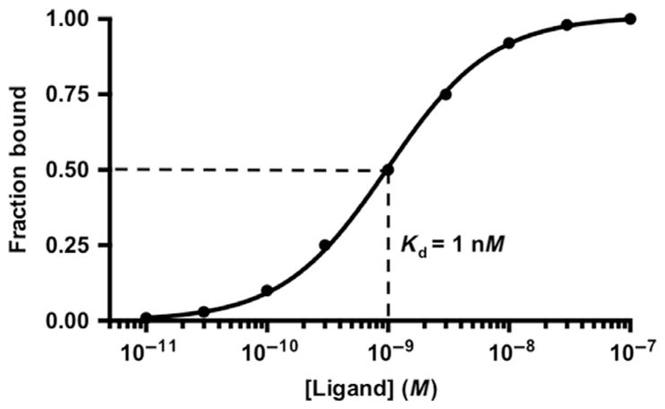
Yeast Titration Curve Fit
$$MFI=B_{max}\frac{X}{K_{D}+X}+Background$$
← Normalized by Bmax and Background

Slide 54
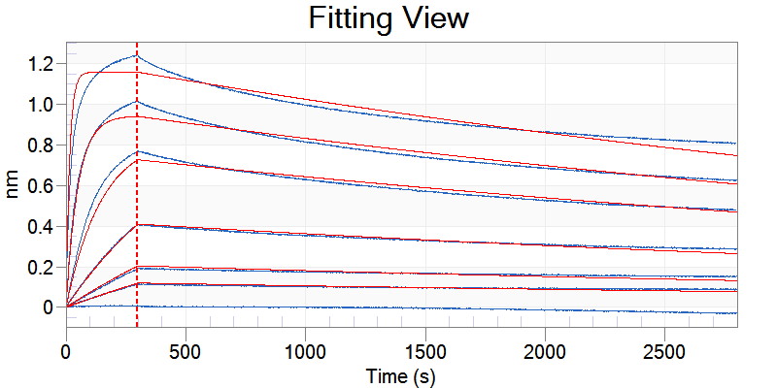
Octet - 29FmonomAb
Global Fit (Association and Dissociation) All Sensors
100 nM 29F monomAb
30 nM
10 nM
2.5 nM
1 nM
0.6 nM
0 nM (control)
k_{D} (M) | k_{D} error | k_{on}(1/Ms) | k_{on} error | k_{dis}(1/s) | k_{dis} error | Full χ² | Full R²
2.68e-10 | 1.51e-12 | 6.54e+05 | 3.38e+03 | 1.75e-04 | 3.89e-07 | 7.6248 | 0.9958

Slide 55
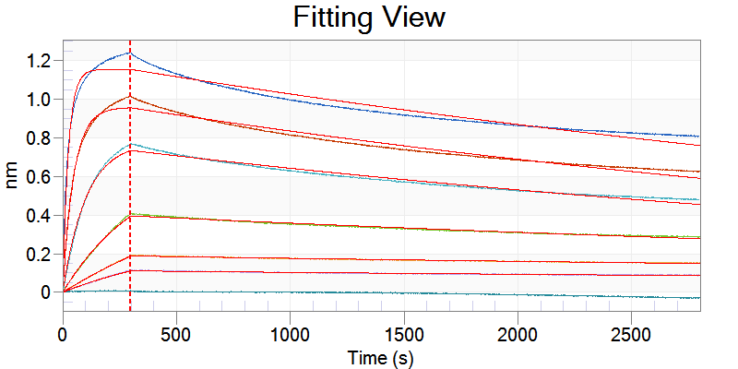
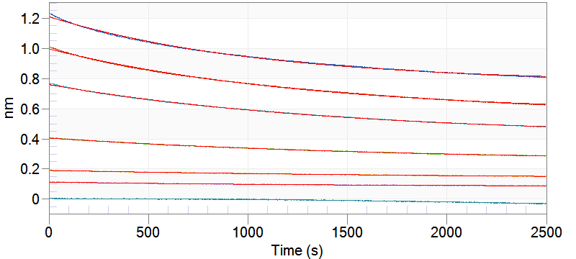
Octet - 29FmonomAb → Dissociation values
Local Fit (Association and Dissociation) All Sensors
Sensor | k_{D} (M) | k_{on}(1/Ms) | k_{dis}(1/s) | Full χ² | Full R²
100 nM | 4.24e-10 | 3.94e+05 | 1.67e-04 | 2.5168 | 0.9495
30 nM | 2.87e-10 | 6.71e+05 | 1.93e-04 | 1.1003 | 0.9747
10 nM | 2.01e-10 | 9.53e+05 | 1.92e-04 | 0.482 | 0.9839
2.5 nM | 1.32e-10 | 1.08e+06 | 1.42e-04 | 0.0671 | 0.9933
1 nM | 8.98e-11 | 1.04e+06 | 9.31e-05 | 0.0074 | 0.997
0.6 nM | 3.55e-11 | 2.83e+06 | 1.01e-04 | 0.0083 | 0.9898
Local Fit (Dissociation) All Sensors
Sensor | k_{dis}(1/s) | k_{dis} error
100 nM | 9.37e-04 | 3.02e-06
30 nM | 7.75e-04 | 2.13e-06
10 nM | 6.82e-04 | 1.86e-06
2.5 nM | 5.61e-04 | 2.46e-06
1 nM | 4.35e-04 | 6.12e-06
0.6 nM | 6.50e-04 | 1.05e-05

Slide 56
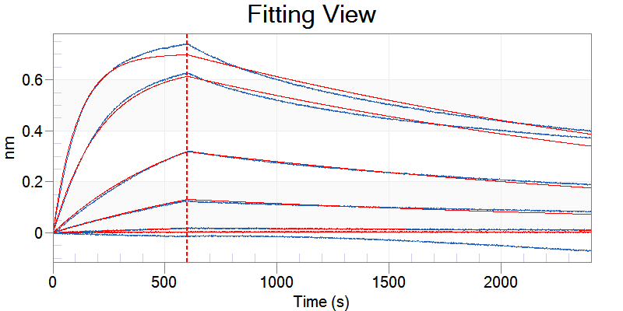
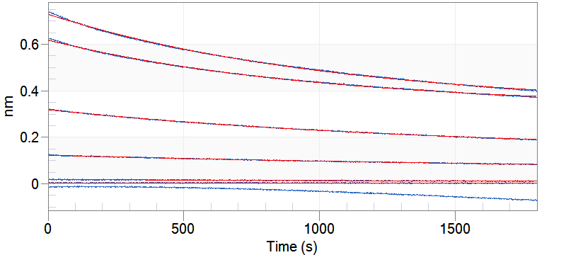
Octet – 29FeL1.7 monomAb (former Mut7)
Global Fit (Association and Dissociation) (all sensors)
k_{D} (M) | k_{D} error | k_{on}(1/Ms) | k_{on} error
7.56e-09 | 2.26e-11 | 4.35e+04 | 1.12e+02
k_{dis}(1/s) | k_{dis} error | Full χ² | Full R²
3.29e-04 | 4.98e-07 | 1.2381 | 0.9982
Local Fit (Dissociation) All Sensors
Sensor | k_{dis}(1/s) | k_{dis} error
200 nM | 9.39e-04 | 3.55e-06
100 nM | 1.01e-03 | 3.90e-06
30 nM | 6.56e-04 | 3.53e-06
10 nM | 4.32e-04 | 9.27e-06
2.5 nM | 1.83e-04 | 5.09e-05
1 nM | 2.67e-07 | 3.63e-05

Slide 57
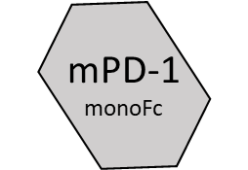
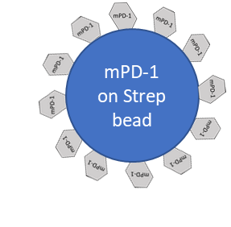
Moving to the Kinetic Exclusion Assay (KinExA)
Modified KinExA Protocol
Prepare samples with constant ligand and titrated antigen.
Incubate at 37°C for 72 hours
Prepare beads by coating with biotinylated titrated antigen.
Expose samples to beads for short time (<1 min) to capture any free constant ligand.
Incubate at 4°C with detection antibody for 15-20 minutes.
Run flow.
Mixed and equilibrated
Antibody at
fixed concentration
mPD-1 (labeled irrelevant) dilyution series
Y
Free antibody captured on beads (will collect any bivalent clones only bound on one arm)
Detect with anti-mouse-AF647

Slide 58
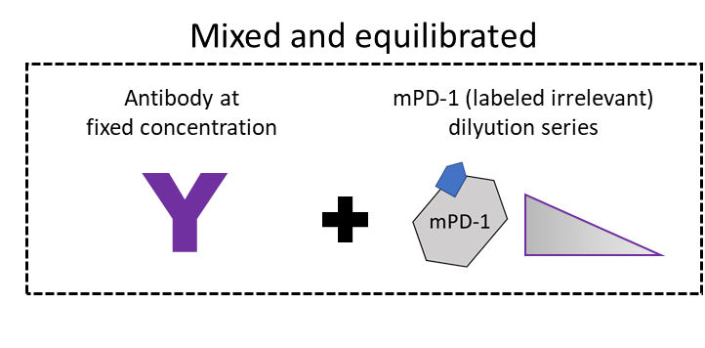
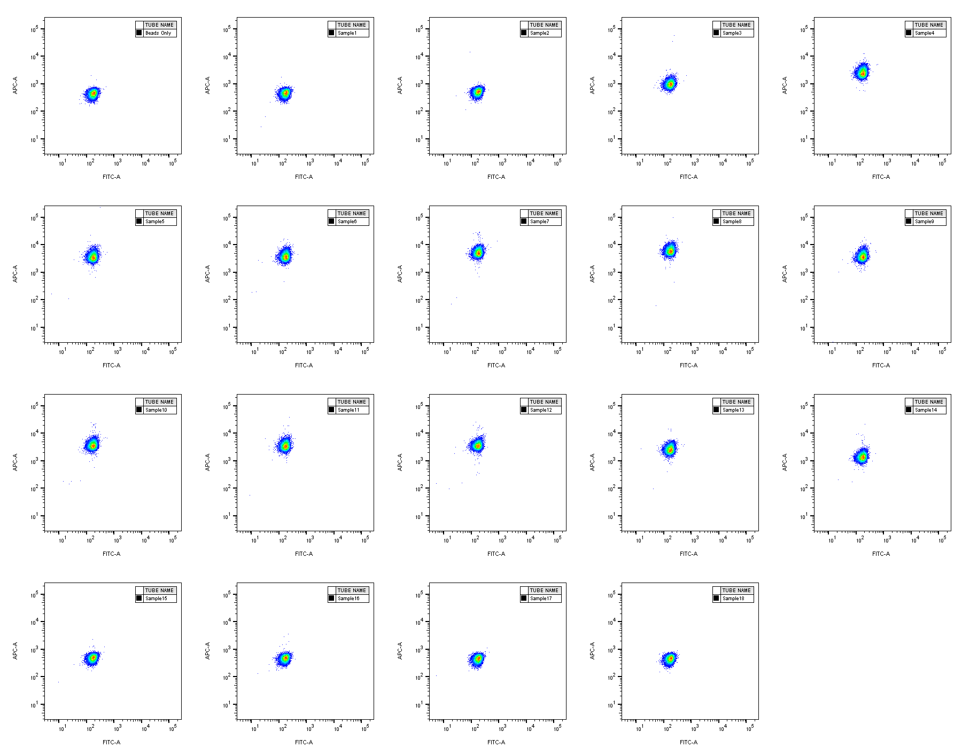
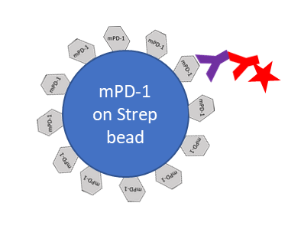
KinExA Flow Example Plots

Slide 59
KinExA Binding Curves
Darling, R. J., & Brault, P.-A. (2004). ASSAY and Drug Development Technologies, 2(6), 647–657. doi:10.1089/adt.2004.2.647
Smith, M. H., & Fologea, D. (2020). Sensors, 20(12), 3442. https://doi.org/10.3390/s20123442
Bee, C., Abdiche, Y. N., Stone, D. M., Collier, S., Lindquist, K. C., Pinkerton, A. C., Pons, J., & Rajpal, A. (2012). PloS one, 7(4), e36261.
Percentage of Free Antibody Binding Sites
Y
Y
Titrated Ligand Concentration
$$Signal= \frac{{Sig}_{100}−{Sig}_{0}}{2[B_{0}]}\left(\left[B_{0}\right]−k_{D}−\left[A\right]+\sqrt{{\left[B_{0}\right]}^{2}+2\left[B_{0}\right]k_{D}−2\left[B_{0}\right]\left[A\right]+k_{D}^{2}+2\left[A\right]k_{D}+{\left[A\right]}^{2}}\right)+{Sig}_{0}$$

Slide 60
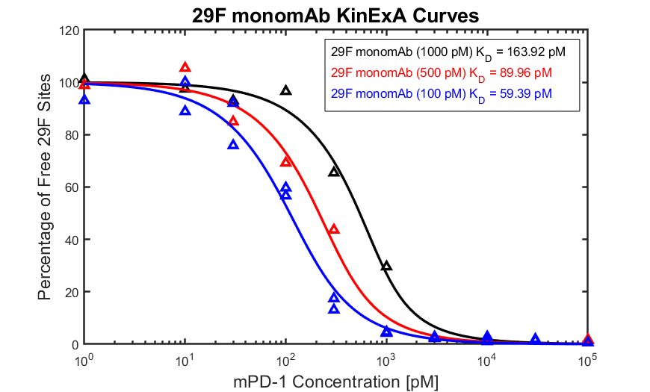
KinExA Binding Curves – Local Fit
Local Fit: Allow Sig100, Sig0, k_{D} and Active Constant Ligand to vary for each curve

Slide 61
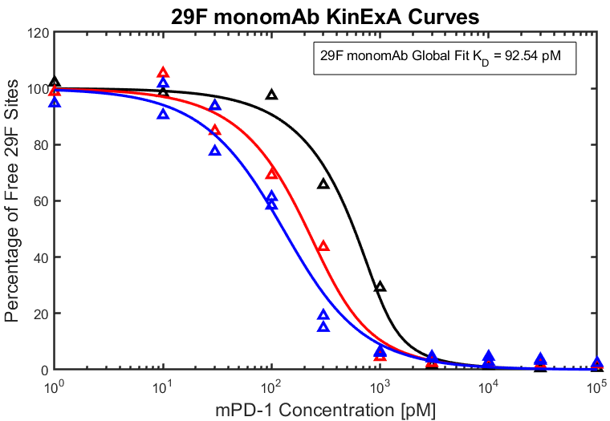
KinExA Binding Curves – Global Fit
Global Fit: Allow Sig100, Sig0, and Active Constant Ligand to vary for each curve but hold k_{D} constant for all curves

Slide 62
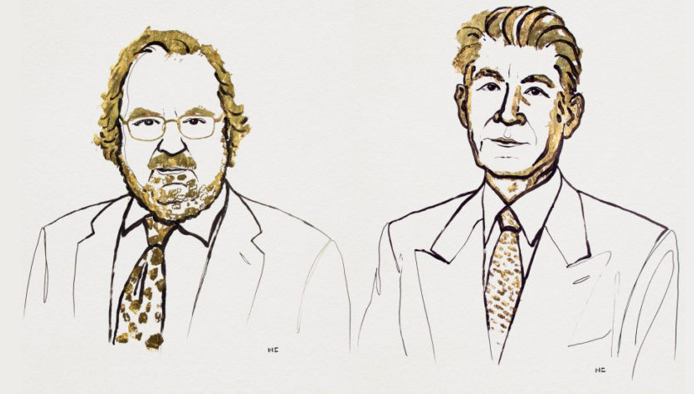
Immune Checkpoint Blockade Therapy
In the Wittrup lab, we uses a variety of protein engineering strategies to understand and develop effective cancer biopharmaceuticals…
Dr. James P. Allison
Dr. Tasuku Honjo
2018 Nobel Prize in Physiology or Medicine for the discovery of cancer therapy by inhibition of negative immune regulation
Illustration by Mattias Karlen, The Nobel Committee for Physiology or Medicine
https://www.nobelprize.org/uploads/2018/10/press-medicine2018.pdf

Slide 63
PD-1 Fully Saturated by mAb?
Parameter | Symbol | Unit | Value
Volume of plasma | Vplasma | mL | 2
Volume of tumor | Vtumor | μL | 100
Tumor Void Fraction | ɛ | -- | 0.24 ^{1,4}
Number of cells in tumor | cellTumor | # | 10^{7 3,4}
Vascular permeability | P | cm/s | 3*10⁻⁷ ²
Capillary radius | Rcap | μm | 8 ²
Krogh cylinder radius | Rk | μm | 75 ²
Antibody affinity** | Kd | nM | 0.5-500
Antibody binding on-rate** | k_{on} | 1/(M*s) | 2*10⁵ ⁴
PD-1 PSS Tumor Conc | PD1ss | nM | 0.0714⁵
PD-1/mAb Internalization Rate** | k_{int} | 1/hr | 0.0194⁵
mAb plasma clearance rate** | k_{clear} | 1/hr | 0.02^{1,4}
Schmidt MM, Wittrup KD. 2009. A modeling analysis of the effects of molecular size and binding affinity on tumor targeting. Mol Cancer Ther. 8(10):2861–2871.
Thurber G.M. , Wittrup K. Dane, A mechanistic compartmental model for total antibody uptake in tumors. Journal of Theoretical Biology. 314 (2012) 57–68
Rhoden, John J., Wittrup, KD. Dose Dependence of Intratumoral Perivascular Distribution of Monoclonal Antibodies. Journal of Pharmaceutical Sciences, 101, 2, (2012) 860-867.
Tisdale, AW., New Protein Engineering Approaches for Potentiating and Studying Antibody-Based EGFR Antagonism, Thesis, Biological Engineering, MIT, 2019
Lindauer et al., Translational Pharmacokinetic/Pharmacodynamic Modeling of Tumor Growth Inhibition… CPT Pharmacometrics Syst Pharmacol. 2017 Jan; 6(1): 11–20.
~10000 receptors per T cell, EGFR = ~80 nM,
Half life = ~35 hours, seems long, but same order of magnitude as Alison’s EGFR int rate
Typical mAb half life = ~35 hours
** To be measured

Slide 64
29Fe3 Library
Equilibrium sort of 10⁸ yeast at 100 nM to select binders
Round 1 Kinetic sort of 5x10⁷ yeast at 30°C
90 hr Positive Control
90 hr Library Sort
0.4%
0.2%
mPD-1 Binding
29Fe2.13
Display (C-myc Tag)
Notes:
We proceeded to make another library and continued with an equilibrium and kinetic sorts now at 30 and 37C

Slide 65
29Fe3 Library
Equilibrium sort of 10⁸ yeast at 100 nM to select binders
Round 2 Kinetic sort of 5x10⁷ yeast at 37°C
60 hr Positive Control
60 hr Library Sort
0.1%
1.0%
mPD-1 Binding
29Fe2.13
Display (C-myc Tag)

Slide 66
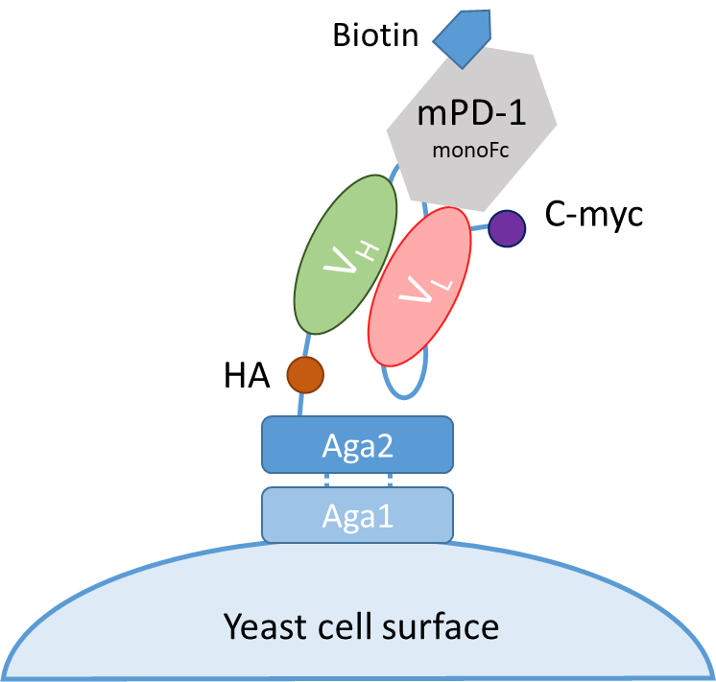
Kinetic testing of 29Fe3 mutants – 90 hours at 37°C
Control 29Fe2.13
Clone 29Fe3.1
Clone 29Fe3.2
A lot of positive charge enrichment, possibly increasing non-specific binding
Increase in HA without c-myc expression
Clone 29Fe3.3
Clone 29Fe3.4
Clone 29Fe3.5
mPD-1 Binding
Display (C-myc Tag)
Notes:
But when we tested these clones individually, they don’t have significantly stronger binding then the control 29Fe2.13 and they have a lot of positive charge enrichment, which could lead to undesired non-specific binding

Slide 67
Kinetic testing of 29Fe3 mutants – 90 hours at 37°C
Control 29Fe2.13
Clone 29Fe3.1
Clone 29Fe3.2
A lot of positive charge enrichment, possibly increasing non-specific binding
Increase in HA without c-myc expression
Clone 29Fe3.3
Clone 29Fe3.4
Clone 29Fe3.5
Display (HA tag)
Display (C-myc Tag)
Notes:
But when we tested these clones individually, they don’t have significantly stronger binding then the control 29Fe2.13 and they have a lot of positive charge enrichment, which could lead to undesired non-specific binding

