Slide 1
20.109 Communication Workshop 5: Research Proposal
Dr. Sean Clarke
Dr. Diana Chien
Helping you communicate effectively.
be.mit.edu/communicationlab

Slide 2
A successful proposal must convince its readers that the proposed work is significant and achievable.
Readers are busy and easily distracted
Opportunities are limited
Time limits on applying again
(whereas there’s always another journal for your paper)
Notes:
Few reviewers will take the time to advocate for your proposal
significance + achievability
Personal experience with grant-writing (NSF)
And we’ll give you an opportunity to practice: articulating a research question, turning into actionable aims

Slide 3
Strategies are the same, from 109 to NIH.
https://youtu.be/lAOGtr0pM6Q

Slide 4
The 109 proposal is a little different
12 minutes + Q&A
Slide-based

Slide 5
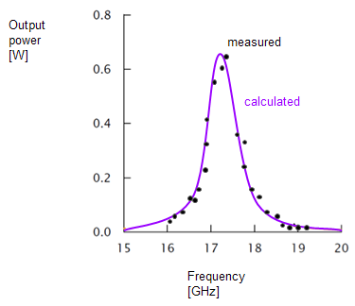
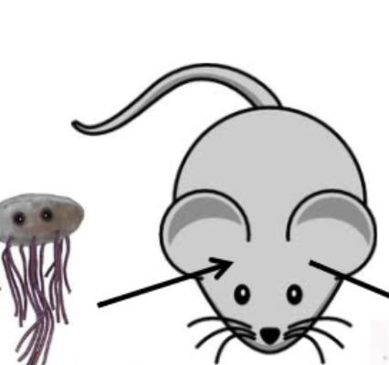
…but it’s mostly the same
Tell us the why, how, and what will result
Identify the knowledge gap
We care about the methods: specify in vitro, in vivo, what system?
“You can’t just shove things into a mouse.”
Show us what expected data will be
If things don’t work, what will you do?
Have controls and work-arounds

Slide 6
Proposals are future papers (with little twists)
Papers:
Question
Outcome uncertain
Findings are exciting
Proposals:
Hypothesis
Outcome certain
Innovation is exciting
Both have sections, tell stories, argue for excitement and validity, methods, controls & statistics

Slide 7
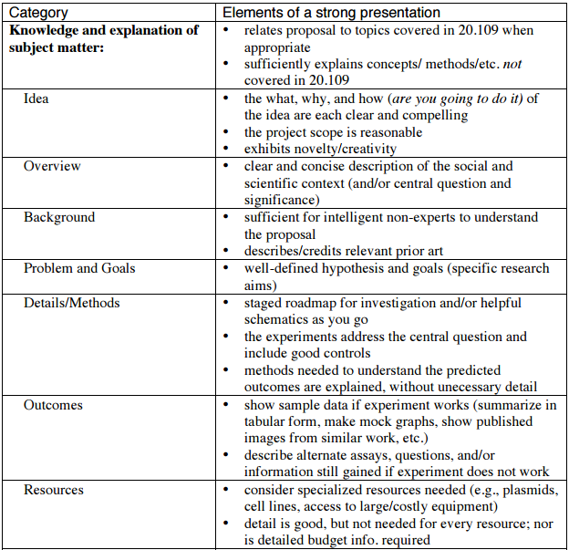
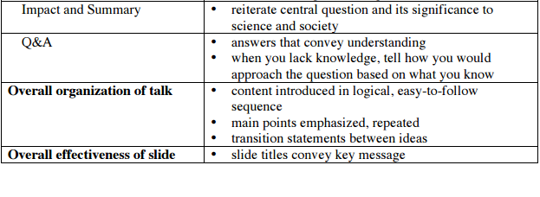
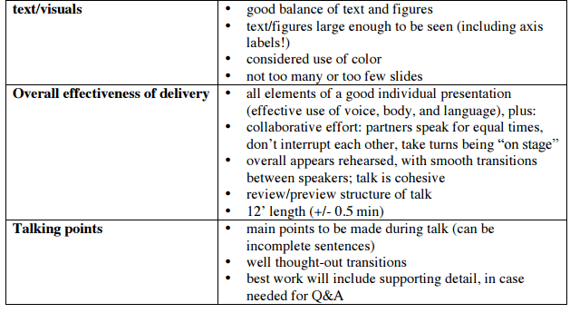
Review assignment rubric
Notes:
Ask instructors what the point distributions are.

Slide 8
Examples & resources
NIH Small Grant Program (R03): appropriate scale http://grants.nih.gov/grants/funding/r03.htm
NIAID: includes alternate approaches if first approach doesn’t work
http://www.niaid.nih.gov/researchfunding/grant/pages/appsamples.aspx
BE Research Guide: http://libguides.mit.edu/bioleng
(email Howard Silver hsilver@mit.edu with suggestions!)

Slide 9
Sections balance two goals…
Overview: brief statement of knowledge gap, research question, and significance
Background
Research Question + Specific Aims
well-defined, testable hypothesis
3-4 tests of that hypothesis
Methods
Outcomes predicted if everything goes according to plan, and if nothing does
Resources needed to complete the work
Impact on science, society
SIGNIFICANT
ACHIEVABLE
SIGNIFICANT

Slide 10
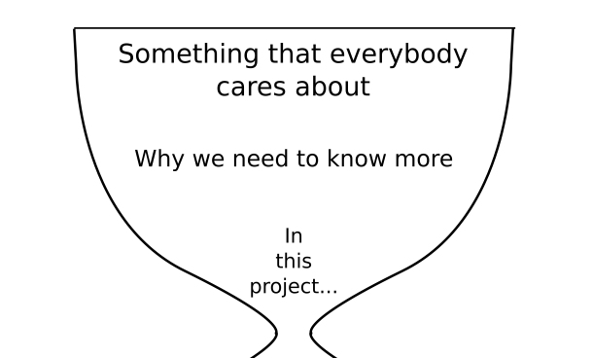
Sections map to familiar ones
1. Overview: Brief statement of knowledge gap, research question, significance, like the first half of an Abstract
2. Background
Orients us like an Introduction
3. Research Question + Specific Aims
Just like Results, posed to the future as an objective or hypothesis

Slide 11
3. Research Question + Specific Aims
Objective/Hypothesis: Our objective is to obtain nanoparticles optimized for targeted drug delivery and imaging of prostate cancer.
We hypothesize that polymer-based nanosponges developed using a step-wise, function-driven design format are an effective modality for simultaneous targeted drug delivery and imaging of prostate tumors.
Dr. Andries Zijlstra, Vanderbilt University

Slide 12
3. Research Question + Specific Aims
Aim #1. Generating a panel of prostate cancer-targeting nanosponges optimized for tumor targeting, drug cargo loading, and drug release kinetics
Aim #2. Identifying the most effective combination of tumor targeting nanosponges considering a combination of different targeting peptides, drug cargo, and release kinetics
Aim #3. Evaluating the use of nanosponge therapy against human prostate cancer using human tissue xenografted in SCID mice
Dr. Andries Zijlstra, Vanderbilt University

Slide 13
Activity: Evaluate the example proposal
Take 8 minutes
Answer the handout questions

Slide 14
Activity: Frame a Research Question + Specific Aims
Pick one of the fields that you and your partner are interested in. (This is just an exercise, not a commitment!)
Identify a testable hypothesis or research question in that field.
Brainstorm 3-4 ways of testing that hypothesis.

Slide 15
4. Methods: lay out an experimental roadmap to meet aims
Include brief statement of overall approach: don’t just dump details
Don’t just say “data analysis”
Metrics, cutoffs, tests?
What would tell you your hypothesis was true?
You don’t have to develop this all on your own: talk to faculty, grad students
How do people usually measure X?
Is there an animal model for Y?

Slide 16
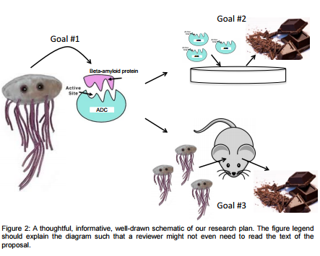
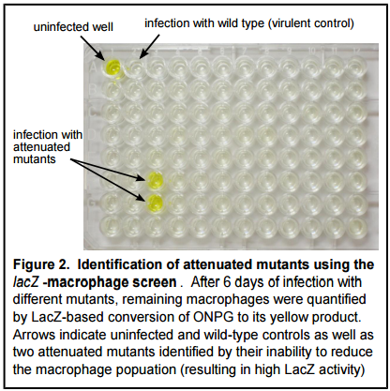
4. Methods: use schematics & visuals
Outline your specific aims:
Demonstrate a method:

Slide 17
5. Predicted Outcomes: Create representative visuals of expected data

Slide 18
5. Predicted Outcomes: What could go wrong?
What are other ways you could test the same question?
Demonstrates that some advance is likely
You can think through potential pitfalls and prepare for them

Slide 19
5. Predicted Outcomes: what could go wrong?
3.2.2.5. Potential problems and alternative approaches.
It is possible that since reovirus T1L antagonizes innate immune responses via multiple mechanisms, as indicated by our preliminary data (Section 1.4.2) and reassortant experiments statistically linking the S2 and L2 genes to IFN antagonism (24), substitution of the T1L M1 gene into the T3D backbone may be insufficient to fully decouple the IFN response from the apoptotic response following infection.
In this case, we will use information derived from Specific Aim 1, to identify other genes associated with IFN antagonism, to generate an “IFN-dead” virus in the pro-apoptotic T3D backbone. The transcriptional networks induced by this virus would then be profiled, as above.
If these approaches fail to segregate apoptosis induction from IFN signaling, we will profile changes in gene expression induced by T1L and T3D in IFNAR-deficient MEFs.
It is also possible that microarray slides or software provided through the GCAT consortium may not be sufficiently robust to accommodate the level of depth of the proposed experiments. In this case, we would then use commercially available microarrays, such as the GeneChip® Human Gene 1.0 ST Array (Affymetrix), similar to those used previously (45).
Geoffrey Holm, R15 application, via niaid.nih.gov

Slide 20
6. Resources: mention unique elements in Methods
You don’t need a dedicated Resources slide.
Will you need a hospital, core facility, collaborators?

Slide 21
7. Impact: reiterate central question & significance
Innovation and Impact: The proposed work is highly innovative at two levels:
The use of unique polymer chemistry in the design of a polymer-based nanoparticle, and
the synergistic function-driven design approach implemented by integrating the expertise of three investigators.
The proposed particle would greatly impact prostate cancer therapy as it would enable tumor specific delivery of established and newly design therapeutics.
Dr. Andries Zijlstra, Vanderbilt University

Slide 22
Group presentation skills
Don’t switch off too frequently
Announce organization & transitions between partners
“Noreen will introduce the Question and the Aims, and then I’ll talk about the Methods…”
Show your excitement! Modulate your voice

Slide 23
See the wiki for example slide deck

Slide 24
Feedback from the journal club presentations
Do interact with your slides
Excessive animations are distracting & inconvenient
Use simple styles
Group content – not everything has to appear one-by-one

Slide 25
There’s additional help
be.mit.edu/communicationlab
NIH Small Grant Program (R03): appropriate scale http://grants.nih.gov/grants/funding/r03.htm
NIAID: includes alternate approaches if first approach doesn’t work
http://www.niaid.nih.gov/researchfunding/grant/pages/appsamples.aspx
BE Research Guide: http://libguides.mit.edu/bioleng
(email Howard Silver hsilver@mit.edu with suggestions!)

