Slide 1
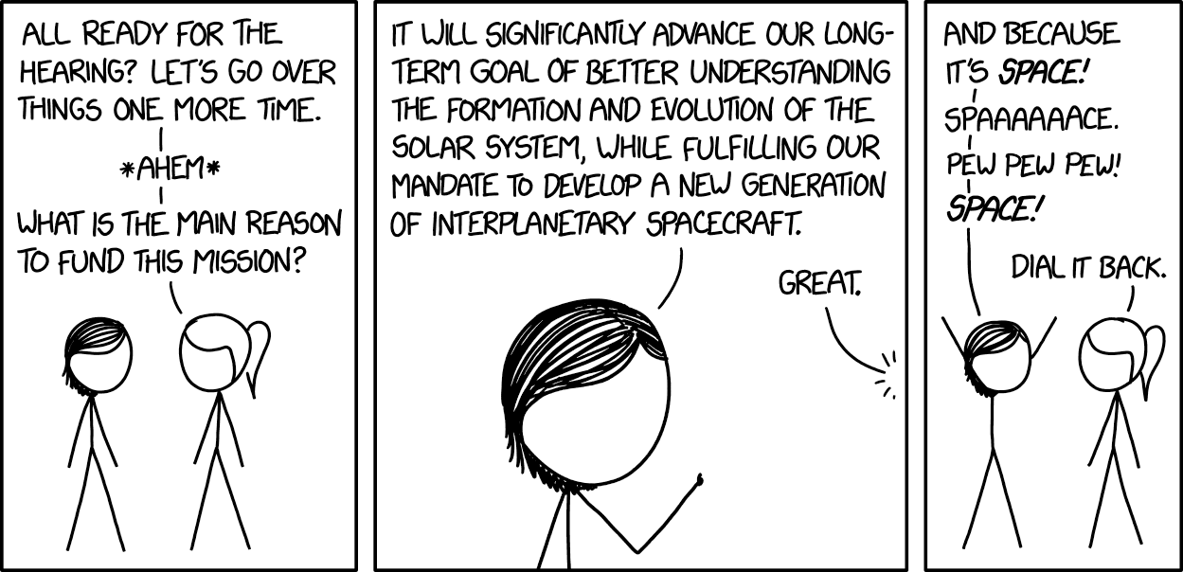
Research Proposal Pitches
Short pitches to class
Work with co-investigator to refine and expand your idea

Slide 2
Proposal pitches
Order based on volunteering
Quick pitch– no slide set up
Set up a problem in biological engineering
What is your proposal to study/solve this problem?
What are a couple ways you will go about achieving this goal?
Questions from classmates and instructors

Slide 3
Next steps
Refine your research question and change it if necessary
Complete the wiki questions for your homework during class
With additional time:

Slide 4
With additional time
Begin to think about the specific aims of your project
Each project will have 2-3 specific aims
Research question: Your overall goal
Specific aim: A specific objective that allows you to make progress toward achieving your overall goal
Ideally, specific aims to come together to address your research question
Think about aims that are more than yes/no answers
Want an aim where you can still learn something and make progress if the experiments don’t turn out as you had anticipated

Slide 5
Example: Can the genetically engineered XKCD enzyme dephosphorylate tau to prevent the development of Alzheimer’s disease?
Specific Aim 1: Test ex_XKCD dephosphorylation activity in vitro
Specific Aim 2: Optimize production and packaging of XKCD enzyme
Specific Aim 3: Test delivery and efficacy of XKCD in vivo using mouse model of AD

Slide 6
Good resource to get started…
The NIH has a good description of how to approach specific aims
https://www.niaid.nih.gov/grants-contracts/draft-specific-aims

