Slide 1
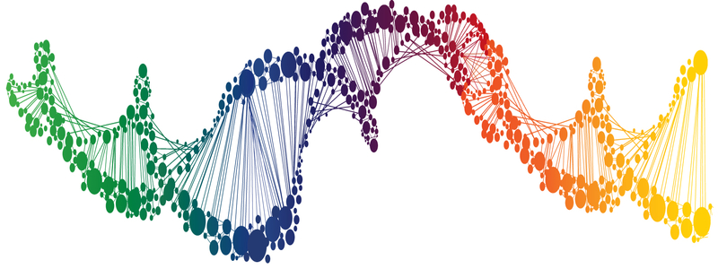
Module 2: Measuring gene expression
BRCA2 and pathway dependency
4/5/18

Slide 2
First, let’s review…
How is DNA damaged?
What is the relationship between DNA damage and mutations?
How is DNA repaired?

Slide 3
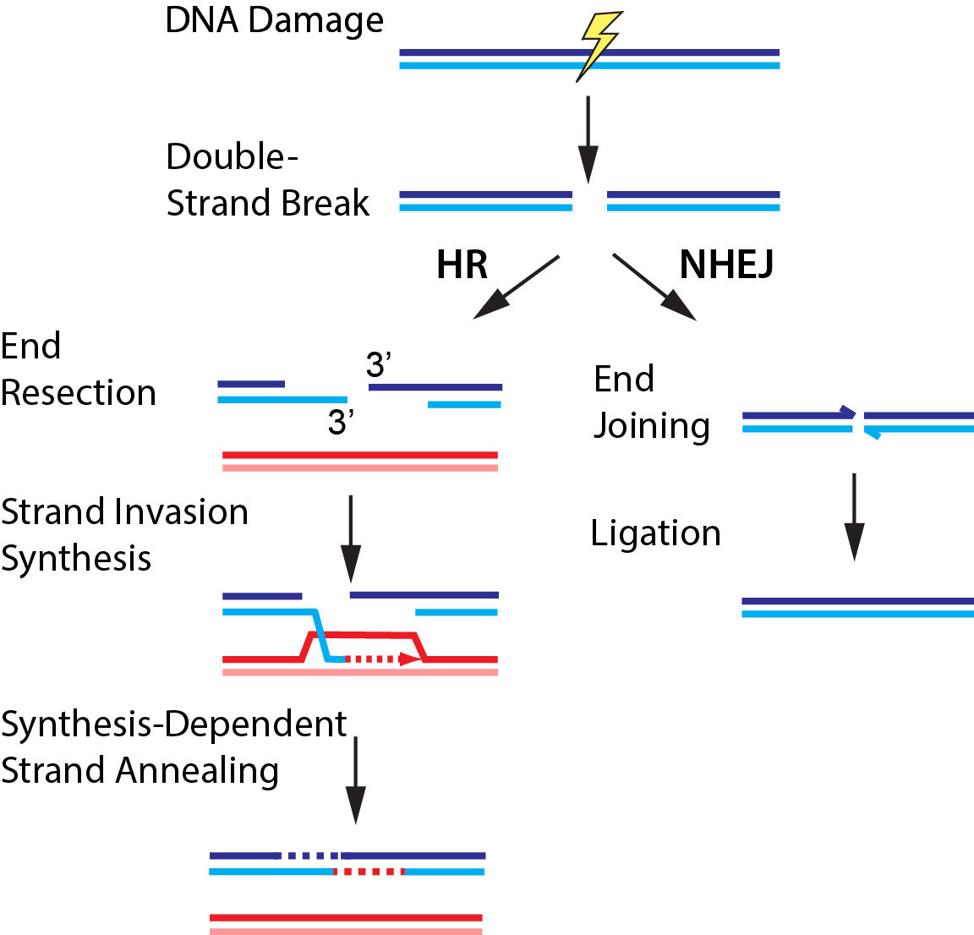
HR and NHEJ repair double-strand breaks

Slide 4
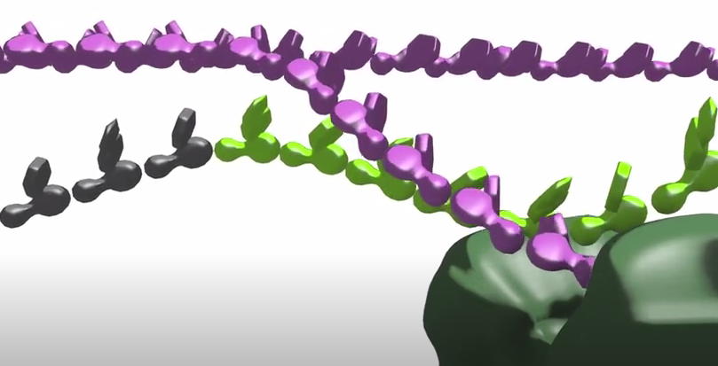
BRCA2 is important in HR
https://www.youtube.com/watch?v=86JCMM5kb2A

Slide 5
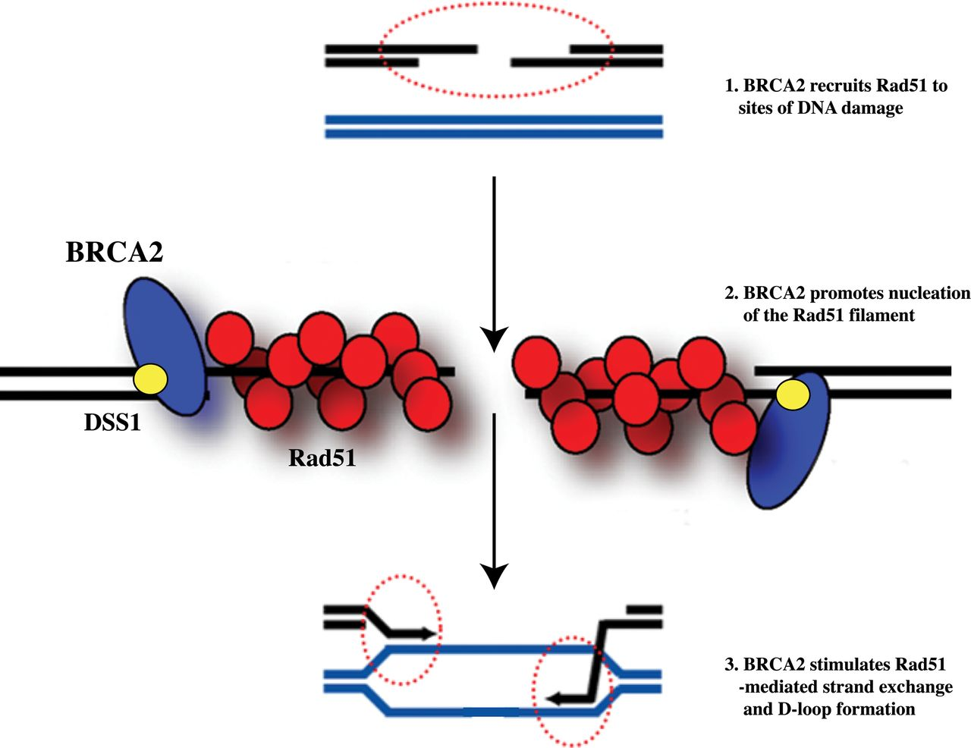
BRCA2 recruits Rad51 to DSBs
1. Promotes nucleation of filament
2. Mediates strand exchange and D-loop formation

Slide 6
What happens when BRCA2 is mutated?
Notes:
Cells reliant on NHEJ which is error prone and leads to mutations / cell death

Slide 7
BRCA1/2 mutations predispose individuals to malignancy
Role identified in mid 1990’s
Mutation carriers as much as 84% and 39% more likely to develop breast and ovarian cancer, respectively

Slide 8
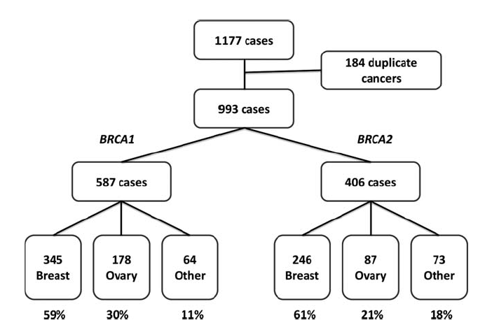
BRCA1/2 mutations not specific to breast and ovarian cancers
*
*
Mersch et al. (2015) Cancer 121:269-275

Slide 9
Role of BRCA1 & 2 in cancer prevalence
BRCA1
BRCA2
What about the DLD-1 cell line?
Mersch et al. (2015) Cancer 121:269-275

Slide 10
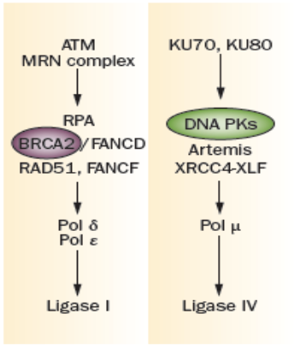
Paradoxical relationship exists between cancer occurrence and treatment
HR
NHEJ
If treatment targets DNA PKs, then cancer cells are unable to repair double-strand breaks
If cancer cells carry a mutation in BRCA2, then cells are dependent on NHEJ for double-strand break repair
Nat Rev (2012) 9:144-155
Notes:
Though mutations in DNA repair pathways lead to cancer, this can be exploited in treatment

Slide 11
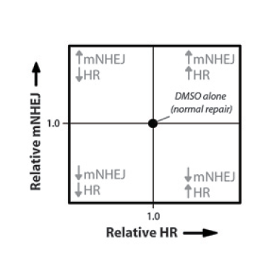
We will test synthetic lethality using previously identified compounds
Flourescence-based reporters used to measure mNHEJ and HR activity
Flow cytometry used to assess relative repair activity in cells
Notes:
mNHEJ = mutagenic NHEJ

Slide 12
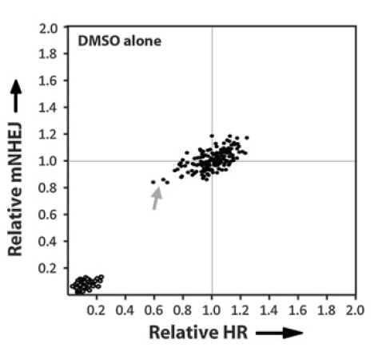
Method tested using DMSO control
Notes:
Points in lower left corner represent cells without activated fluorescence reporters

Slide 13
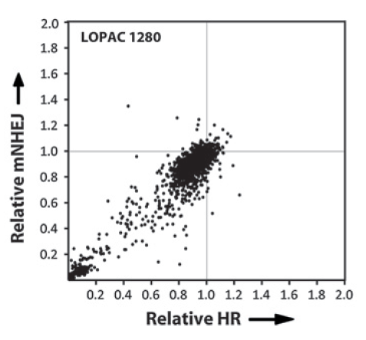
Next, 1280 compound library tested

Slide 14
Six compounds identified that target NHEJ and / or HR
Loperamide = slows contractions of intestines, treatment for gastrointestinal ailments
Mibefradil = blocks calcium channels, treatment for heart conditions
Goglia et al. (2014) Molecular Cancer Therapeutics 14:326-342
Notes:
Notice anything else on this list? Etoposide! How are we mediating unintended results from etoposide? Using pulse rather than incubation.
Hypertension (high blood pressure) and angina (chronic chest pain)
work by slowing the movement of calcium into the cells of the heart and blood vessel walls, which makes it easier for the heart to pump and widens blood vessels. As a result, the heart doesn't have to work as hard, and blood pressure lowers.

Slide 15
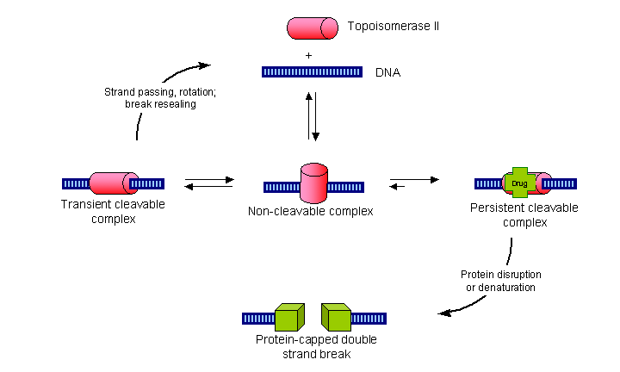
Remember, etoposide generates DSBs
Forms ternary complex with DNA and topoisomerase II, prevents re-ligation of DNA strands resulting in DSB

Slide 16
What will we study in Mod 2?
DNA damage and repair pathways
Role of BRCA2 in DNA repair and cancer
Pathway addiction in cancer treatment
Differential gene expression in cancer cell lines
Laboratory skills:
Mammalian cell tissue culture procedures
Big data analysis methods
Molecular biology techniques

Slide 17
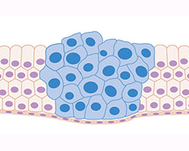
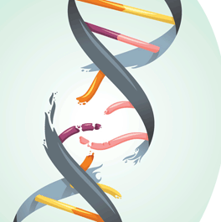
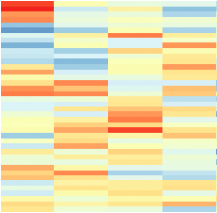
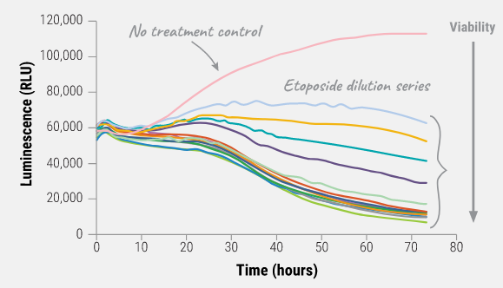
Overview of Mod 2
cancer biology
DNA repair
gene expression
cell viability
Background Information
(published literature)
Experimental Data
(your results!)
Your goal is to synthesize the information / data into a single, coherent story

Slide 18
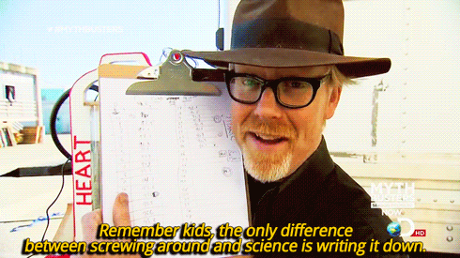

Slide 19
Details for Research article
Submission due: Saturday, Apr 21st by 10 pm
Completed individually
Only one draft
Formatting guidelines:
Prepare using WORD
Text and figures may be separate documents

Slide 20
How will we communicate our science?
Research article structure is more formal
Title and Abstract
Introduction
Methods
Results
Discussion
Complete sentences and paragraphs
References
Notes:
Notes on methods homework:

Slide 21
How will you report your methods?
Let’s first review the methods lessons we learned from our homework…
Sub-sections
Level of detail
Word choices

Slide 22
Methods: sub-sections
Use sub-sections to group procedures
Include descriptive titles
Use logical, rather than chronological order
Separate sub-sections with titles
Brief, but specific
Include an introductory sentence
State the purpose or goal of particular method / group of procedures

Slide 23
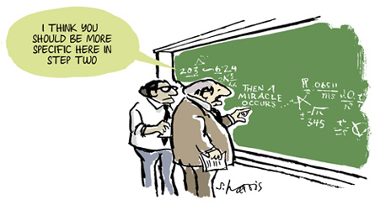
Methods: level of detail
Notes:
Do not tell me about tubes (or removing caps from tubes), putting things in the centrifuge,
Be sure to give final reactions concentrations of reagents
(100 pmol primer)(1 uL) = (X pmol primer)(20 uL)
= 5 pmol final concentration in reaction!!
Exceptions…when concentrations are not known (KLD reaction), transformation

Slide 24
Remember the steps you didn’t do
For time reasons, the teaching faculty completed some procedures…
You should still include these!
Details are provided on the wiki
DO NOT WRITE THAT THESE STEPS WERE COMPLETED BY TEACHING FACULTY
Notes:
Namely, how cells were prepared for actual experiments!

Slide 25
Methods: word choices
the tube vs. the cell lysate
Give more informative, specific information
combined or mixed vs. digested
Be precise about the procedure used
cleaned vs. purified or isolated
Use the more scientific terminology
in order to vs. to
Eliminate unnecessary wordiness
avoid jargon and define all abbreviations
Notes:
pdCas9 was digested in reaction containing…
Resulting fragments were separated using gel electrophoresis (130 V for 45 min).
PUT THE SUBJECT FIRST!!!

Slide 26
Consider sentence structure
“cell lysate was prepared by adding … and proteins were separated using SDS polyacrylamide gel electrophoresis (130 V for 45 min) in TGS buffer … .”
PUT THE SUBJECT FIRST
BE SURE THE SUBJECT AND THE VERB MATCH

Slide 27
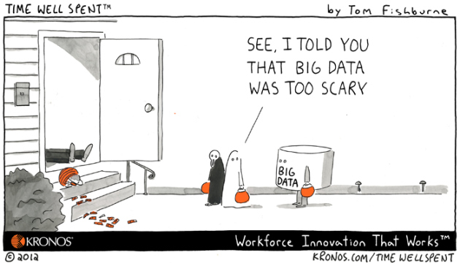
What are your data?

Slide 28
Reporting and interpreting your data
RESULTS
What was the overall goal of these data?
State concisely as an introductory sentence.
If applicable, what was the result of your control?
Was it expected?
What was your result?
Was it expected?
What does this motivate you to do next?
Specifically, what experiment follows?
DISCUSSION
What evidence do you have that your result is correct or incorrect?
How do your controls support your data?
In sum, what do your data suggest or indicate?
Do your data support your hypothesis? Why?
What does this motivate you to do next?
Specifically, what is the next research question?

Slide 29
Remember to tell a story
Introduction and Discussion should match
Results should be connected with transitions
Discussion should ‘tie’ the results together into a cohesive take-home message
Effective redundancy serves a purpose
Each section is crafted for a particular audience

