Slide 1
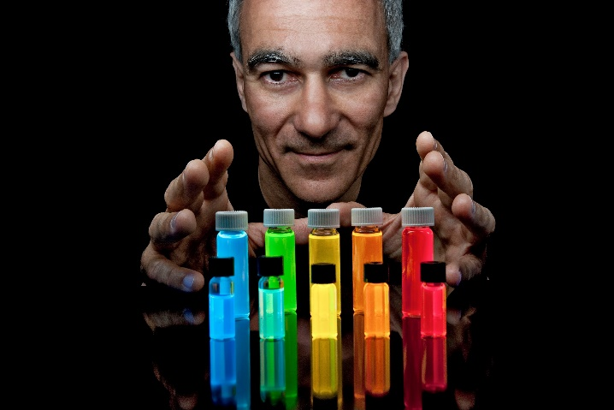
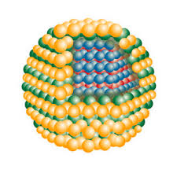
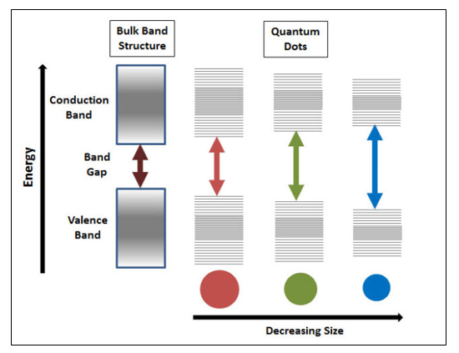
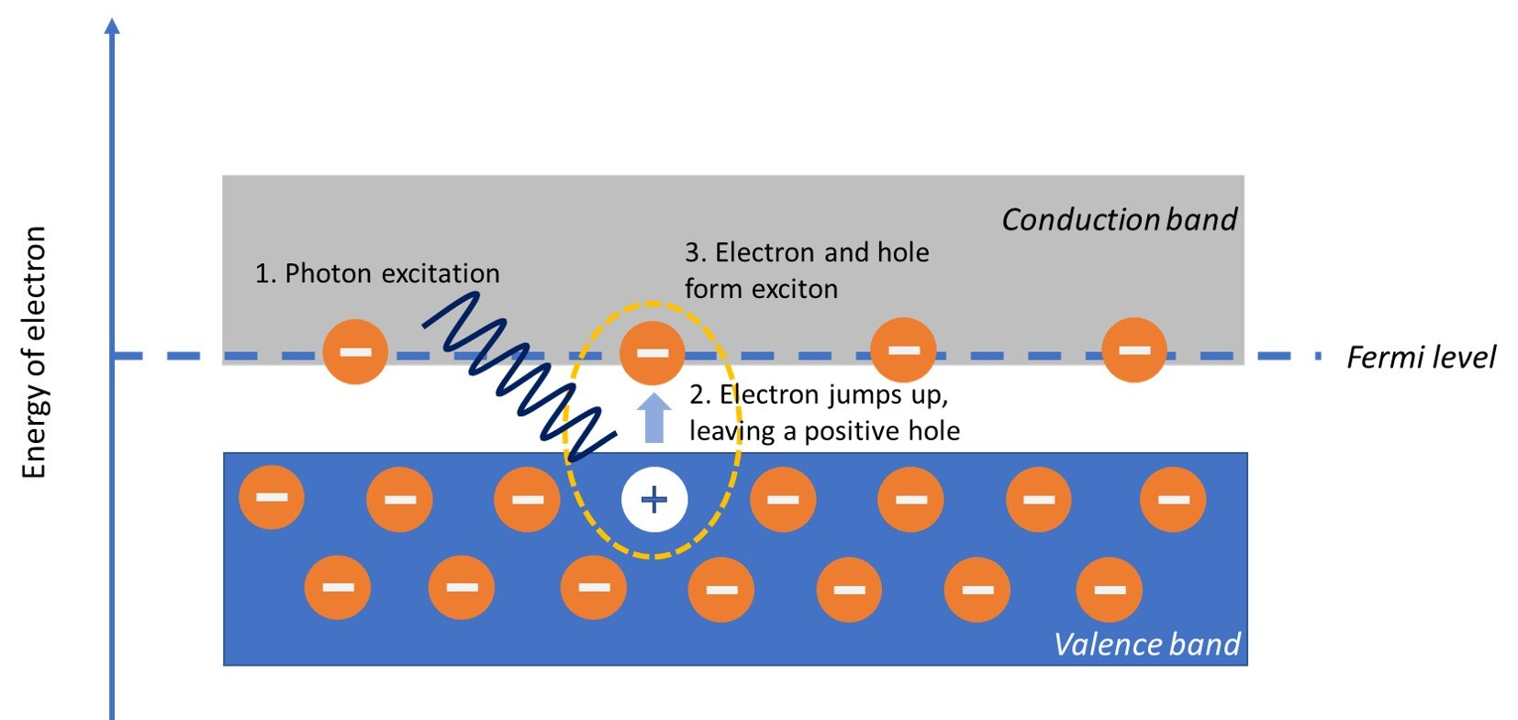
*Semiconductor nanocrystals tunable electro-optical properties
*Broad absorption, narrow emission UV-NIR
*Resistance to photobleaching
* Usually 2-10 nm diameter
*3D quantum confinement
Quantum Dot (QD)
2023 Noble prize winner Prof. Bawendi and his II-VI QDs
by Samsung Display Co

Slide 2
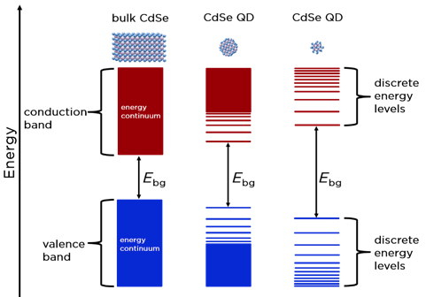
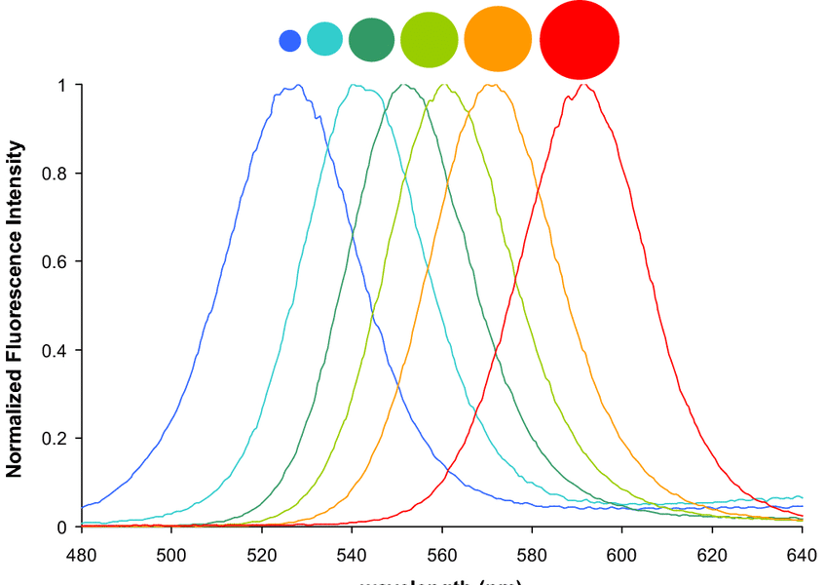
Size tunable CdSe QDs’ fluorescence spectra
Topics in Current Chemistry 378(2)
DOI:10.1007/s41061-020-0296-6

Slide 4
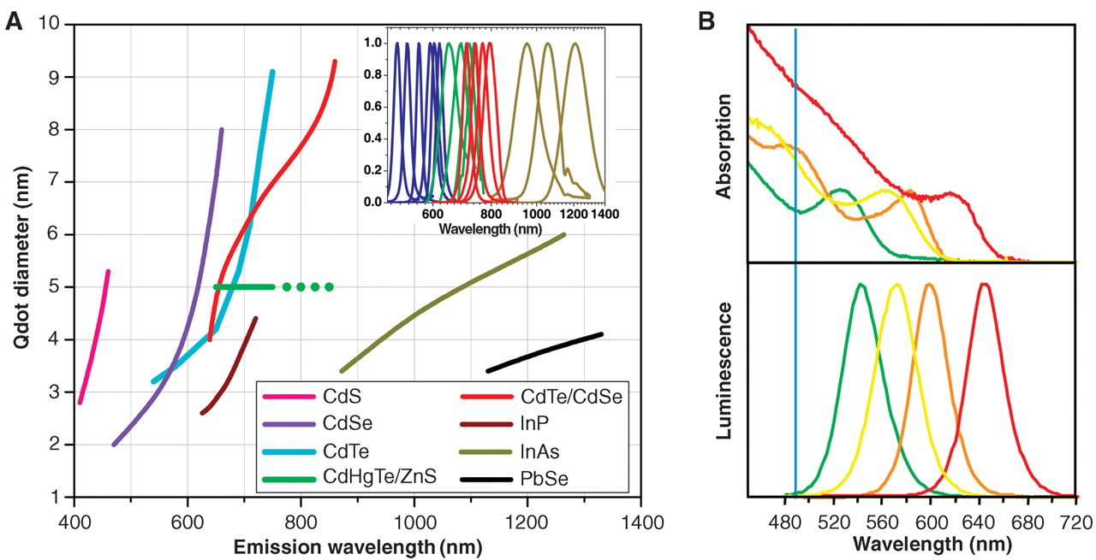
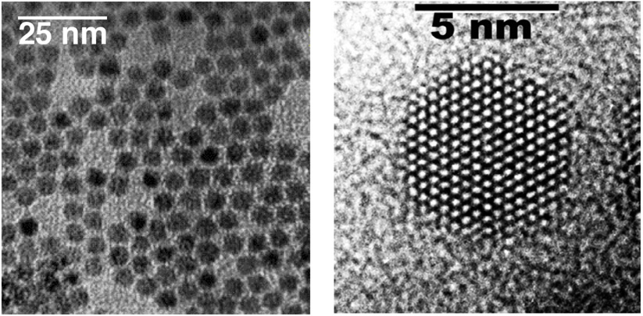
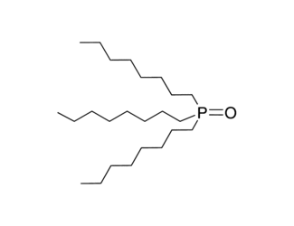
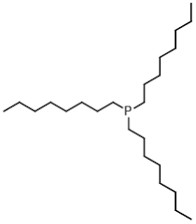
Types of QDs
High-resolution TEM image of CdSe QDs
Emission maxima and sizes of quantum dots of different composition. Quantum dots can be synthesized from various types of semiconductor materials (II-VI: CdS, CdSe, CdTe...; III-V: InP, InAs...; IV-VI: PbSe...) characterized by different bulk band gap energies.
Absorption (upper curves) and emission (lower curves) spectra of four CdSe/ZnS qdot samples. The blue vertical line indicates the 488-nm line of an argon-ion laser.
trioctyl phosphine (TOP)
trioctyl phosphine oxide (TOPO)
http://www.qdots.com/live/upload_documents/xwusbsposter.pdf
S. Weiss, et al. Quantum Dots for Live Cells, In Vivo Imaging, and Diagnostics, Science 307:538-44, 2005. DOI:10.1126/science.1104274

Slide 5
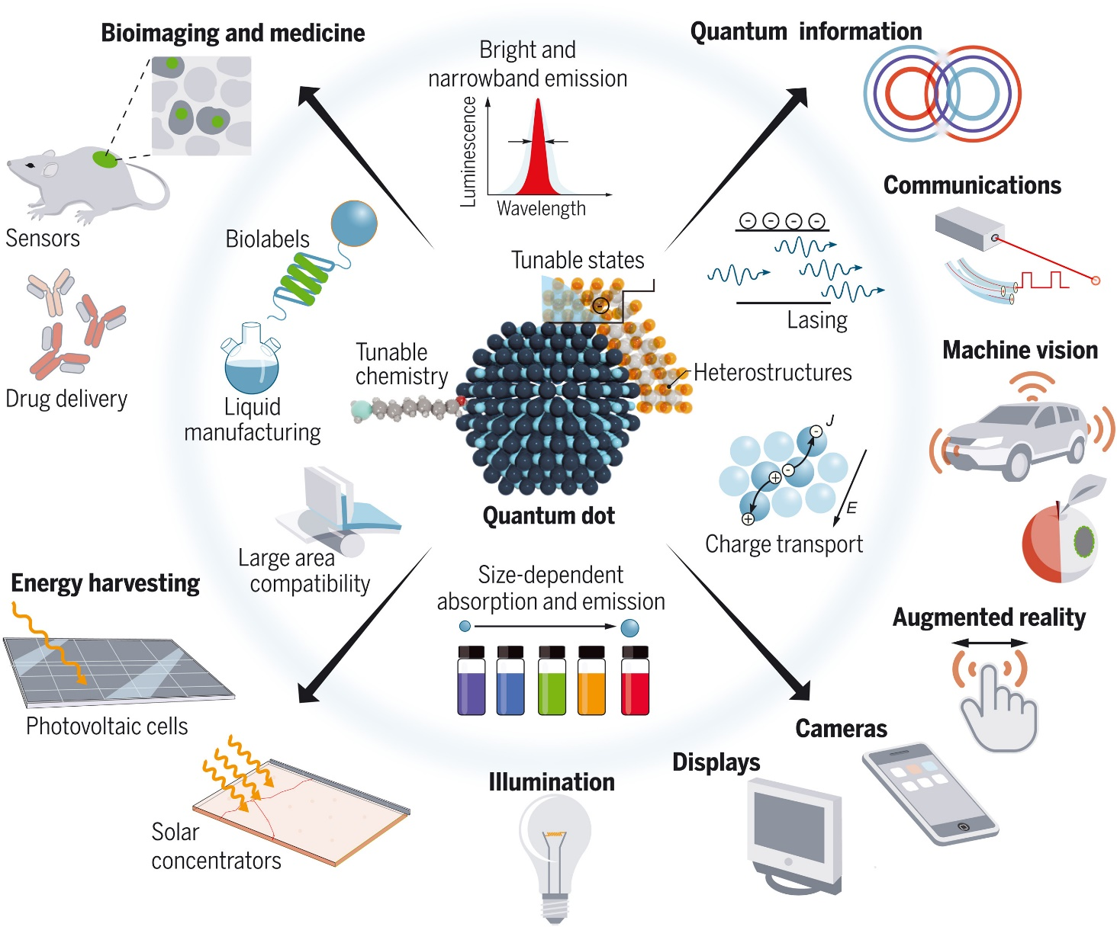
QDs are also used in commercial applications, including:
Photovoltaics
Light-emitting diodes
Lasers
Single-photon sources
Second-harmonic generation
Quantum computing
Cell biology research
Biomedical Imaging
Photodetectors
Photodynamic therapy
Microscopy
Wastewater treatment
F. PELAYO GARCÍA DE ARQUER, et al, Semiconductor quantum dots: Technological progress and future challenges, SCIENCE 2021 Vol 373, DOI: 10.1126/science.aaz8541

Slide 6
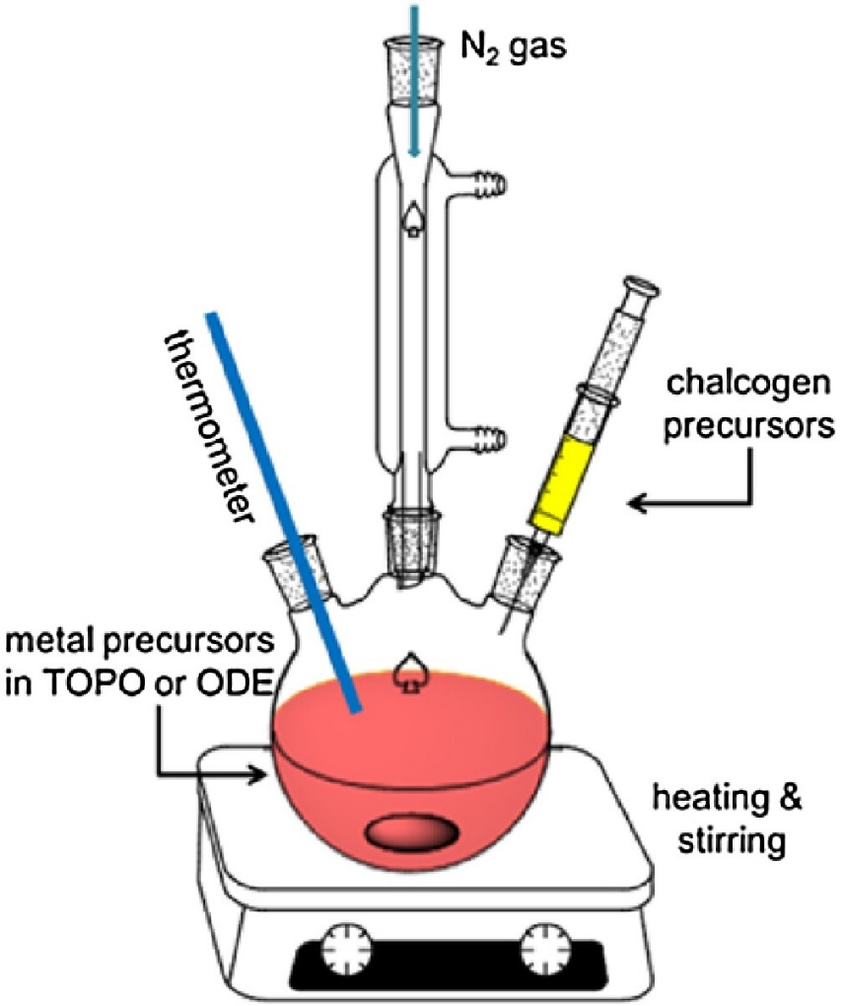
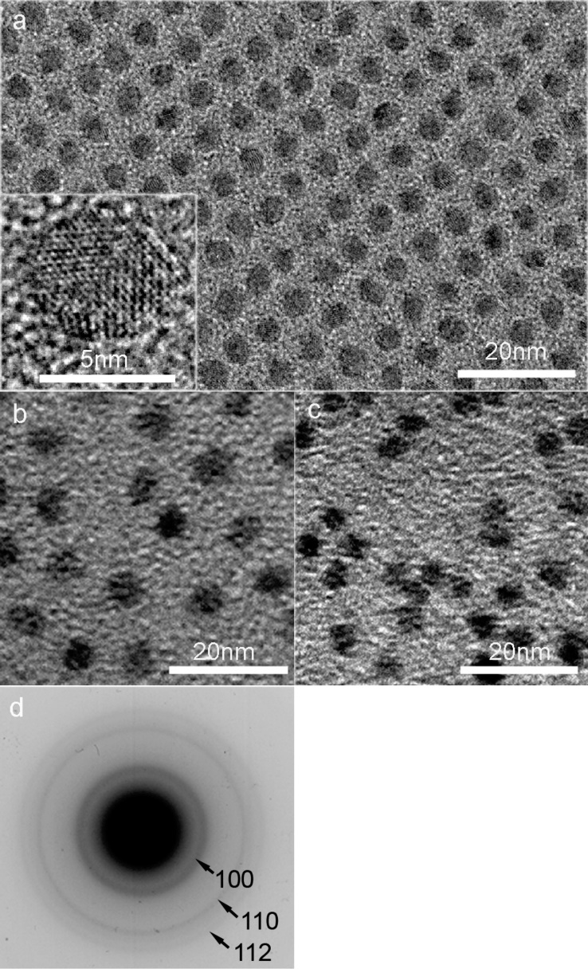
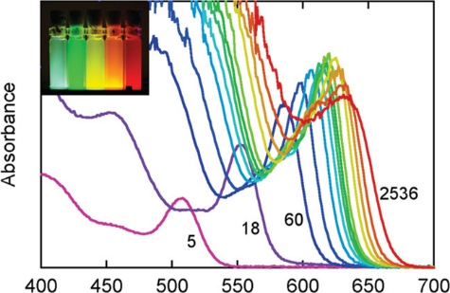
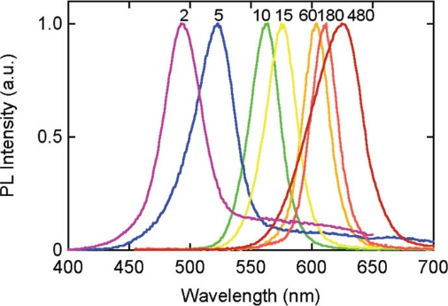
Typical synthesis method for II-VI quantum dots
Hot injection synthesis: TOP/TOPO capped CdSe QDs early work by C. B. Murray, D. J. Norris, and M. G. Bawendi, J. Am. Chem. Soc. 1993, 115, 19, 8706, cited by 7773 publications
Light absorption and emission spectra of CdSe QDs, numbers are the reaction time (particle size increases with the reaction time)
Figure after Y. Park, et al, JPPC, https://doi.org/10.1016/j.jphotochemrev.2017.01.002
After J. Phys. Chem. C 2008, 112, 17849–17854

Slide 7
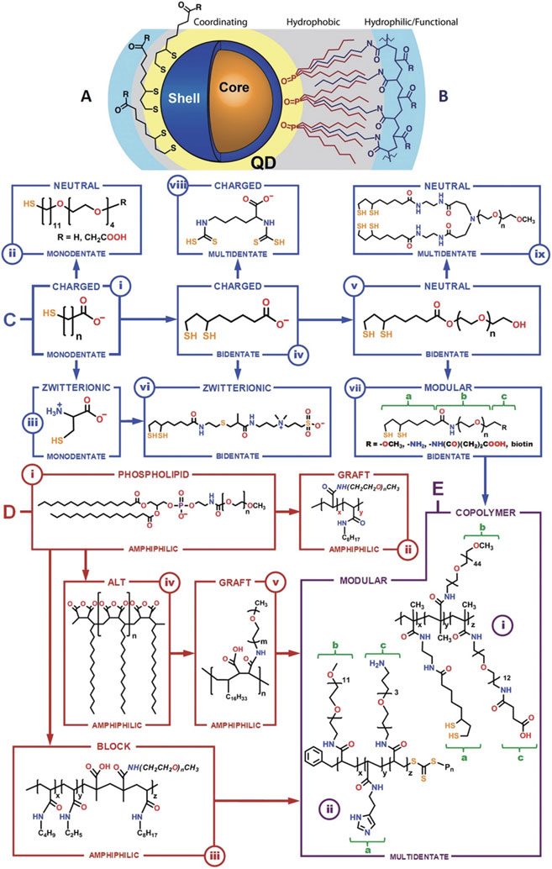

Slide 8
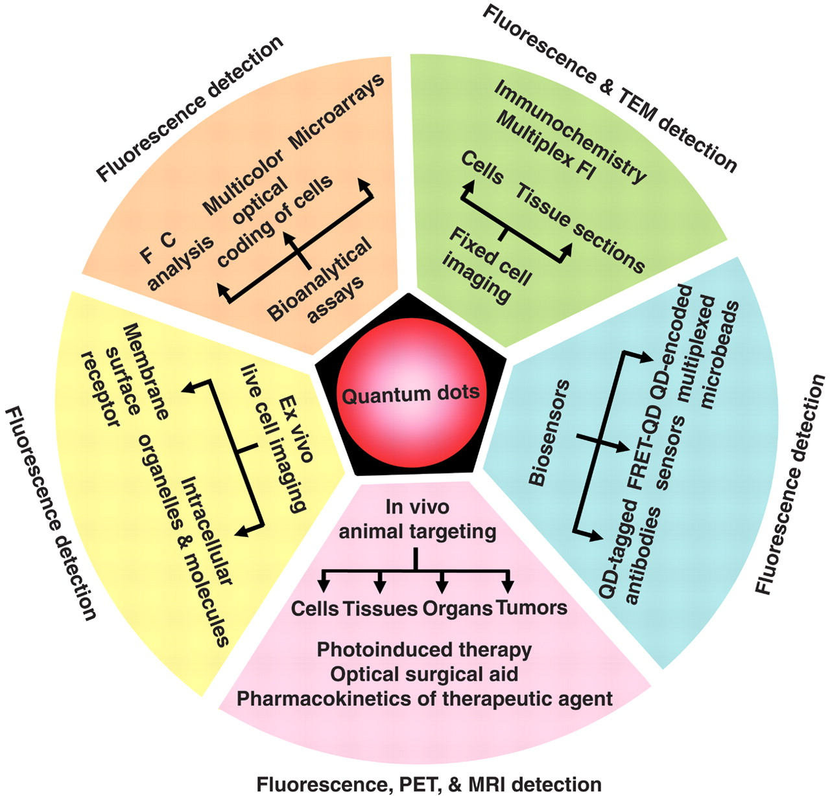
S. Weiss, et al. Quantum Dots for Live Cells, In Vivo Imaging, and Diagnostics, Science 307:538-44, 2005. DOI:10.1126/science.1104274

Slide 9
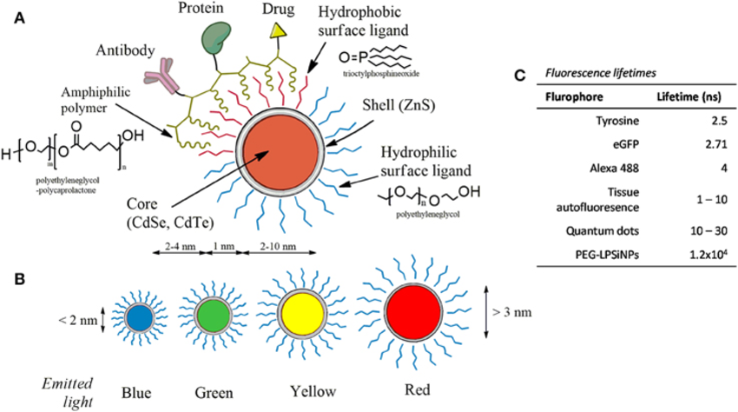
Frontiers in Neuroscience 9(216):480

Slide 10
Synthesis of nearly monodisperse CdE (E = sulfur, selenium, tellurium) QDs
C. B. Murray, D. J. Norris, and M. G. Bawendi, J. Am. Chem. Soc. 1993, 115, 19, 8706–8715
cited by 7773 publications
All manipulationsinvolving alkylcadmium,silylchalconides,phosphines,and phosphine chalconides were carried out using standard airless procedures. Tri-n-octylphosphine[TOP] and bis(trimethylsilyl)sulfide[(TMS)2S]
Method1.The typical preparation of TOP/TOPO capped CdSe nanocrystallites follows: Fifty grams of TOPO is dried and degassed in the reaction vessel by heating to ~200°C at ~1Torr for ~20min, flushing periodically with argon. The temperature of the reaction flask is then stabilized at ~300 °C under ~1 atm of argon. Solution A is prepared by adding 1.00mL (13.35mmol) of Me2Cd to 25.0 mL of TOP in the drybox. Solution B is prepared by adding 10.0mL of the 1.0 M TOPSe stock solution (10.00mmol) to 15.0mL of TOP. Solutions A and B are combined and loaded into a 50-mL syringe in the drybox.
The heat is removed from the reaction vessel. The syringe containing the reagent mixture is quickly removed from the drybox and its contents delivered to the vigorously stirring reaction flask in a single injection through a rubber septum. The rapid introduction of the reagent mixture produces a deep yellow/orange solution with an absorption feature at 440-460 nm. This is also accompanied by a sudden decrease in temperature to —180°C. Heating is restored to the reaction flask and the temperature is gradually raised to 230-260°C.

