Slide 1
L5 – A Probe Discovery Vignette
February 27, 2018
Notes:
.Today, I’ll simply tell you a story about how a collaborative team of investigators used the small molecule microarray platform that we used in 20.109 to discover a chemical probe for a type of protein that has historically proven ‘undruggable.’

Slide 2
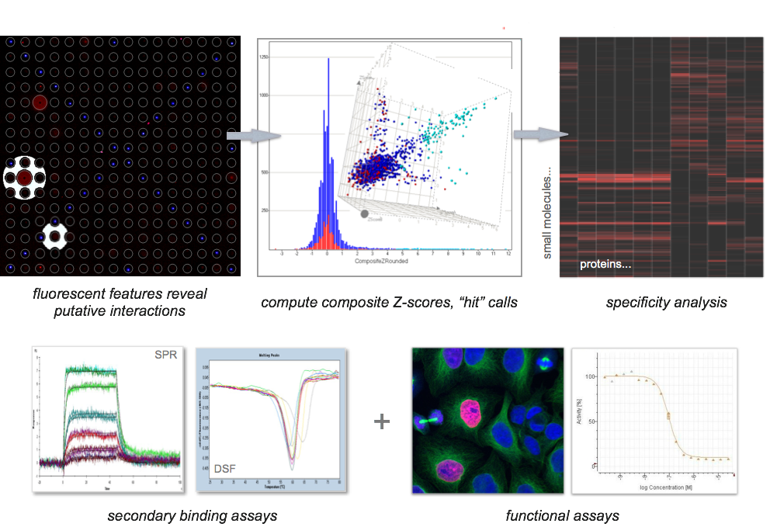
SMM hits to chemical probes
Notes:
Just a reminder about the platform. We like SMMs because they are a quick and cheap tool that enables us to rapidly survey the binding profiles of small molecules to proteins of interest. Let’s simply review the process for you. This is a process that enables chemical probe discovery for proteins for which we no nothing about their function or for which we have not been able to develop target-directed functional assays (reverse chemical genetics).

Slide 3
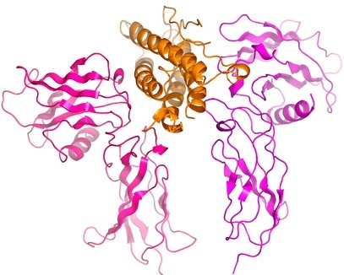

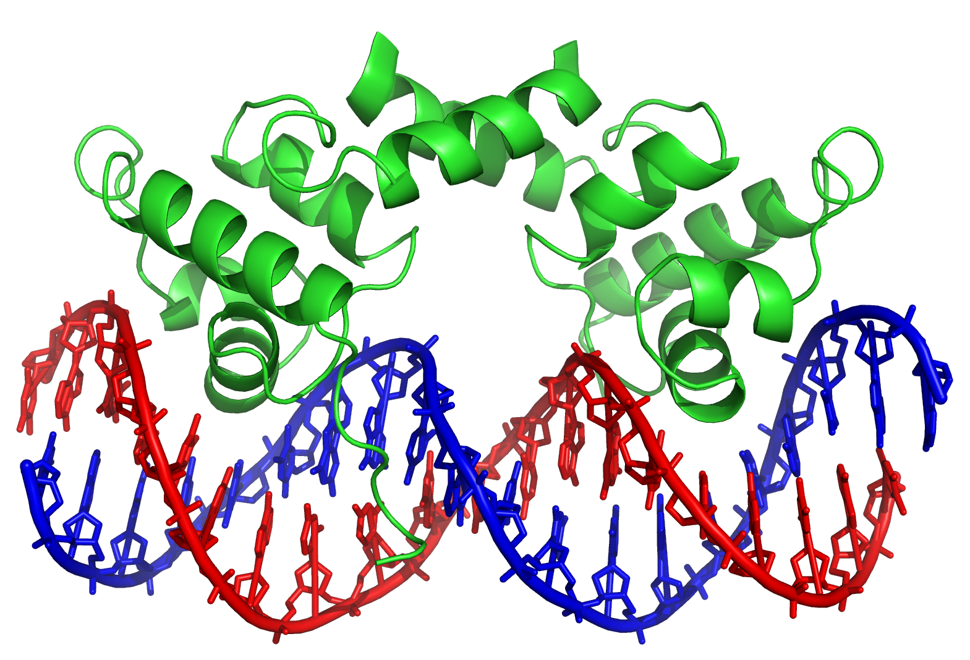
extracellular
factors
the ‘20.320 version’ of biology
membrane receptors
cellular response
intracellular
signaling proteins
transcriptional
regulators
experimental methods
mathematical models
manipulate targets/systems
Notes:
20.320 version of biology, very focused on:
Stimulus at the cell membrane by something like an extracellular factor
Transduction of signal via a receptor at the membrane
Signaling cascades in the cytoplasm, often involving enzymes such as kinases
The cascades make their way into the nucleus, often with some cofactor or cytoplasmic transcription factor translocating to impact binding of a transcriptional complex to DNA. This binding event drives transcription of selected genes which elicit the cellular response
You will learn the details surrounding the molecular interactions involved here in 20.320 and learn experimental methods to study these interactions as well as mathematical methods to model the signaling or transcriptional consequences. You may even learn how to modulate these pathways with drugs or antibodies.

Slide 4
extracellular
factors
membrane receptors
GPCRs
ion channels
kinases
cellular response
intracellular
signaling proteins
kinases
metabolic enzymes
transcriptional
regulators
Notes:
Forest White and Dane Wittrup will probably talk mostly about modulating membrane-anchored receptors and a number of intracellular kinases, including kinases of keen interest to several labs in BE.
These targets happen to be the proteins for which the pharmaceutical industry has had the most success in making drugs, including drugs that target certain membrane-anchored kinases, ion channels and G-protein coupled receptors. Several of these targets have been useful for treating mood disorders or cancers.

Slide 5
extracellular
factors
membrane receptors
GPCRs
ion channels
kinases
clotting factors
cellular response
intracellular
signaling proteins
kinases
metabolic enzymes
transcriptional
regulators
nuclear hormone receptors
Notes:
There has been some therapeutic success for the other protein classes here. For example, clotting factors are typically extracellular enzymes and they have been one of the ‘best drugged’ target classes.
On the transcriptional side, there are several molecules that target nuclear hormone receptors, many of which have known secondary metabolite ligands that can be altered to make therapeutics. Synthetic androgens or synthetic estrogens are good examples of these types of drugs.
These are special examples, however, and the truth is that these two groups – extracellular factors, particularly those that lack enzymatic function, and transcription factors- are considered to be prototypical ‘undruggable’ targets.

Slide 6
extracellular
factors
cytokines – IL-4
chemokines – MCP-1
growth factors - SHH
membrane receptors
cellular response
intracellular
signaling proteins
epigenetic enzymes - HDACs
latent cytoplasmic TFs – NF-kappaB
nuclear hormone receptors – FOXA1
classic transcription factors – MYC, MAX
transcriptional
regulators
Notes:
Our lab has historically focused our chemical probe discovery efforts against these classes. We have executed discovery programs related to some of the key extracellular signaling or recognition classes, including cytokines, other chemokines, and growth factors. We also go after a number of transcriptional targets and have had success against many different types. In the next class, I’ll talk to you about how our lab is trying to modulate MYC-driven transcription via novel methods, including targeting it’s partner protein MAX. This is one of my favorite projects because MYC is deregulated in ~70% of human tumors and a probe can teach us a lot about how to go after this prolific oncoprotein.
Today, I am going to tell you a story about our efforts to target SHH, otherwise known as sonic hedgehog, because ths story is already published and provides a more normal picture of how you might follow up when you find a pinch of magic dust for your favorite target,

Slide 7
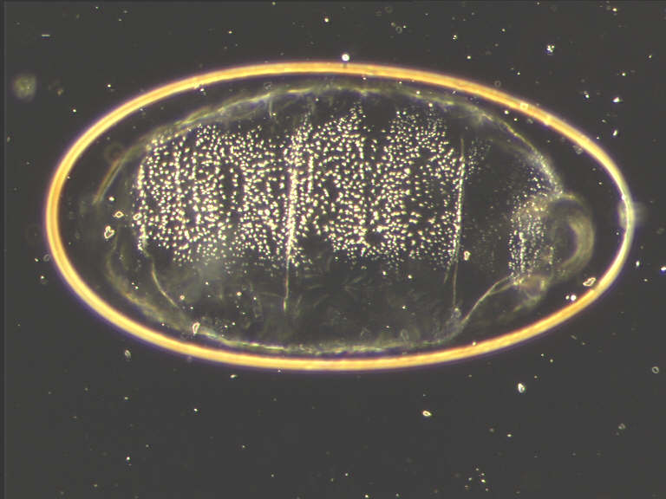
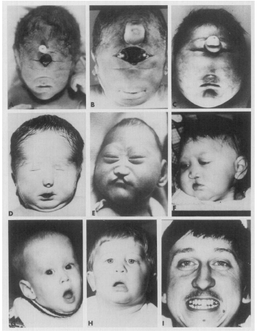


Sonic hedgehog protein
important role in development including limb and brain development
1970s- Embryogenesis Genetic Screen
mutant hedgehog drosophila larva
mutations in Shh are linked with
Holoproscencephaly (HPE)
1995 Nobel Prize- Edward Lewis, Christiane
Nüsslein-Volhard and Eric Wieschaus
sonic
M. Muenke, Seminars in Developmental Biology
Vol. 5, 293-301, 1994
desert and indian
Notes:
The Sonic hedgehog gene was shown in 1978 to control the early development of fruit flies, whose bodies developed spiny protrusions when the protein was blocked. The team that discovered the gene would go on to win a Nobel Prize in 1995 for their work studying mutations in Drosophila embryogenesis.
It is now known that Sonic Hedgehog plays an important developmental role in mammals, including humans, regulating limb and brain development in the embryo and controlling the division of adult stem cells. The first two genes discovered, desert hedgehog and Indian hedgehog, were named for species of hedgehogs, while sonic hedgehog was named after Sega's video game character Sonic the Hedgehog.
In knockout mice lacking components of the hedgehog pathway, the brain, skeleton, musculature, gastrointestinal tract and lungs fail to develop correctly. Holoprosencephaly (HPE) is a cephalic disorder in which the prosencephalon (the forebrain of the embryo) fails to develop into two hemispheres. Normally, the forebrain is formed and the face begins to develop in the fifth and sixth weeks of human pregnancy. The condition also occurs in other species. Cyclopia is one of the most severe defects of holoprosencephaly.

Slide 8
Hedgehog signaling goes beyond embryogenesis
development, differentiation, and disease
dysregulation
signaling pathways responsible for embryogenesis play a critical role in the maintenance of stem cells in adult life and cellular responses to injury
Notes:
Signaling pathways responsible for embryogenesis appear to play a critical role in the maintenance of stem cells in adult life and cellular responses to injury.
Dysregulation of these signaling pathways during adult homeostasis can lead to various events resulting in the development of neoplasia.

Slide 9
Hedgehog proteins ‘de-repress’ Smoothened
Hh-Ptch binding interaction activates Gli-driven transcription
Hedgehog proteins
(Shh, Ihh, Dhh)
Ptch inhibits Smo
when not bound to Hh
Smoothened
GPCR-like protein
(7TM)
signaling
enzymes
Patched
receptor
(12TM)
Gli
transcriptional
activator
Gli
transcriptional
repressor
Target genes: Gli1, Ptc
de-repression of Smo stops partial degradation
of Gli TFs, converting repressors to activators
Notes:
Hh is an extracellular protein that initiates signaling in the hedgehog pathway by binding to its receptor patched, a 12-TM pass protein. In the absence of hedgehog protein patched catalytically inhibits Smoothened, a 7-pass GPCR-like protein in the pathway. When Smo is inhibited, the zinc finger glioma associated oncogene transcriptional activators, referred to here as Gli transcriptional activators, are partially degraded by the proteasome to yield Gli transcriptional repressors. However binding of patched by hedgehog derepresses Smoothened which results in the Gli transcriptional activators trafficking to the nucleus and upregulating target genes. Ubiquitously expressed target genes include hedgehog pathway components Gli and patched with additional gene products varying with cell or tissue type.

Slide 10
overexpression of SHH
Pancreatic Cancer (70%) Prostate Cancer
Gastric Cancer Lung Cancer
Medulloblastoma Ovarian Cancer
activating mutations in SMO
Basal Cell Carcinoma
Ovarian Cancer
loss or mutation of PTCH1
Basal Cell Carcinoma
Medulloblastoma
Rhabdomyosarcoma
Notes:
Loss of PTCH1 in patients with basal cell nevus syndrome predisposes them to basal cell carcinoma (BCC) development. Sporadic BCCs routinely carry mutations in PTCH1 and TP53, consistent with their having been produced by ultraviolet radiation and, in 10% of instances, in SMO.
Pancreatic cancer (70% of tumors have aberrantly expressed Shh) studies involving combinations with gemcitabine (June Science paper), collaborations b/w academic and industrial scientists
DOWNREG = CARDIOVASC, BALDNESS, Etc.

Slide 11
Drugs targeting Hedgehog pathway
antagonists
agonists
Hedgehog proteins
(Shh, Ihh, Dhh)
Ptch inhibits Smo
when not bound to Hh
Smoothened
GPCR-like protein
antagonists
signaling
enzymes
Patched
receptor
Gli
transcriptional
activator
Gli
transcriptional
repressor
Target genes: Gli1, Ptc
Notes:
Smoothened antagonists = cyclopamine, synthetics Smoothened agonists = SAG, purmorphamine

Slide 12
Cyclopamine
Smo antagonist and Hh pathway inhibitor
Veratrum californicum
wild corn lily
cyclopic lamb born of
a sheep that ate corn lily
(Idaho farm, 1957)
Notes:
Cyclopamine was named for one-eyed lambs which were born to sheep which grazed on wild corn lily at a farm in Idaho. In 1957 the US Department of Agriculture started an eleven-year investigation which led to the identification of cyclopamine as the cause of the birth defect.
Beachy Lab (JHU, Stanford) - Cyclopamine inhibits the hedgehog signaling pathway (Hh) by influencing the balance between the active and inactive forms of the smoothened protein. They used the fishing technique in 2002 to find Smo as target.

Slide 13
Cyclopamine
lead for development of anti-cancer agents
Veratrum californicum
wild corn lily
cyclopic lamb born of
a sheep that ate corn lily
(Idaho farm, 1957)
Adult cancers - basal cell carcinoma, medulloblastoma, prostate, breast, pancreas
saridegib
vismodegib
sonidegib
Notes:
Cyclopamine was named for one-eyed lambs which were born to sheep which grazed on wild corn lily at a farm in Idaho. In 1957 the US Department of Agriculture started an eleven-year investigation which led to the identification of cyclopamine as the cause of the birth defect.
Beachy Lab (JHU, Stanford) - Cyclopamine inhibits the hedgehog signaling pathway (Hh) by influencing the balance between the active and inactive forms of the smoothened protein. They used the fishing technique in 2002 to find Smo as target.

Slide 14
Selective targeting of Hh signaling upstream of Smo
gonadal dysgenesis, neuropathies
antagonists
agonists
cancers
Smoothened
GPCR-like protein
antagonists
signaling
enzymes
cartilage
degeneration
Gli
transcriptional
activator
Gli
transcriptional
repressor
Patched
receptor
Target genes: Gli1, Ptc
Notes:
Interestingly, there is still little known about the precise functional differences between the Hh homolgs in human biology. We know that they are expressed differentially in certain tissues. We understand that mutations lead to different developmental phenotypes, and as such, the thinking is that there may be different therapeutic opportunities for the homologs. For example, as we saw, overactivity in SHH are associated with many cancers. Indian hedghog may be a target for cartilage degeneration and bone disorders.
Also of note for therapeutic development, UNDERACTIVITY of all homologs may have implications for cardiac disease as cardiac tissue is unable to regenerate appropriately. This means that you have a limit in therapeutic window before you may have cardiac toxicity. Targeting Shh selectively in the context of cancer may help alleviate these off-target effects.
Reduce side effects for Ihh and Dhh?

Slide 15
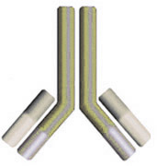


SMM assay: 20 kDa Shh N-terminal fragment
5 µg/mL
20 pg/mL
19 SMM hits
biotinylated
anti-Shh Ab
Alexa-647
streptavidin
2.5 µg/mL
Shh-N
10,000 compounds
Angela, Broad Fellow
Lee Peng, MGH
Ben Stanton, Harvard
Notes:
Shh-N is 20-kDa N-terminal fragment that engages Smo
19 hits total, 13 of which were selective versus other proteins screened against the same set of compounds.

Slide 16

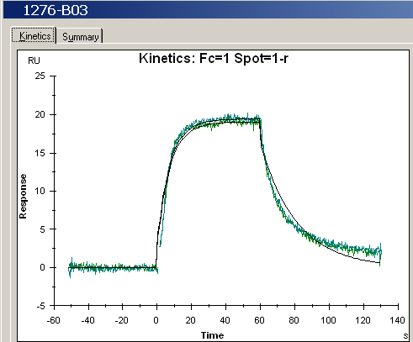



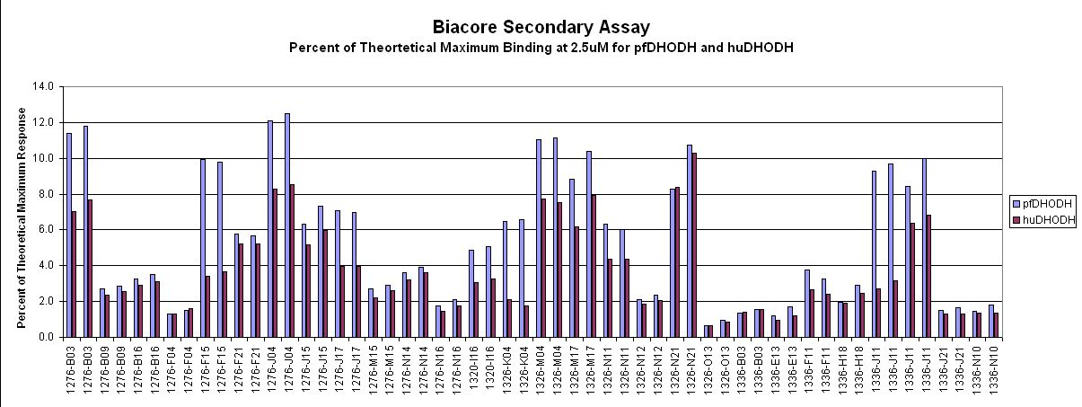
Validating assay positives in secondary binding assays
‘mass sensing’ by Surface Plasmon Resonance (SPR)
protein
flow cell
tag
adding mass leads to
changes in refractive index
R_{max}= (MW_{A}/MW_{L}) x R_{L} x S
matrix on Au chip
prism
light source
detector
% Theoretical Maximum Binding at 2.5 µM Compound
76% of SMM interactions retest by SPR
For Video on SPR, go to:
https://www.youtube.com/watch?v=o8d46ueAwXI

Slide 17

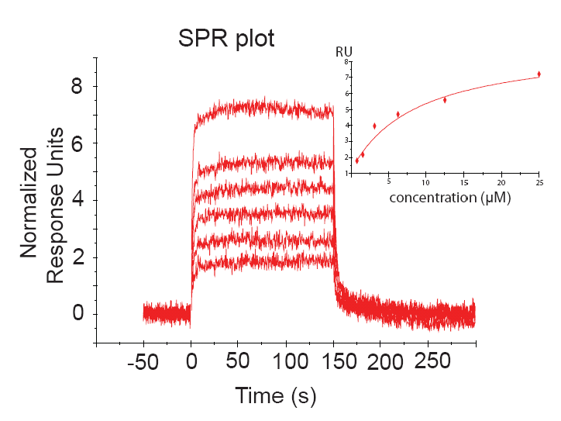
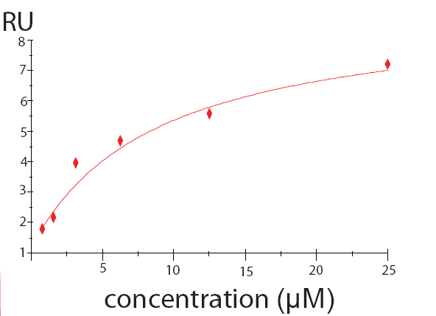
SPR experiments for Shh SMM hits
inject compound
sensorgram
steady-state binding plot
ShhN
gold chip
K_{D} = 9 µM
reverses direction from primary assay
measures binding between immobilized protein and compounds injected in solution
kinetic measurements
ranking assays (k_{on} vs. k_{off,} % Ru_{max})
compound affinity characterization

Slide 18
Measuring GLI-dependent transcriptional activity
quantitative assay for hedgehog signaling
luciferase
1
K_{D} = 9 µM
luciferase reaction
light signal
Notes:
Cell line derived from the NIH/3T3 cell line transfected with GLI-responsive Firefly luciferase reporter from H. Sasaki and a constitutive Renilla-luciferase expression vector. Useful as a cell-based research tool for the quantitative assay of biologically active hedgehog proteins. These cells respond to the presence of hedgehog protein though a light-generating enzyme called luciferase that can be measured with a luminometer.

Slide 19
Measuring GLI-dependent transcriptional activity
SMM hit modulates transcriptional output
1
K_{D} = 9 µM
each value represents 5 technical replicates
error bars denote standard deviation
Notes:
The team noticed a reduction in luciferase signal at concentrations near the affinity constant of the protein-ligand interaction. As you can see, the compound doesn’t reach the levels observed by the control where ShhN protein was not present.

Slide 20
Hit to probe
chemical editing
Stuart Schreiber, Harvard
site of attachment to SMM
18 variants
site of attachment to SMM
K_{D} = 9 µM
K_{D} = 3 µM
improved binding affinity
Remove – ethanolamine, methyl, amine and carbon
Add – phenyl, chloro groups

Slide 21
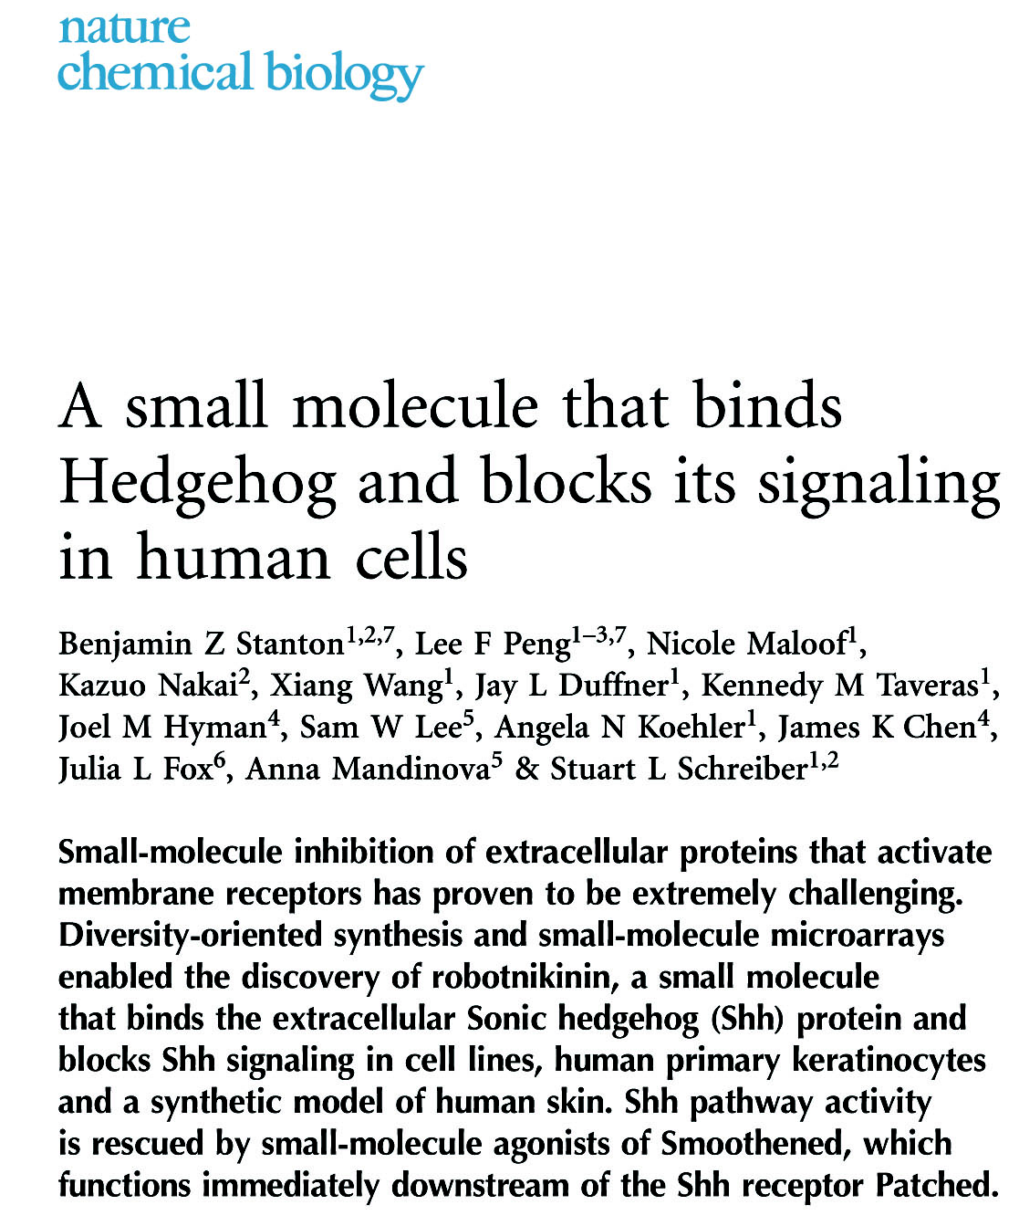
Robotnikinin
Shh binder and antagonist
Doctor Ivo "Eggman" Robotnik
Sonic the Hedgehog

Slide 22
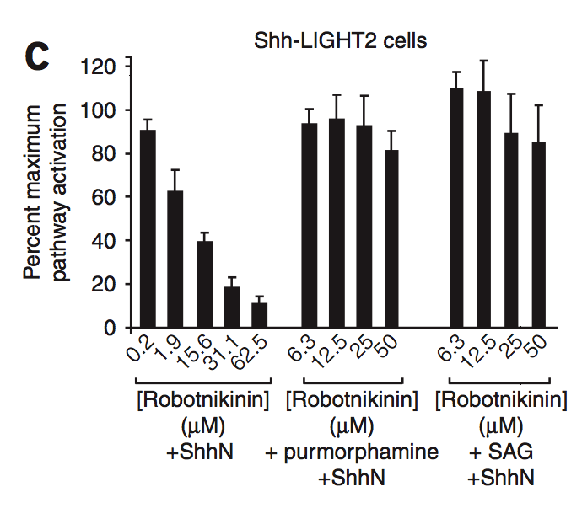
Gli inhibition by Robotnikinin is rescued
by a Smoothened agonist

Slide 23
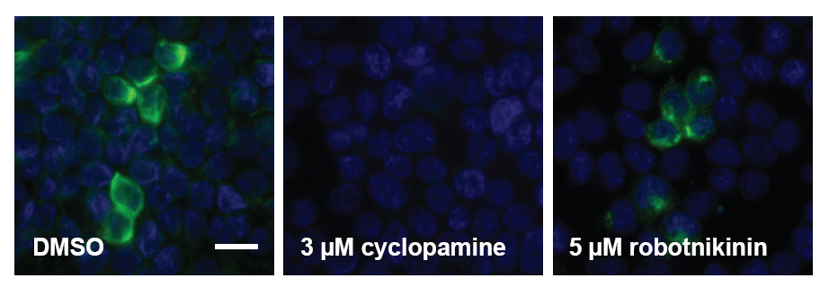
Ligand competition assays
BODIPY-cyclopamine binds to Smoothened at cell surface
Smoothened-overexpressing human embryonic kidney cells
Robotnikinin does not compete with a labeled Smo ligand
Notes:
Even going up to 25 uM there is not an effect

Slide 24
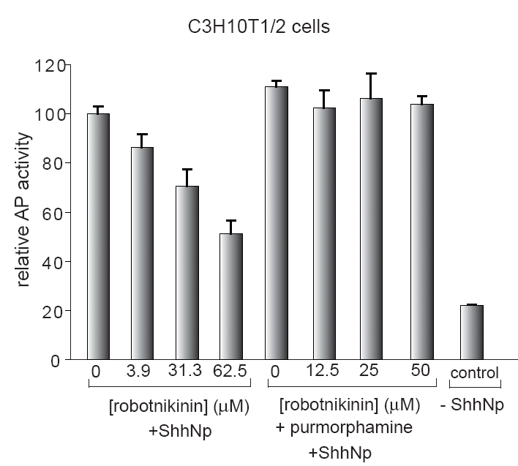
Inhibition of stem cell differentiation
mouse mesenchymal stem cells differentiate into osteoblasts and upregulate
alkaline phosphatase (AP) when stimulated with N-palmitoylated ShhN

Slide 25
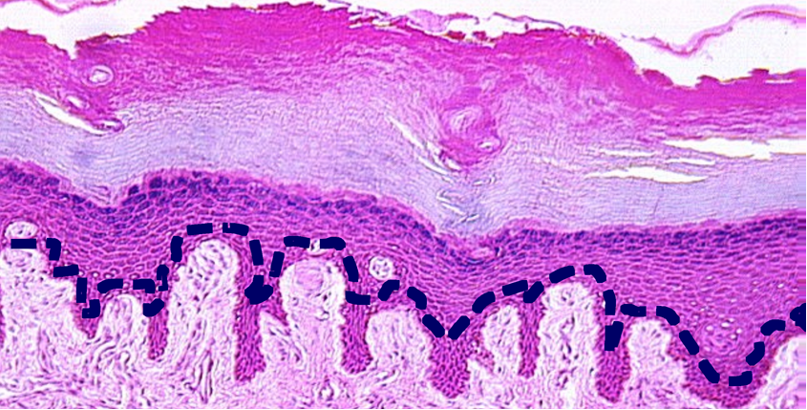
Skin: Robotnikinin blocks lowers levels of GLI2 mRNA
in primary human keratinocyte cells
primary human keratinocytes
isolated from the basal cell layer
measure mRNA by quantitative PCR after 30-hr treatments
Notes:
Look in a more native or relevant context – cells from skin. Shh is known to be expressed in the basal cell layer
Primary keratinocytes are responsive to Shh (supplied in conditioned medium), expression of Gli1 is induced. Rbk inhibits expression, rescued by Pur or SAG.

Slide 26
Robotnikinin blocks lowers levels of GLI1 and GLI2 mRNA in synthetic human skin
MGH synthetic human skin model:
Extract dehydrated collagen matrix from skin grafts
Populate matrix with primary keratinocytes
Culture to form several dermal layers
Incubate with compound, analyze by qPCR and histology
Anna Mandinova, MGH

Slide 27
Shh and the hair follicle – a regulator of luscious locks
SHH
lower levels of Hh expression or signaling is associates with baldness

Slide 28
Exploring stimulation of Shh pathway as a way
to promote hair growth

Slide 29
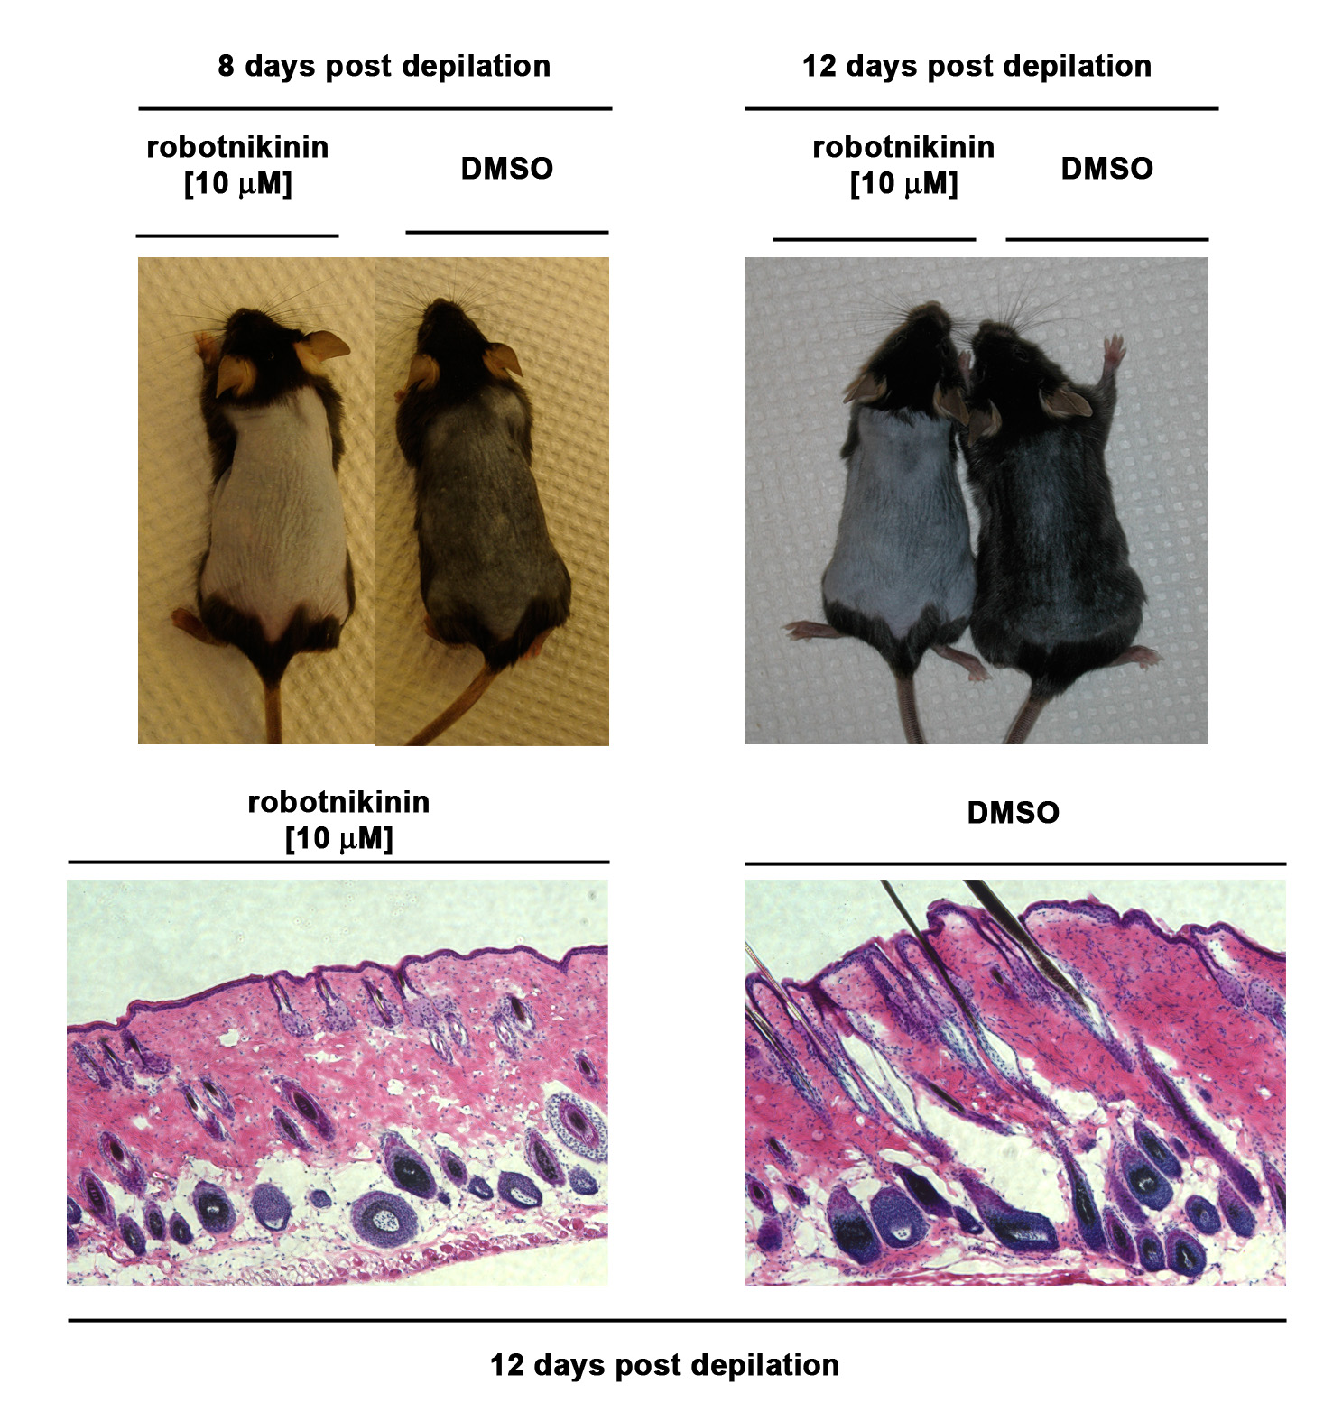

Robotnikinin inhibits hair growth in vitro
8 days post depilation
12 days post depilation
10 uM robotnikinin
DMSO
10 uM robotnikinin
DMSO
Notes:
The histology at the end of the experiment confirms the failure of the hair follicles to enter efficiently anagen. I do not see signs of inflammation or differentiation problems in the skin.

Slide 30
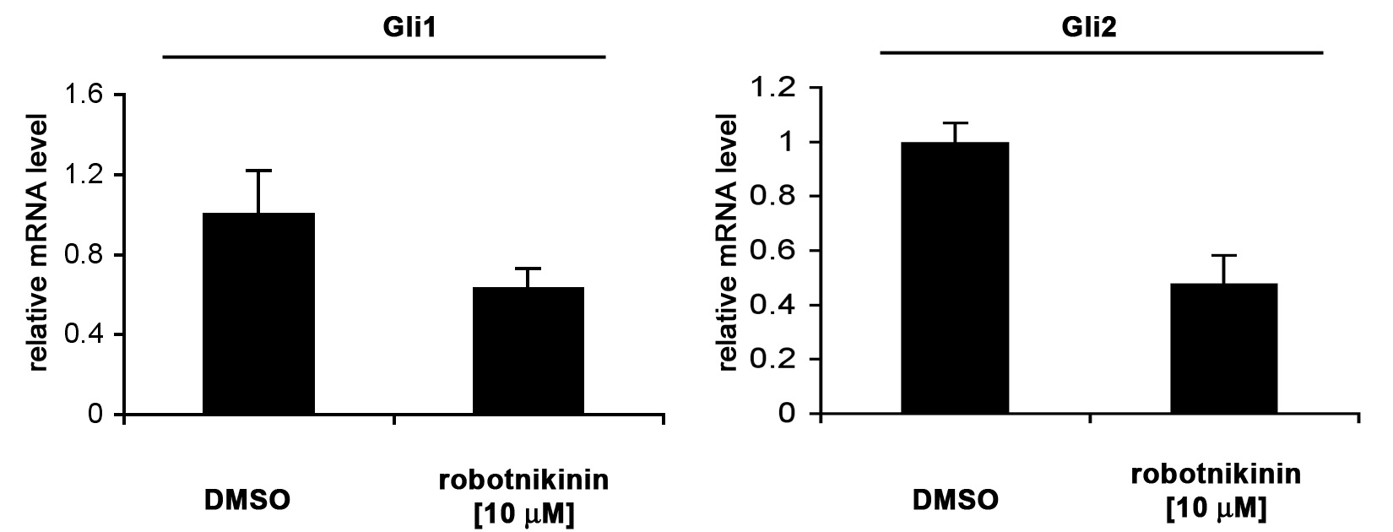
Robotnikinin causes hair follicles to fail anagen phase entry
10 µM Robotnikinin
DMSO
12 days post depilation
robotnikinin treatment shows no signs of inflammation or failed skin differentiation
Notes:
The histology at the end of the experiment confirms the failure of the hair follicles to enter efficiently anagen phase. I do not see signs of inflammation or differentiation problems in the skin.

Slide 31
Hh homolog selectivity
BRD-K81967595
K_{D} (SHH) = 9500 nM
K_{D} (DHH) = 13 nM
>500 fold
BRD-K93170324
K_{D} (SHH) = 7 nM
K_{D} (DHH) = 20000 nM
>2500 fold
antagonists
agonists
Smoothened
GPCR-like protein
antagonists
signaling
enzymes
Patched
receptor
Gli
transcriptional
activator
Gli
transcriptional
repressor
Target genes: Gli1, Ptc
Notes:
Reduce side effects for Ihh and Dhh?
HANDLING IN LAB - PREGNANCY

Slide 32
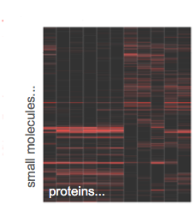
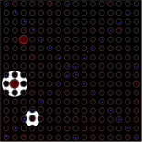
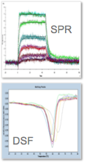
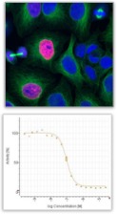

Path for probe discovery, validation, and development
SMM
specificity analysis
secondary
binding
cellular or
biochemical assays
optimize molecules
using chemistry
additional cell biology
animal models
Notes:
Quick flash slide

Slide 33
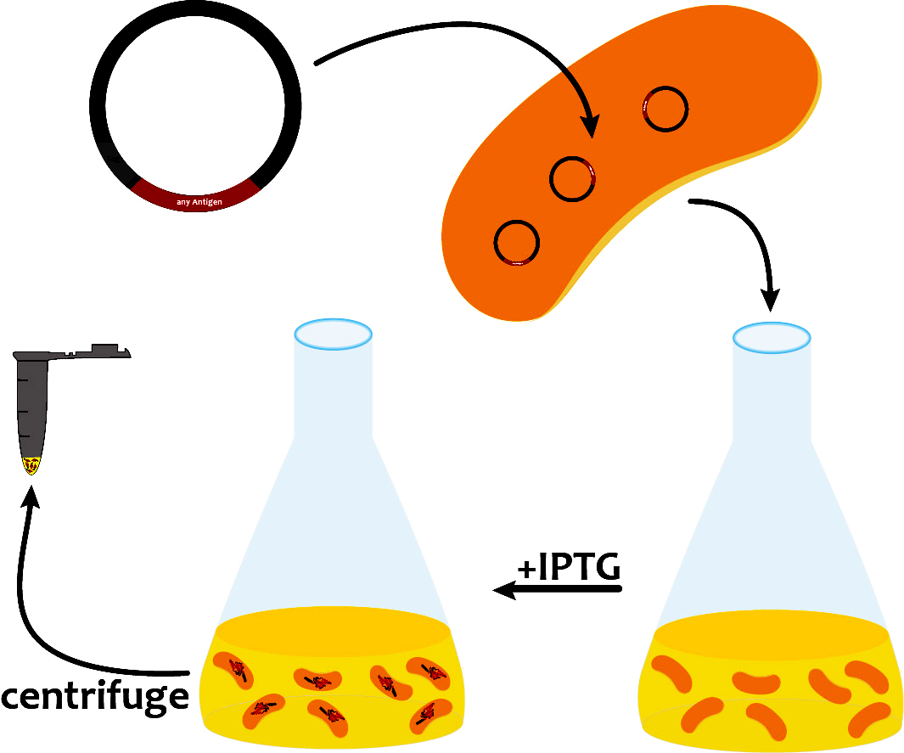
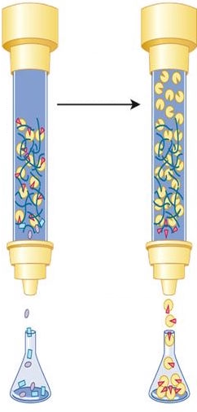
Our path to evaluate FKBP12 ligands
+
in silico cloning; overexpress FKBP12
lab days 1 & 2
purify and analyze FKBP12
lab days 3 and 4
re-analyze screen data
lab day 2
IC₅₀ = X µM
ΔT = Y °C
test FKBP12 and ligands
in enzyme activity assay
lab day 5
test ligands in FKBP12
binding assay
lab day 6
complete data analysis
prioritize best ligands
lab day 7
Notes:
Quick flash slide

Slide 34
Our path to evaluate ligands - lectures
2/8/17 Lecture 1 Intro to chemical biology: small molecules, probes, and screens
2/13/17 Lecture 2 For the love of proteins: FKBP12 and immunophilins
2/15/17 Lecture 3 Small-molecule microarrays
2/21/17 No Lecture
2/22/17 Lecture 4 Quantitative evaluation of protein-ligand interactions
2/27/17 Lecture 5 A ligand discovery vignette: sonic hedgehog
3/1/17 Lecture 6 Engineering transcriptional responses with a small molecule
3/7/17 Lecture 7 Wrap up discussion: suggestions for how to report your findings
Notes:
Quick flash slide

