Slide 1
20.109 Communication Workshop 3: Journal Clubs
Sean Clarke & Diana Chien
BE Communication Lab Instructors
Fall 2016
be.mit.edu/communicationlab Helping you communicate effectively.

Slide 2
Workshop structure
Why subject matters
Discuss an example from the field
Derive principles and strategies
Practice
Leave with a checklist/rubric
Notes:
Explain structure for each workshop:
Look at an example from the field, discuss
Derive general principles & strategies
Work together on practicing these strategies
Leave you with a checklist, rubric – we will have discussed these rubrics with the instructors who are grading your assignments, so that you have a clear sense of what constitutes success. You can use these rubrics to check your own work and also to give your classmates feedback on their work.
Come work on these skills in the Comm Lab at any time!

Slide 3
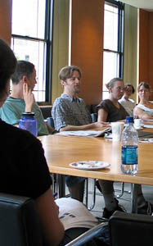
Journal clubs build helpful skills (finding and presenting important parts of scientific work)
Helps you communicate YOUR work better
Required professional activity
Stay up-to-date
Learn collaboratively

Slide 4
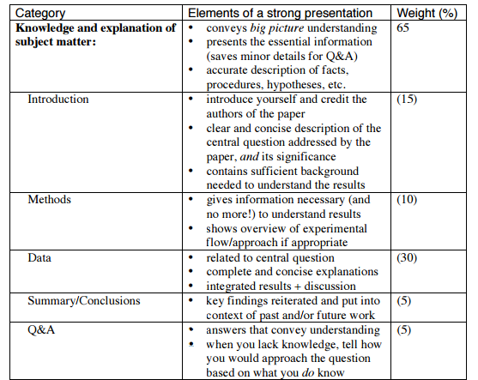
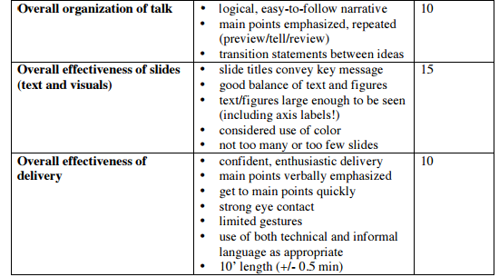
Review assignment rubric
Notes:
[ ] print rubric

Slide 5
Avoid common 20.109 pitfalls
DON’T | DO
Start so late you don’t have time to digest the paper | Give yourself time to read the paper 2-3 times
Be exhaustive List experiments chronologically | Be selective Tell a story
Go outside the 9.5-10.5 minute time | Practice until you know you can hit the time limit
Forget to cite the paper | Include citation in your title slide
Say “we did this” | “The authors did this”
Use illegible labels | Use ≥20pt font Make your own figure labels if helpful Use legible font colors

Slide 6
Skills we’ll discuss today
Crafting a story
Identifying key parts of a scientific work
Designing effective slides
Presenting well

Slide 7
There is additional help
Practice your presentation with a Communication Fellow http://be.mit.edu/becommunicationlab
Susan McConnell (Stanford) Designing effective scientific presentations https://youtu.be/Hp7Id3Yb9XQ

Slide 8
1. Craft a story “Excellent students tell a story.” -Noreen

Slide 9
You only have 10 minutes for your journal club presentation.
What content will you include?
Notes:
Compare to Abstract.

Slide 10
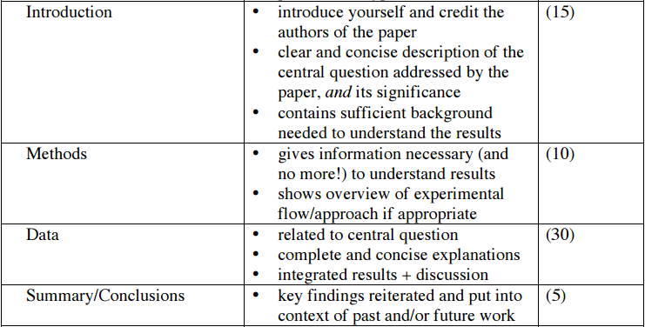
Recall the Hourglass Model for Abstracts

Slide 11
Chronology confuses us
The authors wanted to engineer a calcium sensor’s binding sensitivity.
They ligated DNA into a plasmid,
then they transformed it into cells,
and then they looked at fluorescence data.
But WHY?

Slide 12
Storytelling conveys logic & motivation
The authors wanted to engineer a calcium sensor’s binding sensitivity.
To change the binding site, they did site-directed mutagenesis,
then they expressed the mutant protein in cells,
and then they assessed its binding properties with a fluorescent assay.

Slide 13
Tell us a story
Identify the question/message
Include only essential results
Connect all results back to the question/message
Use titles & transitions that explain logic & motivation

Slide 14
2. Identifying the key parts of a scientific work

Slide 15
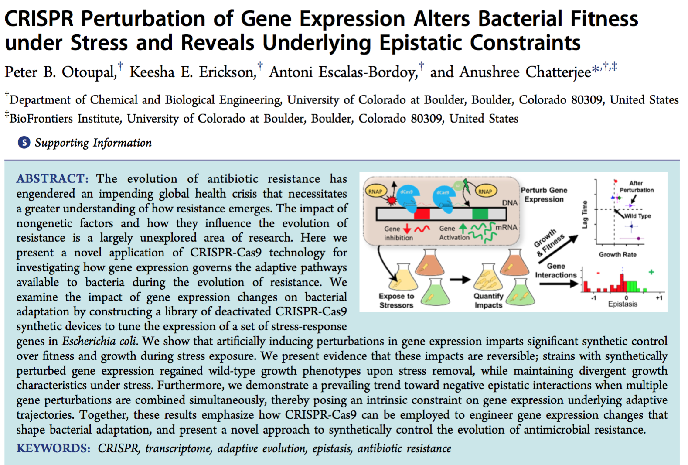
Activity 1: What would you present from Otoupal, et al.? Which 2-3 figures (or parts of figures) would you choose to present? What is their significance to the main question?
Notes:
Which figures you pick may vary depending on what you think the most important story is.

Slide 16
3. Designing effective slides

Slide 17
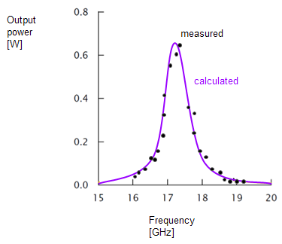
Slide design: use the same principles as figure design
Titles = take-home messages
Show minimum essential data
Avoid clutter
Simplify & break up figures to avoid overwhelming your audience.

Slide 18
Example: Converting a paper figure to a presentation figure
Susan McConnell (Stanford)
Designing effective scientific presentations
https://youtu.be/Hp7Id3Yb9XQ?t=1150

Slide 19
Skills you should demonstrate:
Titles = take-home messages
Show minimal essential data
Remove clutter, improve clarity
Separate/mask panels
Add/move/remove labels
Effective redundancy: align visual, written, & oral
“What would help my audience understand this faster?”
Notes:
[ ] Print out the original figure so students can compare

Slide 20
Titles = take-home messages
 | DON’T | DO
 | Overly general heading Only descriptive | Take-home message; “so what?”
Methods | EMK-1 Knockdown | EMK1/Par1 was knocked down in MDCK (kidney) cells using siRNA
Results | Ca-switch | MDCK cells form a lumen after changing extracellular [Ca⁺²]
 | Mitochondrial ROS induction in cell lines | Mitochondrial ROS induction is decreased in adk⁻ cells
 | Comparison of primer specificity | Primer 1 is better than Primer 2 at differentiating closely-related HIV strains

Slide 21
Avoid light or bright font colors.
Am I legible? Am I legible? Am I legible? Am I legible? Am I legible? Am I legible?

Slide 22
Activity 2: Practice adapting a figure
Pick one figure and break it down as you would for a slide.
What would you show?
What text would you add?
Title = take-home message
Show minimum essential data
Remove clutter, improve clarity
Separate/mask panels
Add/move/remove labels
Effective redundancy: align visual, written, & oral
“What would help my audience understand this faster?”

Slide 23
4. Oral presentation skills

Slide 24
You’ll be the expert, but it takes practice.
Notes:
Pauses can give your audience time to parse a slide, or get their attention again
How do you make sure you’re 10 min? Rehearse!!

Slide 25
Additional help
Practice your presentation with a Communication Fellow http://be.mit.edu/becommunicationlab
Susan McConnell (Stanford), Designing effective scientific presentations https://youtu.be/Hp7Id3Yb9XQ

