Slide 1
L4 – Quantitative Evaluation of Binding Interactions
February 22, 2018
Notes:
Today we will generally discuss about some of the methods that biochemists and engineers use to evaluate the interactions of proteins with other biomolecules or small molecules, with great emphasis on the method that you will be using in lab during this module.

Slide 2
Molecular recognition is ubiquitous in biology
Notes:
Molecular recognition is ubiquitous in biology! Proteins, lipds, sugars, nucleic acids, metabolites, antibodies all come together to form macromolecular structures and signaling pathways in a complex architecture.
BE = describing all of these interactions and fluw through the system in quantitative terms.

Slide 3
The Inner Life of the Cell – Alain Viel, Harvard
https://www.youtube.com/watch?v=FzcTgrxMzZk
Notes:
MCB teaching, 8-minute video with narration and groovy music. It takes you all the way from cell interactions with extracellular matrix, to signlaing pathways that start with membrane receptors following most major cellular processes from the perspective of the biomolecules, including proteins, nucleic acides, lipid structures, sugars, and key signaling small molecules. Maybe give it a watch while you guys are waiting for something to incubate during your lab sections this week.

Slide 4
Basic language of binding interactions
Affinity: strength of the interaction, measured by the corresponding decrease in free energy upon binding
Specificity: relative strength of interaction for a cognate and non-cognate receptor-ligand complex

Slide 5
There are two basic types of non-covalent interactions:
simple binding and allosteric
simple interaction
Some binding interactions are ’simple’ equilibria – each encounter is independent
Adapted from Kuriyan, The Molecules of Life, Chapter 12, Molecular Recognition
Notes:
This is the type of binding interaction we will focus on for the laboratory piece of this class.

Slide 6
There are two basic types of non-covalent interactions:
simple binding and allosteric
simple interaction
Some binding interactions are ’simple’ equilibria – each encounter is independent
allosteric interaction
Others are more complex, involving allostery, where one ligand binding event alters the affinity for another ligand
Adapted from Kuriyan, The Molecules of Life, Chapter 12, Molecular Recognition
Notes:
We have already discussed an example of allostery - FKBP12 ternary complexes!
Kinase analogy in durg discovery, ATP-binding active site, versus site distal to the phosporylation action.

Slide 7
Thermodynamics provide insight into
molecular interactions
As you learned in 20.110, we can think about the following binding-related terms thermodynamically:
• affinity and specificity
• contribution of entropy and enthalpy
• dependence on temperature
• contributions of chemical groups on the ligand and/or the receptor
This information can in turn be used to understand a system and to alter the system (e.g. drug design)

Slide 8
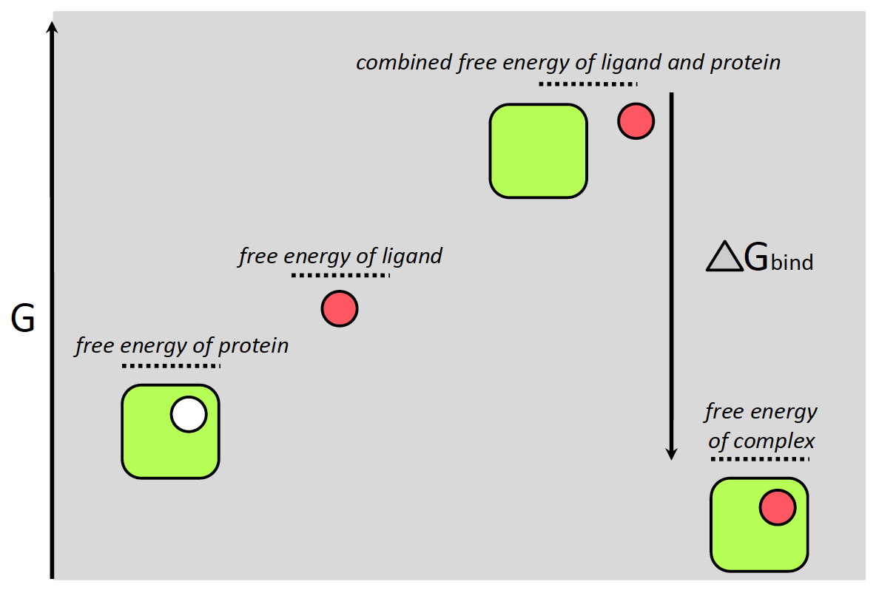
Relationship of ligand binding free energy
to association constants
From 20.110:
Notes:
This is simply to remind you that binding energy can be related to affinity via some simple relationships that are more important for the purposes of 20.110 and 20.320.

Slide 9
Relationship of ligand binding free energy
to association constants
From 20.110:
Notes:
For this class, we will focus more on the relationship highlighted in yellow because it relates the concentrations of protein or receptor to ligand as well as the protein-ligand complex.
P vs. R – interchangeable.

Slide 10
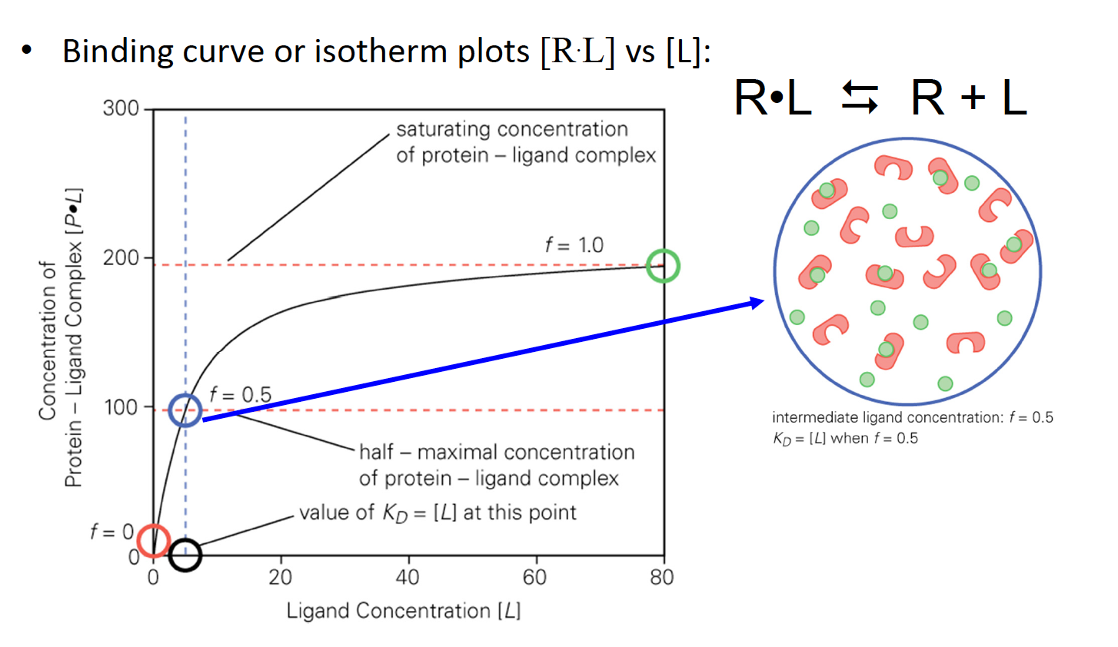
Binding isotherms are half maximal at
[L] = K_{D}
(M)
’binding isotherm plot’
steady-state equilibrium analysis
(M)
Notes:
For this class, this title of the slide is a key take-home message for evaluating the affinities of interactions!!
What would the zoom in of the green circle look like? The zoom in of the red circle?

Slide 11
Logarithmic vs. Linear display of data
historic convention
current convention
as a corollary, choose your concentrations wisely:
1, 3, 10, 30, 100, 300 nM
vs.
50, 100, 150, 200, 250, 300 nM

Slide 12

Range of biologically important interactions
kcal/mol
-4 to -8 kcal/mol
higher K_{D} value
weaker interaction
-8 kcal/mol
-12 kcal/mol
-12 to -17 kcal/mol
-21 kcal/mol
lower K_{D} value
stronger interaction
Adapted from Kuriyan, The Molecules of Life, Chapter 12, Molecular Recognition

Slide 13
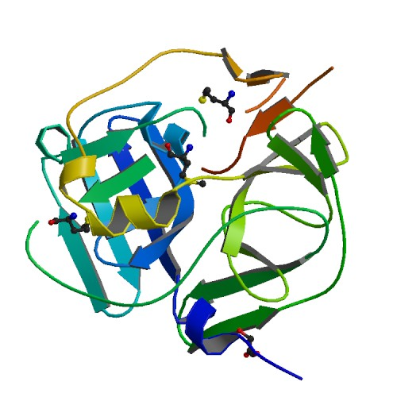
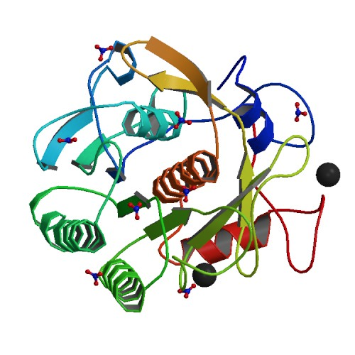
Specificity in molecular recognition
discrimination among targets
Proteinase K
low specificity
Aliphatic/X
Aromatic/X
Tobacco Etch Virus (TEV) protease
high specificity
Glu-X-X-Tyr-X-Gln/Ser
Notes:
Some molecules have low specificity, meaning that they show little discrimination among their targets. Other proteins have very high specificity, interacting with only a few targets. Proteases highlight this observation.
For example, non-specific proteases will cleave peptide bonds of almost any peptide. Proteinase K, which cleaves the peptide bond following either an aliphatic or aromatic amino acid, is used in DNA and RNA purification protocols to indiscriminately digest cellular proteins.
The Tobacco Etch Virus (TEV) protease, by contrast, is a highly specific protease that is extremely useful in protein engineering because it recognizes a seven amino acid consensus sequence, Glu-X-X-Tyr-X-Gln/Ser, that can be inserted into recombinant proteins. We use this sequence all of the time in my lab when we prepare fusion proteins that we would like to cleave at some point. This is particularly useful in protein purification.
The ability to predictably engineer specificity in proteins or in ligands would open up dramatic new avenues for biological engineering. Diverse areas including tissue replacement, bio-remediation and energy production would be revolutionized if we could design the specificity of proteins at will.

Slide 14
Specificity in molecular recognition – kinase drugs
binding constants
Adapted from Zarrinkar et al, Blood (2009), 114: 2984-2992
Notes:
Kinase phylogeny trees

Slide 15
Specificity in drug binding – fractional saturation
Adapted from Kuriyan, The Molecules of Life, Chapter 12, Molecular Recognition
Notes:
How de we think about fractional saturation in terms of drugs?
A drug binds tightly to a given protein and weakly to another undesired target. The drug is delivered at a concentration that is below the value of the K_{D} for the undesired target and very little binding to the undesired target occurs.

Slide 16
Specificity in drug binding – fractional saturation
impact therapeutic effects?
ED₅₀ = effective in 50% patients
TD₅₀ = toxic in 50% patients
Adapted from Kuriyan, The Molecules of Life, Chapter 12, Molecular Recognition
Notes:
How de we think about fractional saturation in terms of drugs?
A drug binds tightly to a given protein and weakly to another undesired target. The drug is delivered at a concentration that is below the value of the K_{D} for the undesired target and very little binding to the undesired target occurs.

Slide 17
But how do we go about measuring these
K_{D} values in a laboratory setting?

Slide 18
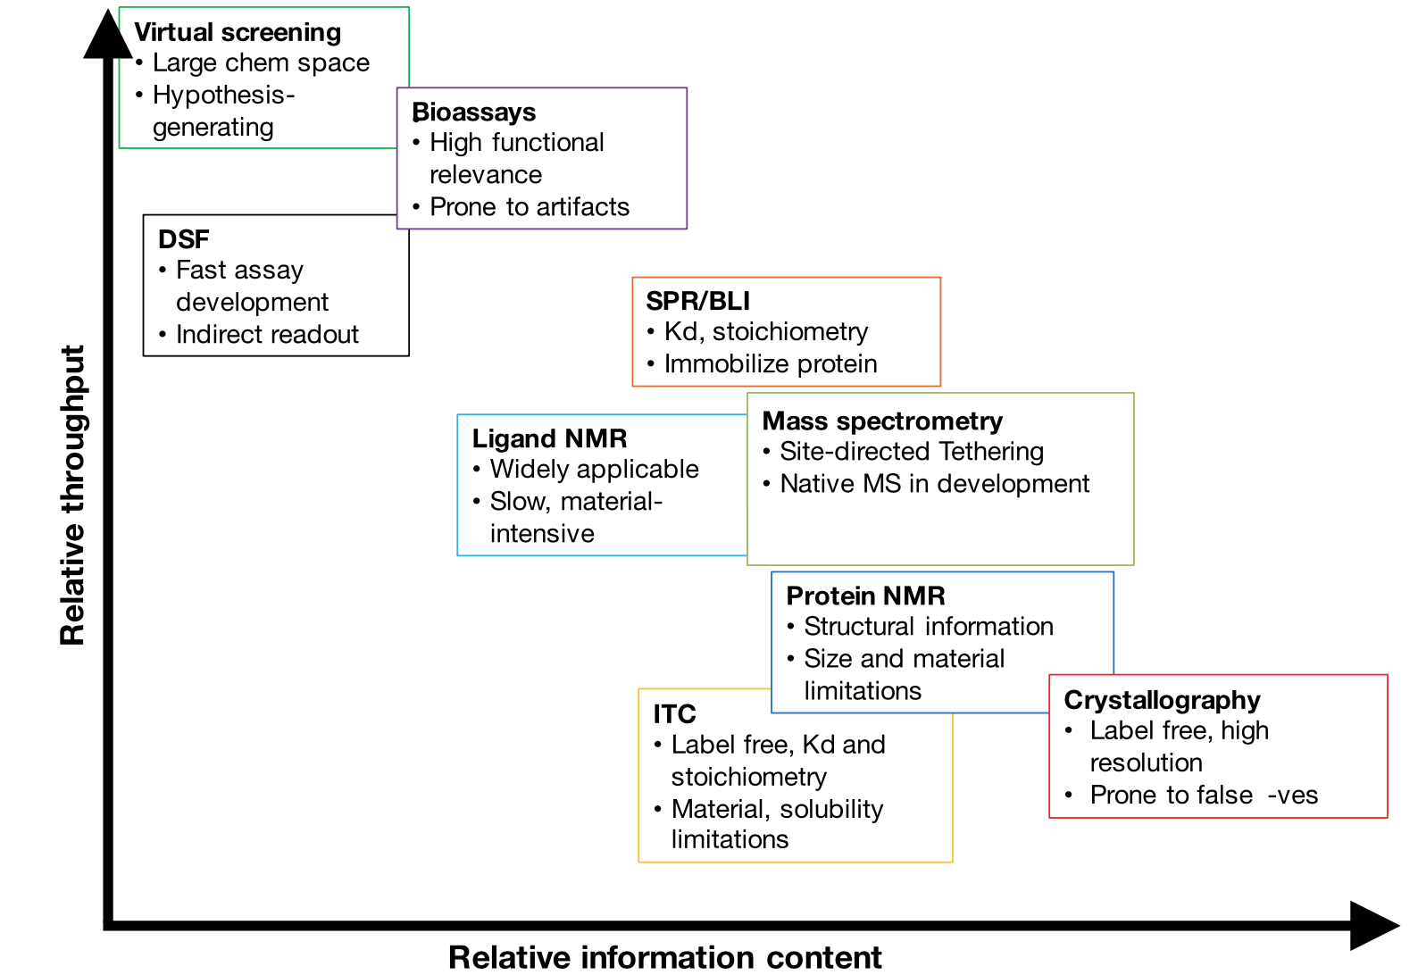
Methods to evaluate binding interactions
L3
L5
L3

Slide 19
Methods to evaluate binding interactions
L3
L5
L3

Slide 20
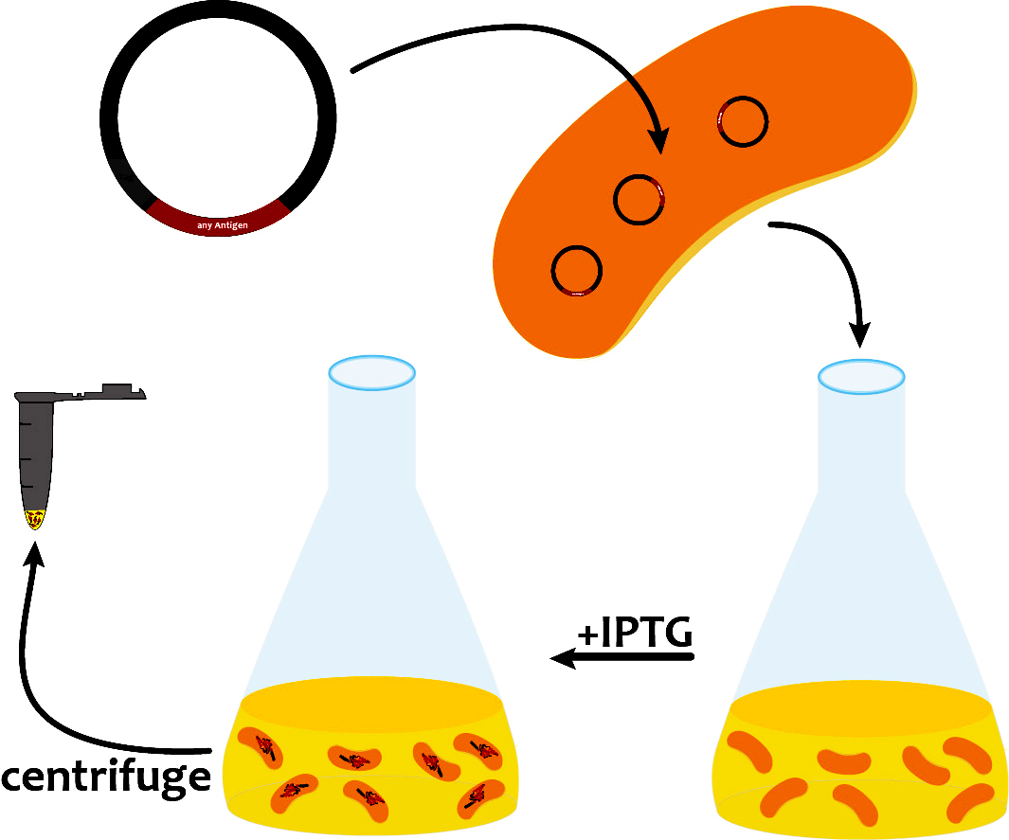
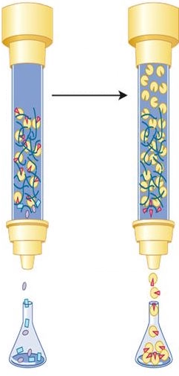
Our path to evaluate FKBP12 ligands
+
in silico cloning; overexpress FKBP12
lab days 1 & 2
purify and analyze FKBP12
lab days 3 and 4
re-analyze screen data
lab day 2
IC₅₀ = X µM
ΔT = Y °C
test FKBP12 and ligands
in enzyme activity assay
lab day 5
test ligands in FKBP12
binding assay
lab day 6
complete data analysis
prioritize best ligands
lab day 7

Slide 21
Measuring a thermal melt profile for a protein
peak fluorescence
protein aggregation
&
dye dissociation
dye binding
Tm = melting temperature
protein melting
hydrophobic dye
protein of interest
Notes:
Key slide - take time to walk through it!

Slide 22
Dyes used to detect protein unfolding
ANS
8-anilinonapthalene-1-sulfonic acid
(1965)
Notes:
The original; molten globule

Slide 23
Dyes used to detect protein unfolding
ANS
8-anilinonapthalene-1-sulfonic acid
(1965)
Nile Red
9-diethylamino-5-benzo[a]phenoxazinone
(1985)
solvatochromic
Nile Red under visible and
UV light in different solvents
Notes:
Brighter; solvatochromic; now used as a lipid visualization tool, often used to quantify to lipids in assays

Slide 24
Dyes used to detect protein unfolding
ANS
8-anilinonapthalene-1-sulfonic acid
(1965)
Nile Red
9-diethylamino-5-benzo[a]phenoxazinone
(1985)
solvatochromic
Nile Red under visible and
UV light in different solvents
SYPRO® Orange
Most common dye for DSF/TS
(2004)
binds nonspecifically to hydrophobic surfaces;
water quenches fluorescence
Notes:
First dye compatible with typical qPCR instruments in lab based on excitation and emission. Many next generation analogs that are now brighter.

Slide 25
Dyes used to detect protein unfolding
ANS
8-anilinonapthalene-1-sulfonic acid
(1965)
Nile Red
9-diethylamino-5-benzo[a]phenoxazinone
(1985)
solvatochromic
Nile Red under visible and
UV light in different solvents
SYPRO® Orange
Most common dye for DSF/TS
(2004)
binds nonspecifically to hydrophobic surfaces;
water quenches fluorescence
CPM
N-[4-(7-diethylamino-4-methyl-3-coumarinyl)phenyl]maleimide
(2008)
only fluoresces after reacting with Cys residues
Notes:
Cys residues are deeply buried within a protein as they are hydrophobic; when the protein denatures they become available to react with CPM.
What might be a limitation of this dye for some targets? NOT ALL PROTEINS HAVE CYS RESIDUE. Also, it turns out you need a special filter on your qPCR or plates reader due to a nonstandard excitation/emission profile.

Slide 26
What happens when you add a small molecule?
peak fluorescence
protein aggregation
&
dye dissociation
dye binding
Tm = melting temperature
protein melting
hydrophobic dye
protein of interest

Slide 27
Thermal shift assays with small molecules
Adapted from Dr. Salemme at thermofluor.org
Notes:
Do you think most molecules ‘stabilize’ proteins?

Slide 28
Real thermal shift screens with small molecules
Adapted from Dr. Salemme at thermofluor.org
Notes:
Most thermofluor screening campaigns produce “destabilizing” hits (e.g Delta Tm is negative) in addition to stabilizing hits (Delta Tm positive), presumably reflecting preferential ligand binding to partially unfolded protein states. Many such compounds may appear as active hits in corresponding enzymatic assays of target activity, but rarely develop extensive SAR relationships, and are often shown to act promiscuously against multiple protein targets.

Slide 29
Real results from thermal shift studies
assay development
protein + dye
dye only
protein only
consider optimizing buffer conditions –
pH, cofactors
Adapted from Collaborative Crystallisation Centre

Slide 30
Real results with thermal shift assays
three replicates
sharp, smooth melt
post-transition quench
pre-transition is flat
T_{m} ~59 °C
raw fluorescence thermal curves
first derivative representation
Adapted from Collaborative Crystallisation Centre

Slide 31
Real results with thermal shift assays
no melt transition is observed
WHY?
raw fluorescence thermal curves
Adapted from Collaborative Crystallisation Centre

Slide 32
Protein disorder continuum
intrinsically disordered
highly structured
Notes:
It is estimated that 15–25% of recombinant proteins give non-ideal denaturation curves that include high fluorescence at room temperature baseline and/or lack a sigmoidal transition to the unfolded state (Crowther et al., 2010). Typical causes of non-ideal denaturation profiles include: lack of a compact, globular fold (i.e. intrinsic disorder), lack of hydrophobic core and/or hydrophobic patches on the solvent-exposed surface of the folded protein, or poor protein stability at room temperature. In cases such as these, thermal shift assay cannot be used.

Slide 33
Protein disorder continuum
intrinsically disordered
highly structured
calcineurin
Notes:
Remember calcineurin from our intro to FKBP12?

Slide 34
Determining apparent dissociation constants
hexokinase and glucose
Experiment 1:
test a wide range of glucose concentrations
Kd is likely between 0.2 and 1.7 mM
Experiment 2:
test 16 concentration of glucose
fit to single binding event model (red)
apparent Kd ~ 1.12 +/- 0.05 mM
Notes:
Graphpad program

Slide 35
Determining apparent dissociation constants
hexokinase and glucose
Experiment 1:
test a wide range of glucose concentrations
Kd is likely between 0.2 and 1.7 mM
Experiment 2:
test 16 concentration of glucose
fit to single binding event model (red)
apparent Kd ~ 1.12 +/- 0.05 mM
Notes:
Graphpad program, I would have extended the data further to really convince yourself that you have reached saturation of binding.

Slide 36
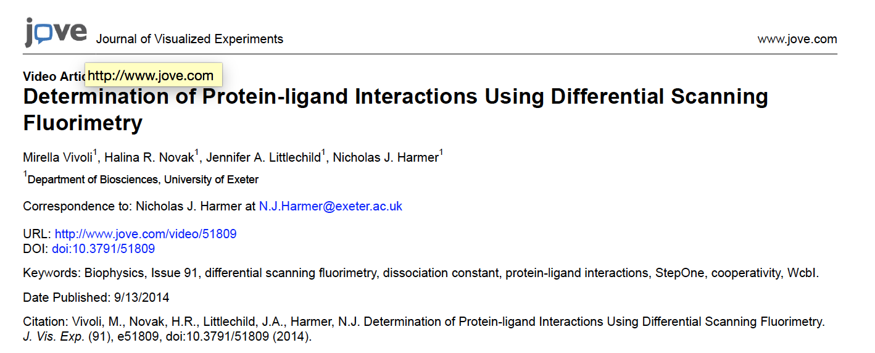
Determining apparent dissociation constants
Step-by-step protocols with more examples
We will put this on the Wiki for you!
Notes:
Graphpad program

Slide 37
Target engagement in cells:
cellular thermal shift assays (CETSA)
western
blot
compound
% soluble protein
vehicle
compound
vehicle (DMSO)
Temperature (°C)
compound treatment
in cells
heating and cooling
lyse cells
separation
(optional)
detection
Notes:
Illustration of the general assay procedure. The cells are incubated with compounds or controls followed by a transient heating step, cell lysis, an optional step in which the irreversible aggregates are separated from the soluble proteins and finally detection illustrated by the graph showing remaining levels of soluble target protein.

Slide 38
Anticipated results from CETSA assays
T_{agg} curve
ITDRF curves
vehicle
compound
compound A
compound B
compound C
% soluble protein
% soluble protein
ΔT
Temperature (°C)
log [compound] (M)
IsoThermal Dose Response Fingerprint
‘apparent potencies’ at single temp
Notes:
Anticipated results from CETSA experiments performed in two different ways. a) Example T_{agg} curve for a target protein in the presence (red squares) and absence (grey circles) of ligand when subjected to a heat gradient. b) Example ITDRF_{CETSA} curves for three compounds with different apparent potencies.

Slide 39
Real results from CETSA assays
thymidylate synthase drugs in K562 cells
T_{agg} curve
ITDRF curves
floxuridine
5-fluorouridine
raltitrexed
5-FU
floxuridine
CBK115334
DMSO vehicle
quadruplicate data from one independent experiment
Notes:
Illustration of T_{agg} curves for TS in K562 cells. Data are shown for unliganded TS in the presence of DMSO (green circle), floxuridine (blue triangle) and raltitrexed (magenta square). The vertical dotted line at 50°C represents the temperature selected for the isothermal experiment. Note that high T_{agg}values should not be considered as reliable measures of potency and permeability as these temperatures may influence cell membrane integrity (6). Data are provided as the average and SEM from two independent experiments performed in duplicate for raltitrexed and as individual data points from one experiment in duplicate for floxuridine. Adopted with permission from Macmillan Publishers Ltd: Nat. Commun. 7 (2016), copyright

Slide 40
General considerations for CETSA design
Adapted from the NIH Assay Guidance Manual

Slide 41
CETSA for high-throughput screening
384-well
assay plate
centrifugation
fluorescent
plate reader
Adapted from the NIH Assay Guidance Manual

Slide 42
Small molecule stabilizers to aid crystallization
improving structural biology efforts

Slide 43
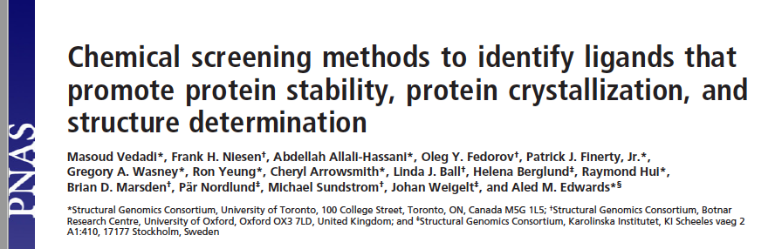
Small molecule stabilizers to aid crystallization
improving structural biology efforts

Slide 44
Our path to evaluate ligands - lectures
2/8/17 Lecture 1 Intro to chemical biology: small molecules, probes, and screens
2/13/17 Lecture 2 For the love of proteins: FKBP12 and immunophilins
2/15/17 Lecture 3 Small-molecule microarrays
2/21/17 No Lecture
2/22/17 Lecture 4 Quantitative evaluation of protein-ligand interactions
2/27/17 Lecture 5 A ligand discovery vignette: sonic hedgehog
3/1/17 Lecture 6 Engineering transcriptional responses with a small molecule
3/7/17 Lecture 7 Wrap up discussion: suggestions for how to report your findings

