Slide 1
Finish this (start PCR) before prelab
Make 100 uM gRNA stock (e.g. 20 nmol → 200 uL nuclease-free water)
Make primer mix (10 uM of each primer in 20 uL volume)
2 uL gRNA (forward primer)
2 uL RevP (reverse primer)
16 uL nuclease-free water
Take PCR tube and label with your team
10.25 uL nuclease-free water
1.25 uL primer mix (from #2) (OK to use P20)
1 uL pgRNA plasmid (Pipette up at the front)
12.5 uL Q5 Hot Start 2x Master Mix

Slide 2
M2D3: Clone psgRNA expression plasmid
Set up reaction to generate gRNA_target plasmid
Pre-lab discussion
3. Continue generation of psgRNA
4. Transform pgRNA_target into bacteria

Slide 3
Mod2 Overview
Research goal: Increase the yield of commercially valuable byproducts in E.coli using CRIPSRi technology to target genes involved in mixed-acid fermentation pathway.
Last Lab:
Chose metabolic gene of interest and designed sgRNA to target it
This Lab:
Clone sgRNA into vector to create plasmid that targets gene of interest
Next Lab:
Confirm correct sgRNA cloning and do preliminary CRISPRi system preparations

Slide 4
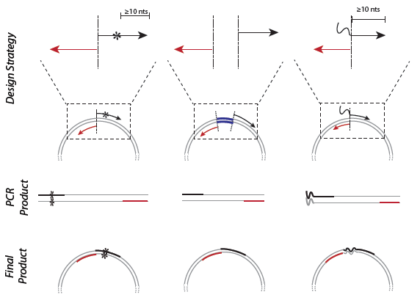
Use site-directed mutagenesis (SDM) to engineer plasmid DNA
NEB Q5 SDM kit
Create specific, targeted changes in double-stranded plasmid DNA
Point
Mutation
Deletion
Insertion
Notes:
Insertions—we’re inserting our gRNA sequence
deletions
Substitutions—you can take a single base and change it to something else
Forward primer: contains desired mutation
PCR product: linear
Final product: circular plasmid

Slide 5
SDM Primers
sgRNA
(made by you!)
Insertion Sequence
Fwd primer
dcas9 handle
Universal reverse primer

Slide 6
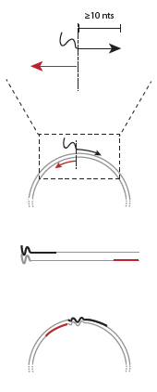
Insertion of DNA via SDM
Primers lined up back to back
dcas9
sgRNA
Linear PCR product
Blunt end ligation
Notes:
Squiggly line is the gRNA sequence, we added the 3’ handle
Reverse primer anneals back to back with the 5’ region of the forward primer
insertion is incorporated at the 5’ end of forward primer
Major product after PCR
Product after blunt ligation
We will transform this into NEB5a and Will send for sequencing to confirm our product.

Slide 7
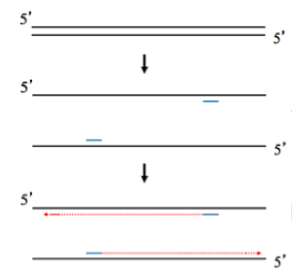
SDM Part 1: PCR amplification of DNA
Ingredients
dNTPs
Hi-Fi Q5 Polymerase
Buffer (pH, cofactors like Mg²⁺)
H₂O
…
…
98 °C
55 °C
72 °C
25 cycles
…
…
Notes:
Very high fidelity polymerase, very low error rate (> Pfu > Taq), with 3’ to 5’ endonuclease activity), hot start so you can set up at room temperature
Mg2+ cofactor for polymerase
Buffer
Primers (0.5 uM)
dNTPs
Template DNA: 25 ng pgRNA
Water
-
Melt, anneal (temperature for primers to bind), extend (polymerase to copy DNA)
Ingredients: Forward primer, Reverse primer, Polymerase, dNTPs, Template (gRNA expression vector), Buffer (pH, cofactors like Mg2+), H2O

Slide 8
SDM Part 1: PCR amplification of DNA
Ingredients
Forward Primer (Insertion)
Reverse Primer (CRISPRi reverse primer)
Template (psgRNA)
dNTPs
Hi-Fi Q5 Polymerase
Buffer (pH, cofactors like Mg²⁺)
H₂O
…
…
98 °C
55 °C
72 °C
25 cycles
…
…
Notes:
Very high fidelity polymerase, very low error rate (> Pfu > Taq), with 3’ to 5’ endonuclease activity), hot start so you can set up at room temperature
Mg2+ cofactor for polymerase
Buffer
Primers (0.5 uM)
dNTPs
Template DNA: 25 ng pgRNA
Water
-
Melt, anneal (temperature for primers to bind), extend (polymerase to copy DNA)
Ingredients: Forward primer, Reverse primer, Polymerase, dNTPs, Template (gRNA expression vector), Buffer (pH, cofactors like Mg2+), H2O

Slide 9
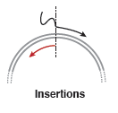
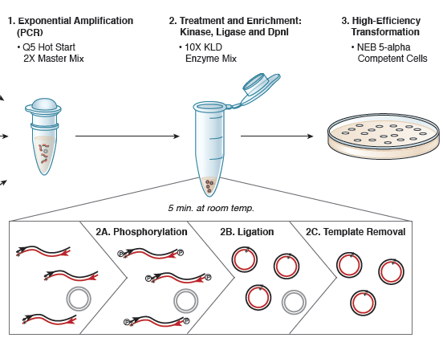
SDM Part 2: Recover circular plasmid product using Kinase-Ligase-Dpn1 (KLD) enzyme mix
Exponential Amplificaion (PCR)
Q5 Hot Start 2x Master Mix
2. Treatment & Enrichment: Kinase, Ligase and DpnI
10x KLD enzyme mix
3. High-efficiency transformation
NEB 5-alpha competent cells
Notes:
Phosphorylation video: https://www.neb.com/applications/dna-modification/dna-end-modification/dna-phosphorylation
https://www.neb.com/tools-and-resources/video-library/the-mechanism-of-dna-phosphorylation
Parent selectively digested due to methylation by DpnI
Highlight parent/template DNA
Kinase phosphorylates (NEB video on phosphorylation?)
Ligase repairs phosphate backbone (circularize plasmid)
Dpn1 cleaves methylated DNA, which removes the template DNA

Slide 10
Phosphorylation video:
https://www.neb.com/tools-and-resources/video-library/the-mechanism-of-dna-phosphorylation
Kinase
Ligase
Dpn1
KLD
reaction
Kinase – Phosphorylation required for phosphodiester bond formation
K:
L:
Ligase – Forms phosphodiester bond to circularize plasmid
D:
Digests methylated DNA. Why does this target the template?
Notes:
Kinase phosphorylates (NEB video on phosphorylation?)
Ligase repairs phosphate backbone (circularize plasmid)
Dpn1 cleaves methylated DNA, which removes the template DNA

Slide 11
For today
Continue production of sgRNA plasmid
Work on journal club in down time
For M2D4…
Create a journal club slide (in ppt) and script for 1 figure from your paper
Use the homework checklist on the wiki for guidance

Slide 12
For homework, make a Journal Club presentation slide
Craft 1 slide using your JC article to present the data from a figure.
Your slide should show the data and highlight the key finding(s).
The information should be clear and large enough to read.
Keep text to a minimum. (NO figure captions on slide!)
The title should state the take-home message of the data that are shown.

Slide 13
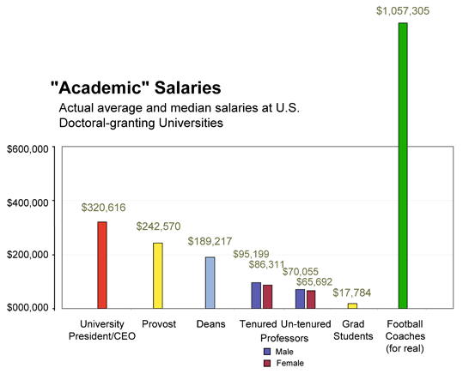
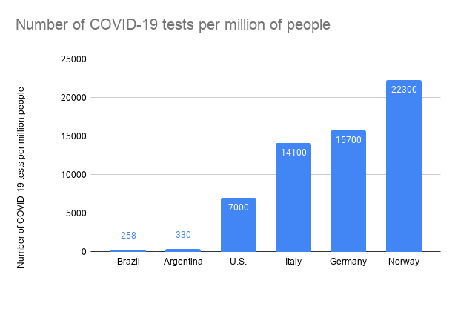
EXAMPLE SLIDE: Football coaches are the highest paid academic employees at doctoral-granting universities
Data represent expression of Y using method A
Possibly something about the control(s), if applicable
Perhaps an important note about the data that is not already stated in the title
Transition to next slide…
COVID-19 tests / million people
PhD Comics

