Slide 1
Engineered bacteria for the conversion of amyloid plaques to dark chocolate
Shannon K. Hughes and Noreen L. Lyell

Slide 2
Alzheimer’s affects 5.4 million Americans
Information about disease and progression
Transition statement linking to β-amyloid plaques (written on slide and/or stated verbally)

Slide 3
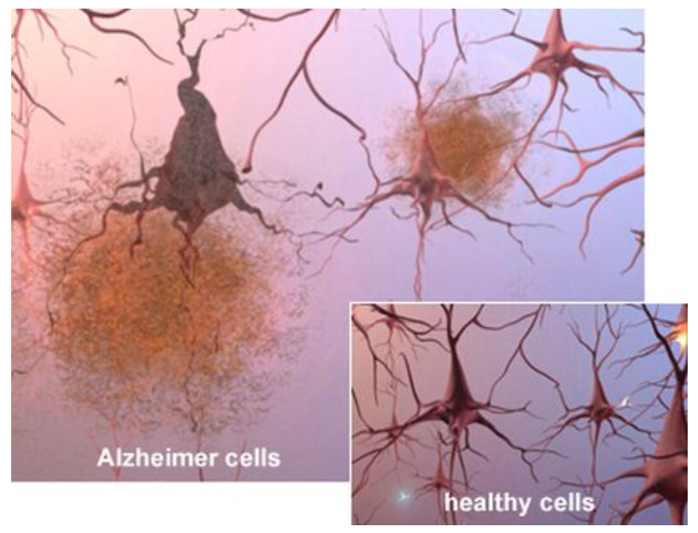
β-amyloid plaques contribute to degeneration of nerve function
General information about plaque origin and structure
Block cell-cell communication
Induce apoptosis
Lead to generalized destruction of brain tissue

Slide 4
Symptoms of Alzheimer’s may be alleviated by elimination of plaques
Information about current field of research
Briefly, what has been done
Though some progress has been made in reducing plaques, our aim is to convert them to usable product

Slide 5
Novel amyloid-to-dark chocolate (ADC) enzyme recently discovered
Identified in our laboratory using a yeast two-hybrid screen
Information about ADC enzyme

Slide 6
Research aim: use ADC to convert β-amyloid plaques to dark chocolate
Goal 1: Optimize the production of genetically engineered ADC using non-toxic E. coli strain
Goal 2: Determine enzymatic efficiency of engineered ADC in vitro using harvested β-amyloid plaques
Goal 3: Measure efficacy of engineered ADC in vivo using a mouse model of Alzheimer’s disease

Slide 7
Optimize production of ADC in E. coli
Engineer BL21(DE3) to express ADC
Clone ADC into pXYZ
Test protein expression
Additional steps…
Potential setback
Possible solution

Slide 8
Determine enzymatic efficiency of ADC using β-amyloid plaques
Research goal
Steps…
Potential setback
Possible solution

Slide 9
Measure efficacy of ADC in vivo using mouse model
Research goal
Steps…
Potential setback
Possible solution

Slide 10
Include impact statement
Include significance of your research as it relates to science and society

Slide 11
Conversion of β-amyloid plaques to usable product in treatment of Alzheimer’s

