Slide 1
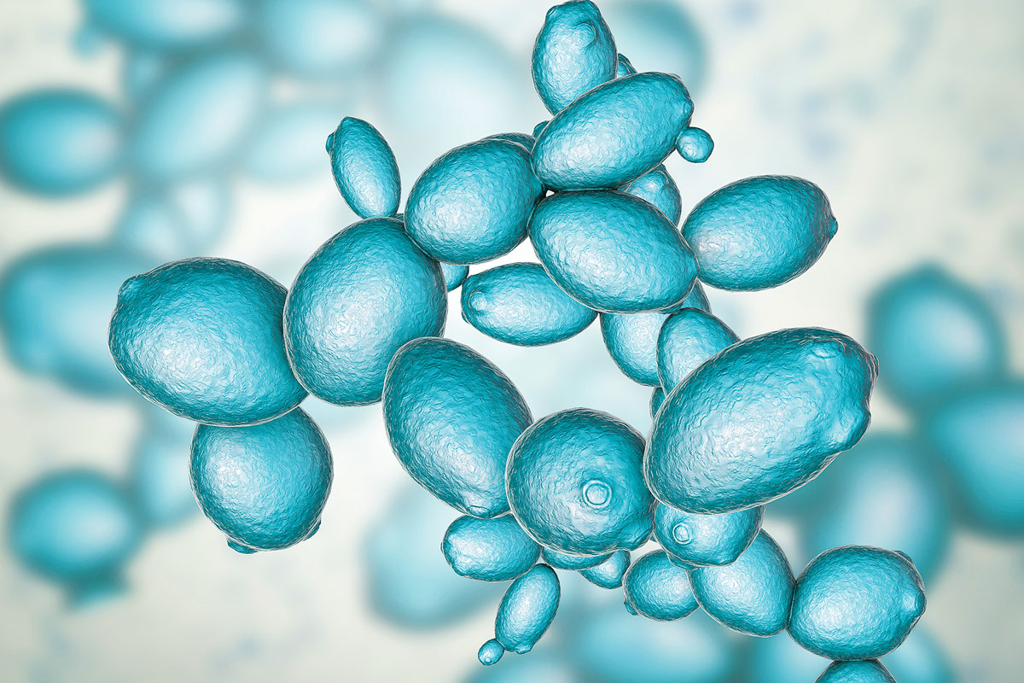
Module 2: Protein engineering to create a model system for bioremediation of heavy metals
3/14/23

Slide 2
Overview of Module 2 goals
Research:
Genetically modify a yeast iron transporter to preferentially take up cadmium as a model for bioremediation
Technical:
Protein engineering:
Site-Directed Mutagenesis
Mutant expression
Functional assays:
Elemental analysis of metal uptake
Cell tolerance of metal uptake
Communication:
Journal article presentation
Research article

Slide 3
Module Outline
M2D1: Environmental heavy metal contamination
Intro
M2D2: Model system – target selection and engineering approach
M2D3: Model system – choosing and modifying a chassis
Design
M2D4: Screening a system—high throughput vs functional screens
M2D5: Analysis of elemental metals – laboratory and field approaches
Test
M2D6: Applying remediation strategies—advantages and pitfalls
M2D7: Engineering a problem-specific bioremediation solution
Apply
M2D8: Comm Lab
Review

Slide 4
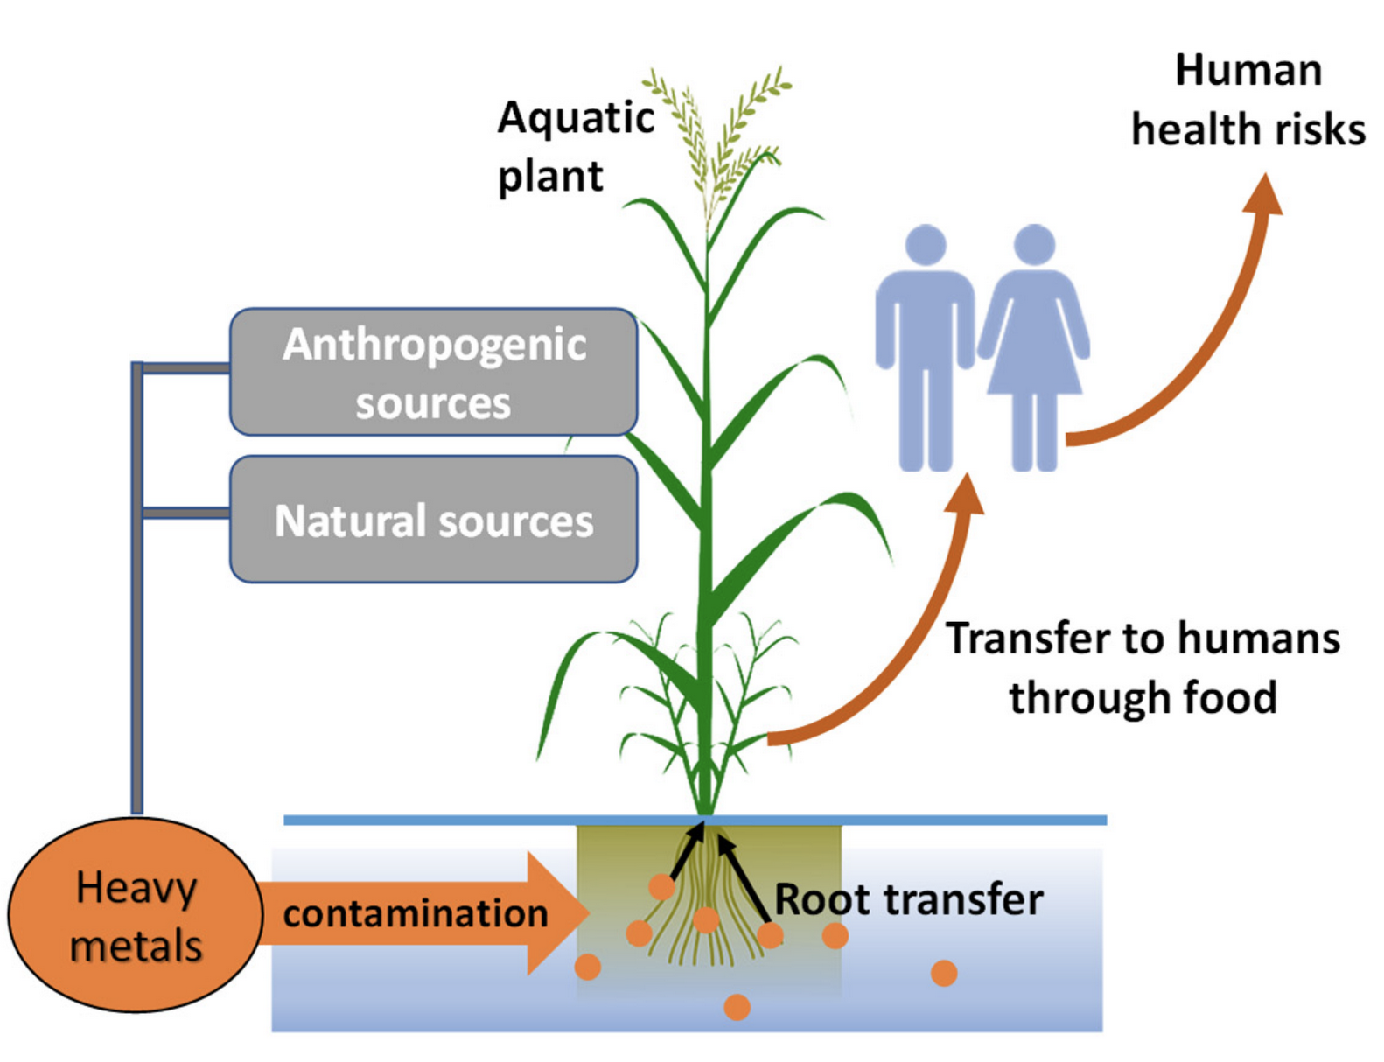
Overview of today’s lecture
Heavy metals
What are they?
What are their uses?
How do heavy metals get into environment?
Geogenic sources
Anthropogenic sources
What happens after heavy metal exposure
To soil
To plants
To humans
How can we mitigate heavy metal contamination?
adapted from Uddin et al.

Slide 5
Heavy metals and their uses

Slide 6
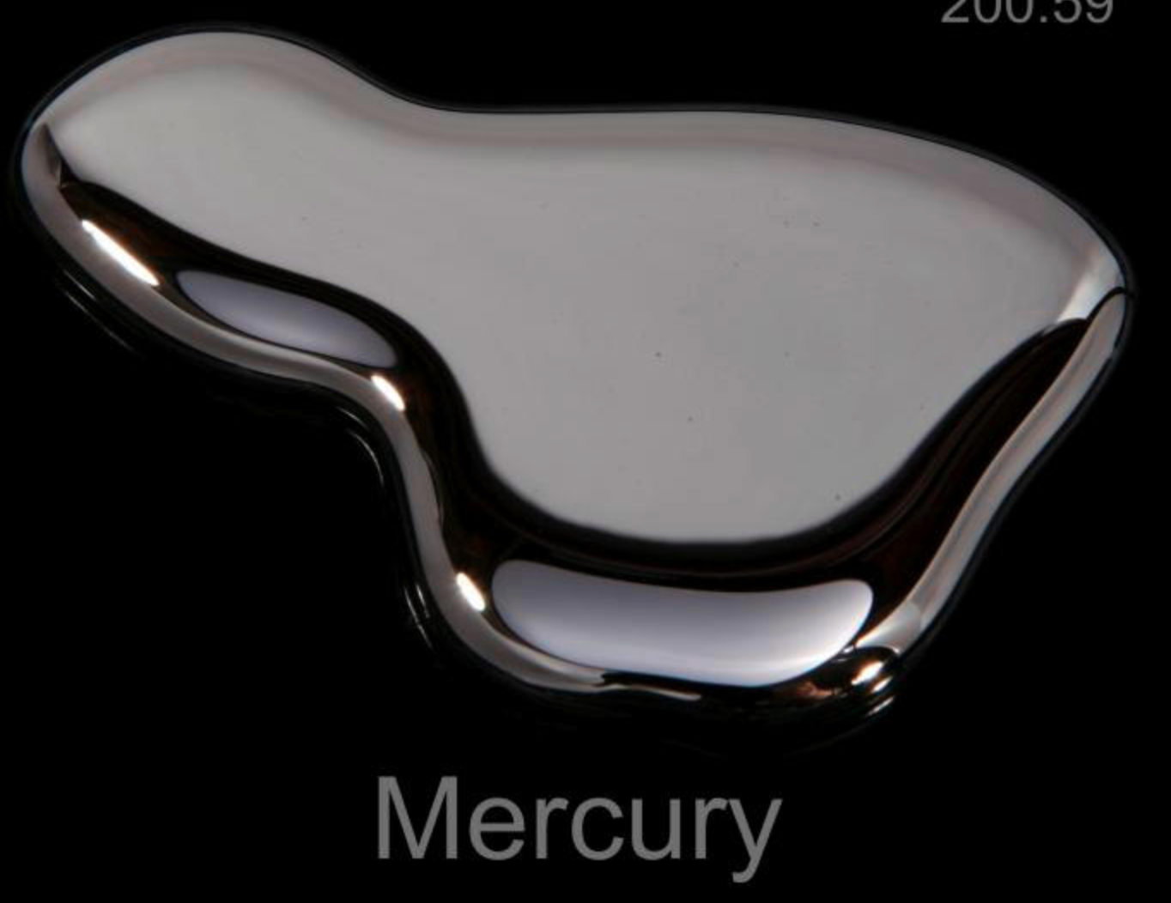
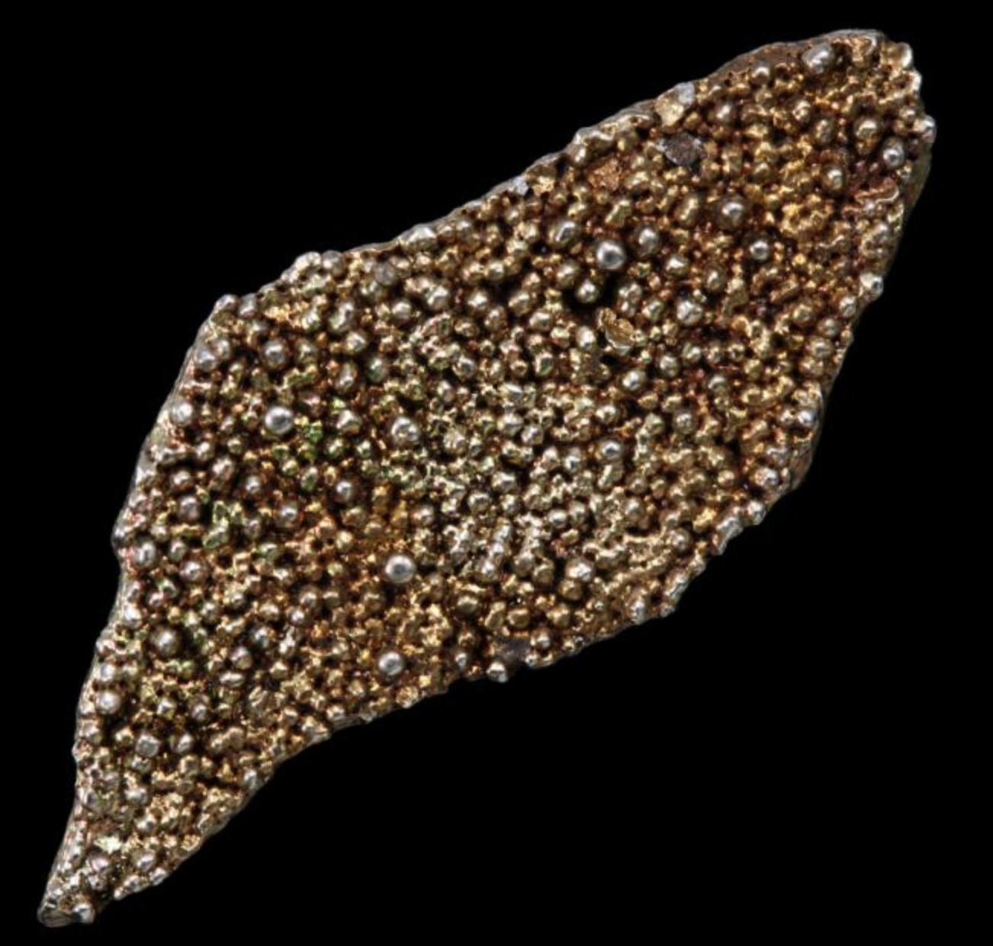
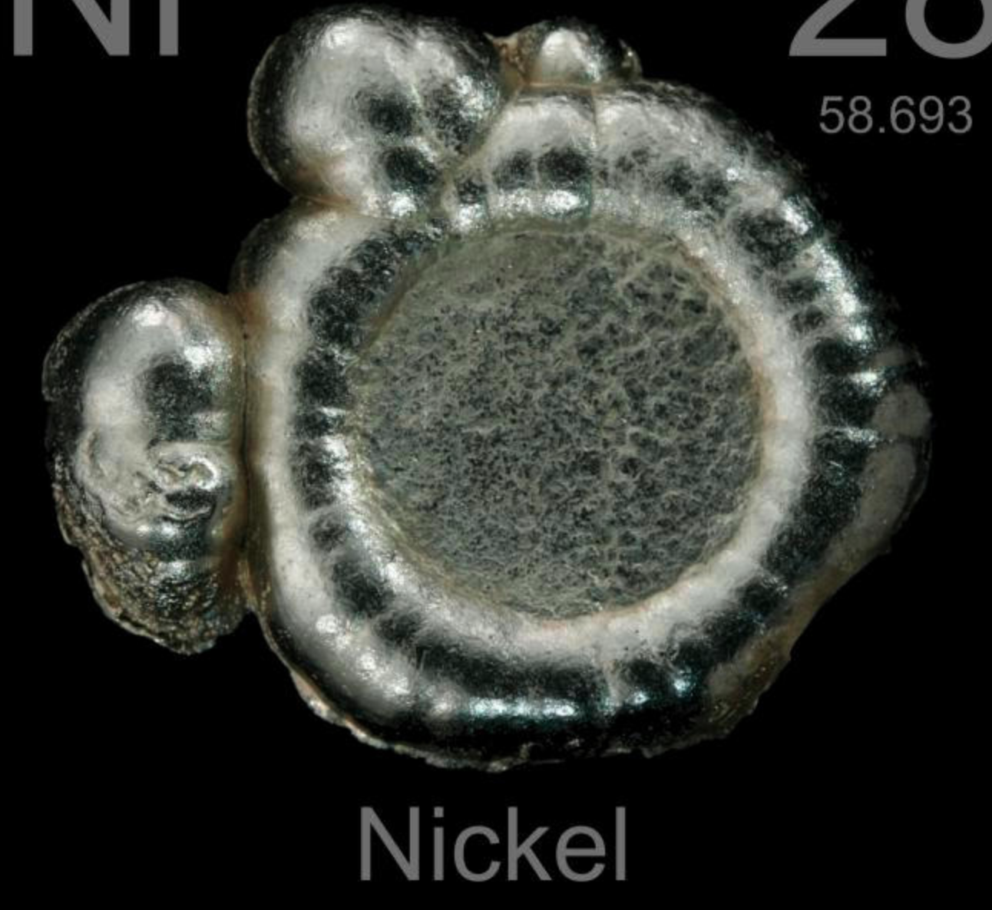
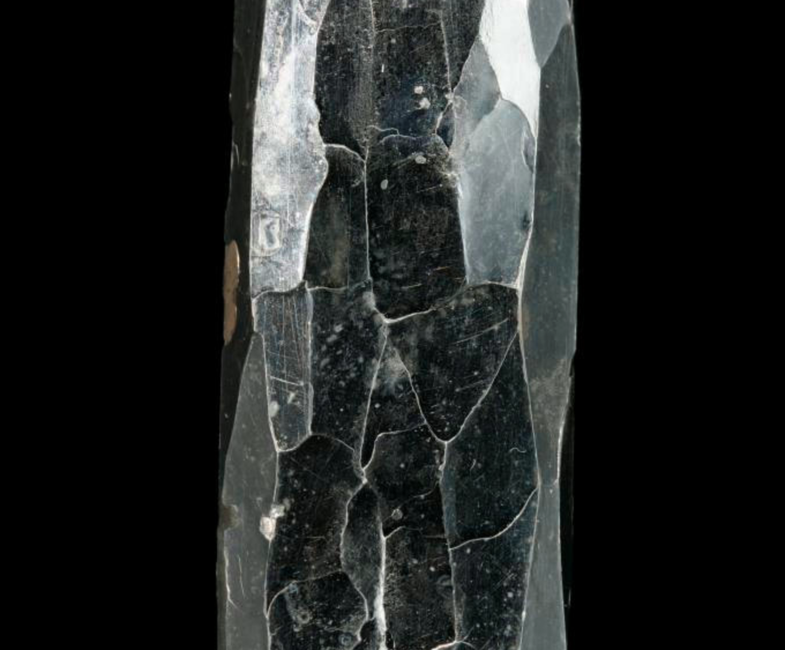
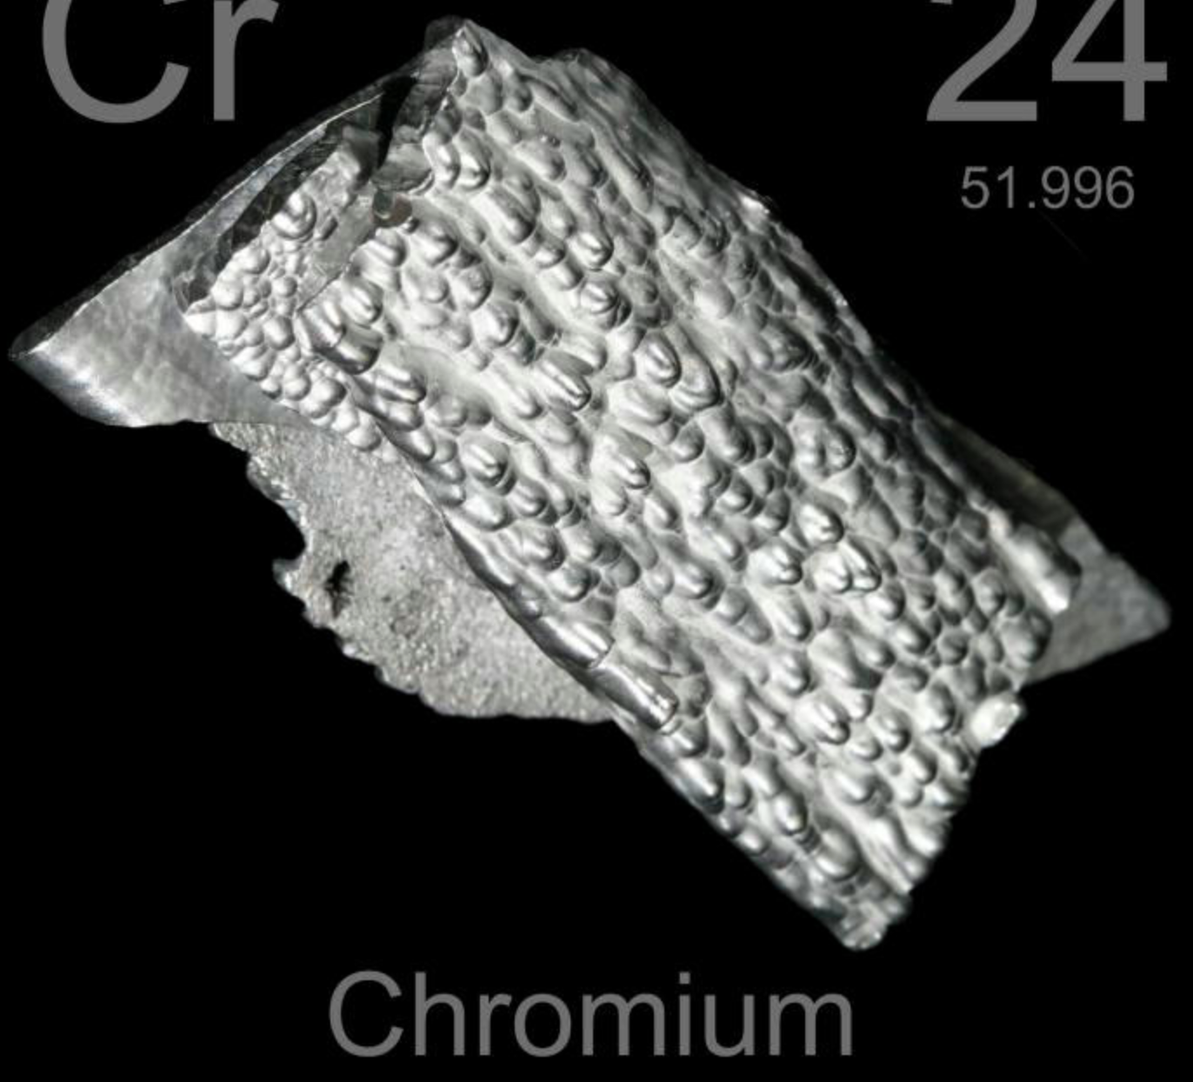
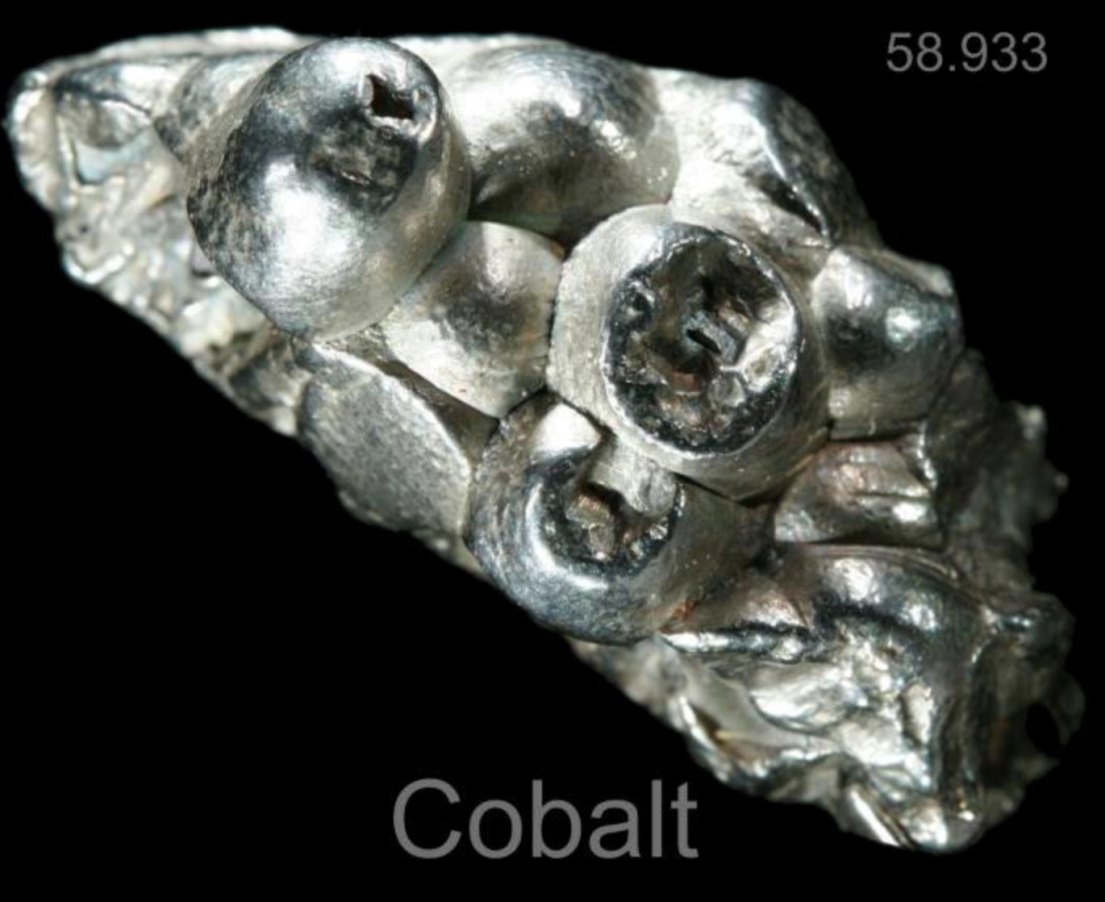
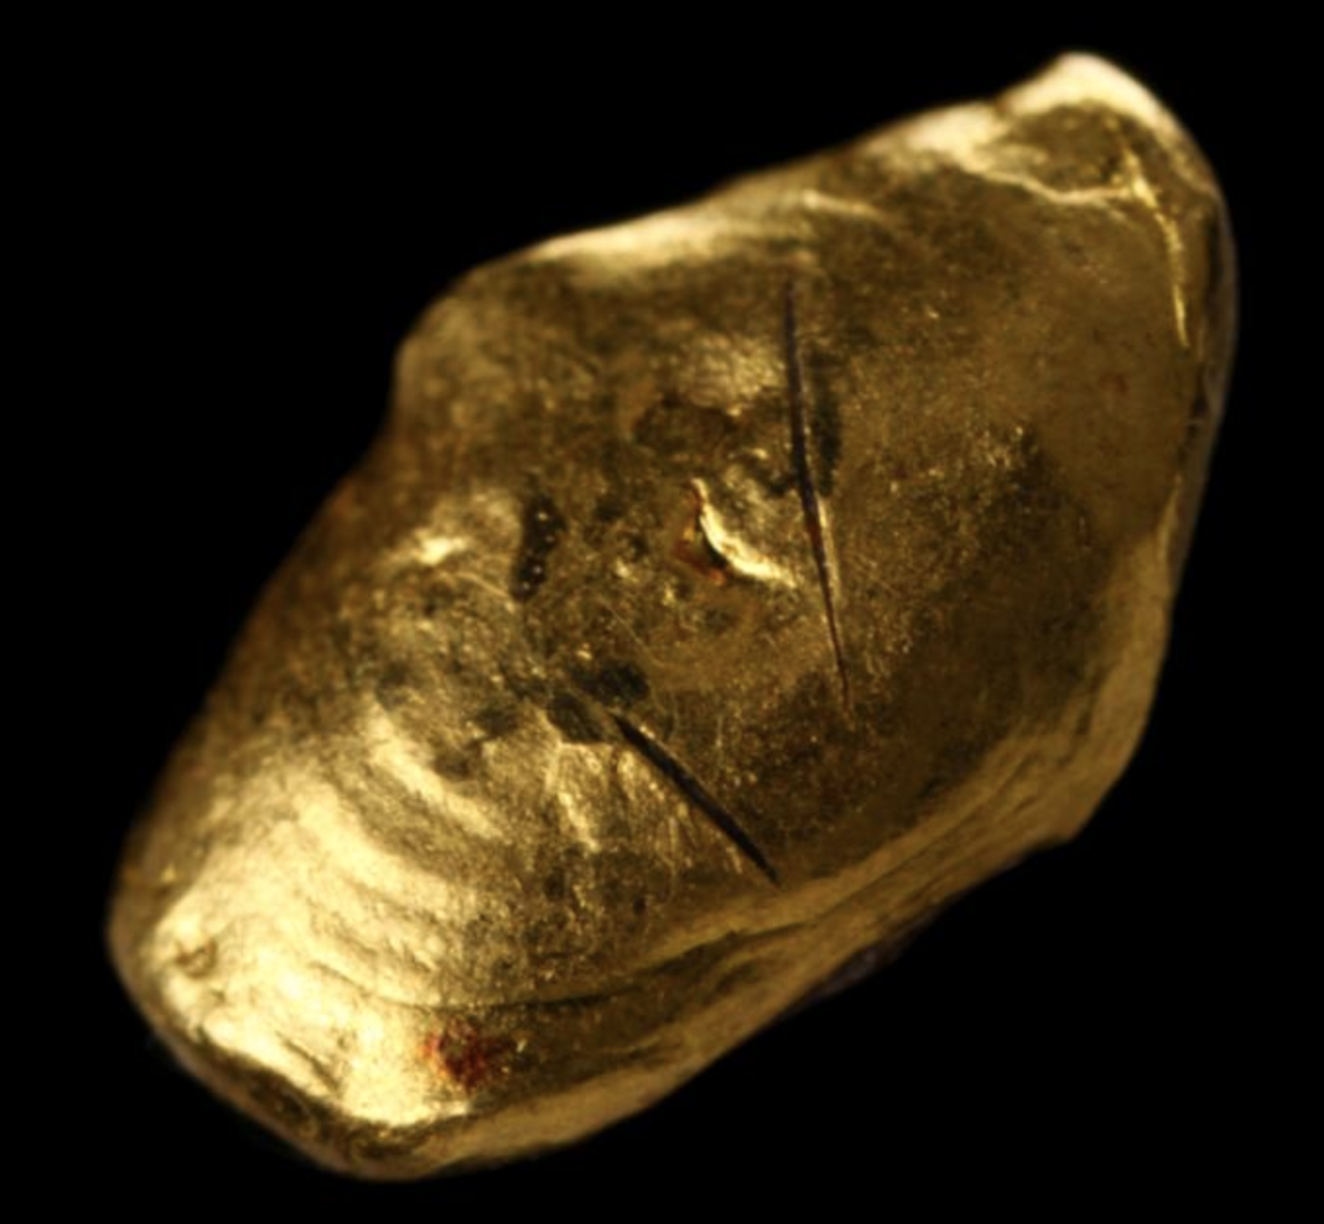
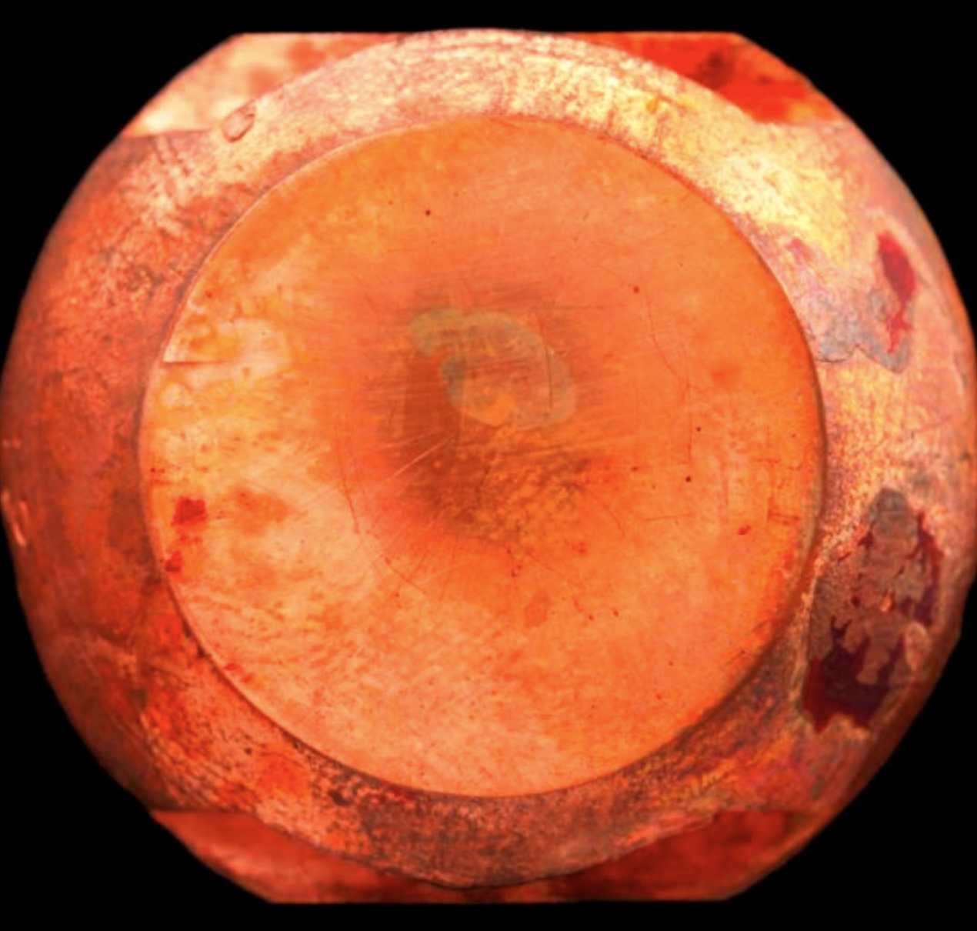
Heavy metals
Cadmium
xxx
Manganese
Copper
Gold
© Theodore Gray

Slide 7
Heavy metals
Heavy metals is poorly defined as a term
Relatively high atomic density (greater than 5 g/cm³)
Atomic number > 20
Exhibit metal-like properties
Cadmium
xxx
Manganese
Copper
Gold
© Theodore Gray

Slide 8
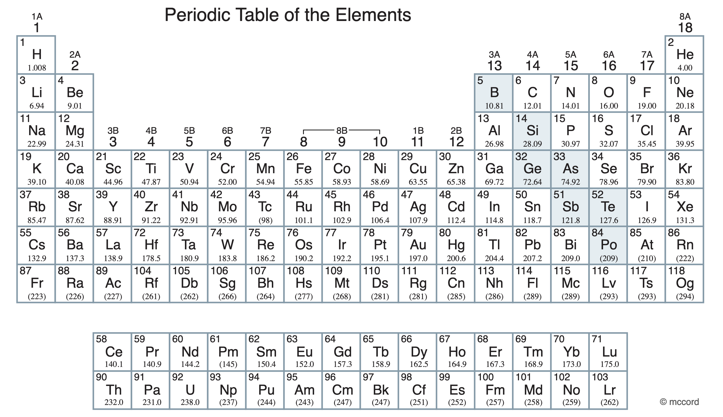
Commonly encountered heavy metals have multiple uses
chromium
iron
cobalt
copper
manganese
nickel
zinc
arsenic
silver
cadmium
lead
platinum
mercury
gold

Slide 9
Metals can act as protein co-factors in human biology

Slide 10
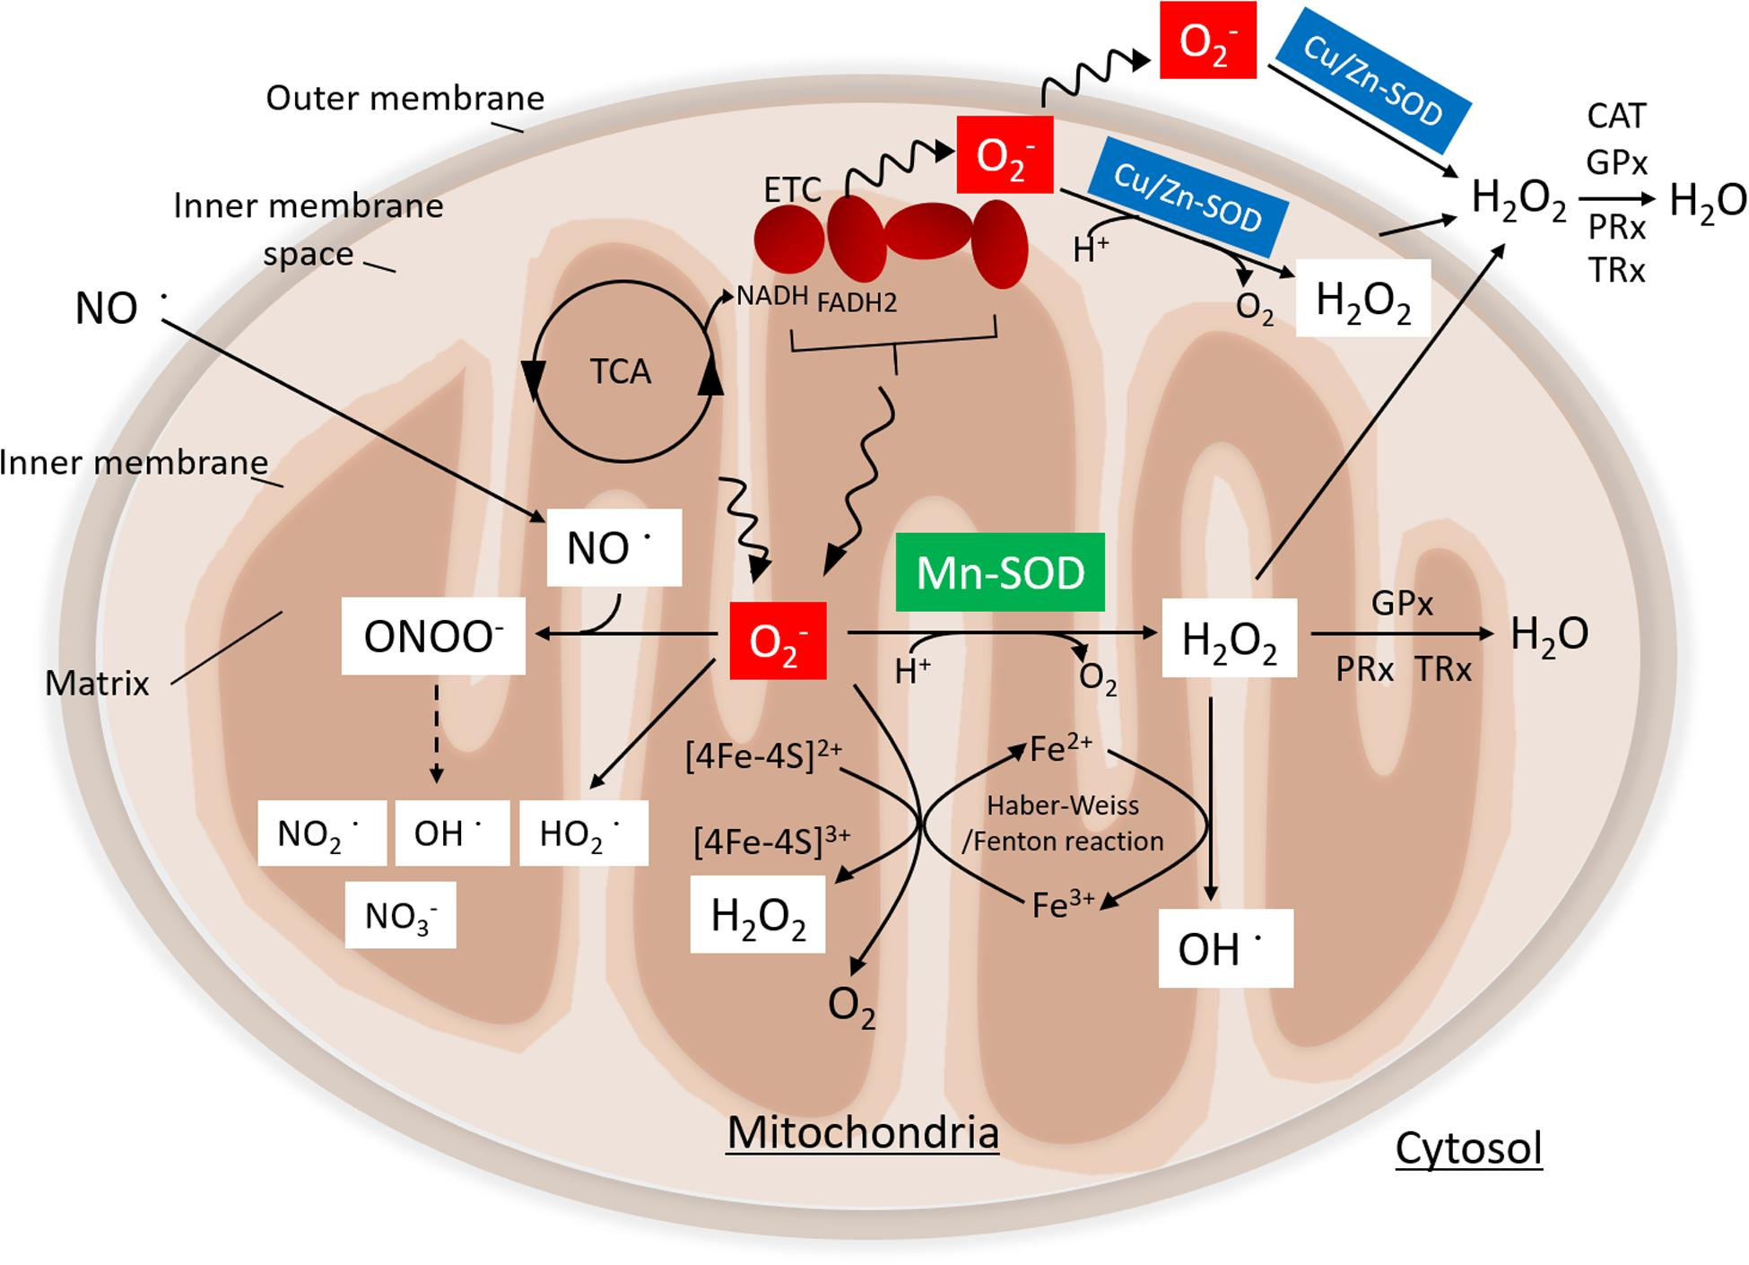
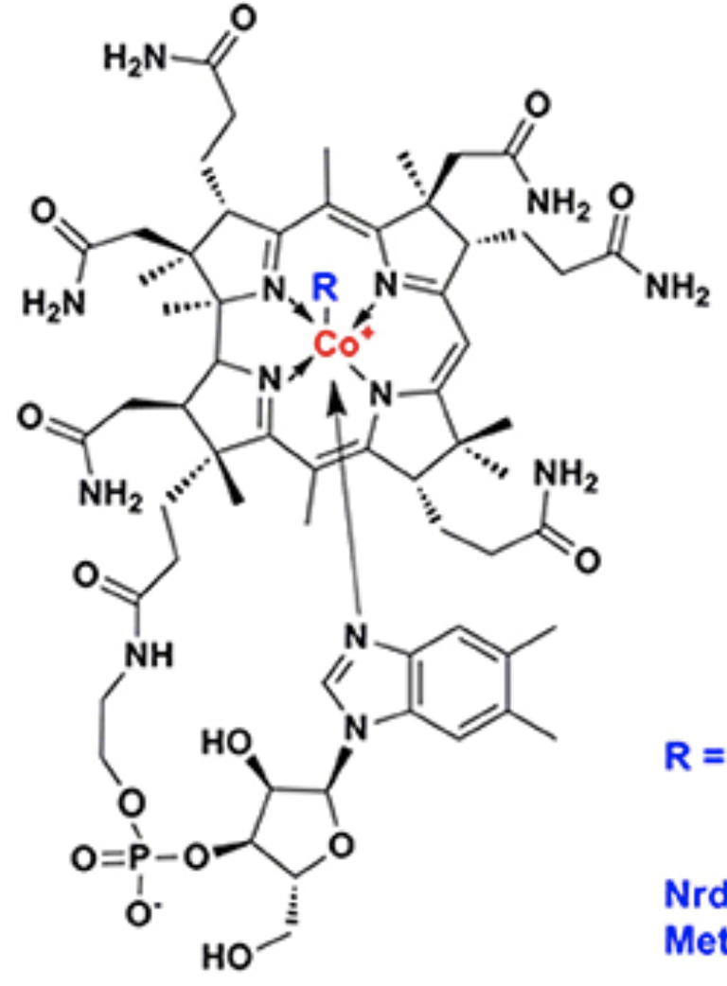
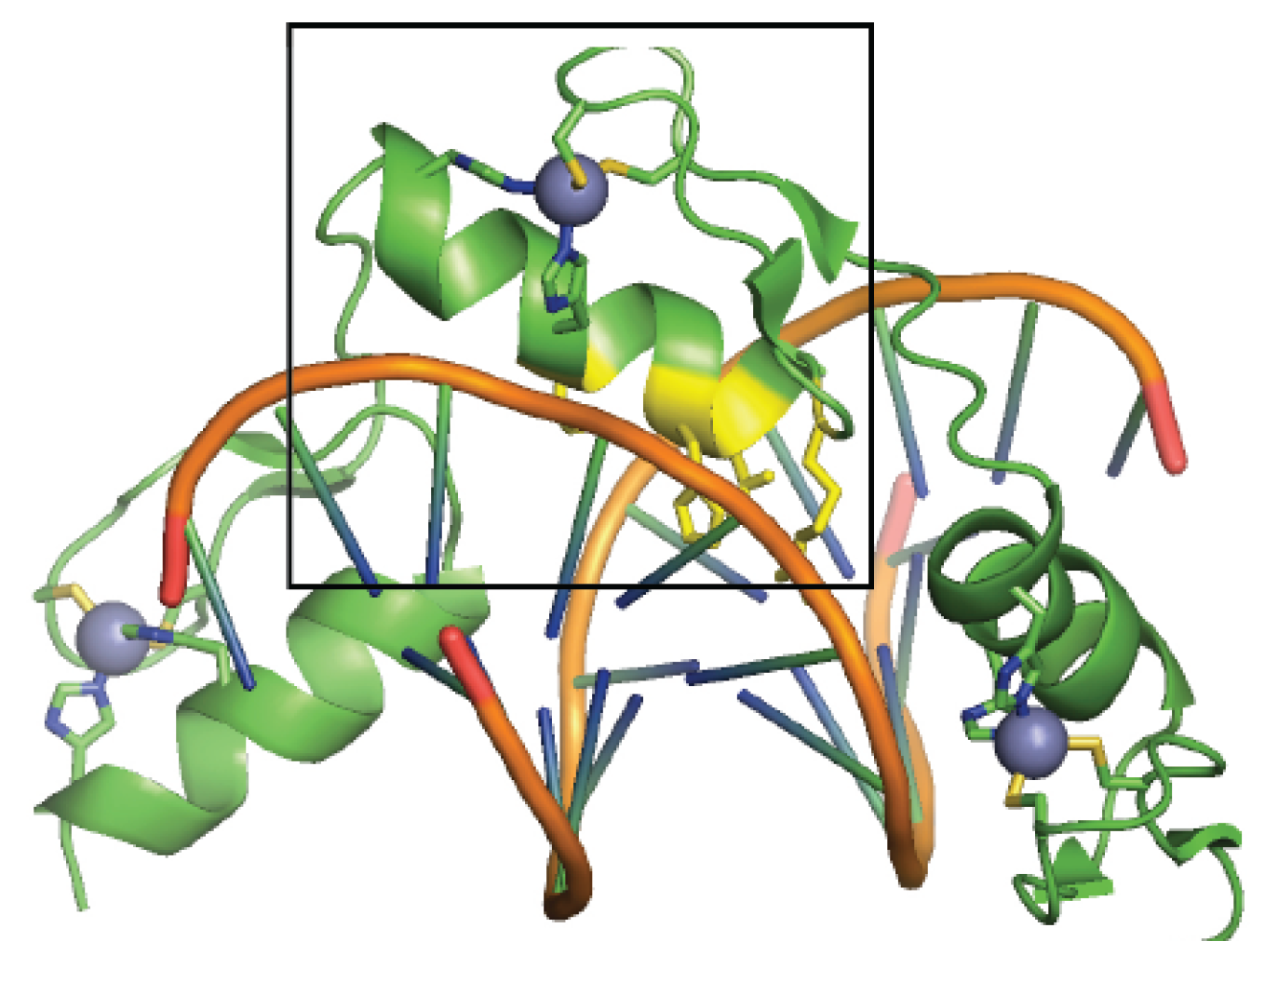
Metals crucial for metabolic activity are also known as essential elements
Iron
Manganese / Copper
Cobalt
Heme B subunit
Zinc
vitamin B12
Mitochondrial SOD cofactors
zinc finger motif

Slide 11
Heavy metals have value as “precious metals”

Slide 12
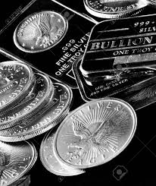
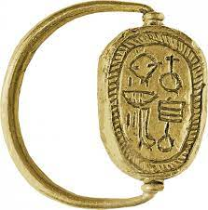
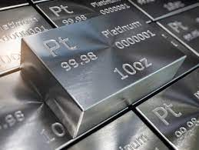
Precious metals have economic and cultural value
Silver: $21 / oz
Ag
Gold: $1,858 / oz
Au
Platinum: $979 / oz
Pt

Slide 13
Many heavy metals play a role in manufacturing

Slide 14
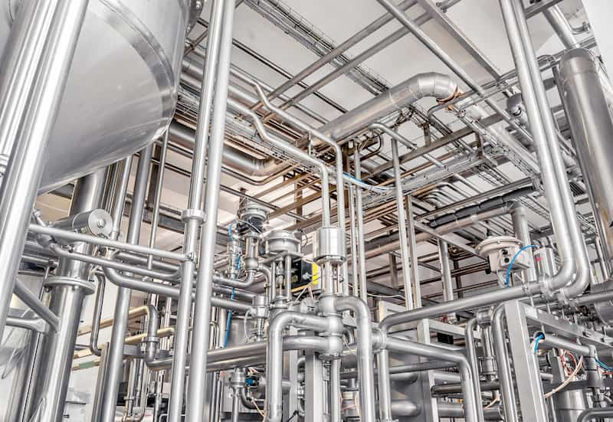
Heavy metals are used to manufacture common materials
Dyes and Pigments
Prussian Blue
Pb
Fe
Co
As
Ni
Cu
Zn
Fe
Cr
Ni
Stainless Steel

Slide 15
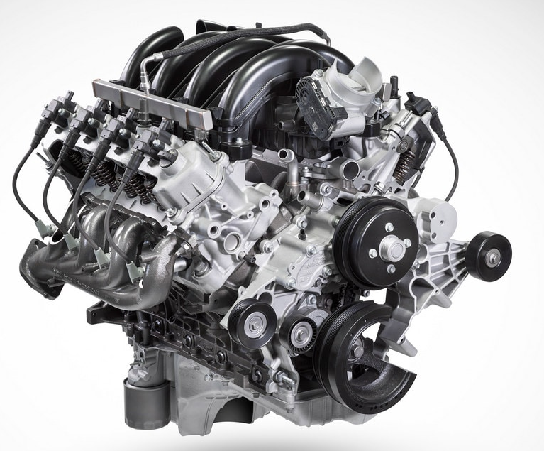
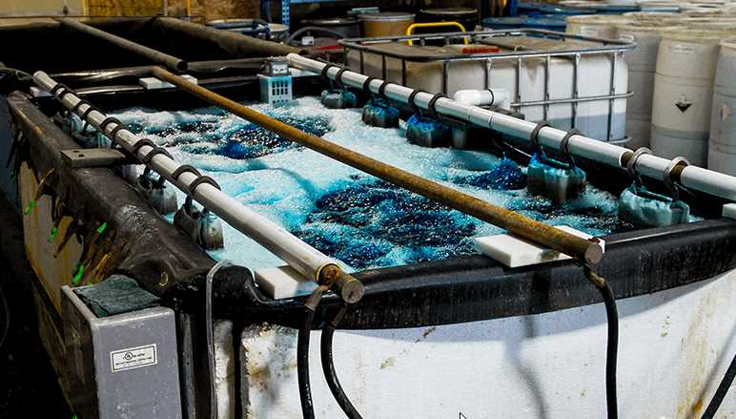
Heavy metals are frequently used in coating and electroplating for everything from automotive to aerospace machinery
Chrome plating
Zn
Ni
Cu
Au
Pt
Cd
Mn
Ag
Cr

Slide 16
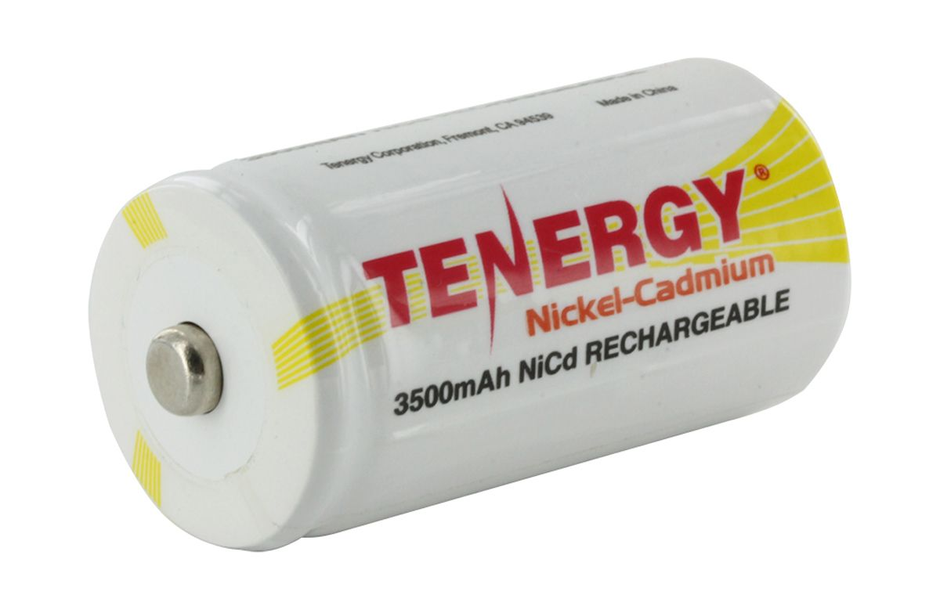
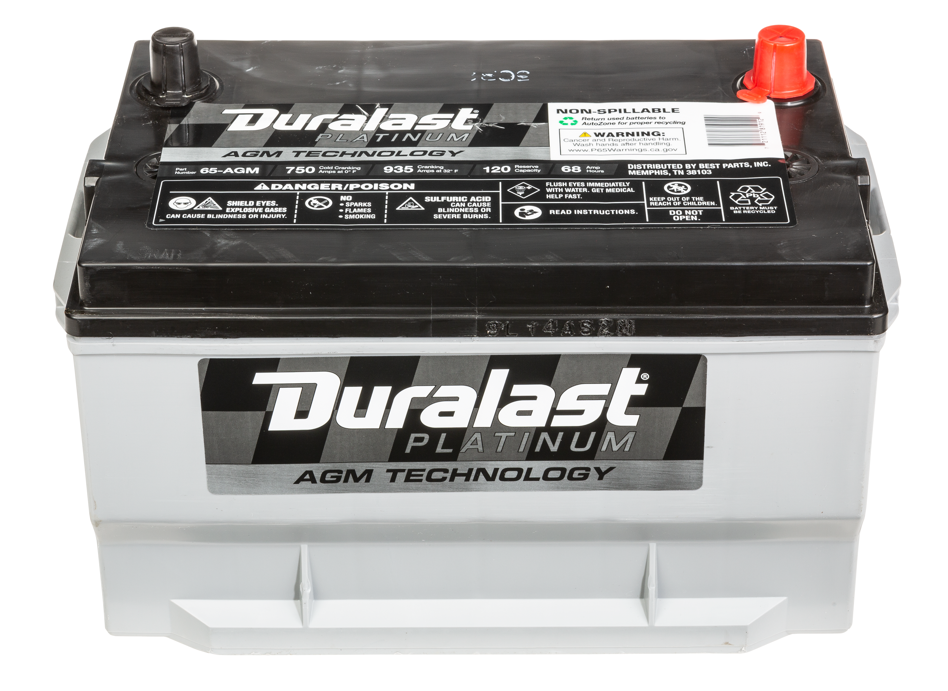
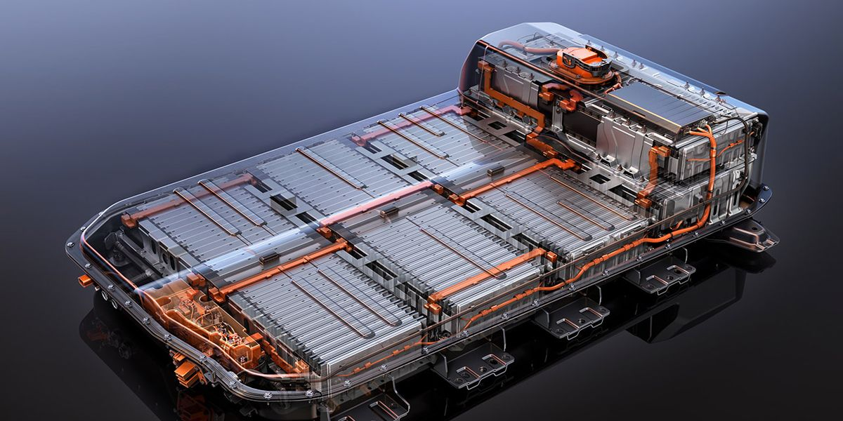
Batteries utilize heavy metals
Alkaline batteries
Cd
Ni
Mn
Zn
Lead-Acid battery
Pt
Au
Pb
EV Battery
Cu
Ni
Mn
Co

Slide 17
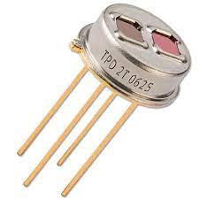
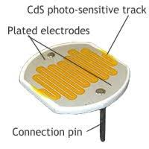
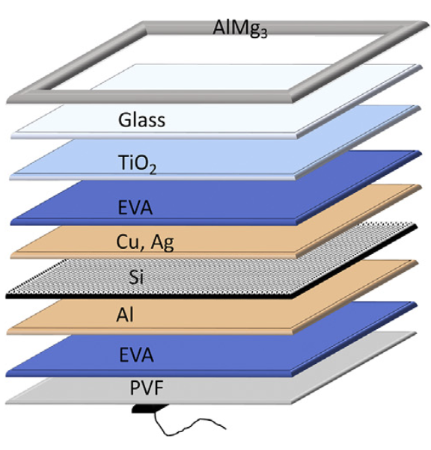
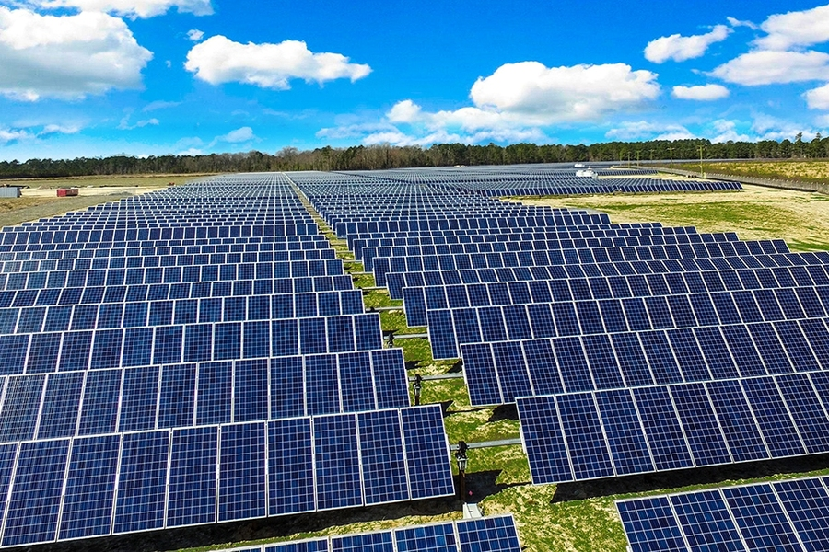
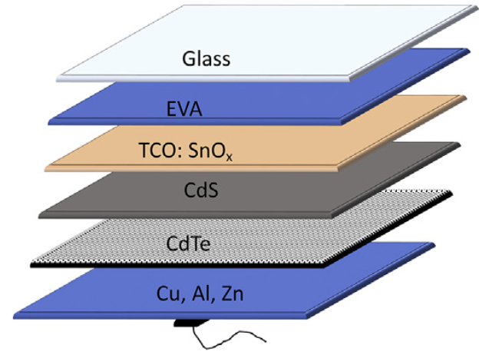
Photovoltaic cells, photoresistors, infrared detectors all use heavy metals
Infrared detectors & Photoresistors
Cd
Pb
Cu
Hg
Solar photovoltaic cells
crystalline-Silicon
Cu
Cadmium-Telluride
Cd
Ag
Zn
Pt

Slide 18
Some heavy metals are highly toxic at low exposure levels

Slide 19
Environmental contamination and its consequences

Slide 20
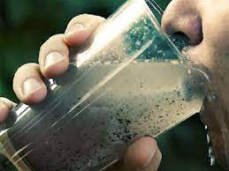
There are 2 main routes of heavy metal release into the environment
Geogenic sources
Anthropogenic sources
Weathering of rocks
Agrochemicals
Industrial activity
Volcanoes
Smelting and mining activity
Sewage and waste disposal

Slide 21
Hou et al. 2021

Slide 22
Agrochemicals release heavy metals into the soil
Fertilizers
Sewage sludge fertilizer contains heavy metals
Fly ash from coal plants
Inorganic phosphate-based fertilizers increase cadmium in the soil
Some disagreement if the fertilizers release cadmium or increase bioavailability
Pesticides and fungicides
Can contain heavy metals as contaminants

Slide 23
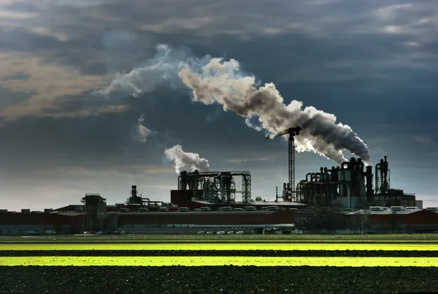
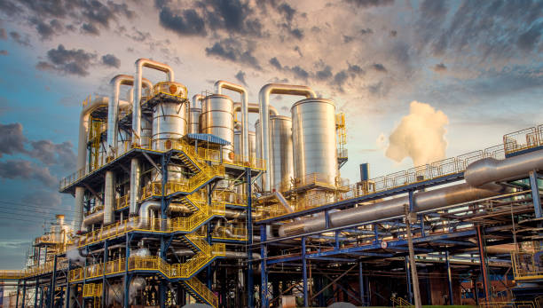
Industrial activity contributes to heavy metal contamination
Coal-fired power stations release:
Cu, Zn, Cd, Ni
Chemical processing which involves heavy metals is required to produce common goods
Plastics
textiles
electronics
wood preservatives
automotive components
The waste generated in manufacturing can leach into the environment

Slide 24
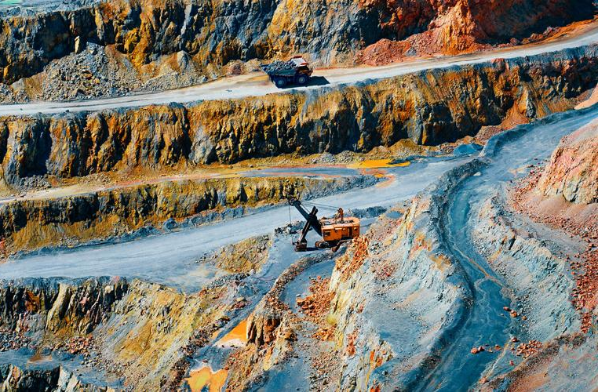
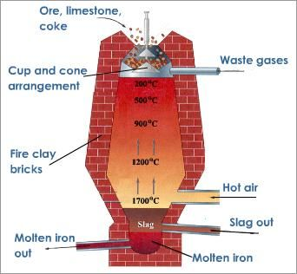
Smelting and mining activity produce metal contaminants
Mining
Disruption of sedimentary layers can release embedded heavy metals
Waste runoff from mining sites contaminates water
Blast Furnace
Smelting
Slag generated from refinement of metal can contain contaminants
Smelting zinc produces slag containing lead and cadmium
Heavy metal particulates are also released

Slide 25
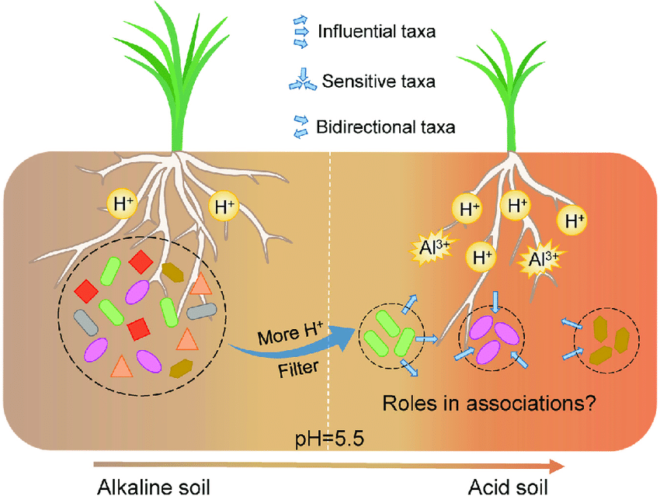
Heavy metals fundamentally change soil microbial richness
Decrease in soil viability
lower microbial biomass
less biodiversity
Reduced nitrogen fixing
Reduced microbial metabolism
reduced essential enzyme activities
reduced litter breakdown
Altered microbial communication
Changes in soil ecosystem
Zhang et al. 2022

Slide 26
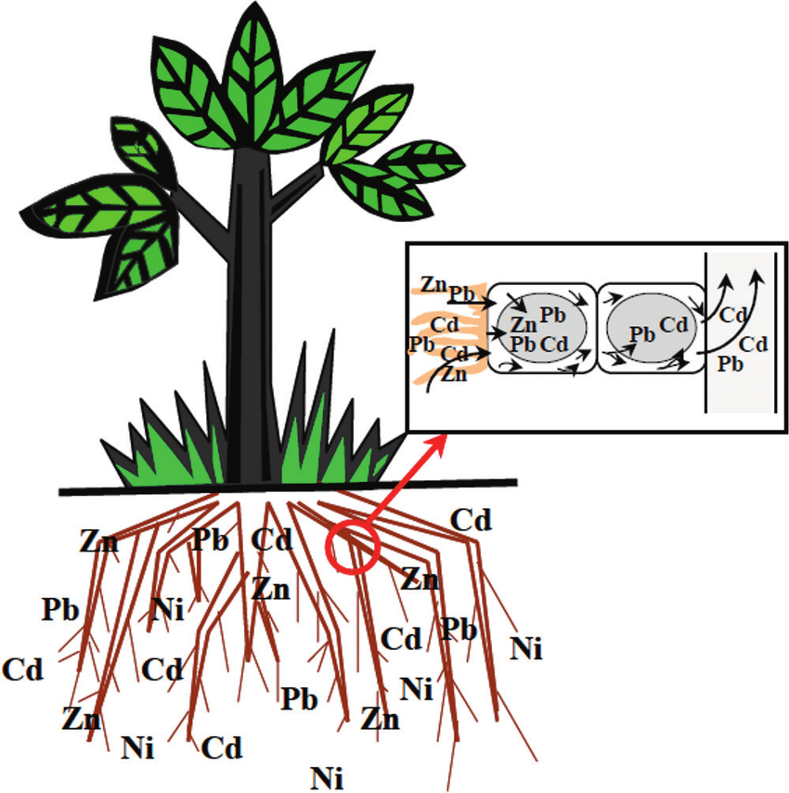
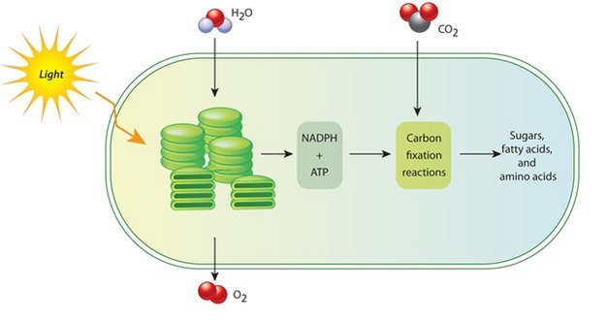
Heavy metal accumulates in plants and disrupts essential biology
Most heavy metal enters the plant through the roots and accumulates there
General stress response
obstruct chloroplast structure
disrupt electron transport
Oxidative stress
Generate reactive oxygen species
Lipid peroxidation
DNA damage and chromosome abnormalities
Adiloglu, 2018

Slide 27
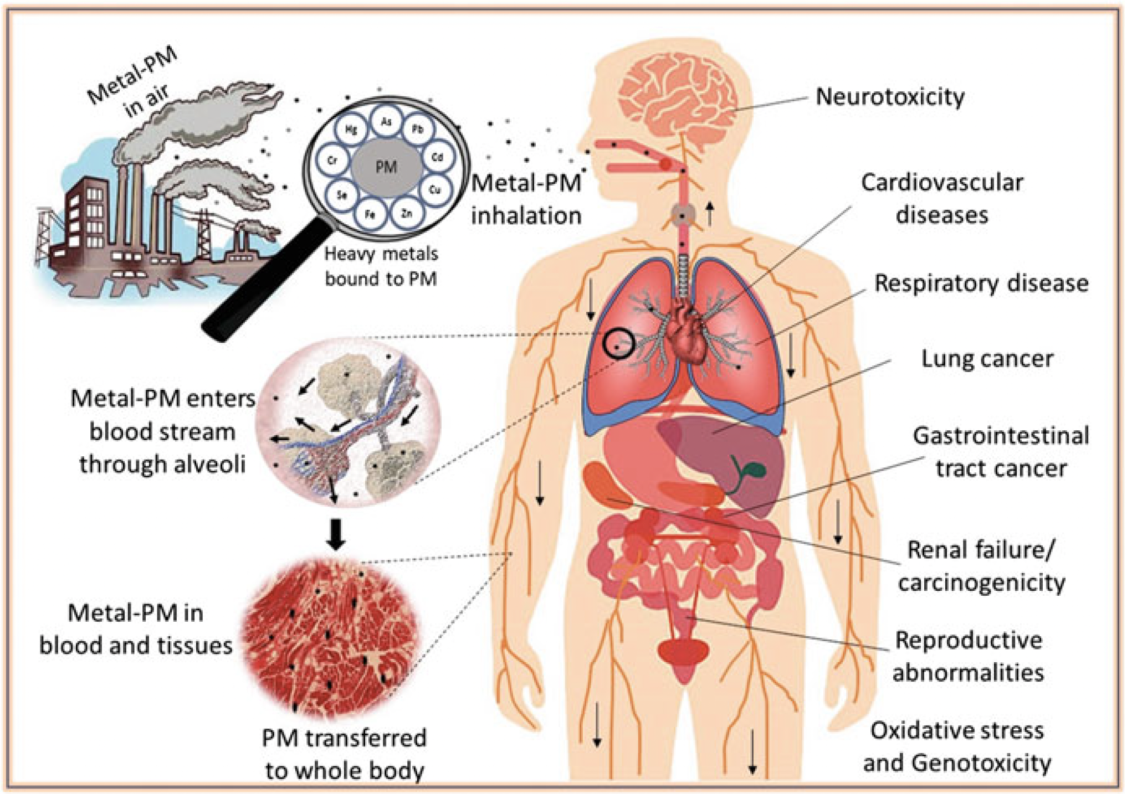
Heavy metal exposure has wide ranging effects on human health
Routes of exposure
Inhalation
Ingestion
Dermal
Health effects
Systemic toxicity
Damage of multiple organs
Reviews of Environmental Contamination and Toxicology. Volume 253

Slide 28
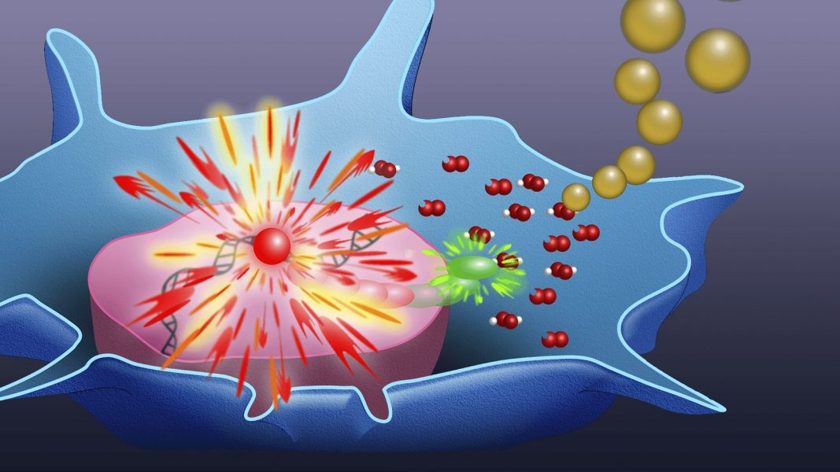
There are multiple proposed mechanisms for metal toxicity
Protein disruption
Inhibit enzymes through thiol, sulfhydryl, amide group binding
Broad enzyme inhibition
Inhibits enzymes involved in DNA damage repair
Many heavy metals are known or putative carcinogens
Replace essential metal cations and cofactors
Oxidative stress
Disrupt mitochondrial function
Generate reactive oxygen species

Slide 29
What can we do to mitigate this issue?

Slide 30
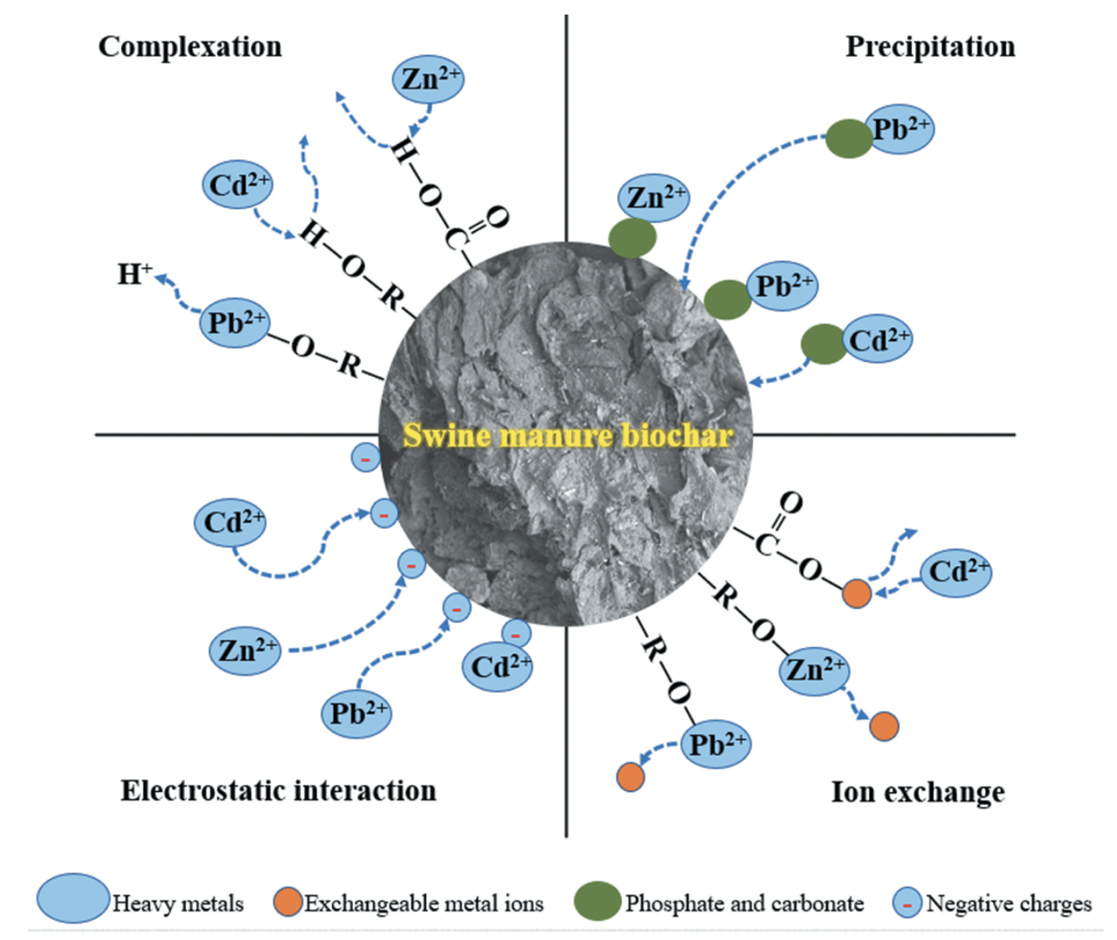
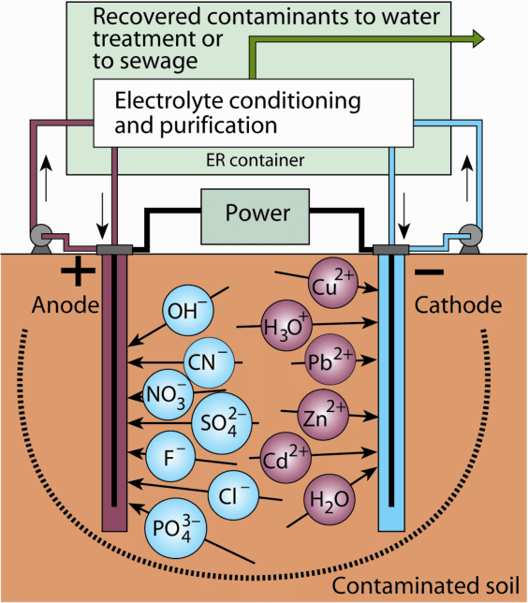
Physical and chemical mitigation of heavy metal contamination
Soil Amendment with Biochar
Electrokinetic remediation
Soil excavation / soil washing
Chemical precipitation from wastewater

Slide 31
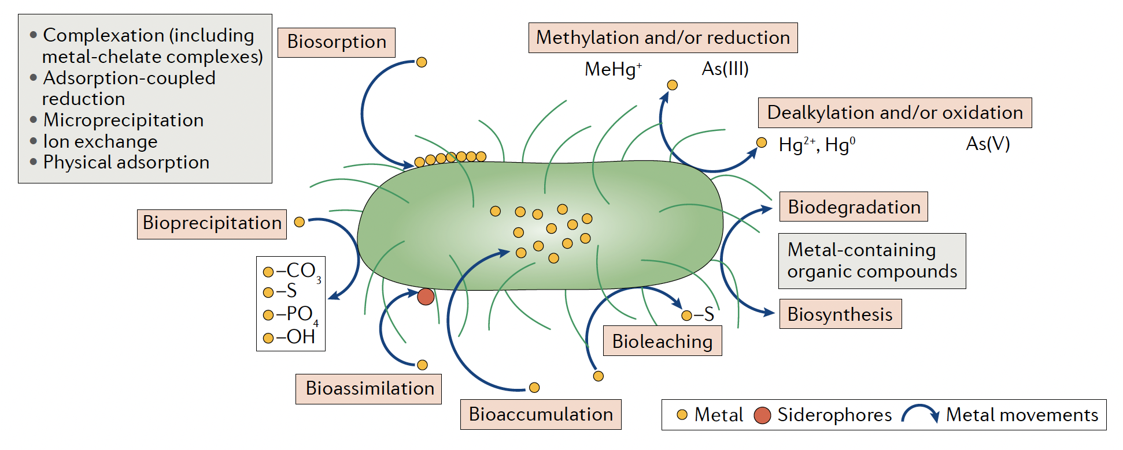
Bioremediation is a useful tool to mitigate heavy metal contamination
Bacteria, yeast, and plants have natural defenses against heavy metal damage
These defenses can be engineered to create effective remediation models for pollutants

Slide 32
How does this all relate to your Mod2 project?
Begin the early stages of the process to create bioremediation model
Alter a Saccharomyces cerevisiae cell surface protein
Fet4
Low-affinity iron permease reported to take up other metals
Use rational design protein engineering to create a mutant form of Fet4
Reduce preference of Fet4 for iron and identify mutations that increase preference for cadmium
Explore mutagenesis and functional screening

Slide 33
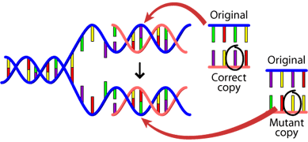
In lab today and tomorrow
Examine secondary and tertiary structure of Fet4 and previous literature to determine mutations that have the potential to alter affinity of the transporter from iron to cadmium
Design mutagenesis primers to create your designed mutation

