Slide 1
1
Module 3 overview
lecture lab
1. Introduction to the module 1. Examine protein structure
2. Rational protein design 2. Identify mutants
3. Binding behavior 3. Analyze protein data
4. Fluorescence and sensors 4. Design new mutants
5. High throughput screening 5. Write mini-report

Slide 2
2
Lecture 1: Introduction to the module
I. Engineering proteins
A. Proteins as machines
B. Pericam as a machine for monitoring signaling
II. Importance of calcium sensing
A. Signaling in cells
B. Applications of calcium imaging
III. Overview of the lab

Slide 3
proteins are machines!
3
https://www.youtube.com/watch?v=cfqCkOziWfc
https://www.youtube.com/watch?v=_GPDsQnnvrA
Viel, Lue et al. (2013) BioVisions at Harvard University

Slide 4
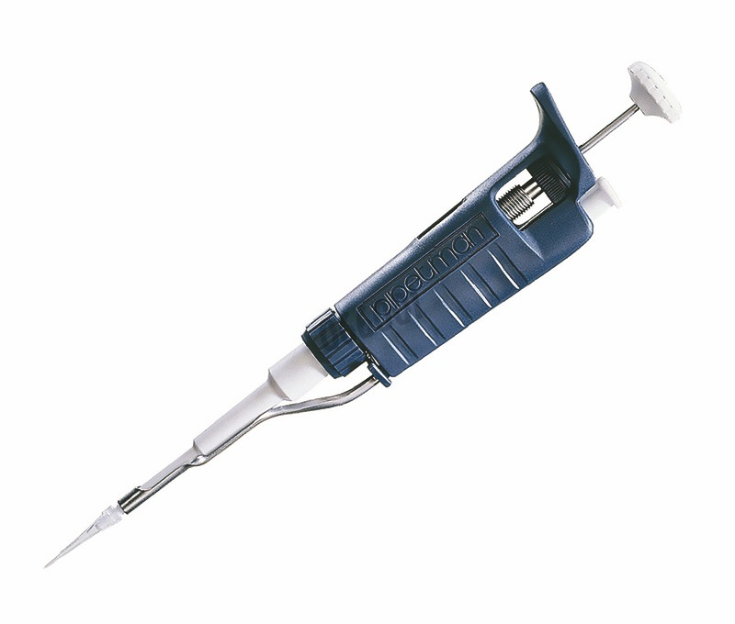
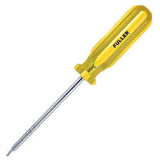
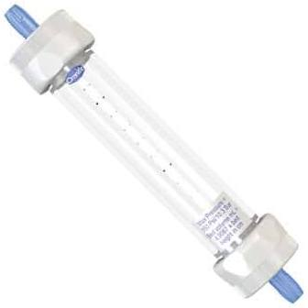
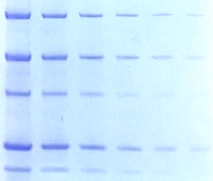
we can use engineering tools
to manipulate proteins
4

Slide 5
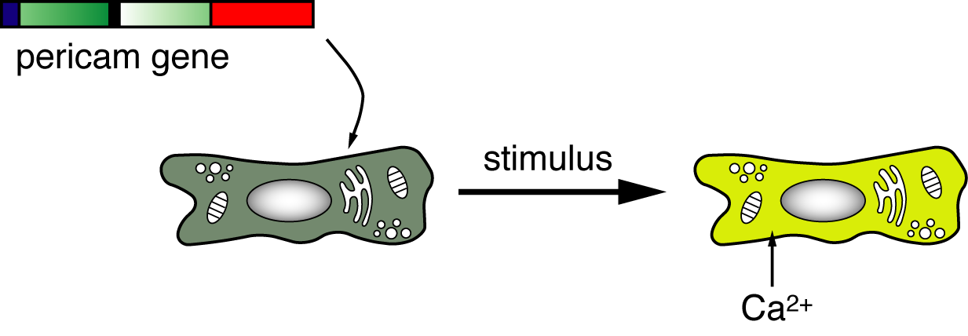
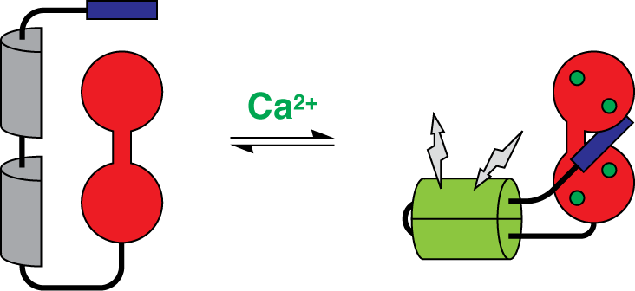
5
pericam: a protein-based machine for measuring [Ca²⁺]
calmodulin (CaM)
M13 peptide
green fluorescent protein (GFP)
Nagai et al. (2001) Proc. Natl. Acad. Sci. USA 98: 3197-202

Slide 6
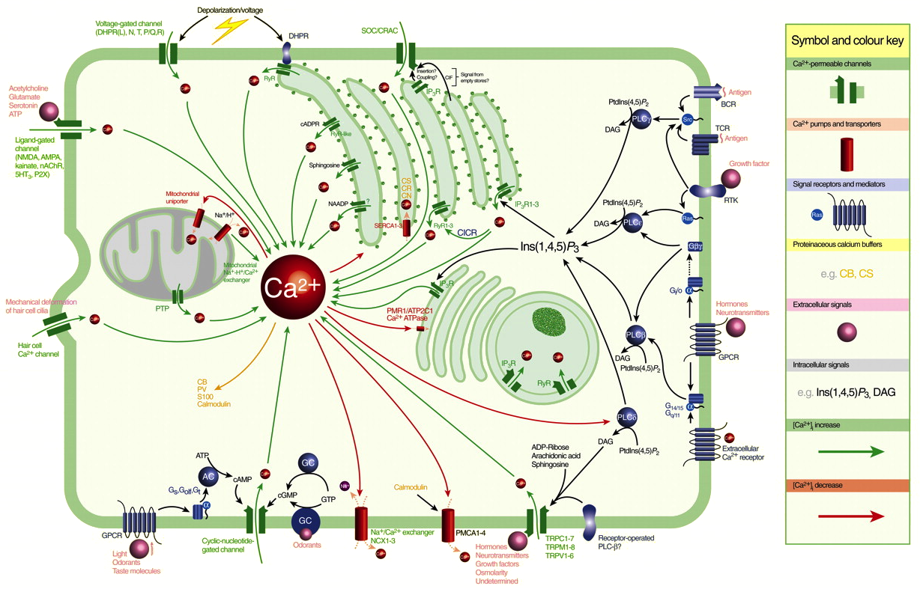
6
calcium ions are a nexus of numerous cell signaling processes
Nowycky et al. (2002) J. Cell. Sci. 115: 3715-3716

Slide 7
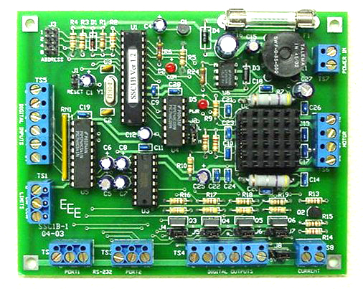
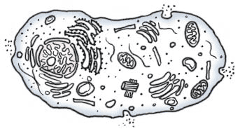
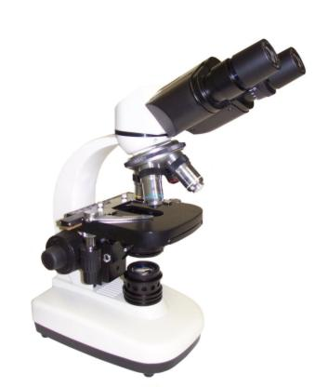
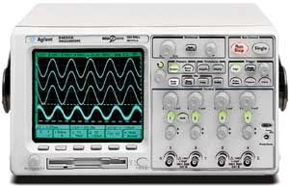
7
Ca²⁺ sensors are engineering tools as well as products of engineering

Slide 8
8
intracellular calcium imaging for analyzing signaling pathways
here, cellular-level calcium signaling reflects drug action;
useful for drug development and screening
Chang et al. (2017) https://doi.org/10.1371/journal.pone.0174181

Slide 9
calcium imaging also reveals intercellular communication, e.g. in the brain
Ahrens et al. (2012) Nature

Slide 10
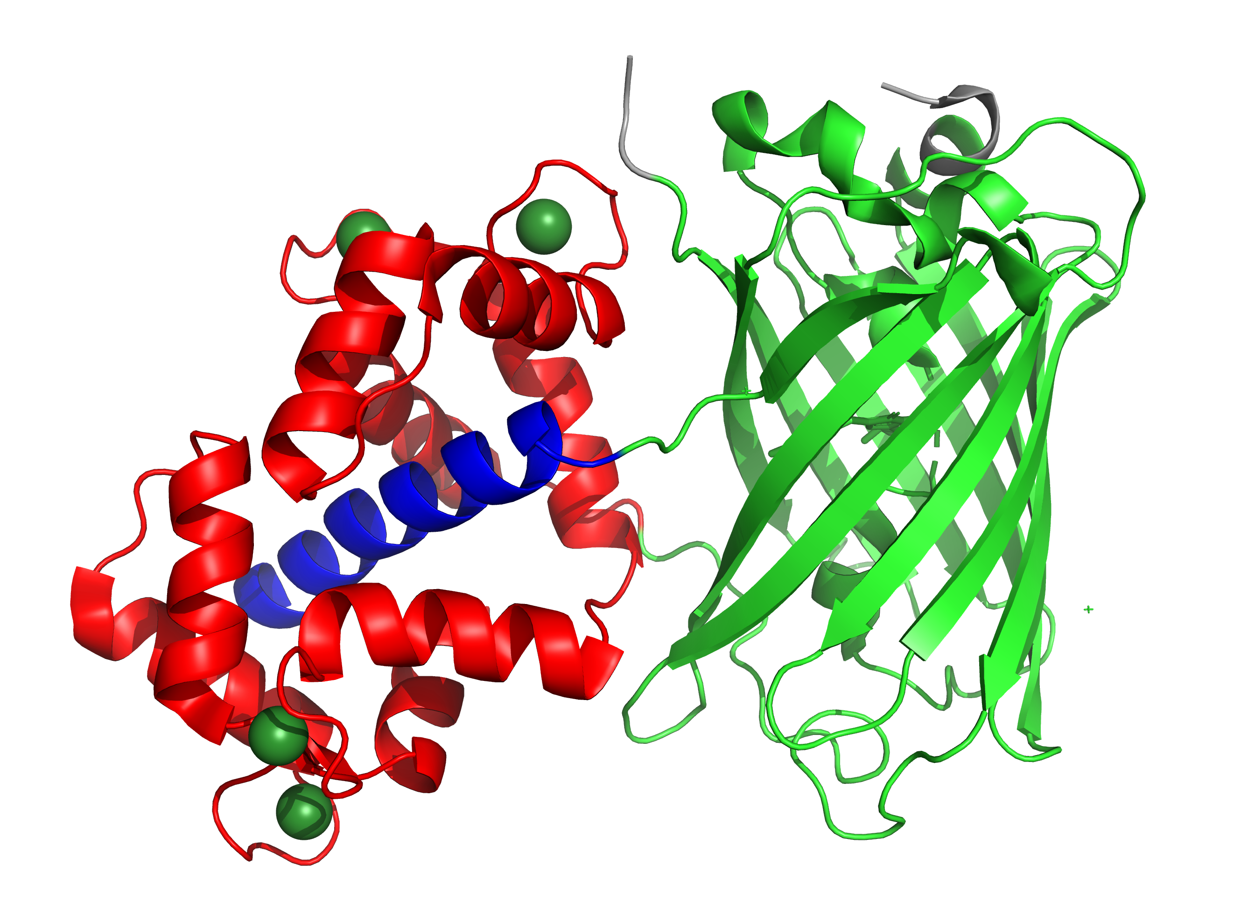
10
pericam architecture: M13, GFP, CaM
Wang et al. (2008) Structure 16: 1817-27

Slide 11
11
Why is this jellyfish glowing?
https://www.youtube.com/watch?v=Zymi47FQSGo

Slide 12
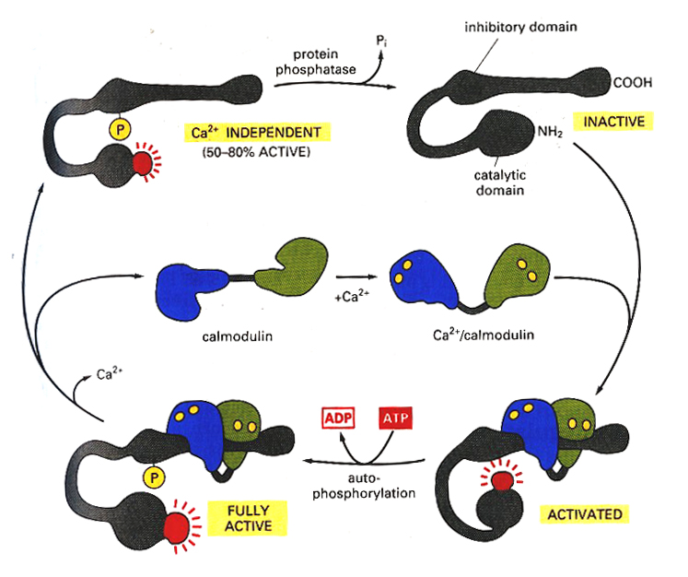
CaM is a calcium-dependent
enzyme activator
12
Alberts et al. (1994) Molecular Biology of the Cell, 3rd Ed.

Slide 13
CaM binds calcium ions using the EF hand motif
13
EF hand is a helix-loop-helix structure with a Ca²⁺-binding site in the loop
CaM contains four EF hand motifs
Branden & Tooze (1999) Introduction to Protein Structure, 2nd Ed.

Slide 15
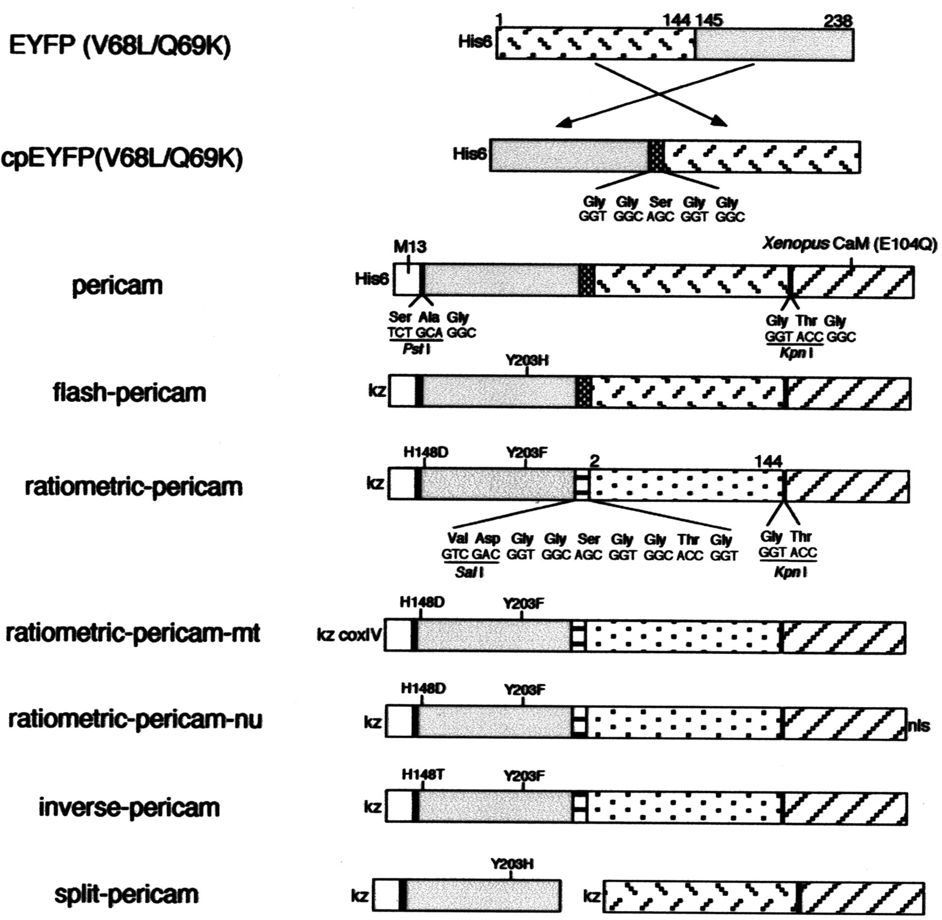
15
pericam mutations can alter spectral properties, binding properties,
and localization properties
parent construct
dynamic range
ratiometric ΔF
mitoch. localization
nuclear localization
inverse ΔF
fun
Nagai et al. (2001) Proc. Natl. Acad. Sci. USA 98: 3197-202

Slide 16
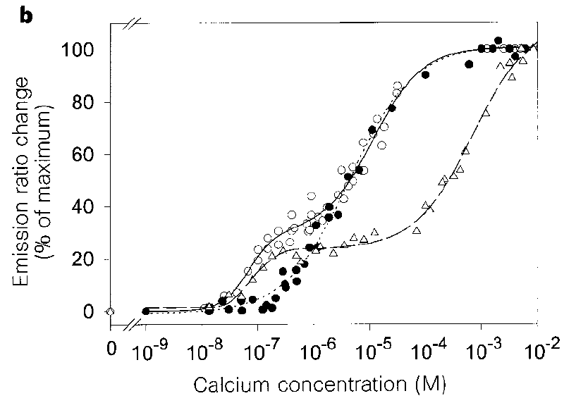
16
mutations can also affect calcium sensitivity;
both affinity and slope/shape of transition can be affected
Miyawaki et al. (1997)
Nature 388: 882-7
E31Q
WT CaM
E104Q
In this module, our goal will be to influence the calcium binding of “inverse pericam” through rational protein engineering

Slide 17
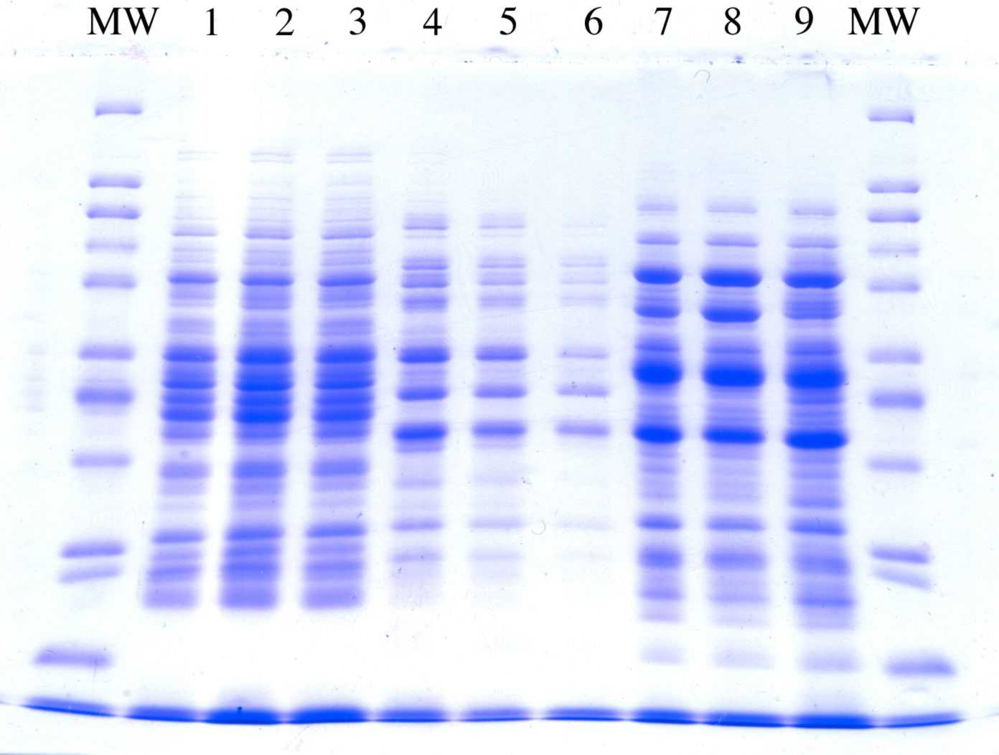
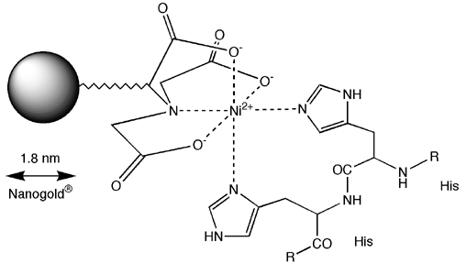
17
Step 1: Mock express and purify inverse pericams for analysis
Skills:
• Analyze sequence files and identify mutations
• Review expression and purification approaches
• Evaluate purified IPC

Slide 18
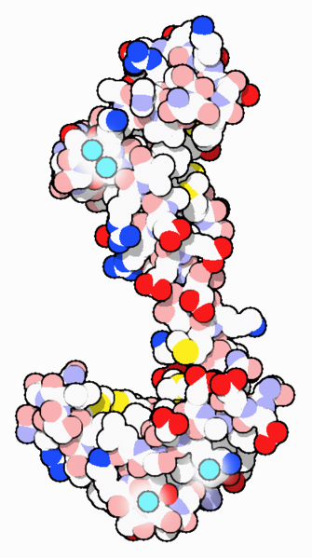
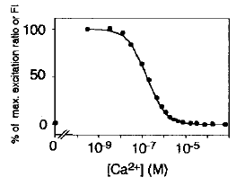
18
Step 2: Analyze calcium titration behavior of mutant pericams
Skills:
• Prepare titration experiment
• Use software to extract binding parameters from the data
• Pool data from others to observe patterns
* * * * * * *
MADQLTEEQIAEFKEAFSLFDKDGDGTITTKELGTVMRSLGQNPTEAELQDMINEVDAD
* * * *** * * * *
GNGTIDFPEFLTMMARKMKDTDSEEEIREAFRVFDKDGNGYISAAELRHVMTNLGEKLT
* ** * * *
DEEVDEMIREADIDGDGQVNYEEFVQMMTAK

Slide 19
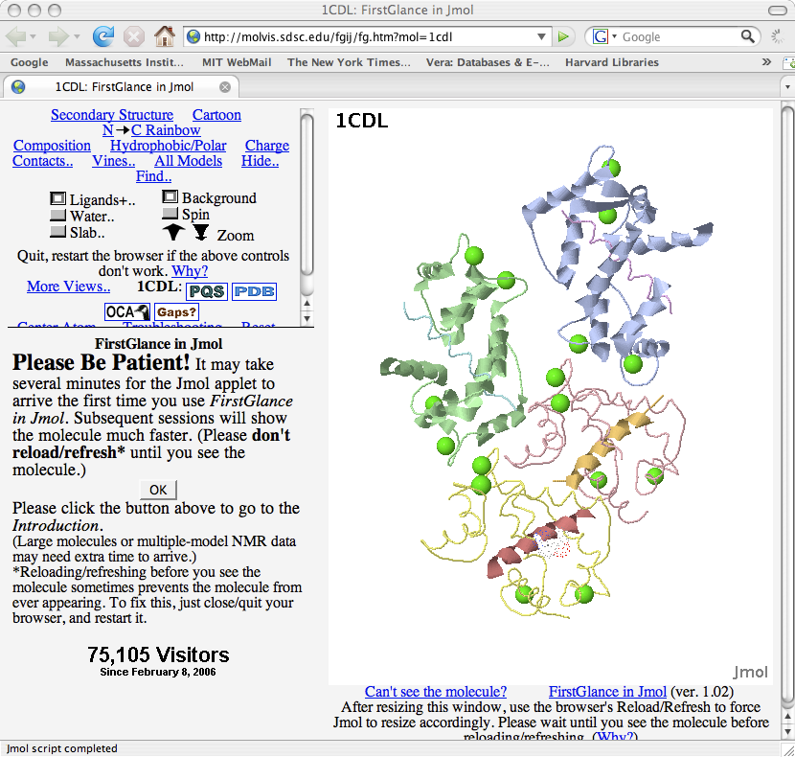
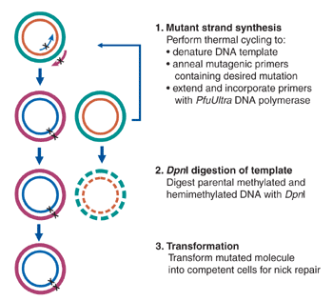
19
Step 3: Design and implement new mutations to affect inverse pericam’s calcium sensitivity.
Skills:
• Consider effects of previously designed mutants
• Design primers to make site mutations in the pericam gene
• Anticipate performing mutagenesis using PCR

