Slide 1
1
Module 3 overview
lecture lab
1. Introduction to the module 1. Examine protein structure
2. Rational protein design 2. Identify mutants
3. Binding behavior 3. Analyze protein data
4. Fluorescence and sensors 4. Design new mutants
5. High throughput screening 5. Write mini-report

Slide 2
2
Lecture 2: Rational protein design
I. Structure-based design
A. Protein structures
B. Using structural data
II. Computational structure prediction
A. Energy-based methods
B. Database-driven methods

Slide 3
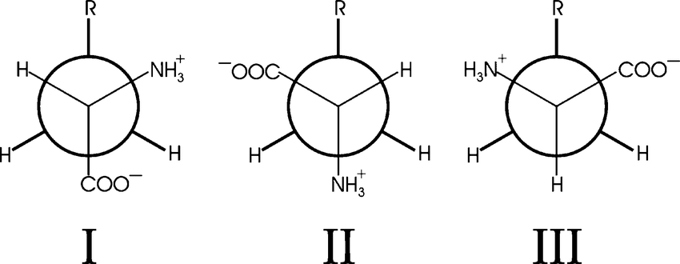
3
Why can’t we just design molecules computationally?
consider a small protein of 100 residues:
~200 backbone dihedral angles (3 positions each)
>100 sidechain dihedrals
also, slight variability in angles, bond lengths, etc.
counting dihedrals
only gives 3³⁰⁰
conformations
= 10¹⁴³ total!
Newman projections:
looking along each bond
https://www.researchgate.net
Levinthal Paradox: Searching all possible conformations would take longer than the age of the universe, yet proteins generally find their native state within milliseconds.
let’s see: 5 billion years = 1.6 x 10¹⁷ seconds / 10¹⁴³ = 10⁻¹²⁶ s
fastest computers are in the GHz range, not quite up to the task…
protein structural data is therefore critical for design

Slide 4
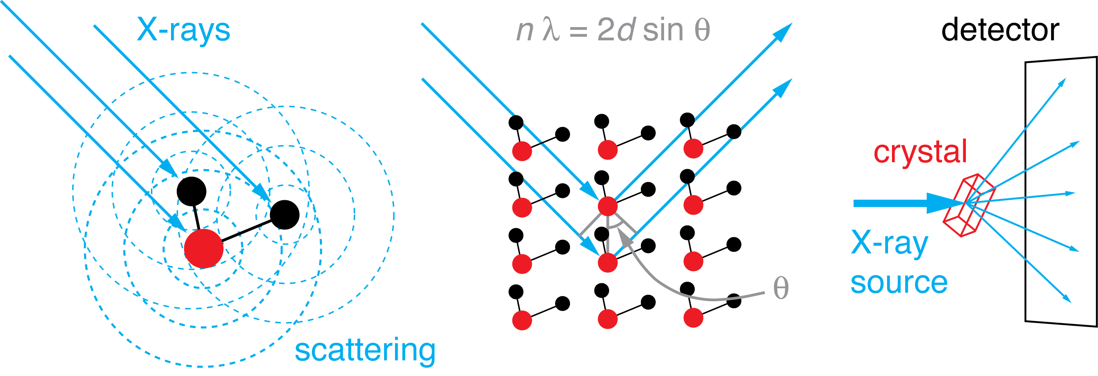
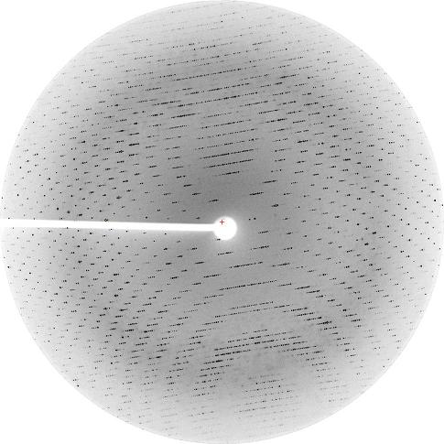
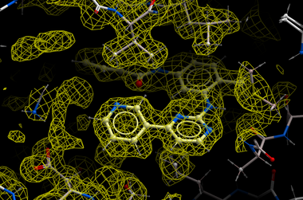
4
protein structures are usually determined by X-ray crystallography and nuclear magnetic resonance spectroscopy
http://chemwiki.ucdavis.edu
http://www.molsoft.com/gui/icm35_small.png

Slide 5
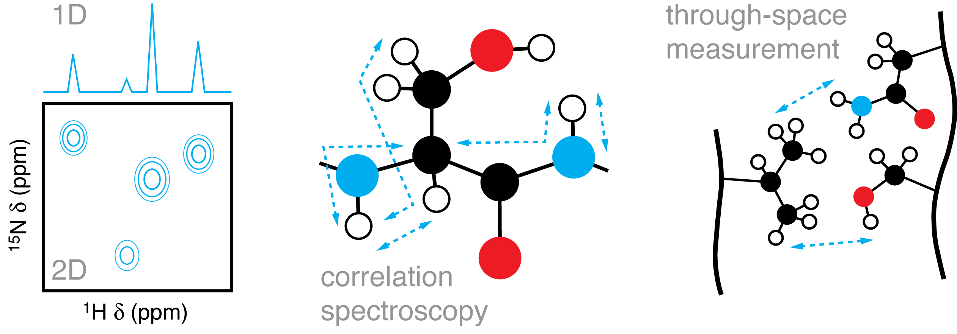
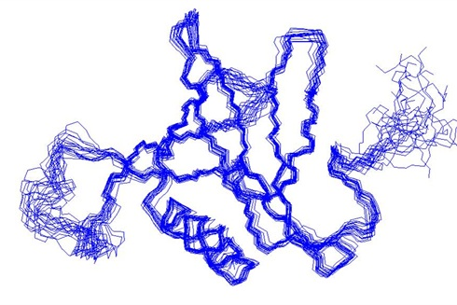
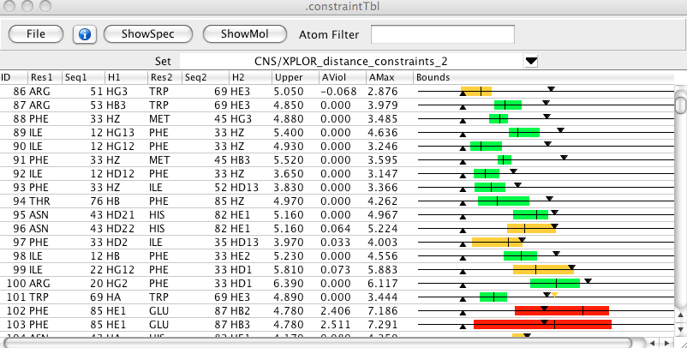
5
protein structures are usually determined by X-ray crystallography and nuclear magnetic resonance spectroscopy
http://www.onemoonscientific.com/nvjChunks/ch16s02.html
http://medicine.yale.edu/pharm/images/gallery188_77739SB5.jpg

Slide 6
6
protein structures can be accessed from the RCSB Protein Data Bank
• deposition required by most journals
• currently over 160,000 structures
http://www.rcsb.org

Slide 7
7
structures can be viewed and downloaded from the PDB
HEADER HISTOCOMPATIBILITY ANTIGEN 15-FEB-94 1DLH TITLE CRYSTAL STRUCTURE OF THE HUMAN CLASS II MHC PROTEIN HLA-DR1 COMPLEXED TITLE 2 WITH AN INFLUENZA VIRUS PEPTIDE COMPND MOL_ID: 1; COMPND 2 MOLECULE: CLASS II HISTOCOMPATIBILITY ANTIGEN (HLA-DR1) (ALPHA COMPND 3 CHAIN); COMPND 4 CHAIN: A, D; COMPND 5 ENGINEERED: YES; COMPND 6 MOL_ID: 2; COMPND 7 MOLECULE: CLASS II HISTOCOMPATIBILITY ANTIGEN (HLA-DR1) (BETA CHAIN); COMPND 8 CHAIN: B, E; COMPND 9 ENGINEERED: YES; COMPND 10 MOL_ID: 3; COMPND 11 MOLECULE: ENTEROTOXIN TYPE B PRECURSOR; COMPND 12 CHAIN: C, F; COMPND 13 ENGINEERED: YES SOURCE MOL_ID: 1; SOURCE 2 ORGANISM_SCIENTIFIC: HOMO SAPIENS; SOURCE 3 ORGANISM_COMMON: HUMAN; SOURCE 4 ORGANISM_TAXID: 9606;
...
ATOM 1 N GLU A 3 19.098 63.939 8.356 1.00 65.17 N ATOM 2 CA GLU A 3 19.182 65.361 8.775 1.00 63.51 C ATOM 3 C GLU A 3 20.437 65.645 9.610 1.00 57.46 C ATOM 4 O GLU A 3 21.376 64.830 9.650 1.00 56.65 O ATOM 5 CB GLU A 3 17.963 65.723 9.636 1.00 65.27 C ATOM 6 CG GLU A 3 17.726 64.695 10.676 1.00 70.69 C ATOM 7 CD GLU A 3 16.627 65.038 11.664 1.00 73.29 C ATOM 8 OE1 GLU A 3 15.483 65.312 11.269 1.00 74.15 O ATOM 9 OE2 GLU A 3 16.942 64.953 12.842 1.00 79.97 O ATOM 10 N GLU A 4 20.419 66.763 10.328 1.00 50.45 N ATOM 11 CA GLU A 4 21.562 67.120 11.132 1.00 49.51 C ATOM 12 C GLU A 4 21.313 67.458 12.588 1.00 43.07 C ATOM 13 O GLU A 4 22.169 67.189 13.445 1.00 46.41 O ATOM 14 CB GLU A 4 22.323 68.269 10.476 1.00 51.47 C ATOM 15 CG GLU A 4 23.588 67.860 9.745 1.00 61.20 C ATOM 16 CD GLU A 4 24.007 68.917 8.771 1.00 66.24 C ATOM 17 OE1 GLU A 4 24.001 70.103 9.183 1.00 68.17 O ATOM 18 OE2 GLU A 4 24.293 68.587 7.581 1.00 70.25 O ATOM 19 N HIS A 5 20.214 68.139 12.857 1.00 32.86 N ATOM 20 CA HIS A 5 19.917 68.535 14.210 1.00 25.97 C ATOM 21 C HIS A 5 18.443 68.716 14.290 1.00 21.73 C ATOM 22 O HIS A 5 17.776 68.988 13.272 1.00 13.21 O ATOM 23 CB HIS A 5 20.544 69.894 14.540 1.00 31.82 C ATOM 24 CG HIS A 5 22.039 69.961 14.340 1.00 34.38 C ATOM 25 ND1 HIS A 5 22.946 69.677 15.344 1.00 35.60 N ATOM 26 CD2 HIS A 5 22.779 70.275 13.249 1.00 34.30 C ATOM 27 CE1 HIS A 5 24.176 69.800 14.882 1.00 31.82 C ATOM 28 NE2 HIS A 5 24.103 70.161 13.612 1.00 34.75 N

Slide 8
8
let’s consider the CaM-M13 structure in particular…
we will look at Ca²⁺ binding sites
we should also look at the CaM/M13
interface … why?
CaM + M13
CaM-M13 hybrid
CaM
responds to lower [Ca²⁺]
Branden & Tooze (1999) Introduction to Protein Structure, 2nd Ed.
Porumb et al. (1994) Protein Eng. 7: 109-15.

Slide 10
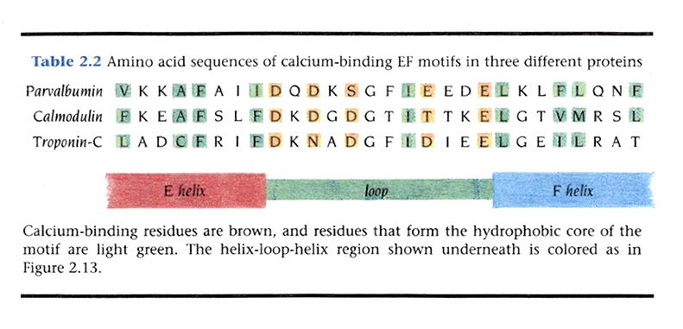
10
molecular homology: a useful information source
What are the implications of homology for designing mutations?
Branden & Tooze (1999) Introduction to Protein Structure, 2nd Ed.

Slide 11
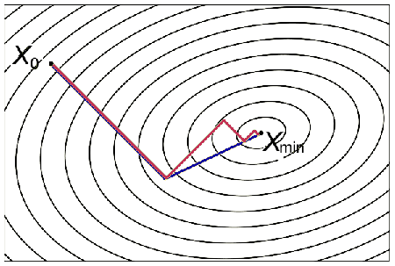
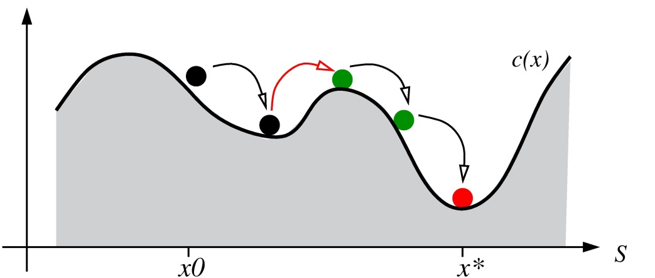
computational methods traditionally useful as an adjunct to structural data
11
(1) estimating protein structures and stabilities following alterations
(2) predicting structural motifs and even whole structures de novo
traditional approach uses energy functions to model protein behavior
E_{tot} = E_{bond} + E_{angl} + E_{dihe} + E_{impr} + E_{VDW} + E_{elec} + E_{Hbond} + ...
use the energy function in two ways:
1. conjugate gradient minimization
deterministic, finds nearest minimum
2. molecular dynamics
stochastic, overcomes barriers
2013 Nobel Prize in Chemistry
Karplus, Levitt, and Warshel

Slide 12
12
MD example: simulation of anthrax toxin dissociating from its receptor
~6 ns simulation
www.ks.uiuc.edu/Gallery/Movies/
key challenges for molecular dynamics:
1. computational requirements, especially for large molecules
2. need to account for solvent
3. danger of being trapped in energy wells (simulated annealing helps override)
start simulation at high temperature,
then gradually reduce
Net result: molecular dynamics doesn’t work well for ab initio protein structure...
alternative is to use structural information to make predictions

Slide 13
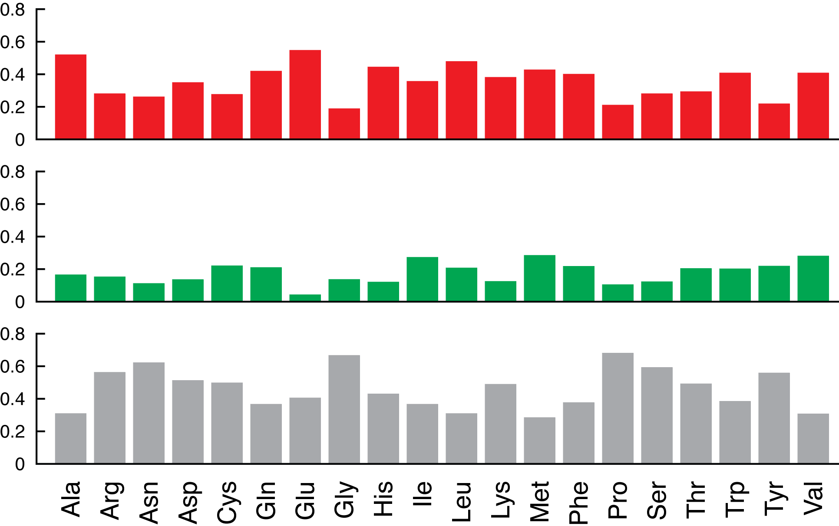
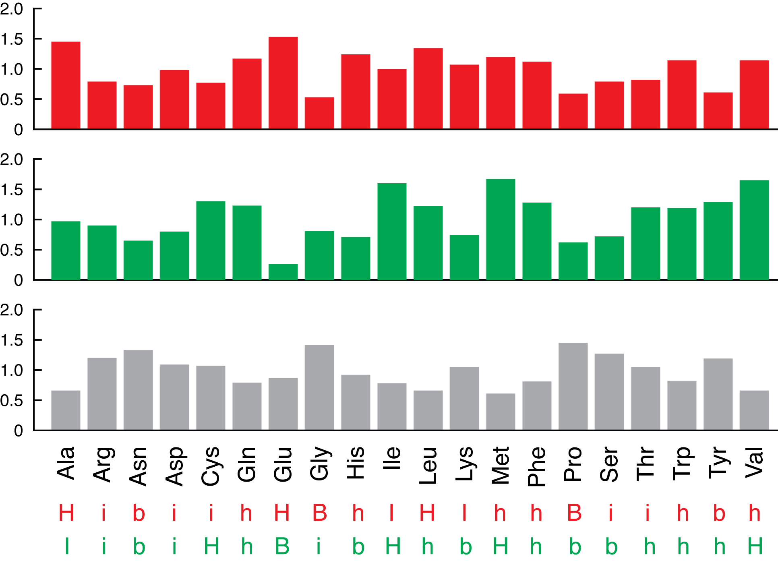
13
Simplest example: secondary structure prediction
structural “potentials” P_{α}, P_{β}, etc.
alpha
beta
conformational frequency
normalized conf. frequency
coil
structural propensities: H > h > I > i > b > B
Chou & Fasman (1974) Biochemistry
Notes:
structural propensities (high to low):
H, h, I, i, B, b

Slide 14
14
Example: Search for helical regions
1. Locate clusters containing 2/3 h or H residues.
2. Extend helical segment in both directions until terminated by tetrapeptides with <P_{α}> < 1.0; breakers are b₄, b₃i, b₃h, b₂i₂, b₂h₂, bi₃, bi₂h, bih₂, and i₄.
3. Pro cannot occur in the inner helix or at the C-terminal end.
4. Pro, Asp, and Glu prefer the N-terminal end, and His, Lys, and Arg prefer the C-terminal end; these residues score better if necessary at helical ends.
Helical regions selected as any segment of six residues or longer with <P_{α}> ≥ 1.03 as well as <P_{α}> > <P_{β}>, and satisfying 1-4 above.
MADQLTEEQIAEFKEAFSLFDKDGDGT
MADQLTEEQIAEFKEAFSLFDKDGDGT
hHihHiHHhIHHhIHHhiHhiIiBiBi
Analogous procedure for finding beta regions...

Slide 15
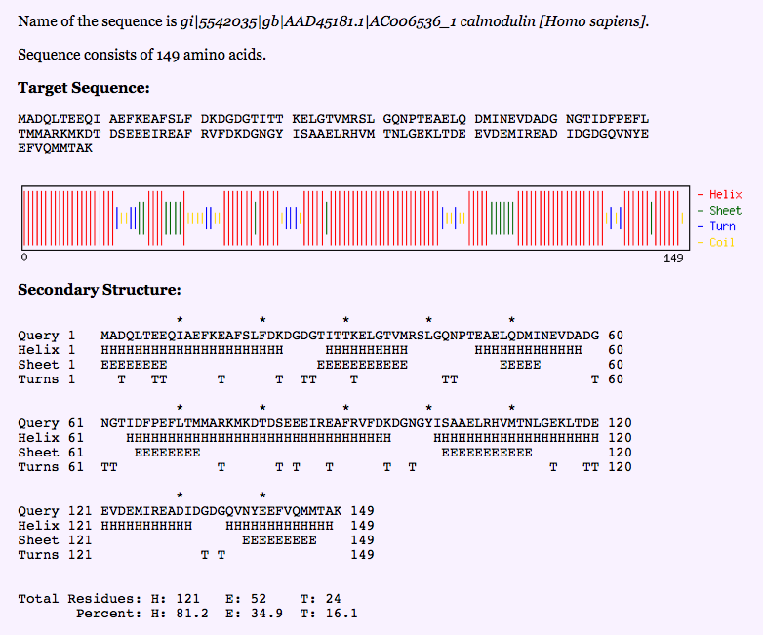
http://www.biogem.org/tool/chou-fasman/
15
What are limitations of the Chou-Fasman method and how could one improve on it?

Slide 16
16
a hybrid approach uses fake “energies” derived from empirical structural preferences (e.g. Rosetta)
entropy, solvation
treated implicitly
if E_{new} < E_{orig}, accept
if E_{new} ≥ E_{orig}, accept with
P = exp{(E_{new} – E_{orig})/T}
to compute the energy score: van der Waals, H-bonding, electrostatics, disulfides, solvation, torsion/rotation, and reference (unfolded) E values are calculated from statistics of real protein structures
Leman et al. (2020) Nat. Methods 17: 665-80

Slide 17
17
a recent breakthrough uses artificial intelligence (Google AlphaFold)
AI predicts distance matrices for protein sequences, Rosetta refines structures
observed
equivalent to
experiment
predicted
protein structure prediction
contest (CAST)
distance
matrices
Does this resolve the
Levinthal Paradox?
Senior (2020) Nature 577: 706-10
Callaway (2020) Nature 588: 203-4

