Slide 1
Research Paper structure and writing process 20.109 Workshop
Sean Clarke
Diana Chien
Helping you communicate effectively.
be.mit.edu/communicationlab
Notes:
You already know a lot of the mechanics of writing individual paper components: Abstracts, Methods, Figures.
Here we’ll talk more about crafting overall structure, how the different parts should fit together.
Provide you with some different models for conceptualizing how parts fit together.
Also concrete recommendations on what to do/what not to do.

Slide 2
So you want to write a paper…
What goes where?
When do you write what?
How does a successful paper work?

Slide 3
There are no explicit models for successful papers.
When you read a paper or sentence you like, collect it!
Analyze what makes it especially clear & compelling.
Try using their techniques.

Slide 4
Revising is essential
Do not try to write this paper in one day.
Draft the sections in order, then set aside the paper for several days.
If you get stuck: outline, write topic sentences, work on the next section, look at examples
Get feedback:
peers, instructors, Comm Lab Fellows! be.mit.edu/communicationlab

Slide 5
Papers are often thought of as linear…
…yet are both read and written
nonlinearly.
http://dbis.rwth-aachen.de/~derntl/papers/misc/
Notes:
Showed this slide to you during Abstract workshop

Slide 6
Papers are best written out of order.
Authors
Figures, tables, legends
Methods
Results
Introduction
Discussion
Acknowledgments
References
Title and Abstract
Notes:
We will look at examples of Results, Introduction, and Discussion today

Slide 7
The sections of a paper answer different questions.
Authors
Figures, tables, legends
Methods
Results
Introduction
Discussion
Acknowledgments
References
Title and Abstract
Notes:
We will look at examples of Results, Introduction, and Discussion today

Slide 8
Figures, Results, Discussion: What goes where?
 | DATA + CONCLUSIONS | INTERPRETATION + SPECULATION
Figure captions
Results
Discussion

Slide 9
Figures, Results, Discussion: What goes where?
 | DATA + CONCLUSIONS | INTERPRETATION + SPECULATION
Figure captions | What’s shown and how did you get it? | No
Results | Verbal explanation of what figures show | No
Discussion | No | Explain Synthesize Speculate

Slide 10
Figures show “minimal essential data” visually
Include all data necessary to your conclusions, including controls
Do not include irrelevant data
Do not exclude contradictory data
Remember our earlier discussion of good figures and captions (slides on wiki)
Notes:
Where else did we talk about this minimal essential concept? Some figures may end up in Supplementary.

Slide 11
Results = What did you find in your research?
Subsections get take-home titles
What you did + What you learned from the data
Build to a conclusion with transitions
No speculation
Simple language, past tense

Slide 12
Activity: Analyze a real paper (p.760) Take 10 minutes in groups of 3 or 4
Compare the results with the figures.
Are these parts organized well?
What do you think of the Figure titles vs. the Results subheadings?
Assess the paragraphs within the results.
Do they follow the rules of organization (in order to x, we did y)?
Do they draw conclusions? Are they overly speculative?

Slide 13
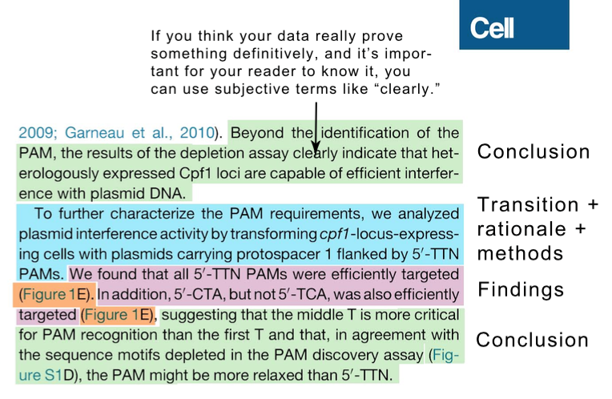
Activity: Analyze a real paper
The Comm Lab CommKit has online
advice + annotated examples
for major paper sections

Slide 14
Introduction = Why did you do this research?
Your research taught you something, right?
Introduction convinces the reader that this knowledge is worth having
background + knowledge gap + here we show

Slide 15
Introduction = Why did you do this research?
Your research taught you something, right?
Introduction convinces the reader that this knowledge is worth having
background + knowledge gap + here we show
Activity: Let’s read the Introduction to this paper
Individually, take 5 minutes

Slide 16
Introduction = Why did you do this research?
Your research taught you something, right?
Introduction convinces the reader that this knowledge is worth having
background + knowledge gap + here we show

Slide 17
Discussion = What does this research mean?
aka, a chance to say what you think instead of what you know
Don’t repeat the Results.
Restate the take-home message.
Give context: How does this fit with other reported studies and expectations?
Why is this important?
What are the caveats and limitations?
What interesting questions does this raise?
How might this impact this/other fields?
Avoid sweeping conclusions that are not substantiated by your or others’ research.

Slide 18
Activity: Analyze the Discussion Take 8 minutes in groups of 3-4
What is the impact?
Where might it lead?
How’s their speculation level?
Are there any limitations mentioned?

Slide 19
Paragraph structure helps you and reader
One paragraph = one thought.
1st sentence summarizes this thought.
Last sentence reiterates.
Elaborate in a logical order, for example:
pro then con
most to least important evidence
chronological

Slide 20
References connect your paper to the research ecosystem
Built over the course of the paper
Make sure you include papers that…
reach conflicting conclusions
are from your competitors
were published during the course of your work
(Reviewers will be looking)

Slide 21
Acknowledge others for contributions
Give proper credit for
Ideas
Results
Methods
Equipment
Experimental Help
Funding
…wherever it is appropriate:
Introduction, Results, Discussion, Acknowledgments

Slide 22
A riddle:
We are written last and read first.
What are we?

Slide 23
Revising is essential
Set aside the paper for several days.
Look for logical gaps and inconsistencies.
Cut ruthlessly. Use simple, direct constructions.
Have others read the paper and give feedback Use the Comm Lab Fellows! be.mit.edu/communicationlab

Slide 24
Assignment or paper questions?
Due 5pm, Sun. Nov. 20th
20% of course grade (full rubric on wiki)
Title and Abstract 10%
Introduction 2-3 p. 10%
Methods 3-4 p. 20%
Results and Figures 4-5 p. 50%
Discussion 2-3 p. 10%
(12pt., double-space except Abstract, max.14 pages)

