Slide 1
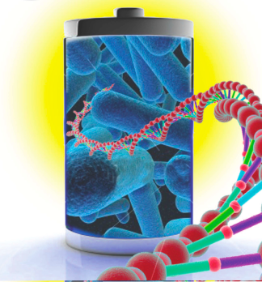




Virus Based Materials
20.109 Spring 2017

Slide 2
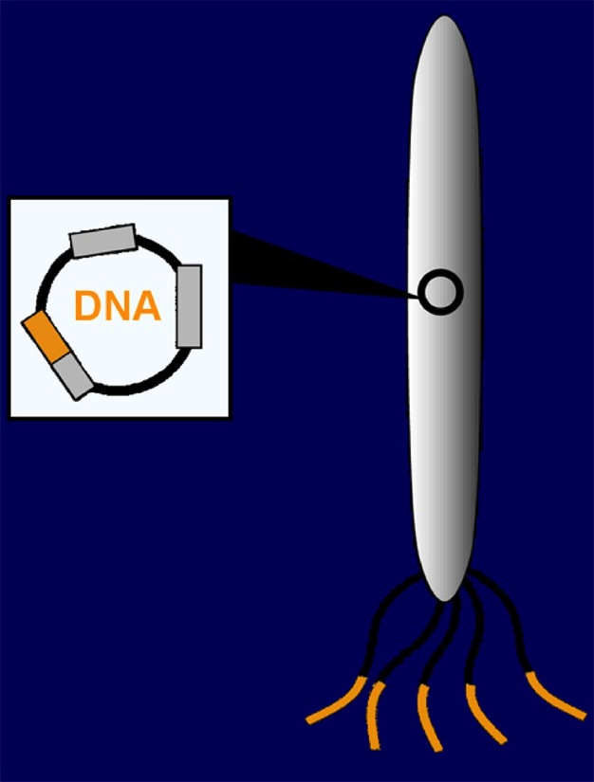
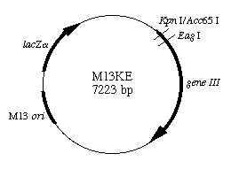
A Combinatorial Approach…..
Using Bacteriophage, or “phage”
A virus that infects bacteria
Protein
Coat
Gene 3
insertion
(New England BioLabs)
Gene
Peptide Insert Expressed
on Protein 3

Slide 3

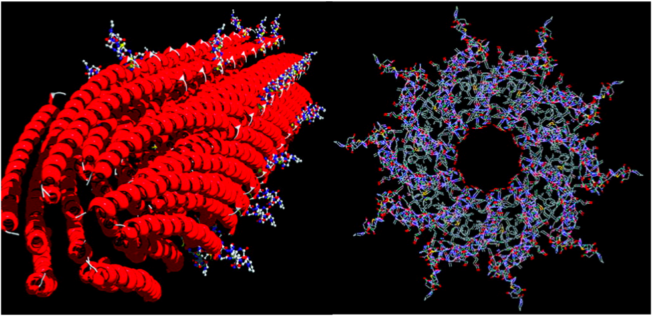
M13 bacteriophage
~ 900 nm
ssDNA
2,700 copies of pVIII coat proteins
~ 6.5 nm
Images created by Steven Kottman, published in Science (2004) 303, 213

Slide 4









Construction of p8 library
5’-Gnm (nnm)₆ nnG-3’
3’-A CGT Cnm (nnm)₆ nnC CTA G -5’
p8 inserts
lacZ α
gVIII
+
M13SK
viral vector
Double cut DNA
+
ori
Digestion
-
gIII
……
Ligation
and
……
Recombinant
Recombinant
Transformation

Slide 5
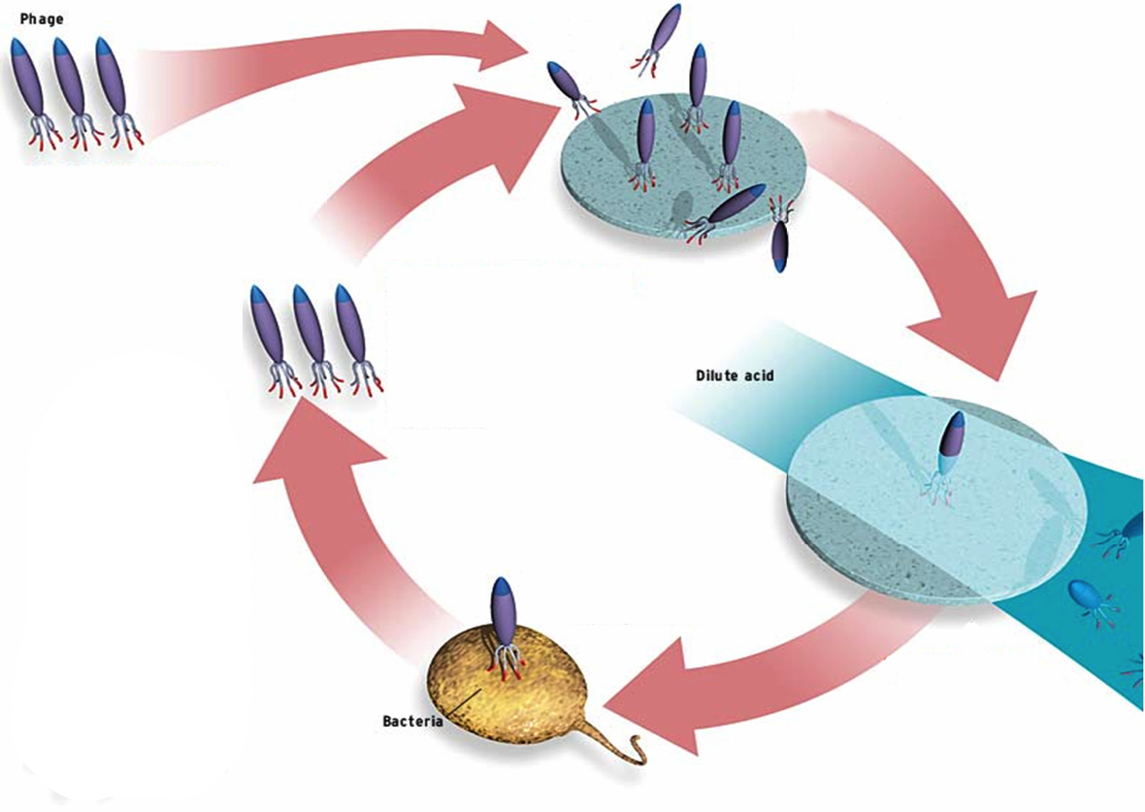
Peptide Libraries & Selection
Substrate Screening
Substrates:
Semiconductors
Insulators
Metals
Magnetic Materials
Conducting polymers
CNTs
Phage Library
Repeat
Amplification
Washing
Nature,405, 665, 2000
Nature Materials,4,496 2005
Nature Materials, 5,234,2006
Nature Nanotechnology, 2010
Nature Nanotechnology, 2011
Nature Nanotechnology, 2012
Nature Communications, 2013
Nature Communications, 2014
Nature Materials, 2015
http://www.spectrum.ieee.org/WEBONLY/publicfeature/nov03/1103bio.html#f3
Science, 296, 891,2002
Science, 303, 213, 2004
Science, 312,885, 2006
Science , 324,1051, 2009

Slide 6
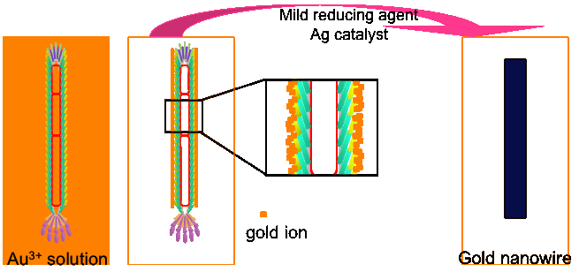
Schematic Diagram for Gold Nanowire
Gold ions
  Incubated with p8#9
  Partly reduced by ascorbic acid
  Formation of nanowires in static condition with silver catalyst
  (VSGSSPDS) Chung-Yi Chiang
Youjin Lee

Slide 7
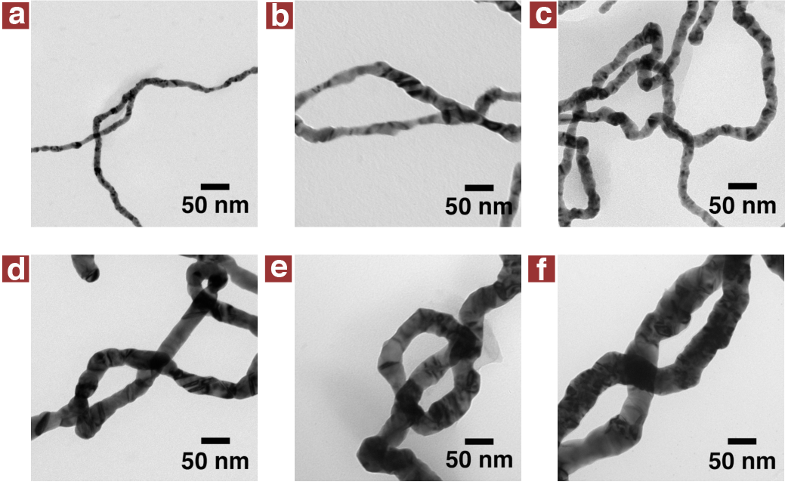
TEM Images of Gold nm Nanowires
Relatively uniform diameter along the length 10,15, 20, 25, 30, 50 nm

Slide 8
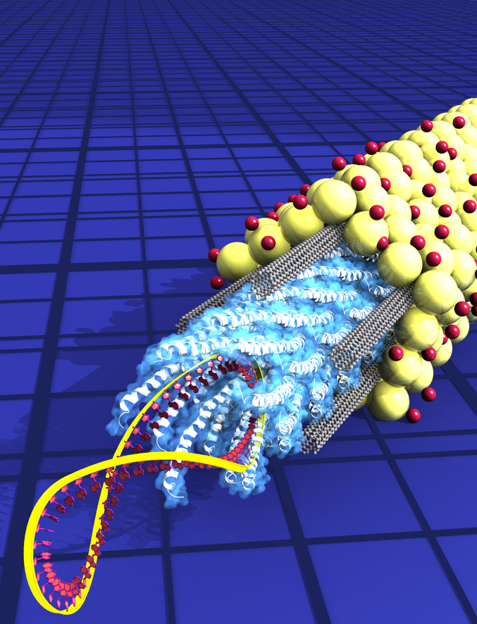
From
DNA
to Device

Slide 9

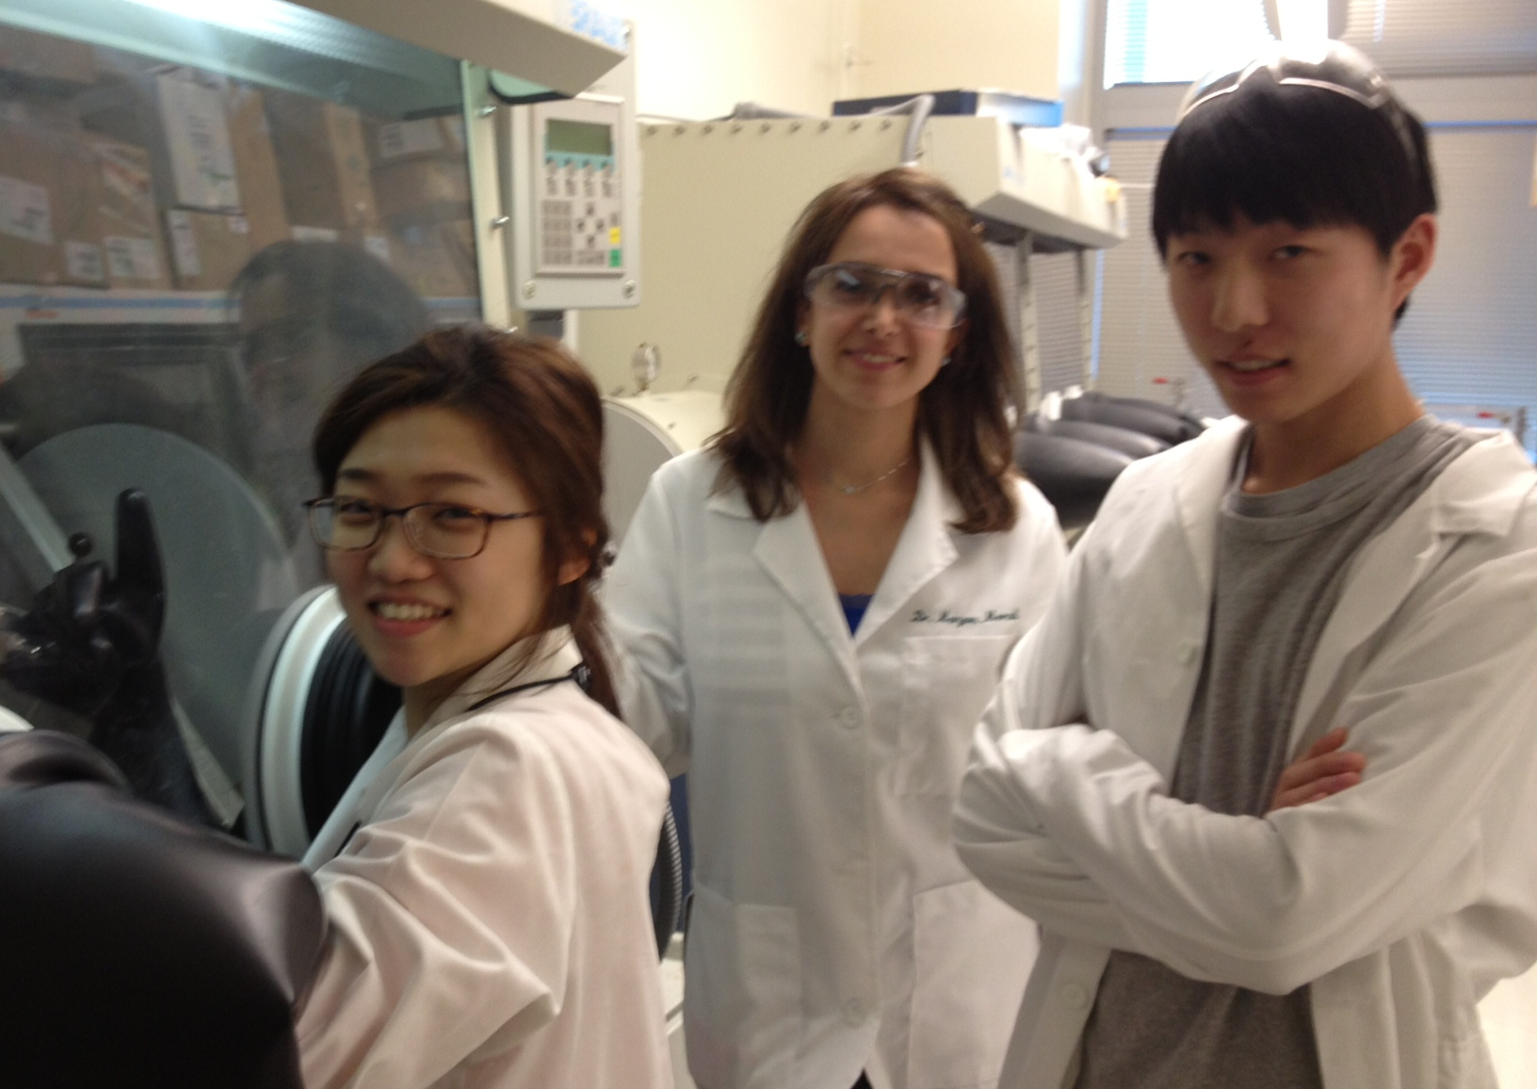

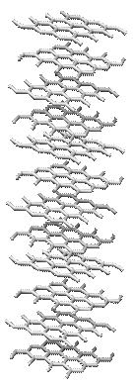
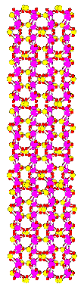



Energy Storage: Lithium ion battery
e⁻
e⁻
Discharged state
Charged state
Discharging
Anode
Cathode
Li₆C (graphite anode)
Li₂O/Coº (cobalt oxide anode)
C (graphite anode)
Co₃O₄ (cobalt oxide anode)
FePO₄ cathode
CoO₂ cathode
= Li⁺
LiFePO₄ cathode
LiCoO₂ cathode
= LiPF₆

Slide 10
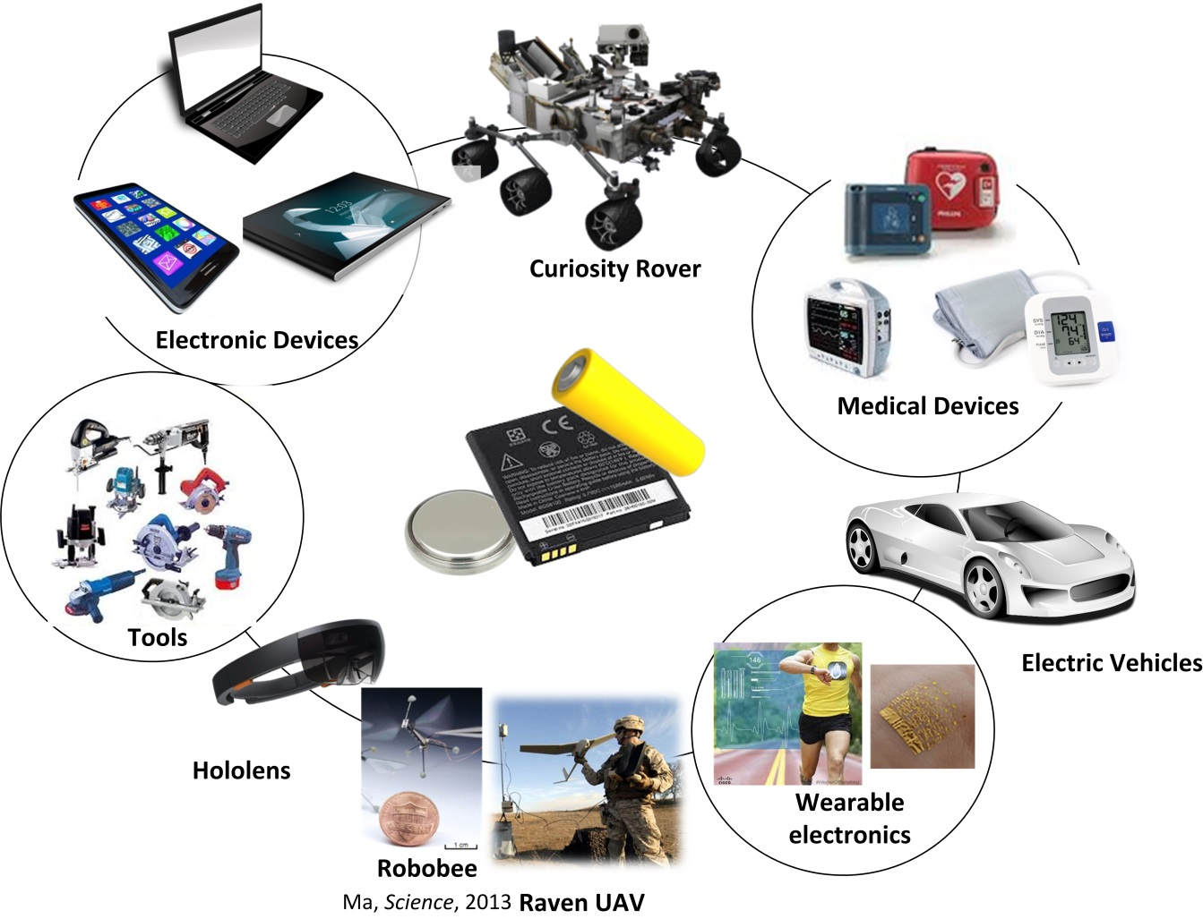
Portable Battery Applications
Battery Requirement:
High energy density
High power
Light weight
Flexible

Slide 11
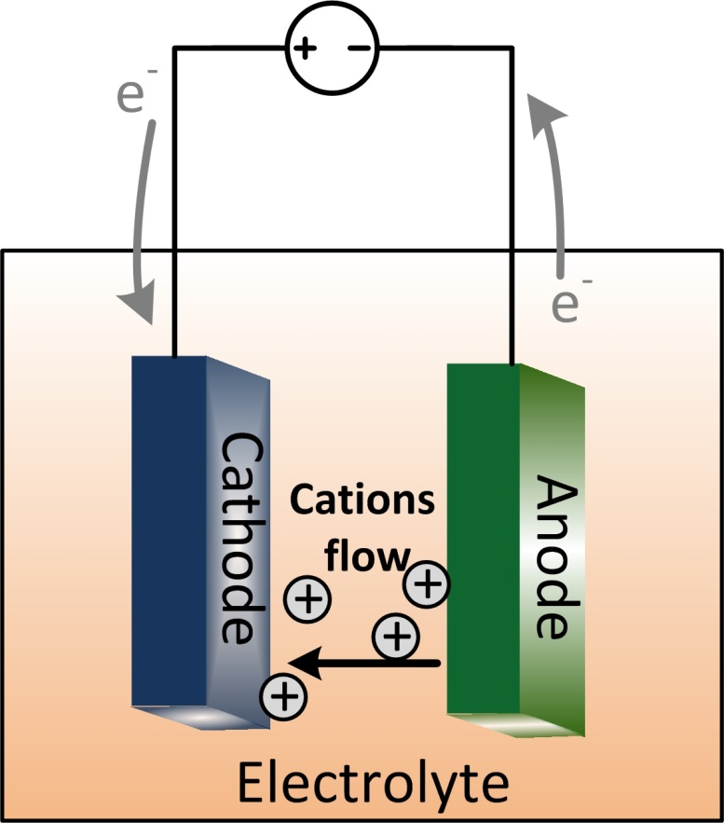
Batteries: Concept and Principle
Battery is a storage device which converts chemical energy into electrical energy
Main components:
  Anode or negative electrode
  Cathode or positive electrode
  Electrolyte – flow of ions

Slide 12
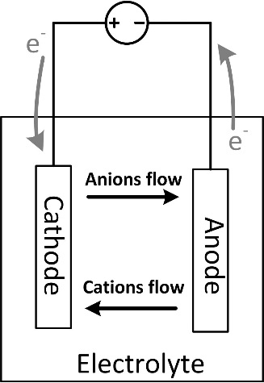
Operation of a cell
Discharge:
  When cell is connected to an external load, electrons flow from the anode, which is oxidized, through the external load to the cathode, where the electrons are accepted and the cathode material is reduced.
  The electric circuit is completed in the electrolyte by the flow of anions (negative ions) and cations (positive ions) to the anode and cathode, respectively.

Slide 13

Cathode vs Anode
Negative electrode, oxidation, loss of electron
Positive electrode, cathodic reaction, gain of electron
Li Li⁺ + e⁻
Cu²⁺ + 2e⁻ Cu

Slide 14
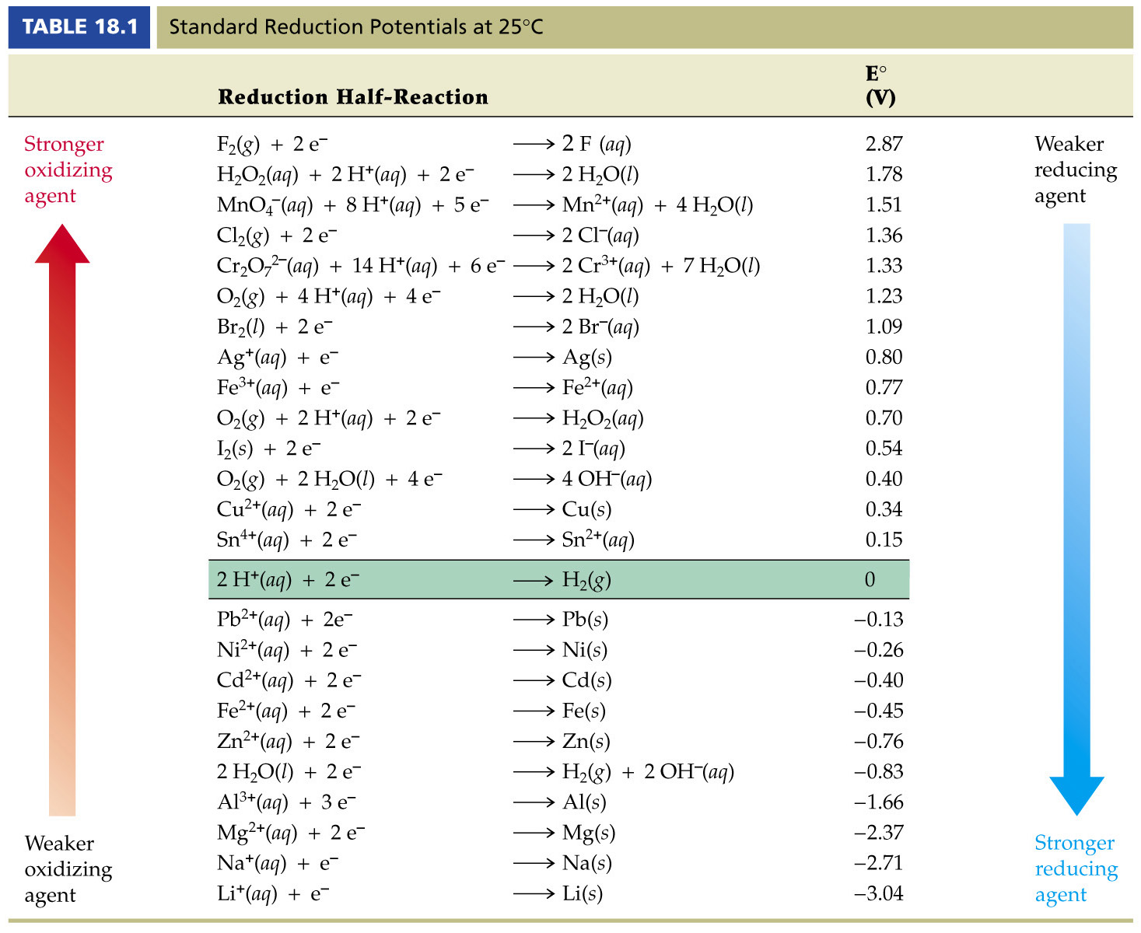
Theoretical Voltage
The standard potential of the cell is determined by the type pf the active materials (cathode and anode) in the cell.

Slide 15
Theoretical Capacity
Theoretical capacity of a cell is determined by the amount of active materials in the cell.
Theoretical capacity is the total quantity of electricity involved in the electrochemical reactions (in terms of coulombs or ampere-hours).
  1 gram-equivalent weight of material deliver 96,485 C or 26.8 Ah. (Farday Constant, magnitude of electric charge per mole of electrons)
Theoretical capacity for Zn (Molecular Weight 65.4 g)
Zn²⁺ (aq)+ 2e⁻ Zn (S)
$$\frac{2e− × 96485 A.sec}{1 mole}×\frac{1 hour}{3600 sec}×\frac{1000 mA}{1Amp}×\frac{1 mole}{65.4 g}=820 mAh/g$$

Slide 16
Cathode and Anode design consideration
Choose electrode materials with:
  High standard potential difference
  Fast reactions at electrodes
  High capacity
  Stable electrodes
  lightweight

Slide 17
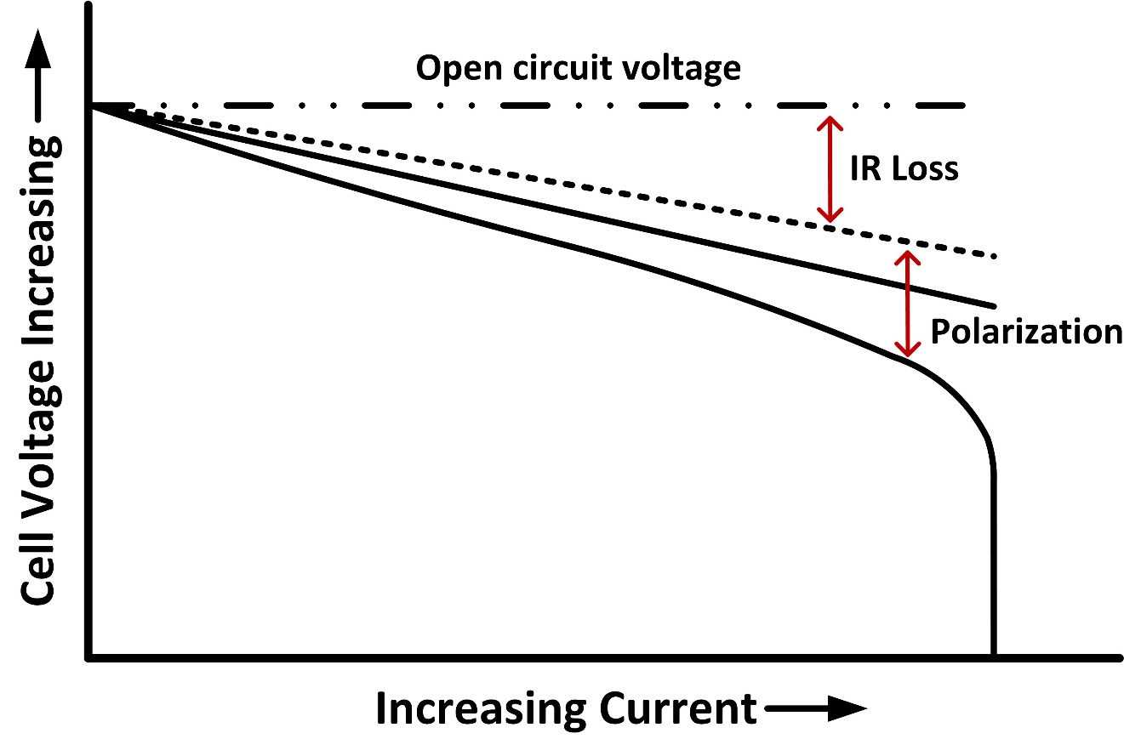
Operation of a Cell
Useful delivered voltage by a cell is reduced by:
  IR drop
    Due to the internal impedance of a cell
  Polarization
At what operating conditions a cell can deliver most of the theoretical available energy?
Cell Polarization as a function of operating current (Linden’s Handbooks of Batteries)

Slide 18

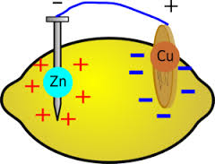
Lemon Battery
Making a battery with a lemon, penny and galvanized nail (Zn-coated) as the electrodes
  Negative electrode?
  Positive electrode?
  Why do we need the lemon?
  What if we use 2 pennies?
Zn²⁺ (aq)+ 2e⁻ Zn (S) -0.76(v)
Cu²⁺ (aq)+ 2e⁻ Cu (S) 0.34 (v)

Slide 19
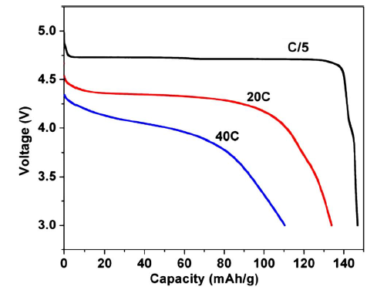
Battery Metrics
Capacity: Amount of charge stored
ie. gravimetric capacity in mAh/g
Energy Density: Energy stored in a cell
Wh/kg (Gravimetric)
Wh/L (Volumetric)
C-Rate: Is a measure of a rate at which a battery is discharged relative to its maximum capacity.
1C means that the discharge current will discharge the entire battery in 1 hour.
Charge or discharge rate C/X
X = # hours to (dis)charge
X. Ma et al. J. Electrochem.Soc. 157 8 A925-A931 (2010)

Slide 20
Classifications of Cells and Batteries
Primary cells
Not capable of being recharged electrically
Good shelf life,
high energy density at low to moderate discharge rate,
No or little maintenance
Ease of use
Secondary or rechargeable cells
Can be recharged electrically
High power density
High discharge rate
Flat discharge curve
Good low temperature performance
Fuel cells
Active material are fed into the cell from an external source
Capable of producing electrical energy as long as the active materials are fed to the electrodes
Reserve batteries
Primary type
long term storage

Slide 21
Battery Performance-Upper limits of Energy Density

Slide 22

Batteries and Fuels
Rechargeable Batteries:
High power density
High discharge rate
Flat discharge curve
Good low temperature performance
1 Wh/kg ~ 1 mile diving range

Slide 23
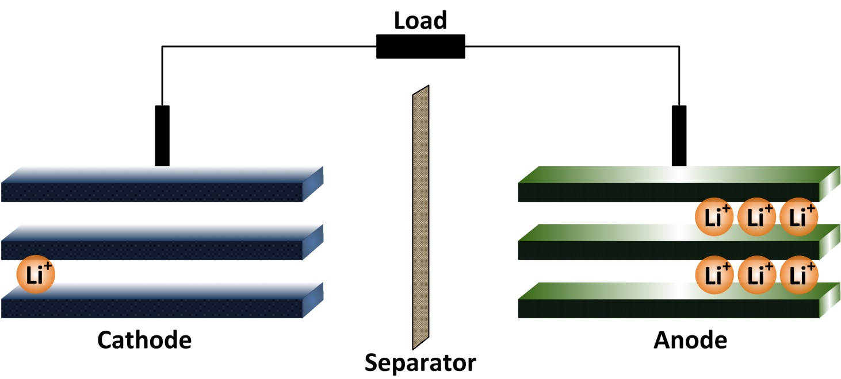
Lithium ion Batteries (LIBs)
LIBs are comprised of cells that employ lithium intercalation compounds as the positive and negative electrodes
Li⁺+ e⁻+ Li_{x}CoO₂ Li_{1+x}CoO₂
Li Li⁺+ e⁻
Li⁺+ e⁻+ Co⁴⁺ Li⁺+Co³⁺

Slide 24
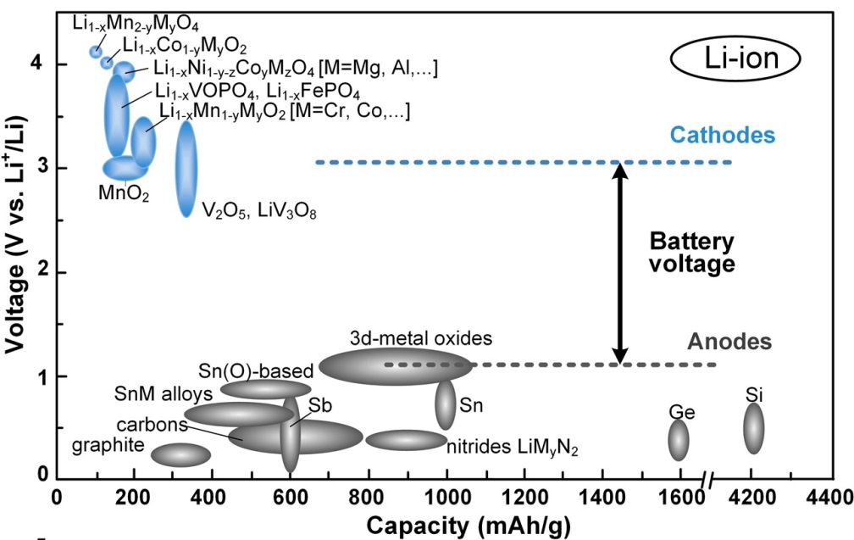
LIBs: Possibilities and Challenges
LIB electrode materials requirements:
Reversibly incorporate Lithium without structural change
High redox potential between anode and cathode
Incorporate large quantities of lithium
High lithium ion diffusivity
Good electronic conductivity
Prepared from inexpensive reagents
Low cost synthesis
Capacities of common Li-ion electrode materials. Chem. Mater. 2014, 26.

Slide 25


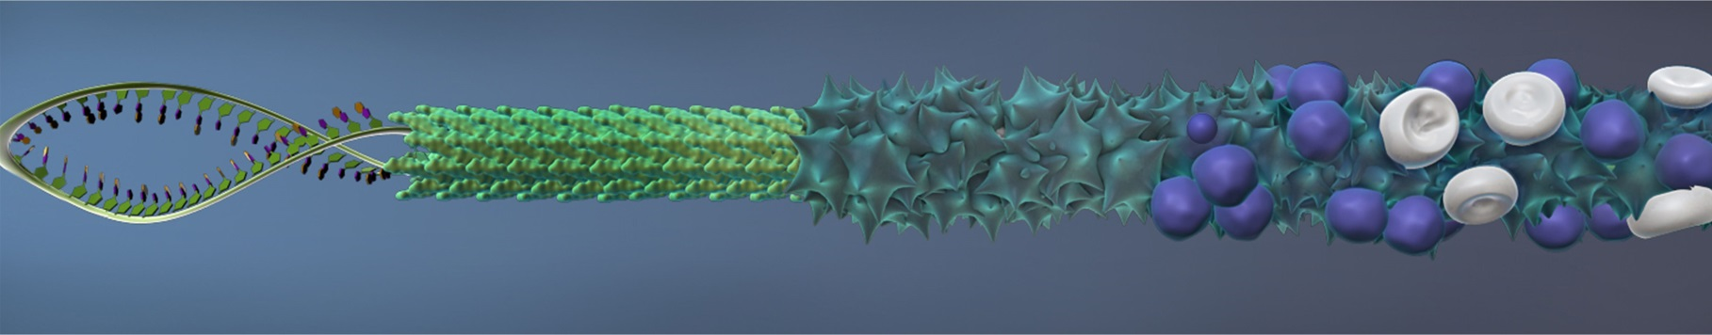
How to Improve the State of the Art?
Problems:
Ion diffusivity
Electronic conductivity
Solutions:
Nano-structuring the functional materials
  Increasing surface to volume ratio
Increasing the electronic conductivity by integrating conductive additives
    Creating percolating network

Slide 26
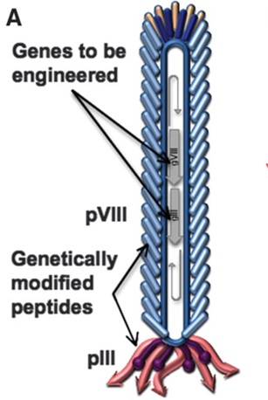
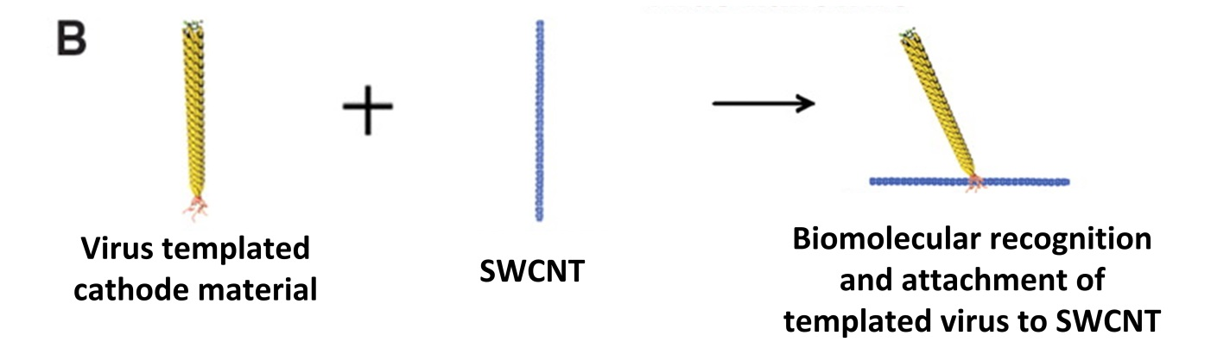
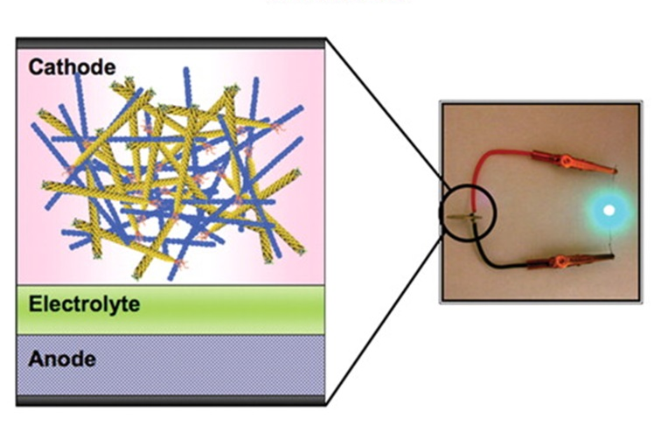
Studying Bio-templated Materials for LIBs for the First Time
The Bio-cathode materials with SWCNT on the tail of the virus.
  Improved energy density
  Imporved power density
Yun Jung Lee et al., Science (2009)

Slide 27
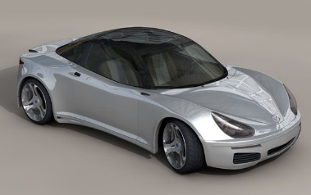
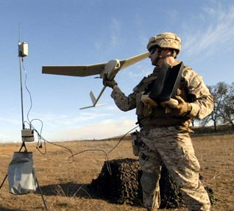
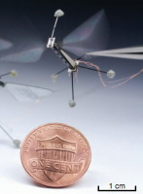
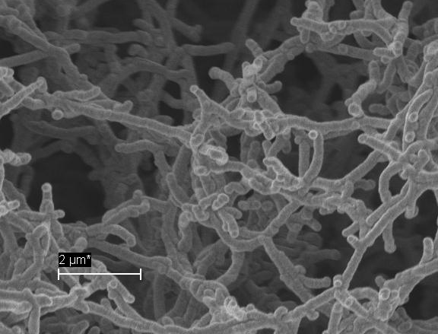
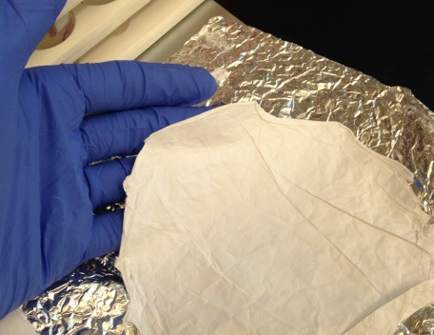
Bio-Enabled Energy Storage on a Continuum of Scales
Unmanned Aerial Vehicles
Electric Ground Vehicles
Virus-Templated Metal Nanofoams
Lithium-Oxygen,
Sodium-Oxygen,
Sulfur-Based Cathodes,
Sodium Intercalation,
Carbon Nanotube/Active Material Bio-enabled Composites
Li-O₂
(12,000 Wh/kg Theor.)
Small Scale
Large Scale
Above: Raven UAV
Below Left: Virus-templated Nickel current collector
Below Right: “Robobee”
Ma, Science, 2013
Wearable Electronics
Power Density Limited
Electrospun Interpenetrating Battery Cloths
Below: Electrospun polymer matte
Cost and Portability Limited
Grid and Microgrid
Biotemplated Sodium-Ion Batteries
Lithium and Sodium Sulfur Batteries
Flow Batteries

Slide 28
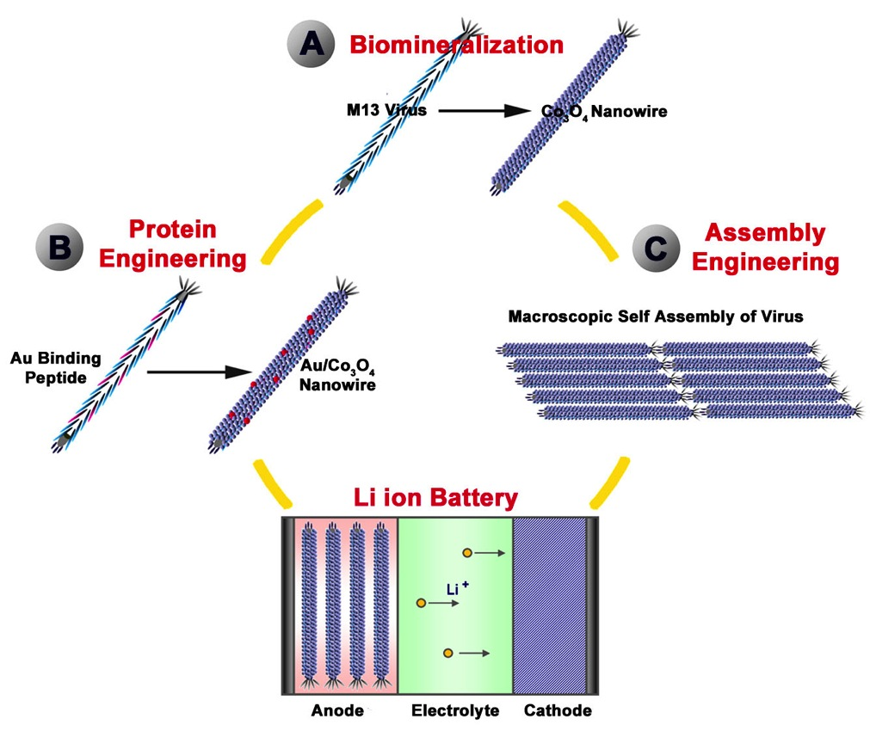
Kitae Nam
Paula Hammond, Yet-Ming Chiang
Science, 312, 885-888, 2006

Slide 29
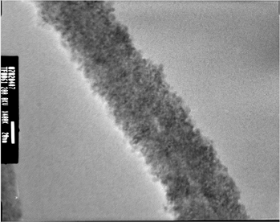
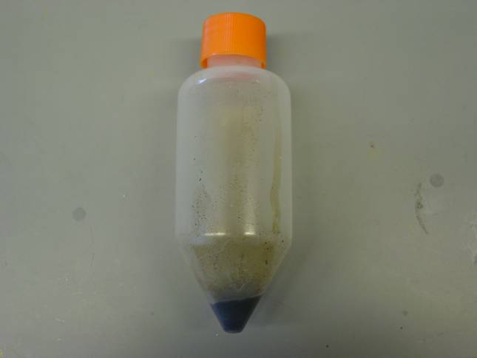
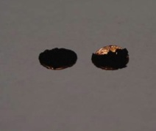
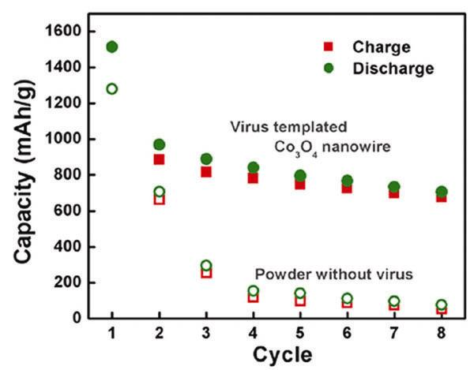
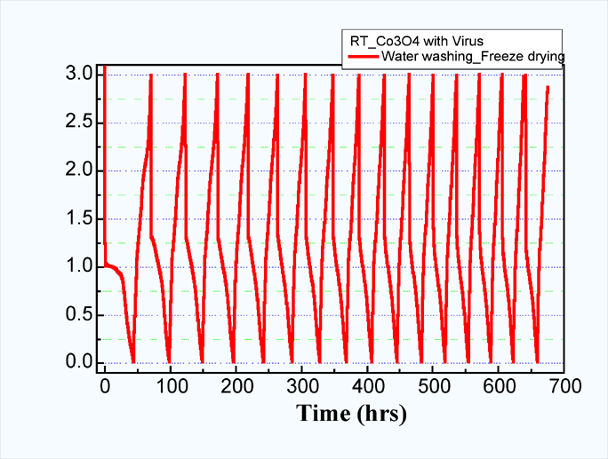
Generation 1 Virus Based Battery Virus - Co₃O₄ Anode
Li
Separator + Electrolyte (LiPF₆)
Cobalt coated Virus in solution state
Co₃O₄ virus
Cu
Anodes grown and assembled
in flask by virus !
Theor. capacity for
stoichiometric rxn
with 8 Li per Co₃O₄
Virus based anode
wires placed on Cu
1st Cycle irreversibility due to additives
Initial Gen 1
cycling (vs. Li) shows all of the virus- produced Co₃O₄ is electrochem. active
commercial
Reversible Capacity : 600 to 750 mAh/g
about 2 times higher than carbon based anode

Slide 30

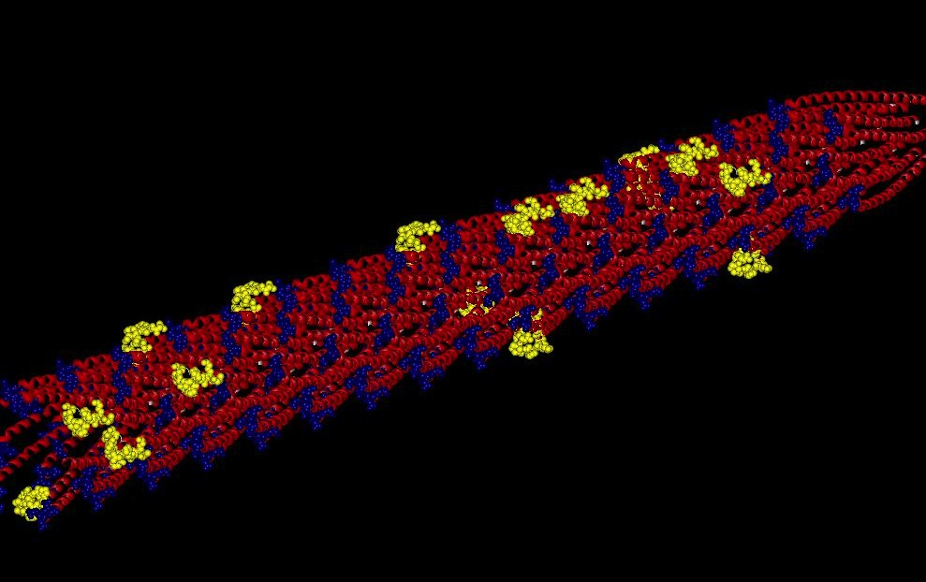
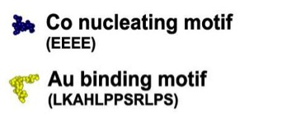
Engineered M13 viruses for the hybrid Au-Co₃O₄ nanowire
Au-specific peptide selection using phage display library
Gold binding peptide sequence:
LKAHLPPSRLPS
Peptide library
Genetic engineering with plasmid system
Au nanoparticle can be attached with this motif
Elution
Amplification
Notes:
Gold nanoparticles were chosen based on their ability to provide high electronic conductivity where needed, the ability to maintain a thermodynamically stable interface with Co3O4, and the potential to act as a chemical catalyst for electrochemical reactions at the nanoscale. We designed a bifunctional virus template that simultaneously expressed two different peptide motifs.
To improve this further, we again turned to genetic engineering. While keeping the genetic code for the cobalt assembly, we added an additional strand of DNA that produces virus proteins that bind to gold. Therefore, two types of protein were fused around the virus as shown in Figure 3. The viruses then assembled as nanowires composed of both cobalt oxide and gold particles. The resulting electrodes stored 30 percent more energy than the pure cobalt oxide version.

Slide 31
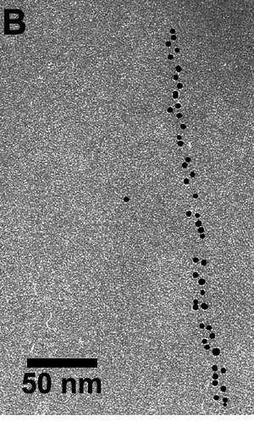
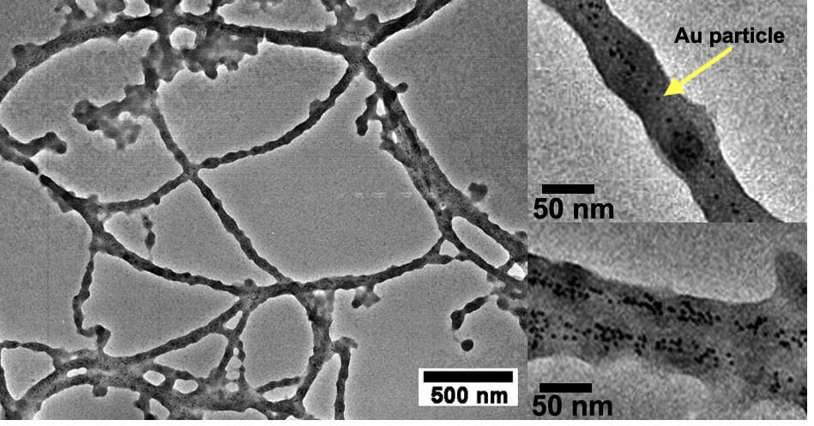
Genetic Modification Produces New Hybrid Anodes for Increased Capacity Au-Co₃O₄ Nanowire
Gold nanoparticles bound on the virus
Cobalt oxide nucleation & growth
Has gene to grow co oxide and gene to bind gold
Notes:
After removing excess unbound gold nanoparticles by centrifugation, Co3O4 was nucleated and grown via the tetra-glutamate functionality, resulting in hybrid nanostructures of 5 nm Au nanoparticles spatially interspersed within the Co3O4 wires

Slide 32
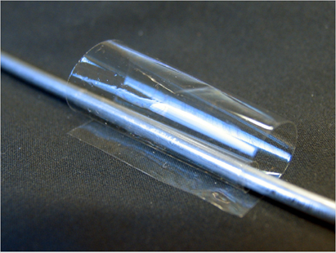
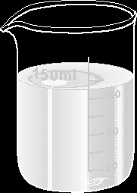
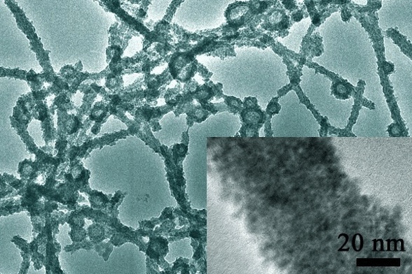
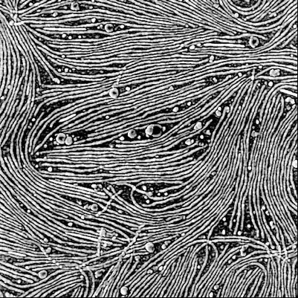
Battery
Material
Polymer
Virus
Virus mediated nanobattery components
Transmission Electron Microscope Images
Virus enabled assembly
of nanostructured battery
Atomic Force Microscope Images

Slide 33

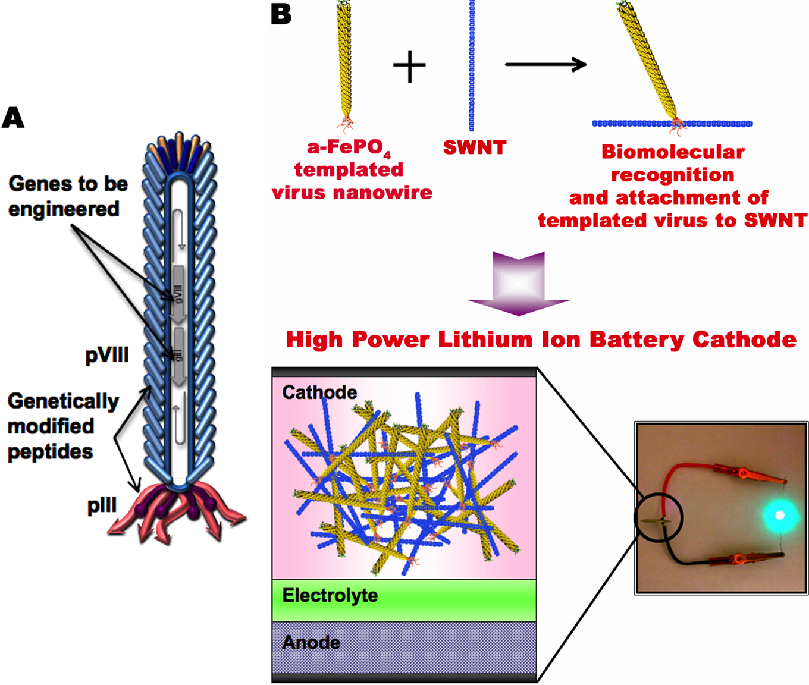
Genetically Engineered High Power Battery by Encoding Multiple Genes
Science , 324,1051, 2009
Yun Jung Lee Hyunjung Yi, Gerd Ceder , Michael Strano

Slide 34
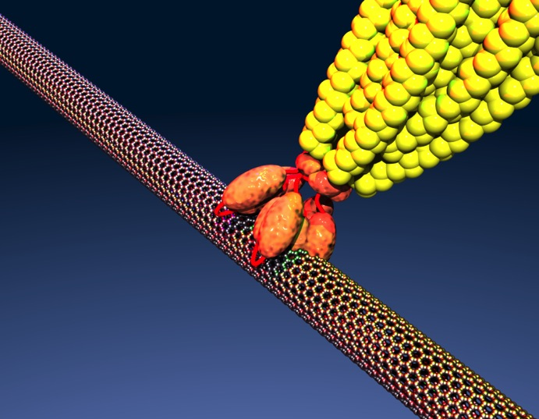
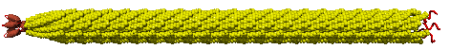
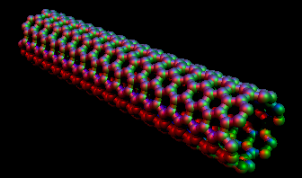
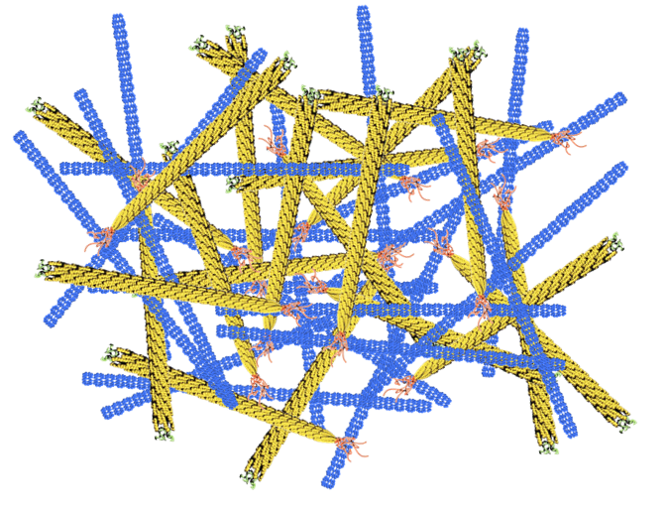
Virus Binding Carbon Nanotubes

Slide 35
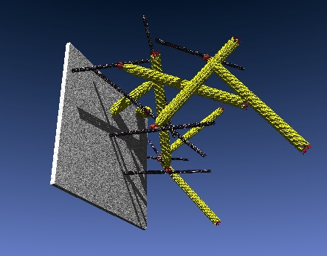
Genetically Engineered High Power Cathode
-
Electrons from the current collector can transport along SWNT “highway” networks percolating throughout the electrodes transferring energy in a very short time.

Slide 36
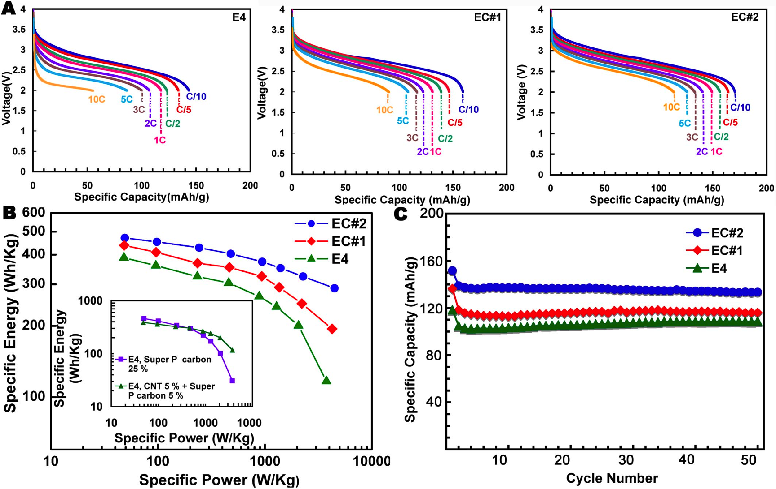
Electrochemical Properties of a-FePO₄ Viral Nanowires
1 C
High power performance scales with the binding affinity of p3 toward SWNTs.
Stable capacity retention reflects structural stability of hybrid nanostructures.

Slide 37


Slide 38



http://www.dsjournal.com/armyseeksheud.html
Li air batteries
900 Wh kg⁻¹
Li ion batteries
~250 Wh kg⁻¹
Current limitations for
Li-air electrodes
Large overpotential
Low current density
Cycle life
Cost efficiency
Bruce, P. G. et al. Nature Materials (2011)

Slide 39


