Slide 1
to the 20.109 lab!
Orientation (M0D0):
EHS laboratory-specific training
Introductions
Prelab: Laboratory logistics
Orientation exercise – your first protocol
Preparations for M1D1

Slide 2
Introductions
What year are you at MIT?
Do you have any research experience you want to share?
Where in the universe would you go if you got the chance? / What’s something that you like? (Hobby, favorite book, movie, game, show…)

Slide 3
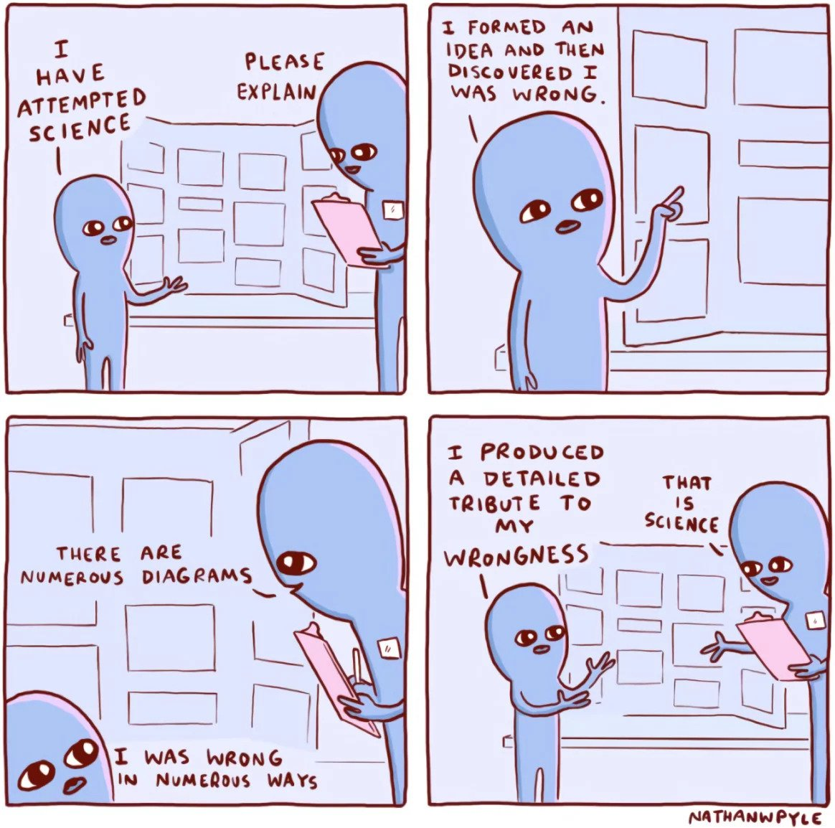
Where can you find the instructors?
Noreen Lyell
Office: 16-317
Email: nllyell@mit.edu
Becky Meyer
Office: 16-319
Email: rcmeyer@mit.edu
Jamie Zhan
Office: 16-469
Email: zhanj@mit.edu
Office hours will be established

Slide 4
Core missions of 20.109
Collect authentic data
Elements of design, unknown outcomes
Practice communicating your science
Written & oral, in homework and assignments, a lot of feedback
Working in collaboration with colleagues
Experiments completed in teams
Assignments are completed individually or in teams (as noted)
Class-wide collaboration (for data acquisition and analysis)
Integrity (personal reflections)
The faculty are here to help – come to us with questions!

Slide 5
Key deadlines this semester
Assignment | % final grade | Due date
Data summary | 15 | 10/12 (draft), 10/22 (revision)
Research talk | 5 | 10/1
Journal club presentation | 15 | 11/1 & 2 or 11/3 & 4
Research article | 20 | 11/21
Research proposal presentation | 20 | 12/8 or 12/9
Lab notebook | 5 | at the end of each module
Homework | 10 | daily
Participation | 5 | daily for notebooks, 4 blog posts
Quizzes | 5 | 2 per module
individual : 65%
team: 35%

Slide 6
Homework helps!
A chance to practice technical/ scientific writing
Technical writing is a very specific style
Requires conciseness, clarity, and precision
Each piece of homework will become a component of a major assignments
Allows you to get individualized feedback on first draft of work
Homework, collectively, is only worth 10% of your final grade
Not because it isn’t important
Gives you a chance to make mistakes without serious damage to your grade
Homework must be submitted by 1:05pm on the day of lab
Submit as .doc or .pdf to Canvas
Write your name in the text of the document
Document name: Your name_assignment name/identifier

Slide 7
Class policies to note (also on wiki!)
Absences from lecture will impact participation points accumulated throughout the semester.
You are responsible for getting lecture material even if you are absent
Laboratory attendance is mandatory
Excused absences should be discussed with the Instructors as soon as possible.
Unexcused absences = 1/3 of a letter grade deduction from the final grade on the major assignment for the module (for example, a B+ would become a B).
If absent, you may be required to attend a different laboratory section to complete experiments.
Late policy for homework and major assignments is very generous!
In lieu of extensions
Each day late for homework = -0.3pts /10
Each day late for major assignment = -3pts /100
Work will not be accepted 1 week past the due date

Slide 8
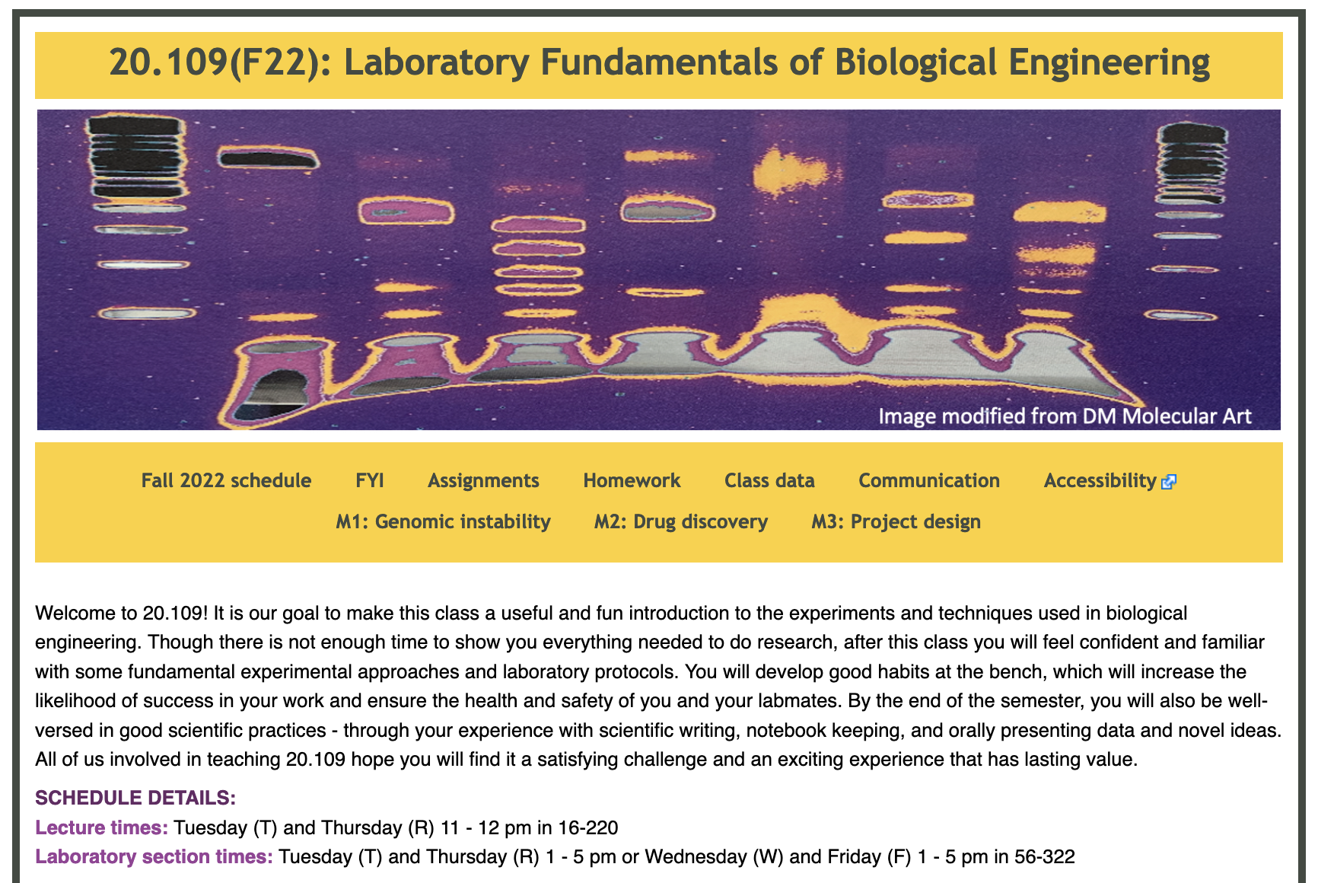
Welcome to the wiki! The wiki is your lifeline…
http://engineerbiology.org/wiki/20.109(F22):Fall_2022_schedule

Slide 9
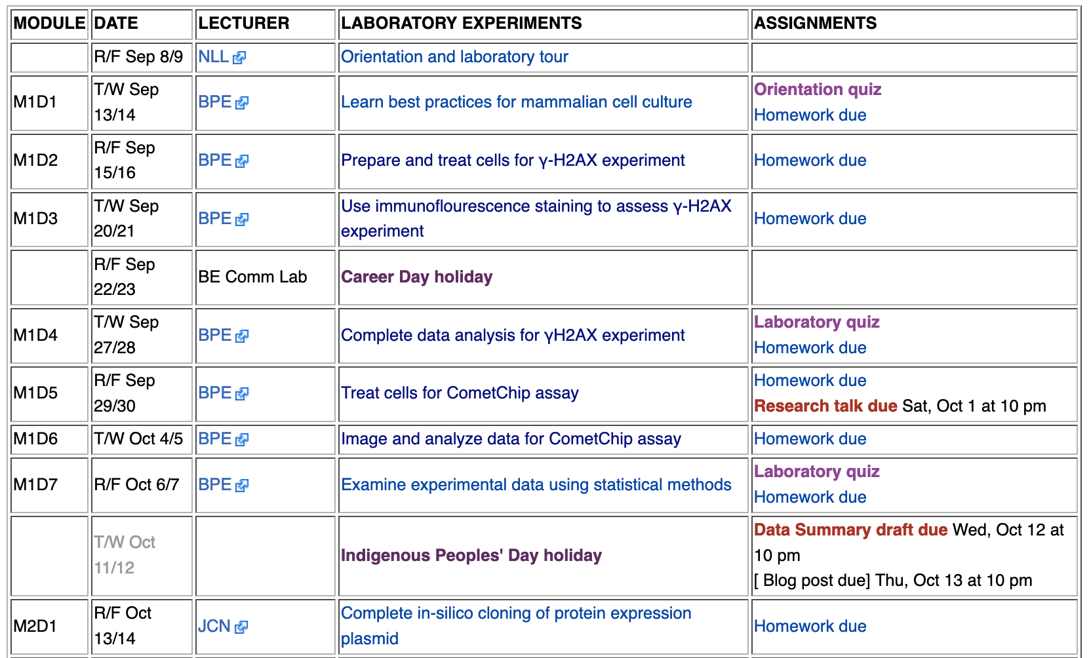
If the wiki is your lifeline, the Schedule page is your best friend

Slide 10
A laboratory day in the life of a 109er
Lab starts at 1:05pm
You must alert me in advance if you will be late or are sick
Quiz starts immediately at 1:05pm (on lectures and laboratory material)
M1D4, M1D7, M2D4, M2D7…as noted on the wiki!
Submit homework to Canvas by 1:05pm
Participate in interactive prelab discussion
Typically 15-45 minutes with focus on experimental details
Design and Experiment!
Keep notes in electronic laboratory notebook (Benchling)
Q & A throughout the afternoon

Slide 11
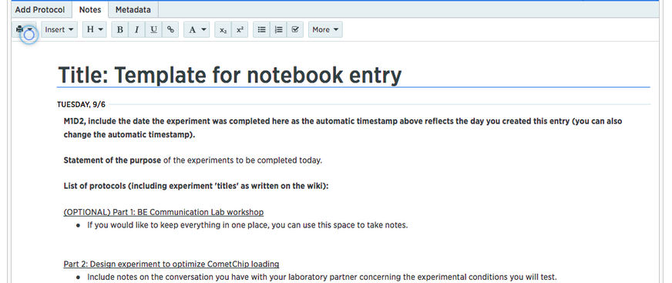
Record your science in Benchling
Set up your account: benchling.com
Title your project “20.109(F22)_YourName”
Make each module a new folder
Make each day a new entry within the appropriate module folder
Share with your Instructor and TA
Jamie (zhanj@mit.edu) and Alexander (ahos@mit.edu)

Slide 12
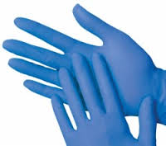
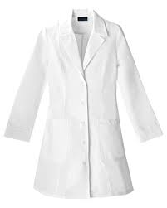
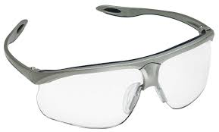
Remember your personal protective equipment (PPE)
Item | Worn (BE guidelines)
Gloves | When working with chemical or biological materials Change when entering tissue culture room!
Lab coat | When working with chemical or biological materials Change when entering tissue culture room!
Goggles | When handling large quantities of powder or liquid due to chance of splash When pipetting toxic chemicals (mutagens) When using ethanol burners In conjunction with face shield at UV transilluminator

Slide 13
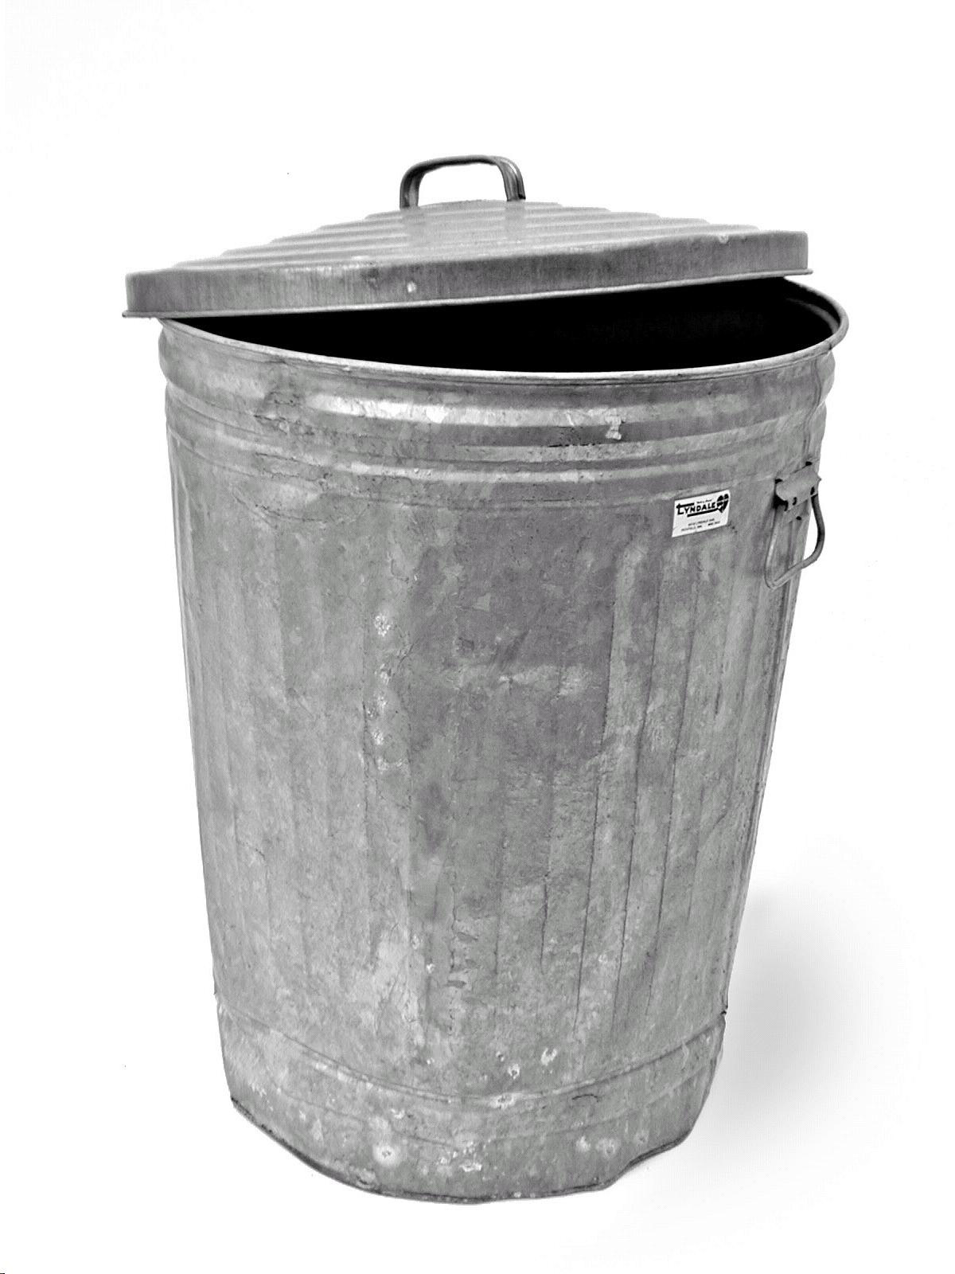
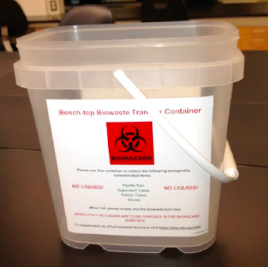
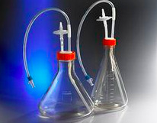
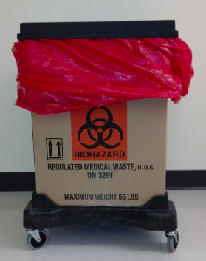
Correctly dispose of waste
regular trash can benchtop waste sharps container liquid waste vacuum flask
Please empty benchtop waste every lab
biowaste box

Slide 14
For today:
Complete lab orientation with a partner
Your ”forever” lab partner will be assigned prior to the next lab session based on questionnaire responses or by request
http://engineerbiology.org/wiki/20.109(F22):Laboratory_tour
Orientation quiz on M1D1!
For M1D1:
Complete homework assignments (see ‘Homework’ tab on wiki)
http://engineerbiology.org/wiki/20.109(F22):Homework
Prepare for orientation quiz
Complete, screen capture EHS training certificate(s)
Read Mod1 overview page and M1D1 introduction

