Slide 1
Module 1: Protein engineering
DNA engineering
2/4/16

Slide 2
Mod 1 assignment overview
Protein engineering summary
Abbreviated written article that details your experimental results
Opportunity for revision
Completed with laboratory partner
Protein engineering mini-presentation
Short ‘elevator pitch’ that relays the key results and impact of your project
Completed individually

Slide 3
Your engineering task in Mod 1:
Alter Ca²⁺ binding properties of inverse pericam protein

Slide 4
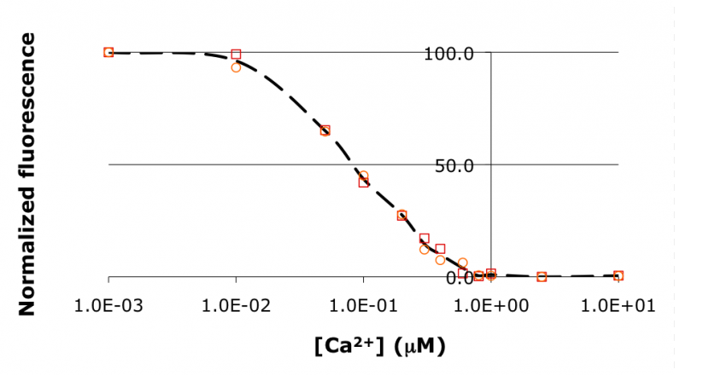
Inverse pericam (IPC) dims with Ca²⁺

Slide 6
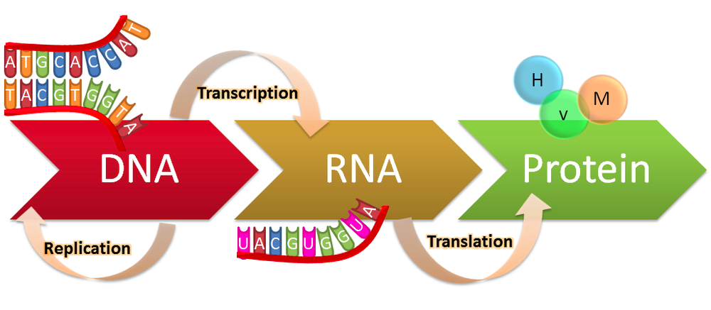
The central dogma
http://genius.com/Biology-genius-the-central-dogma-annotated

Slide 7
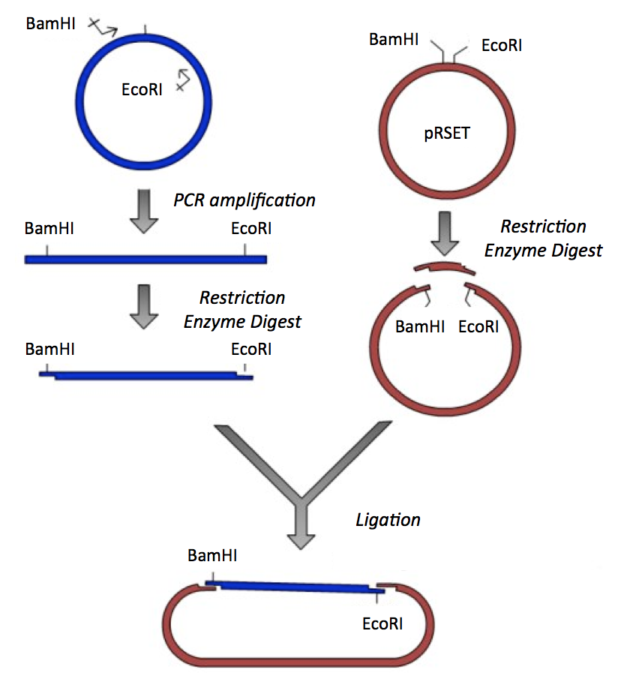
How do we engineer DNA?
Amplification
Digestion
Ligation

Slide 8
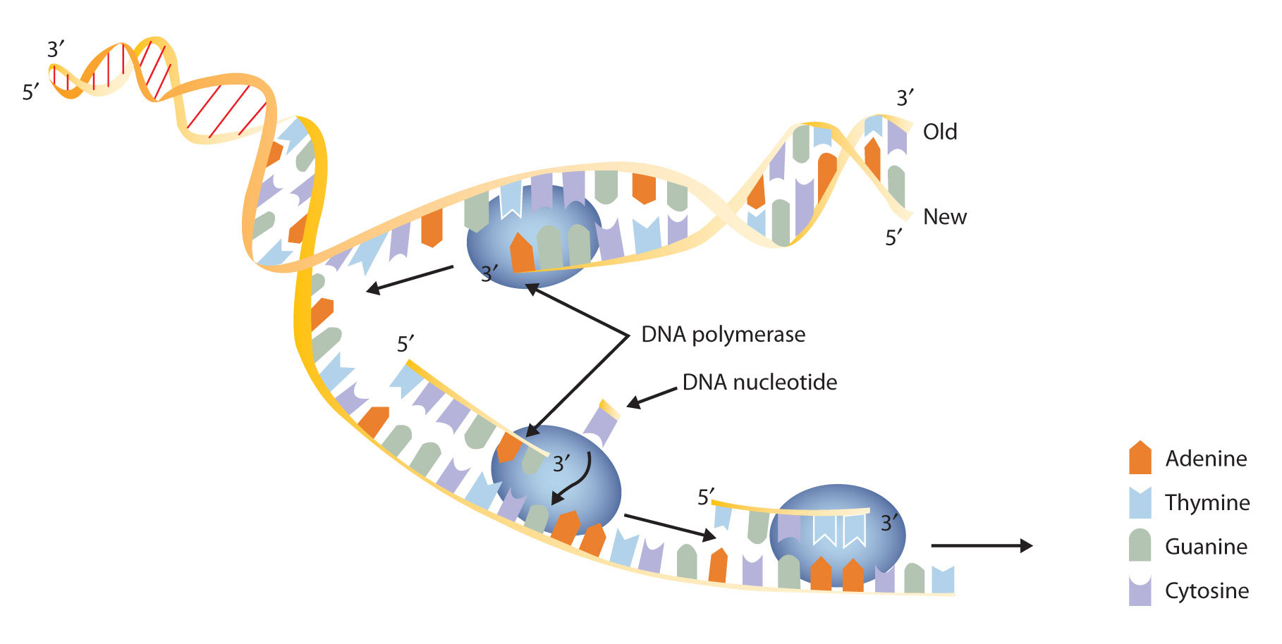
Amplification
Who are the key players?
2012books.lardbucket.org
Notes:
In DNA replication, the first two bases are always RNA, and are synthesized by another enzyme called primase. Enzymes,helicase and topoisomerase II, are required to unwind DNA from a double-strand structure to a single-strand structure to facilitate replication of each strand consistent with the semiconservative model of DNA replication.

Slide 9
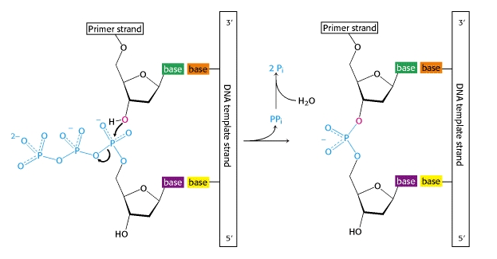
DNA polymerase
Catalyzes formation of polynucleotide chains
Requires a primer base-paired to template
http://www.ncbi.nlm.nih.gov/books/NBK22374/
Notes:
Catalyzes nucleophilic attack of 3’ OH of polynucleotide chain on the 5’ a-phosphate group of nucleoside triphosphate
DNA polymerase can add free nucleotides only to the 3' end of the newly forming strand. This results in elongation of the newly forming strand in a 5'-3' direction. No known DNA polymerase is able to begin a new chain (de novo); it can only add a nucleotide onto a pre-existing 3'-OH group, and therefore needs a primer at which it can add the first nucleotide. Primers consist of RNA or DNA bases (or both).

Slide 10
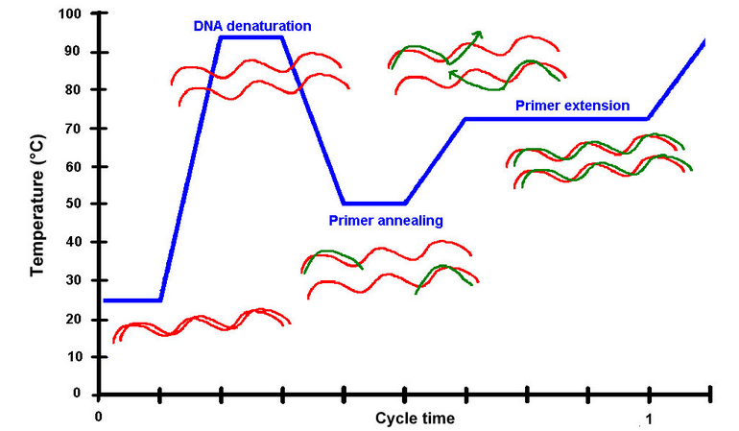
Polymerase chain reaction (PCR)
How many cycles until your product is generated?
splice-bio.com
Notes:
Tell student to draw first three cycles

Slide 11
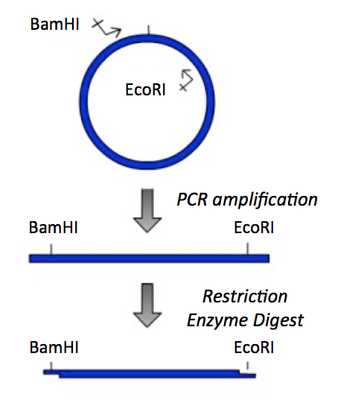
What are we amplifying?
Primers enable you to specify which region of DNA is amplified by polymerase
Notes:
Highlight primer details on image…landing sequence, flap sequence, RE recognition sequence and talk about reason for each
PCR amplification product will be ‘blunt ended’

Slide 12
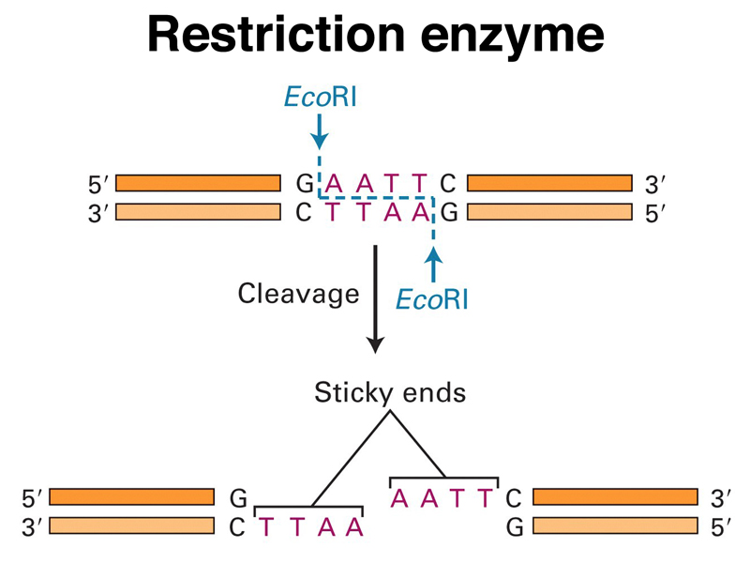
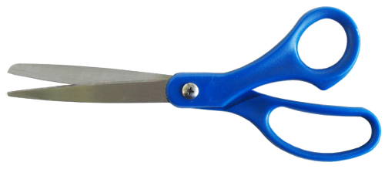
Digestion

Slide 13
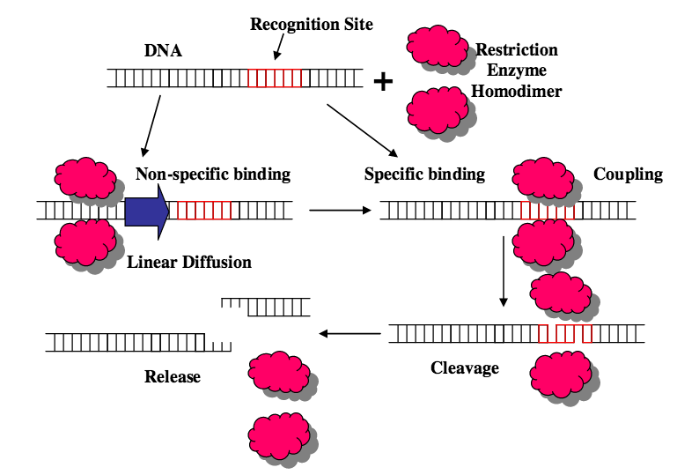
Restriction enzymes
Function as homodimers
Each dimer cleaves backbone at site of palindromic recognition sequence
www.idtdna.com
Notes:
actual mechanism by which a
restriction enzyme cuts the DNA to which it is bound has not been demonstrated. The
conventional wisdom holds that hydrolysis mediated by met
al ion binding is the
paradigm

Slide 14
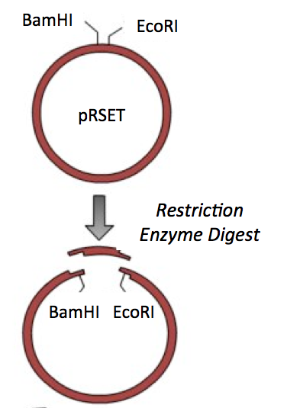
What are we digesting?
What should we consider when performing a
double digest?

Slide 15
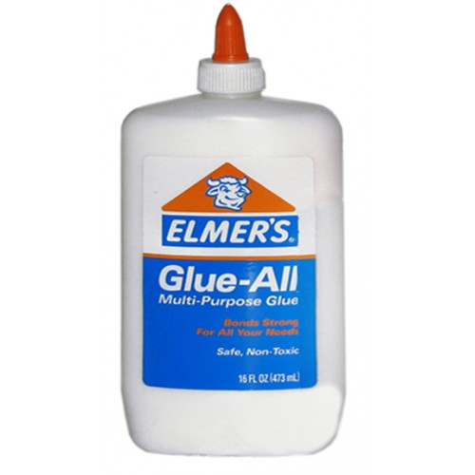
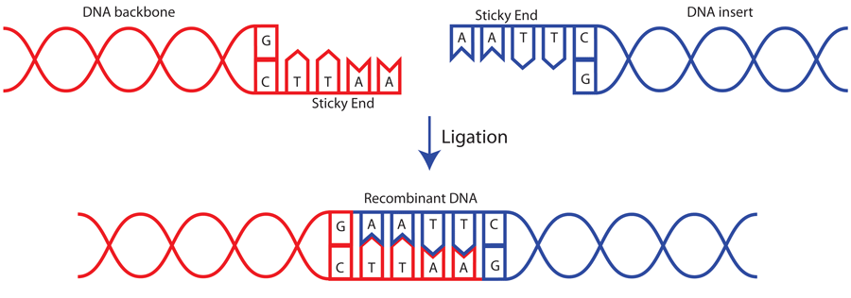
Ligation
www.addgene.org

Slide 16
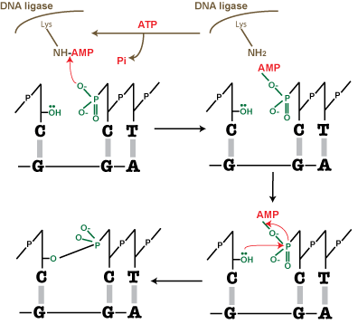
DNA ligase
Forms covalent phosphodiester bond between 3’ OH acceptor and 5’ phosphate donor
Requires ATP
bitesizebio.com
Notes:
The second step is the enzymatic reaction, which is shown schematically in Figure 2.. DNA ligase catalyzes the joining of the 3′-OH to the 5′-phosphate via a two step mechanism. First, the AMP nucleotide, which is attached to a lysine residue in the enzyme’s active site, is transfered to the 5′-phosphate. Then the AMP-phosphate bond is attacked by the 3′-OH, forming the covalent bond and releasing AMP. To allow the enzyme to carry out further reactions the AMP in the enzyme’s active site must be replenished by ATP.
Adenylation (addition of AMP) of a lysine residue in the active center of the enzyme, pyrophosphate is released;
Transfer of the AMP to the 5' phosphate of the so-called donor, formation of a pyrophosphate bond;
Formation of a phosphodiester bond between the 5' phosphate of the donor and the 3' hydroxyl of the acceptor.

Slide 17
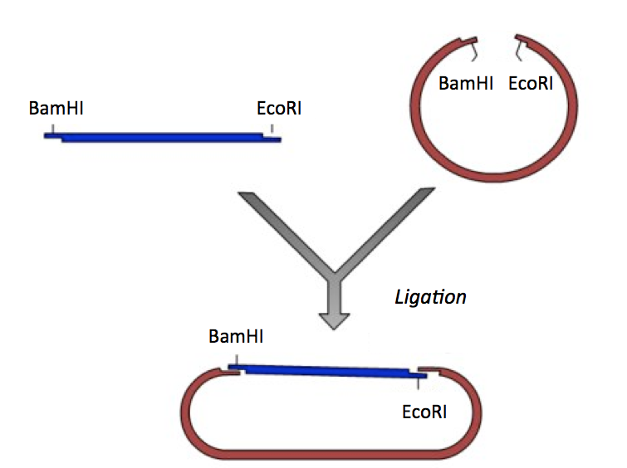
What are we ligating?
Note: in your laboratory exercise only the ‘top’ DNA strand is represented…remember this when determining basepair sites of digestion and ligation.

Slide 18
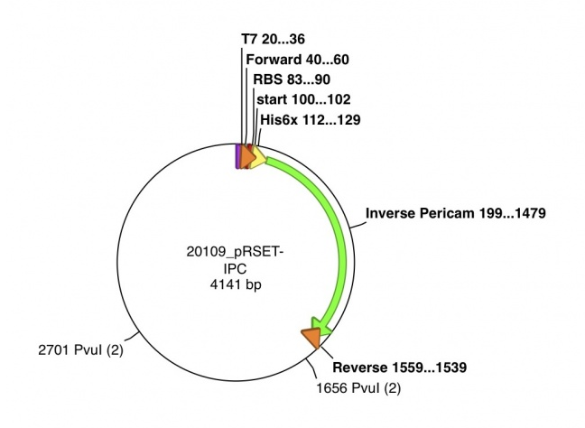
How do we confirm our product?
Transformation
Purification
Digestion
Notes:
Add plasmid map of pRSET-IPC

Slide 19
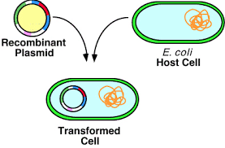
Transformation
Incubation
Heat shock
DNA taken in by competent cells
Recovery
Selection
Why do we transform the ligation product?
blog.opentrons.com

Slide 20
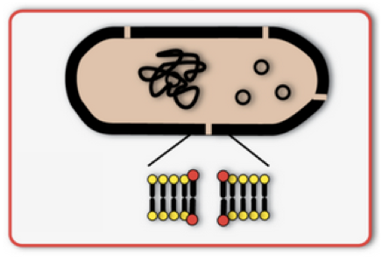
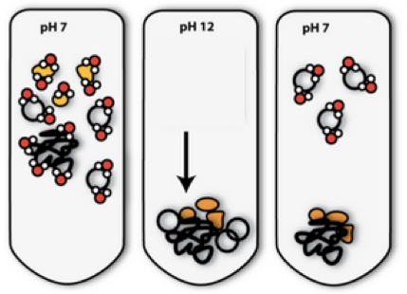
Purification
Resuspend cells
Lysis
Neutralization
Separates chromosomal DNA from plasmid DNA
Wash
Resuspend or elute DNA
Why do we purify (mini-prep) the ligation product?

Slide 21
Digestion, again
Confirmation digests
Ideally, will cut once in insert and once in vector
XbaI and EcoRI?
PstI?
NcoI?
NcoI (450bp)
XbaI (500bp)
NcoI (550bp)
PstI (1250bp)
PstI (4250bp)
EcoRI (2000bp)
pNLL-PCR (6000bp)
Notes:
Write basepair fragment lengths on board…draw gel to illustrate issues with PstI and NcoI

Slide 22
In the laboratory…
Orientation laboratory quiz
Engineer pRSET-IPC product
Template for protein engineering
Confirm pRSET-IPC product

